Slide 1
Revision of Torts

Slide 2
Stella Awards p. 20-21 True or made up?
Case No. 1
Case No. 2
Case No. 3
Case No. 4
Case No. 5
Case No. 6
Case No. 7
Fabricated
True
Fabricated
Fabricated
True
Fabricated
Fabricated from a very old urban legend!

Slide 3
Railroad company
when
even though
while
so
caused
causing
result
resulted
cause
as/since
have
therefore

Slide 4
Railroad company
hadn´t wouldn´t have
hadn´t reached wouldn´t have
hadn´t exploded wouldn´t have been
hadn´t been wouldn´t have sued
had been have been

Slide 5
A tort, in common law jurisdictions, is a civil wrong which 1. _______ causes someone else to suffer 2. _______ or harm resulting in legal liability for the person who commits the 3. _______ act, called a tortfeasor. Tort is a 4. _______ of some duty clearly set by law, not by a 5. _______ agreement between two parties, as in breach of contract. When such a duty is breached, the injured party has the right to institute suit for 6. _____________ damages. Torts may be 7. ___________ in several ways, with a particularly common 8. _______ between negligent and intentional torts. Intentional torts include, among others, certain torts 9. _______ from the occupation or use of land. The tort of nuisance, for example, involves strict liability for a neighbor who interferes with another's 10. ___________ of his real property. Trespass allows owners to sue for 11. __________ by a person on their land. Several intentional torts do not involve land. Examples include false imprisonment - the tort of 12. __________ arresting or detaining someone, and libel, where a 13. ___________ statement is published and damages the plaintiff's reputation. | FAIR LOSE TORT 4. VIOLATE 5. SPECIFY 6. COMPENSATE 7. CATEGORY 8. DIVIDE 9. ARISE 10. ENJOY 11. ENTER 12. LAW 13. DEFAME
unfairly
loss
tortious
violation
specific
compensatory
categorized
division
arising
enjoyment
entrances
unlawfully
defamatory

Slide 6
Legal terms – revision in pairs
Provide an EXAMPLE and a DEFINITION of the term.
You cannot use the term itself!
The term consists of two words.

Slide 7
Example: You have been diagnosed with kidney problems. You have an operation and the surgeon removes your left kidney instead your right kidney by mistake.
Definition: The serious breach of a duty of care by a member of a profession.
Colleague’s guess: gross malpractice

Slide 8
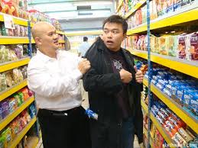
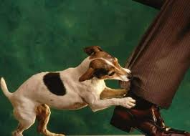
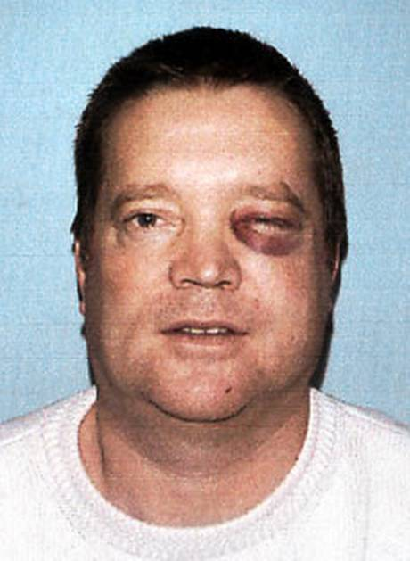
6. Vicarious liability
3. False imprisonment
1. Strict liability
5. Foreseeable harm
4. Actionable defamation
2. Trespass to the person

