Slide 1
Democracy v Fundamental Rights:
The Counter-majoritarian Difficulty

Slide 2
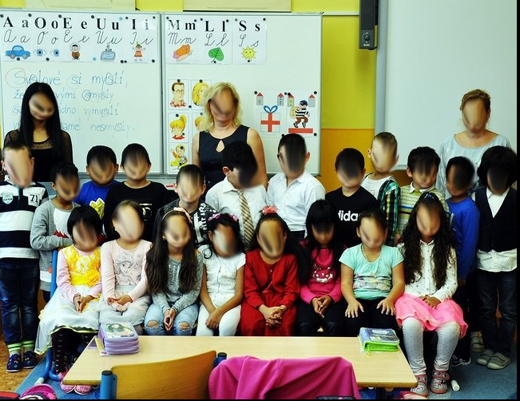
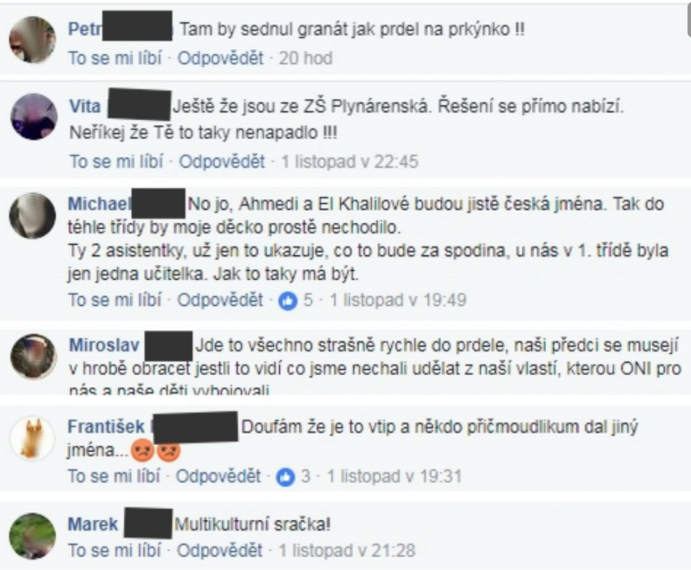
Scenario 1: throw a hand grenade into a classroom!
picture of first year class from multicultural neighbourhood in Teplice published in local newspapers
many (stupid) people reacted on Facebook and elsewhere
is their behaviour covered by freedom of speech?

Slide 3
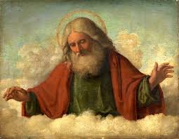
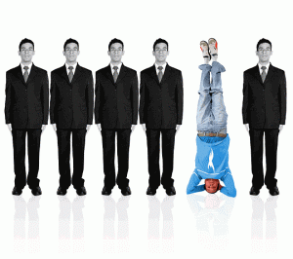
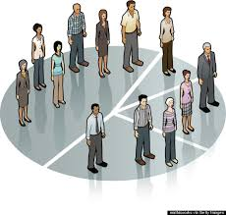
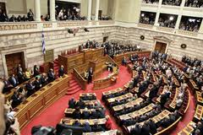
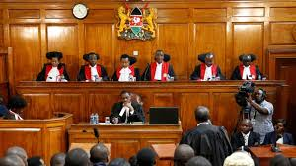
Who should decide about fundamental rights and their meaning?
God etc. = natural rights
  innate to all humans
each person by herself = self-concious decision
  morality?
majority of the people = parliaments
  by law (statute)
supermajority of the people = parliaments / referendums
  by constitutional law (Bill of Rights)
judges = courts
  by (binding) case-law

Slide 4
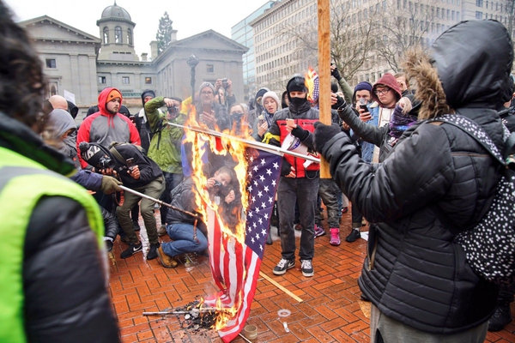
Scenario 2: could you burn a flag?
desecration of US flag was a crime in 48 out of 50 US states
Mr. Johnson burned US flag and was sentenced to a year in prison
Supreme Court (Texas v Johnson, 1989)
  burning of a flag covered by freedom of speech
  5 to 4 majority

Slide 5
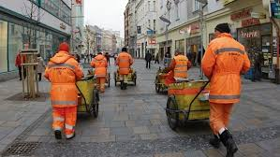
Scenario 3: obligatory public works
Law 367/2011 Coll.
  long-term unemployed must participate in a public work in order to maintain financial support
  adopted in the House of Deputies by 108 votes (69 against)
opposition asked for a review by the Constitutional Court
Pl. ÚS 1/12
  law invalidated for a breach of Art. 9 para 1 of Czech Charter of FR (forced labour)
  many dissenting opinions

Slide 6
The dilemma of counter-majoritarian difficulty
judicial review = courts could strike down statutes adopted by parliaments (a body elected directly by the people) for its unconstitutionality
  concrete judicial review = statute invalidated on the background of a concrete case (injury to an applicant)
  abstract judicial review = statute invalidated without concrete case
CMD coined by Alexander Bickel (The Least Dangerous Branch, 1962)
„The central function, and it is at the same time the central problem, of judicial review: a body that is not elected or otherwise politically responsible in any significant way is telling the people’ s elected representatives that they cannot govern as they would like“ (John Hart Ely)
„The counter-majoritarian difficulty refers to the supposedly anti-democratic nature of judicial review, since it allows courts to overturn the handiwork of elected officials“ (Daniel Farber)

Slide 7
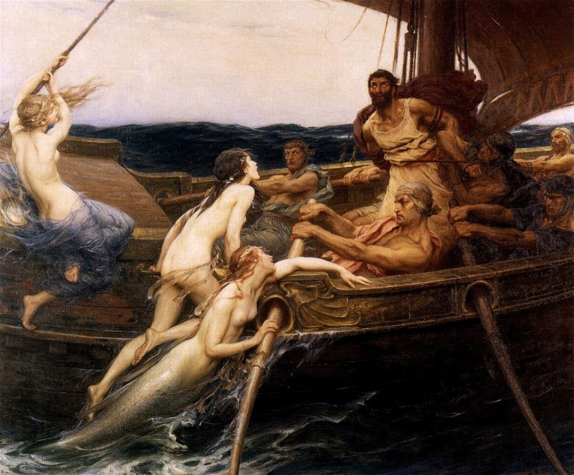
(Abstract) answer: Why judiciary shall have this power
allegory of Ulysses and the Sirens
People (Ulysses) are aware of the temptations of short-term preferences (song of the Sirens) on their long-term constitutional commitments (ship´s course), so they bind themselves to the Constitution (mast) and even if Ulysses protests (legislators accepting current opinions), courts (ropes) save him from losing his mind

Slide 8
Value of different fundamental rights
supporters of JR: some rights (equality, human dignity etc.) must be protected from majoritarian decisions
critics: democracy is crucial, based on one man – one vote principle (legitimacy)
  assumptions: open elections, fair legislative process
threat: tyranny of the majority
  critics: in any case about a right there is a tyranny involved (someone wins or loses)
  but supporters: the case of „discrete and insular minorities“ (United States v Carolene Products, 1938)

Slide 9
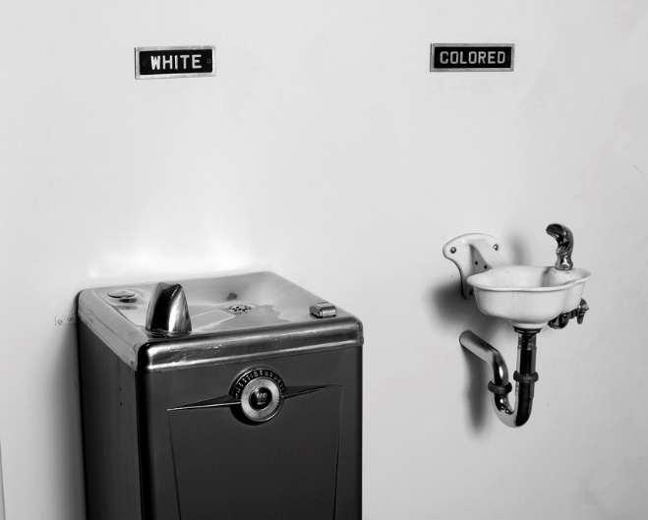
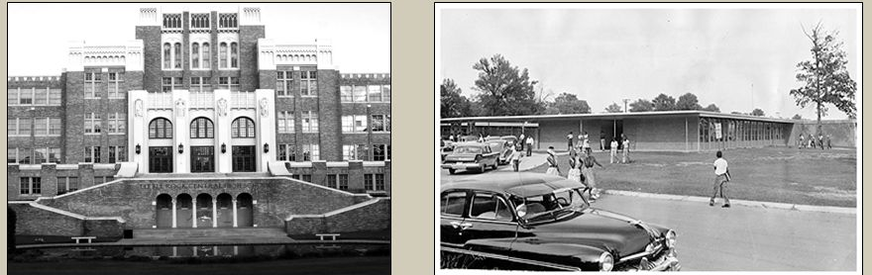
Scenario 4: separate but equal doctrine
all US citizens are equal but it is possible to separate according to race
separation obligatory in 17 US states
Supreme Court (Brown v Board of Education of Topeca, 1954)
  „separate educational facilities are inherently unequal“
  unanimous decision

Slide 10
Value of different fundamental rights
supporters of JR: some rights (equality, human dignity etc.) must be protected from majoritarian decisions
critics: democracy is crucial, based on one man – one vote principle
  assumptions: open elections, fair legislative process
threat: tyranny of the majority
  critics: in any case about a right there is a tyranny involved (someone wins or loses)
  supporters: the case of „discrete and insular minorities“ (United States v Carolene Products, 1938)
    but: do the topical and decisional minorities overlap? (affirmative action un/supported by both blacks or whites)

Slide 11
Rights and institutional (dis)advantages
members of parliament v judges
  directly elected members v appointed
  dependency v insulation from public opinion
decision-making rules
  majority rule in parliaments (representation)
    safeguards against dominance of the majority
  majority rule in courts
    sometimes also safeguards (Czech CC: 9 out of 15 judges to invalidate statute)
    but what is the justification of voting?
intermezzo: do the courts always provide „more rights“?
  Plessy v Ferguson (1896): establishment of the separate but equal doctrine

Slide 12
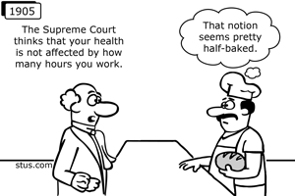
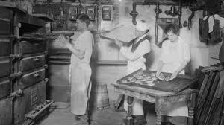
Scenario 5: working conditions of bakers
New York adopted a regulation setting the max working hours of bakers to 10 hours/day (60 h/week)
Supreme Court (Lochner v New York, 1905)
  breach of a freedom of contract (right to sell or purchase labour)
  followed by an era in which the SC stroke down many laws regulating „economic liberty“

Slide 13
What is the meaning of rights?
supporters of JR
  interpretation requires expertise (undetermined texts)
    instruments such as proportionality test applied
  detailed reasoning of the outcome provided
  decision based on a concrete case
opponents of JR
  members of parliament also justify their decisions
  is the meaning of certain right really a legal issue?
    concrete case unimportant in the end
    some decisions rather have moral dimension?

Slide 14
Scenario 6: right to abortion
abortion forbidden in many countries around the world
right of a women to decide about her body or right to life of an unborn child?
US Supreme Court (Roe v Wade, 1973)
  woman´s right to privacy under due process clause prevailed
European Court of Justice (A, B and C v Ireland, 2010)
  Art. 8 ECHR (right to privacy) does not guarantee right to abortion
  Ireland may keep the ban on abortion
Antonin Scalia: „Do we decide on texts and their interpretation or about value judgments?“
  maybe the latter are better left to the common man?

Slide 15
Dissolving counter-majoritarian difficulty
what if courts generally do not act against political majorities?
  supported by empirical evidence (e.g. in the US); reasons:
    judges appointed by democratically elected bodies
    fear of backlash (constitutional changes), no compliance from other powers
    judges with similar values as common man?
people generally have trust in courts
  democratic legitimacy only part of the (whole) picture
but how far could courts go in order not to lose support?

Slide 16
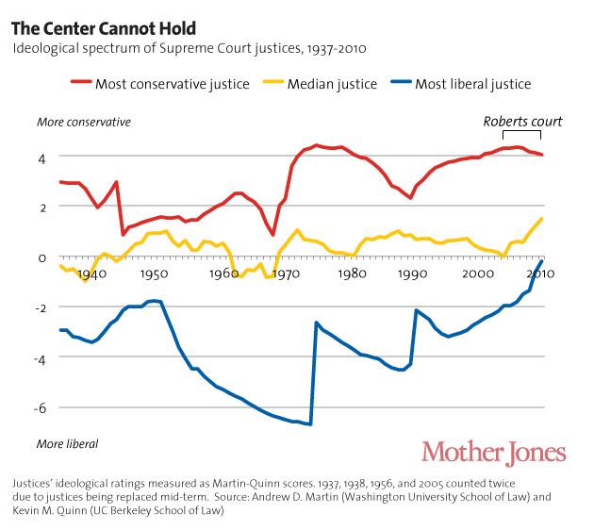
Ideological development of the US Supreme Court

Slide 17
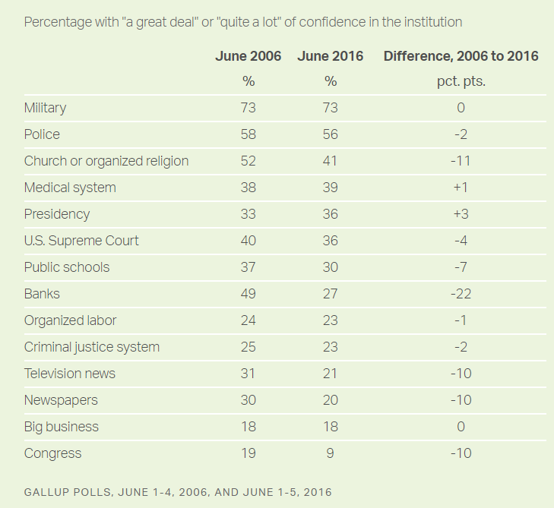
Support for the US Supreme Court

Slide 18
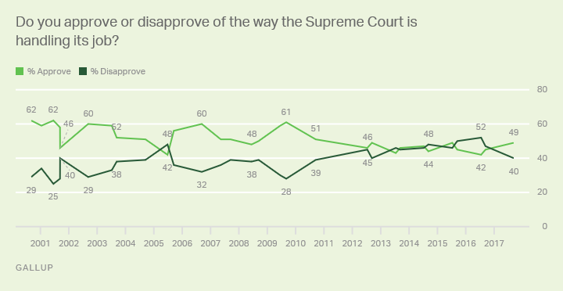
Support for the US Supreme Court

Slide 19
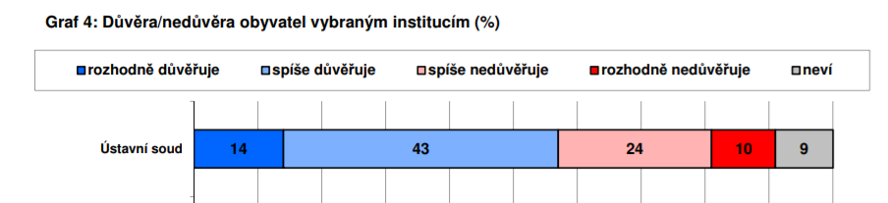
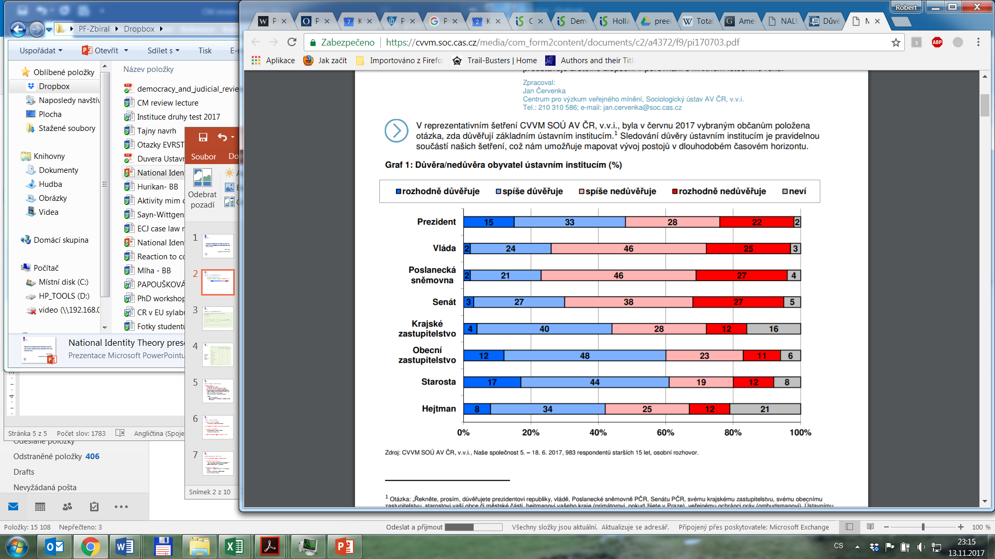
Trust in Czech Constitutional Court

Slide 20
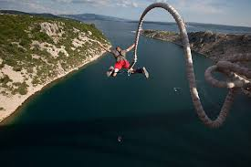
Conclusion
is judicial review good or bad?
  depends on perspective and concrete situations
  disclaimer: our framework apply only to functioning democratic societies
allegory of judiciary as a bungee cord (Friedman)
  courts could stray from the public opinion but eventually get back in line
weak judicial review as a solution?
  court signals breach, then up to a parliament to remedy
  e.g. the UK, Canada

