Slide 1
Representative Democracy and Direct Democracy

Slide 2
Direct or Representative? Topics.
Is Representative Democracy in Crisis? (Blokker)
But What Actually is „Representative Democracy“? (3 stages, basic principles).
Pros
Cons
What values might be better served by the respektive forms of democracy?
Philosophical and Political Context

Slide 3
Principles (or Benchmarks?) of Representative Democracy
Election of Representatives in Regular Intervals
Partial Independence of the Representatives
Freedom of Public Opinion
Making Decisions after „Trial by Discussion“

Slide 4
Evolution of Representation
Parlamentarism (Notables, Deliberation)
Party Democracy (Stable Party Electorates, Party Discipline)
Audience Democracy (Media Experts, Less stability, Social Stratification Less Important, Fluidity)

Slide 5
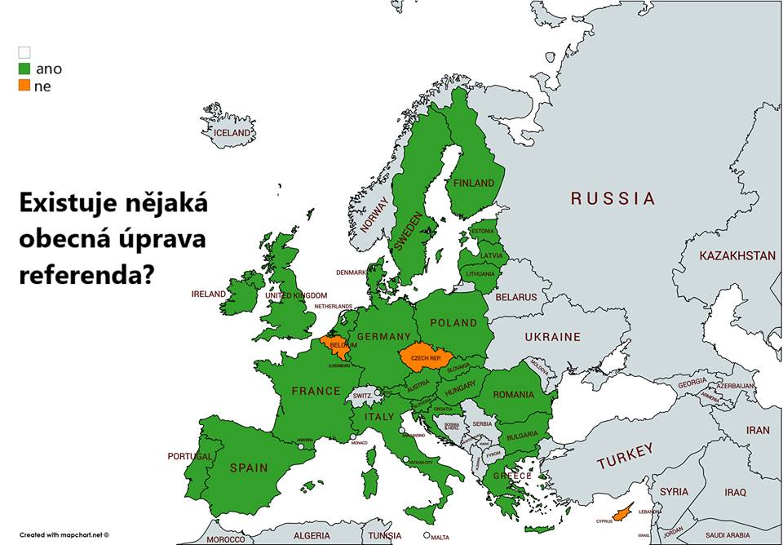

Slide 6
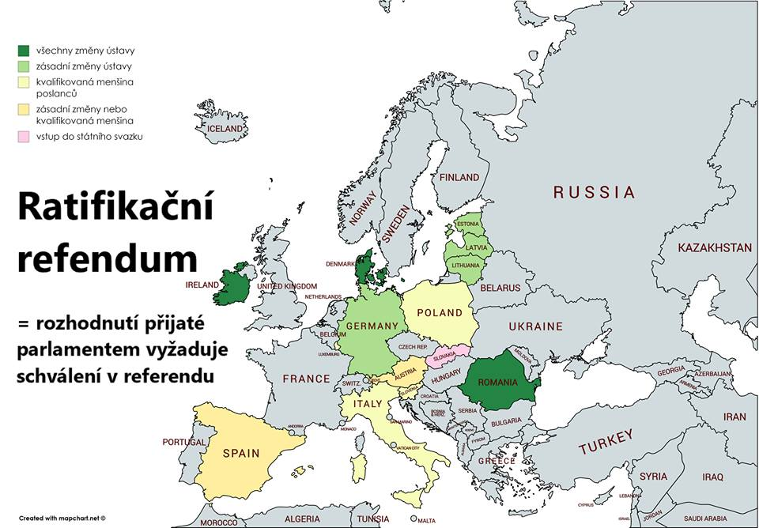

Slide 7
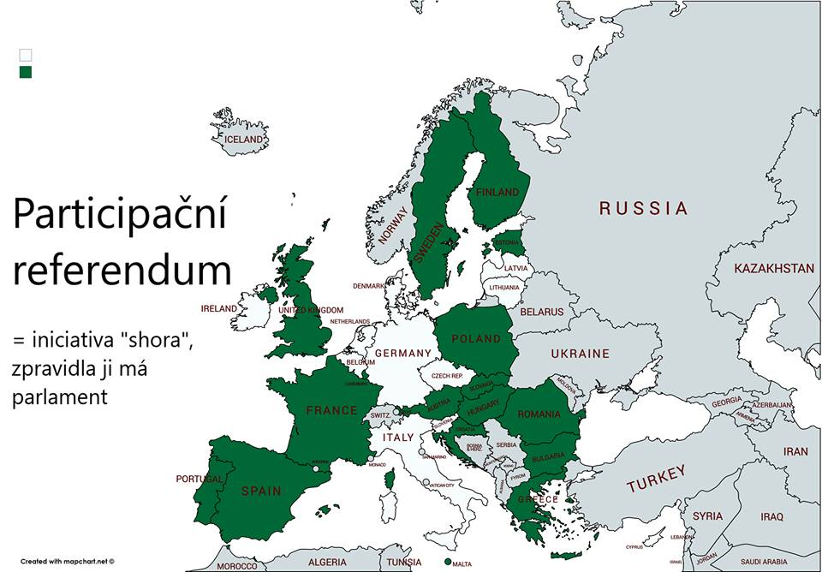

Slide 8
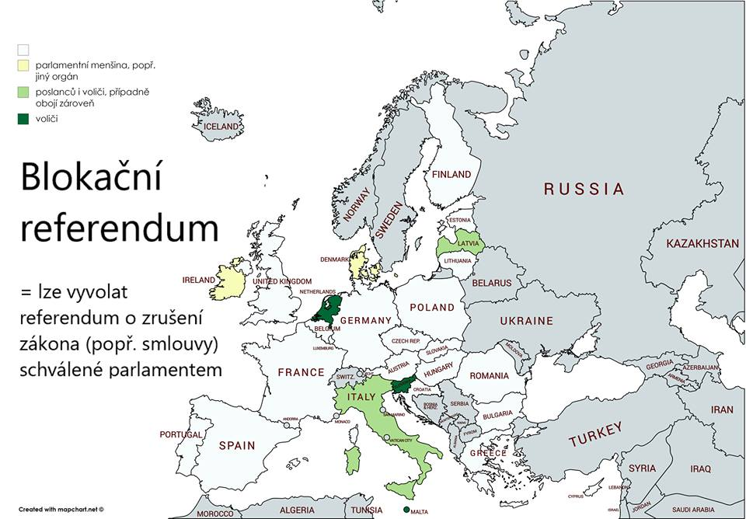

Slide 9
