Slide 1

﻿POLAND
YOUR
BUSINESS PARTNER

Slide 2

﻿Poland
Poland is the 6th EU country
in terms of population.
Poland – basic data
﻿Macroeconomic data:
﻿Data: 07/2018
Area: 312,679 square kilometres
Population: 38,146,000
Birth rate per 1,000 inhabitants: 0.9
Currency: PLN
Language: Polish
Capital: Warsaw
﻿GDP (2017) EUR 467.2 bn
GDP annual growth rate (6/2018) 5.1%
Unemployment rate (9/2018) 3.5%
Inflation rate (9/2018) 1.9%

Slide 3
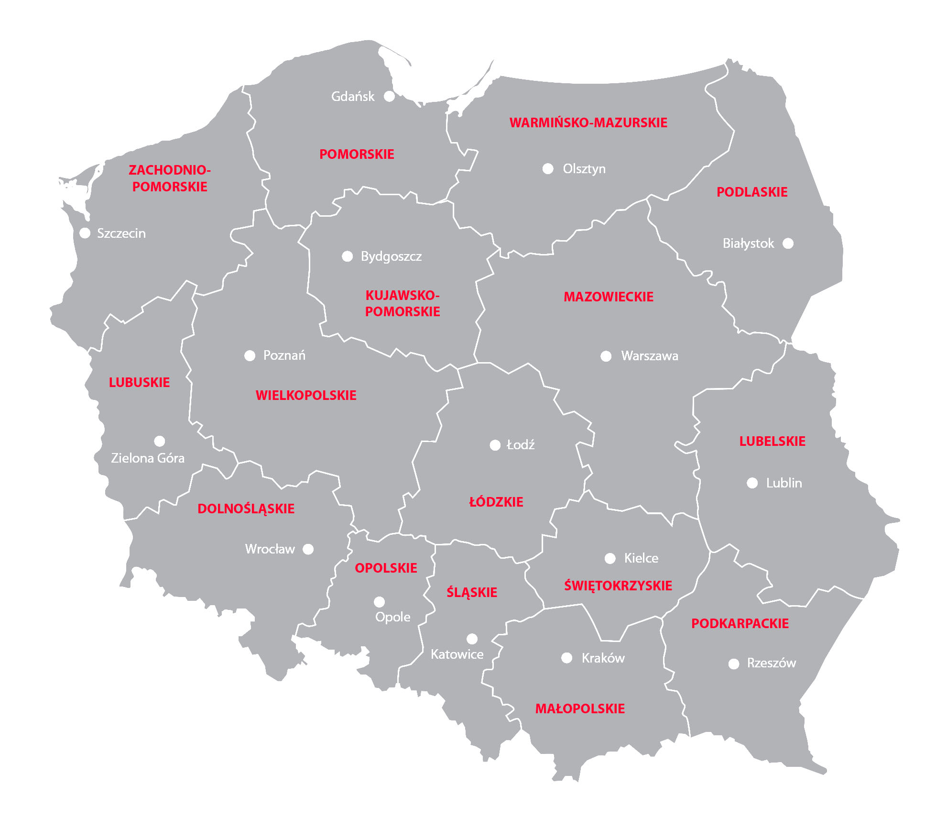
Regions of Poland
Poland is divided into 16 provinces
called voivodeships.

Slide 4
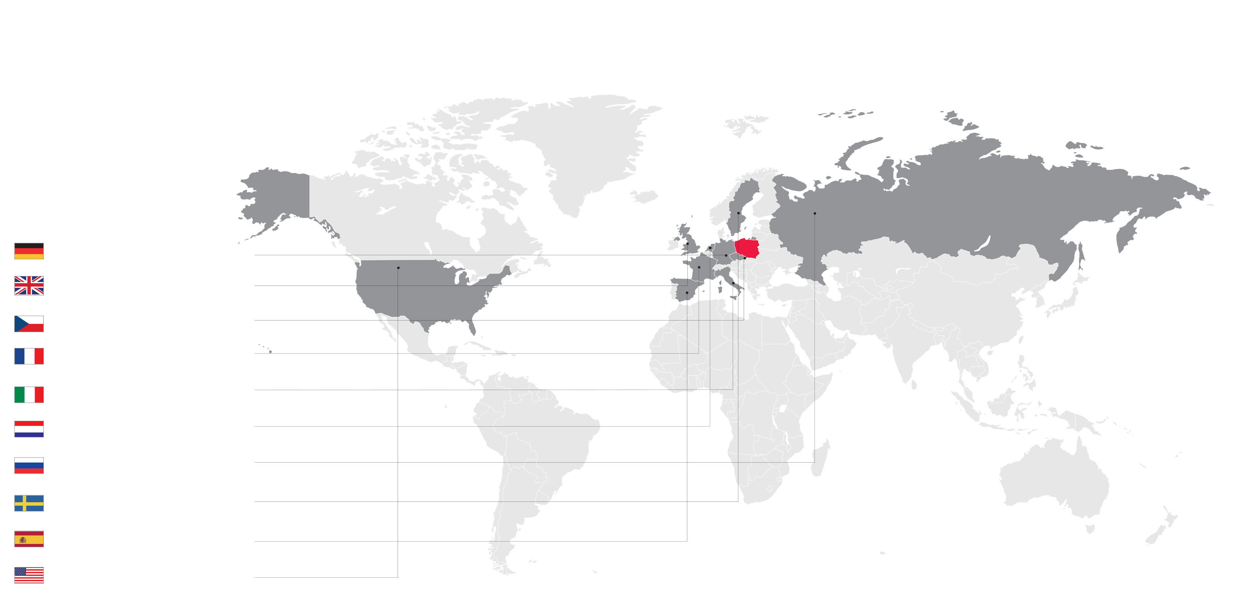
﻿Export
Poland is the world’s 24th exporter (2017) with a 1.26% share in global export. This figure continues to grow.
One fourth of Polish exports are machines, mechanical and electric devices together with their parts and accessories.
With export growing at an annual rate of 6.3% in 2013-2017, Poland ranks 5th among the 50 fastest world exporters,
following Vietnam, Philippines, Ireland, and the Czech Republic.
In 2017 the rate of export growth reached 11.8%, and continued at the level of 7,7% in 2018.
Key export markets
in 2018:
﻿Germany – 28.2% of share, EUR 62,2 billion
Great Britain – 6,2%, EUR 13.7 billion
Czech Republic – – 6.4%, EUR 14.1 billion
France – 5.5%, EUR 12.2 billion
Italy – 4.6%, EUR 10.2 billion
Netherlands – 4.5%, EUR 10.0 billion
Russia – 3.1%, EUR 6.8 billion
Sweden– 2.8%, EUR 6.1 billion
Spain – 2.7%, EUR 5.6 billion
USA – 2.8%, EUR 6.2 billion

Slide 5
Technologically advanced products accounted for 8.4%
of Poland’s total export in 2018.
Poland’s share of world export
2013-2017
1.26%
2017
1.08%
2013

Slide 6
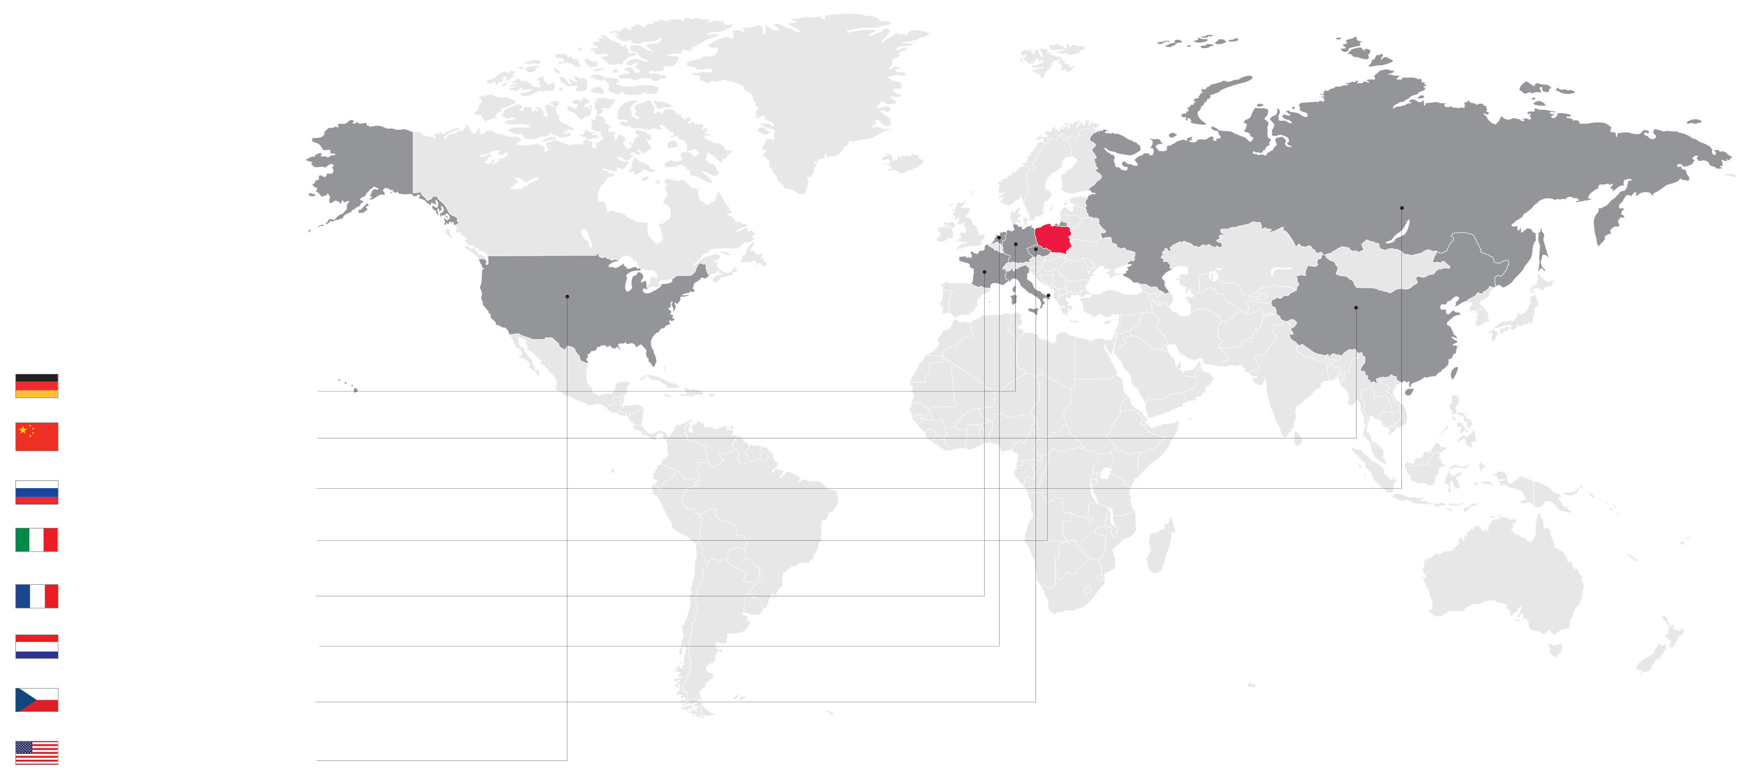
﻿Import
Most of Polish imports (23%) come from Germany, with China and Russia also ranking among the top three sources of import. Polish trade with other countries is mostly of an intra-industry character.
Because of this, the structure of our import resembles the structure of our export.
Key suppliers of goods
to Poland in 2018
﻿Germany – 22.4%, EUR 50.6 billion
China – 11.6%, EUR 26.2 billion
Russia – 7.4%, EUR 16.6 bilion
Italy – 5.0%, EUR 11,3 bilion
France – 3.6%, EUR 8,2 billion
Netherlands - 3.6%, EUR 8.1 bilion
Czech Republic - 3.4%, EUR 7.7 billion
USA – 2.8%, EUR 6.4 billion
Source: Statistics Poland (GUS)

Slide 7
Strengths of Polish economy
Poland is considered one of the five most attractive markets for business in Europe.
Our advantages include macroeconomic stability and the ease of establishing multisectoral cooperation.
Here are some reasons why Poland is an attractive destination for investment:
Ambitious and hardworking people
Diversified economy
Macroeconomic stability
High quality of products and services on offer
Infrastructural investments
Large internal market and access to EU market
Investment data are the best proof of Poland’s attractiveness.
At the end of 2017 the value of liabilities arising from direct foreign investments amounted to EUR 199 billion (National Bank of Poland - NBP)
According to EY’s European Attractiveness Survey 2017,
Poland is the 5th most attractive destination for business in Europe, and the 1st one in the CEE region.

Slide 8
Polish Investment Zone
Key National Clusters:
﻿
Investment-related tax exemptions available across the country.
Focus on well-paid, prospective and stable jobs.
Exemptions granted for 10, 12 or 15 years.
Bonuses for enterprises that help make regional economies more competitive and innovative, and thus contribute to Poland’s economic development.
﻿Source: MPiT
﻿• Klaster Dolina Lotnicza (Aviation Valley Cluster)
• Polski Klaster Aluminium (Polish Aluminium Cluster)
• Mazowiecki Klaster ICT (Mazovia Cluster ICT)
• Klaster Interizon (Interizon Cluster)
• Wschodni Klaster Budowlany (Eastern Construction Cluster)
• Klaster Obróbki Metali (Metal Processing Cluster)
• Zachodniopomorski Klaster Chemiczny „Zielona Chemia” (West Pomeranian Chemical Cluster Green Chemistry)
• Klaster LifeScience Kraków (LifeScience Cluster Krakow)
• MedSilesie – Śląska Sieć Wyrobów Medycznych (MedSilesie – Silesian Medicinal Product Network)
• Śląski Klaster Lotniczy (Silesian Aviation Cluster)
• Nutribiomed Klaster (Nutribiomed Cluster)
• Wschodni Klaster ICT (Eastern Cluster ICT)
• Klaster Gospodarki Odpadowej i Recyklingu (Waste Management and Recycling Cluster)
• Klaster Zrównoważona Infrastruktura (Sustainable Infrastructure Cluster)
• Klaster Logistyczno-Transportowy Północ – Południe (North-South Logistic and Transport Cluster)
• Bydgoski Klaster Przemysłowy (Bydgoszcz Industrial Cluster)
Source: MPiT
﻿In Poland is home to over 130 clusters,
16 of which have
the Key National Cluster (KKC) status.
Key National Clusters (KKCs) are organisations which are pivotal to the national economy and can effectively compete on the international stage.

Slide 9
Poland globally
Poland is among the EU countries with the lowest unemployment rate.
Having dropped to 3.5 % in August 2018, our joblessness rate was the third lowest in the EU following the Czech Republic and Germany.
Source: Eurostat

Slide 10
Poland globally
Poland posting the highest GDP growth in the EU
in the first quarter of 2018
(% growth)
Poland | 1.6
Latvia | 1.6
Finland | 1.2
Hungary | 1.2
Slovakia | 0.9
Lithuania | 0.9
Bulgaria | 0.9
Austria | 0.8
Cyprus | 0.8
Greece | 0.8
Sweden | 0.7
Spain | 0.7
Slovenia | 0.6
Malta | 0.6
Netherlands | 0.5
Portugal | 0.4
Denmark | 0.4
Czech Republic | 0.4
Italy | 0.3
Germany | 0.3
Belgium | 0.3
Croatia | 0.2
France | 0.2
Great Britain | 0.1
Romania | 0.0
Estonia | -0.1
Source: Eurostat

Slide 11
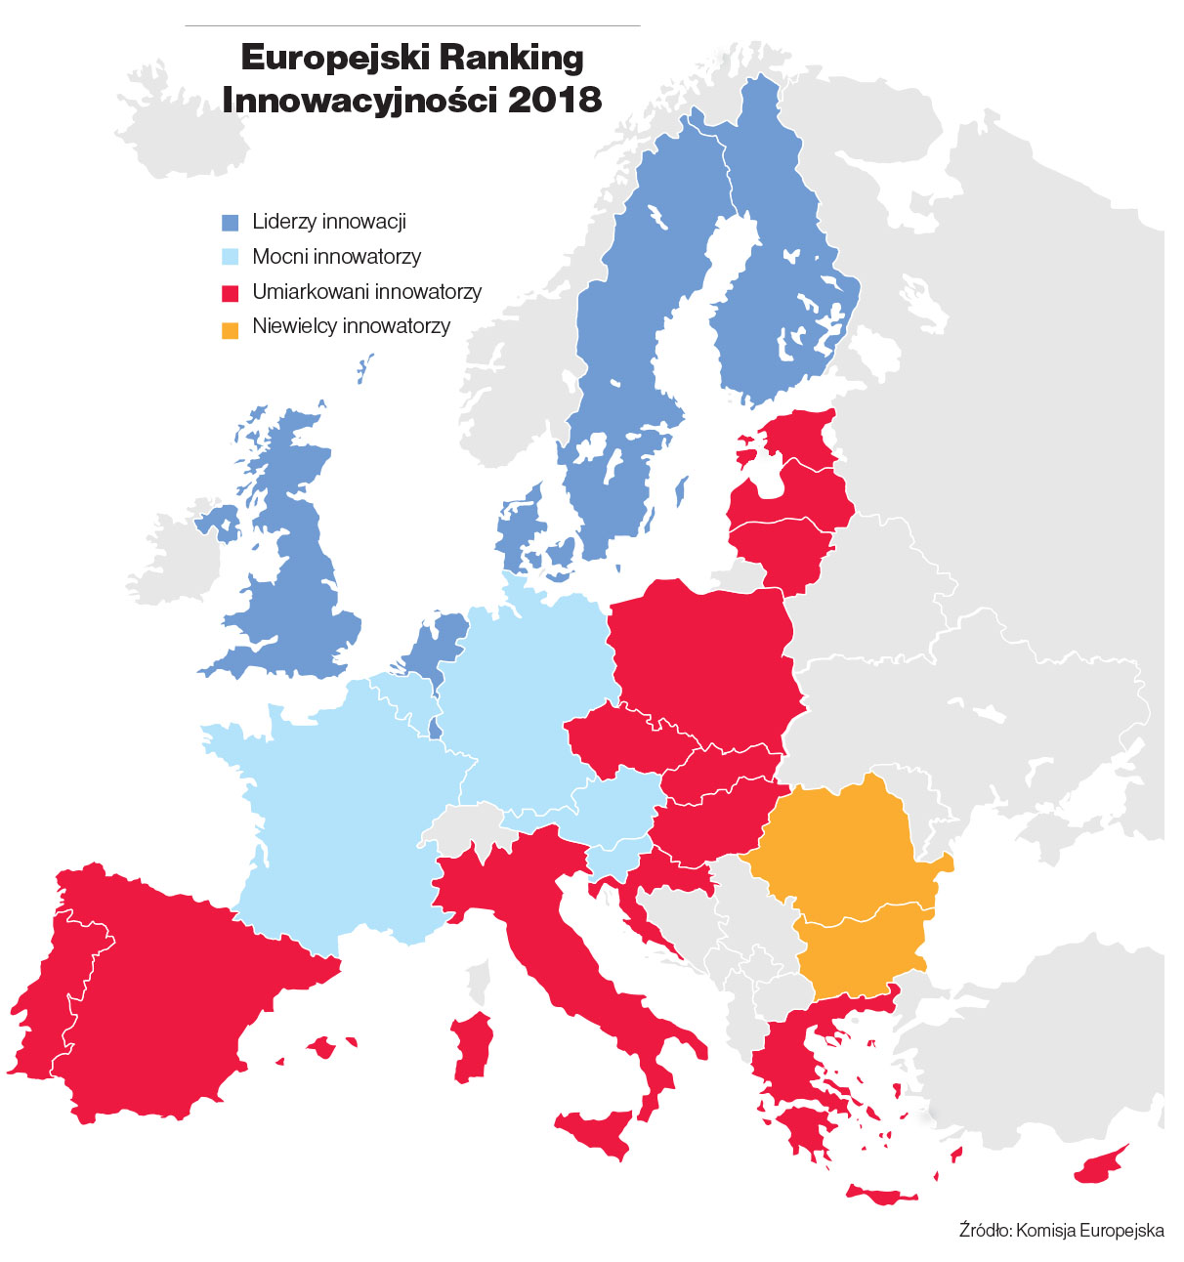
The world’s forty most competitive countries
European Innovation Scoreboard 2018
1. | USA
2. | Singapore
3. | Germany
4. | Switzerland
5. | Japan
6. | Netherlands
7. | Hong Kong
8. | Great Britain
9. | Sweden
10. | Denmark
 | …
32. | Estonia
36. | Slovenia
37. | Poland
Leaders of innovation
Strong innovators
Moderate innovators
Modest innovators
Source: European Commission
Source: World Economic Forum
Competitiveness Report, 2018

Slide 12

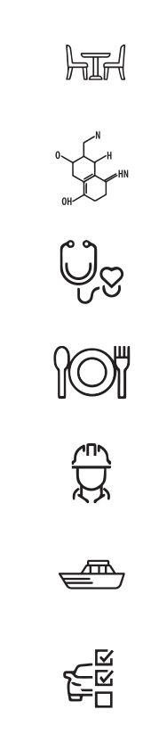
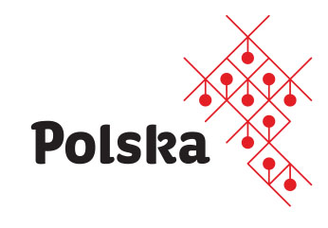
Priority sectors
Poland has selected 12 sectors with export and image potential
to build a strong and widely recognizable Polish Economy Brand. These include:
medical equipment sector
machinery and equipment sector
beauty sector
‘Polish fashion’ sector, including clothing, footwear, leatherware and jewellery
IT/ICT sector
furniture sector
biotechnology and pharmaceutical sector
healthcare services sector
Polish food specialties sector
construction sector
Their development is supported by the Ministry
of Entrepreneurship and Technology, i.a. under the ‘Promotion of economy on the basis of product brands – Polish Economy Brand’ project, sub-measure 3.3.2 of the Intelligent Development Operational Programme 2014-2020.
yachts and recreational boats sector
vehicle and aircraft parts sector

Slide 13


Medical equipment
Poland is a highly appreciated partner as a competitive manufacturer of top quality instruments and devices
used in healthcare, surgery, dentistry and veterinary medicine.
Polish companies export medical equipment mostly to the EU (64%).
In 2017 the value
of Polish medical equipment export
exceeded EUR 1.8 billion.
Its share in the entire export
has been increasing for years:
from 0.3% in 2004
to 0.88% in 2017.

Slide 14

Over 60% of the sector revenue
is generated by export.

Slide 15
Machines and equipment
Growing demand for raw materials stimulates the development of the machinery and equipment sector.
EUR 11,292 million –
machinery and equipment sales in 2017
(Statistics Poland, GUS)
﻿10.7%
share of machinery and equipment in total exports (2017)
The local market of construction machinery comprises 60,000 machines and devices
– including ca. 10,000 mobile cranes,
11,000 diggers, 10,000 caterpillar dozers,
3,000 wheel loaders, etc.

Slide 16
﻿EUR 1.2 billion: value
of Polish machines
and equipment exports in 2017;
18.4% more than during
the same period of 2016
Source: machine.trade.gov.pl
﻿76%
of exports reach EU markets

Slide 17
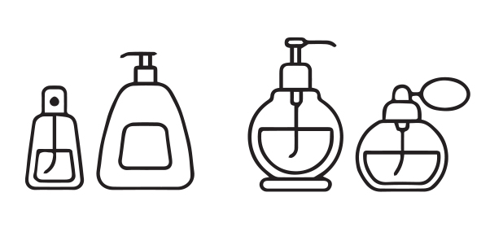
Beauty products
The Polish beauty market ranks
6th
in Europe in terms of market value
and export.
Innovation, high quality and experience are the main reasons the sector is so competitive with other European countries.
﻿400
companies
in the beauty sector

Slide 18
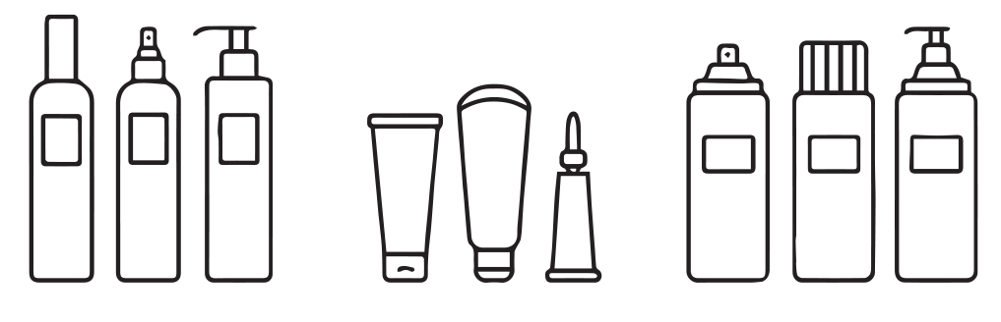
16.1%
﻿43,000
jobs
share of beauty export in total export in 2017

Slide 19
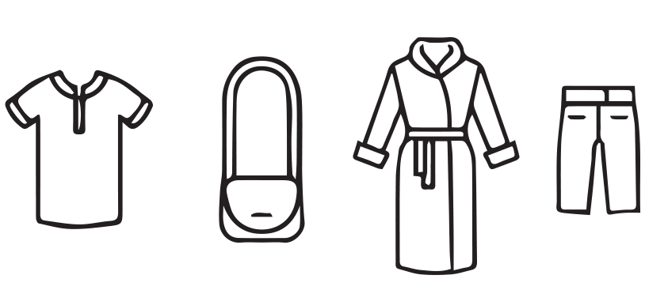
﻿Fashion
The Polish clothing industry is Europe’s 8th in terms of turnover, and 6th
in terms of investments. The Polish designer market is also gaining significance in this sector.
﻿5%
The pace at which
the Polish clothing
and footwear market will grow annually
until the end of this decade, according to Bank Pekao analysis.

Slide 20
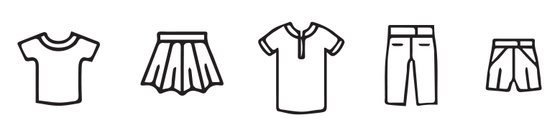
Share of expenses
on clothes and footwear in total HH spending
in selected EU countries
﻿﻿Estonia 6.8%
Portugal 6.3%
Italy 6.2%
Poland 5.2%
Czech Republic 3.6%
Hungary 3.6%
Romania 3.4%
Bulgaria 3.2%
﻿Source: Eurostat
﻿EUR 52
The amount Polish internet users spend on clothes and accessories online

Slide 21
EUR 2,230 million garment production sold in 2017
22,080 number of companies in the clothing sector in 2016
69,000 individuals average employment in the clothing industry in 2016
EUR 4.676 billion clothing export in 2016
﻿Source: GUS
﻿11%
of total European fur production comes from Poland. With leather exports worth EUR 0.36 billion, we are the 6th supplier globally.

Slide 22
﻿IT/ICT
EUR
7.5 billion
Areas of Polish expertise in the ICT sector
Custom software 34.7%
Production of games 22.3%
BPO/ITO services 19.8%
Internet technologies 14%
Software R&D 5%
Hardware R&D 0.8%
Source: ‘Growth prospects of the Polish TCT sector until 2025’ report,
Ministry of Infrastructure and Development
sales
in the Polish ICT sector

Slide 24

﻿Furniture
Due to relatively low costs of labour, high product quality and flexible production, Poland has been a longstanding leader of furniture export.
Value of
furniture sold
(billion EUR)
﻿EUR
11 billion
﻿﻿2010 25.7
2011 30.2
2012 28.8
2013 31.6
2014 35.3
2015 39.1
2016 42.6
2017 46.4
Source: GUS (Statistics Poland), SWAID base
According to KPMG, in 2020 the value of furniture production sold in Poland will amount to ca. EUR 11.7 billion.
Polish export
of furniture
in 2017
150,000
people
5.3%
average annual employment in the furniture sector
in 2016
share of furniture in total export

Slide 25

36.4%
of furniture
is exported
to Germany
43%
﻿ of companies operating on the Polish furniture market sell their products abroad

Slide 26
Biotechnology and pharmaceuticals
Highly qualified specialists and extensive scientific know-how give the Polish biotechnological sector a competitive advantage. Pharmaceutical companies are in turn an important investor
on the domestic market.

Slide 27
﻿184 number of enterprises operating in the biotechnology sector in 2016
8,875 number of people employed in the biotechnology sector in 2016
EUR 2.7 billion value of biotechnology exports from Poland in 2016
PLN 14,413 million value of the pharmaceutical sector production sold in 2017
EUR 2.6 billion value of Polish pharmaceutical exports in 2016

Slide 28
Healthcare service sector
Nearly 400,000 foreign patients visit Poland every year. The potential of health tourism lies in domestic specialist medical services, i.e. cardiology, ophthalmology, or plastic surgeries.
Selected medical procedures in various countries (prices in thousand USD)
 | USA | India | Singapore | Malaysia | Mexico | Hungary | UK | Poland
Bypass surgery | 113 | 10 | 20 | 9 | 3.25 | - | 14 | 7.1
Heart valve replacement | 150 | 9.5 | 13 | 9 | 18 | - | - | 9.5
Hip replacement | 47 | 8.25 | 12 | 12.5 | 12.5 | - | - | 7.9
Dental implants | 1.2 | 1.1 | 1.5 | 2.6 | 0.95 | 0.65 | 1.6 | 0.95

Slide 29
Facilities important to medical tourism
Type of facility | Number of units
General hospitals | 355
Health resorts and sanatoria | 167
Other medical entities (misc.) - Medical entities not classified elsewhere | 590
Clinics offering medical services to women: In vitro and obstetric clinics | 65
Ophthalmology – facilities providing chiefly ophthalmological services | 140
Dental services – facilities providing services | 819
Orthopaedics – facilities providing orthopaedic services | 30
Aesthetic medicine – facilities providing beauty services in the field of aesthetic medicine and dermatology | 110
Rehabilitation – rehabilitation centers other than health resorts, sanatoriums and hospitals | 77
Medical spa centers – hotel centers with extended medical spa offer | 136
Source: Polish Tourism Organisation, 2016

Slide 30
Country | Medical Tourism Index
Canada | 76.87
Great Britain | 74.85
Israel | 74.17
Singapore | 73.96
Costa Rica | 72.78
Italy | 72.01
Germany | 70.69
Philippines | 70.66
Japan | 70.40
France | 70.22
South Korea | 69.97
Spain | 69.33
Brazil | 67.87
Jamaica | 67.68
India | 67.50
Columbia | 67.36
United Arab Emirates | 66.10
Dominican Republic | 66.02
Poland | 65.48
Thailand | 65.46
Argentina | 64.35
China | 63.13
South Africa | 62.05
Mexico | 61.03
Russia | 50.28
Source: International Healthcare Research Center

Slide 31
Food specialities
After Poland joined the EU, the agri-food industry became one of the key sectors
of the Polish economy. Some of its branches have even achieved the status of EU-wide leaders.
Strengths of the Polish agri-food sector
Polish food: natural, healthy, innovative.
Fast adaptation of merchandise to buyers’ needs.
High level of knowledge among sector employees.
Competitive prices.
Modern processing base guaranteeing consistently high quality.
Growing efficiency and productivity of labour.
Advanced quality control procedures and implementation of new quality systems.
Relatively stable financial situation.
High flexibility allowing adaptation to changing market conditions.
﻿10%
share
of food in total export in 2017

Slide 32
﻿81%
of exports went to EU markets in 2017
EUR 54,799 million sold production of food products in 2017
17% fruit and vegetable share in the value of agricultural production in Poland
67% share of fruit and vegetable exports in domestic production
5% Poland’s share of the value of fruit and vegetable production in the EU-28
14% Poland’s share of the EU frozen vegetable production

Slide 33
Construction market
The value of the Polish construction market will exceed PLN 200 billion in 2018.
Size of the Polish construction market in 2014 – 2016 segmented (billion EUR), data in current prices, exclusive of VAT
 | 2014 | 2015 | 2016
Specialist construction works | 63.2 | 69.9 | 67.9
Construction of civil and water engineering facilities | 47.0 | 44.7 | 38.6
Construction works related to erection of buildings | 55.5 | 56.7 | 52.9
Source: GUS (Statistics Poland)
According to GUS data, during the first half of 2018 the construction and assembly production in companies hiring over 9 employees was nearly one fourth higher than a year earlier. Poland’s specialty is construction joinery. In 2017 we exported over 10 million windows and doors. According to the Centre of Sectoral Analyses, Poland is undoubtedly the EU’s biggest exporter with exports worth EUR 1.87 billion.
915,800
people were employed in the construction sector in 2017

Slide 34
82%
of construction exports
went to EU markets in 2017
﻿512,933
﻿national economy entities are listed in the construction section of
the REGON register
﻿3.37%
share of construction in total export in 2017

Slide 35
Yachts and boats
Boats produced in Poland are internationally recognized for their top quality,
prefect finish and attention to detail. Our industry specialises in 6-9 meter long motor yachts.
Strengths of the Polish industry include individual approach,
unique designs and custom orders.
Our industry specialises
in 6-9 meter long motor yachts. In this category, Poland is second only to the United States.
﻿900
companies
﻿﻿﻿22 000

Slide 36
﻿82%
﻿22,000
﻿﻿95%
﻿35,000
of all off-shore yachts registered in Poland in 2017
were motor yachts
yachts are produced in Poland
annually
of the production
is exported
jobs

Slide 37

Car parts
Poland is one of the leaders of the car part sector globally.
EUR﻿
34.7 billion
value of production sold by automotive sector companies
in 2017
EUR
7.7 billion
export of automotive products from Poland in 2017

Slide 38

Aircraft parts
Poland’s share of the European aircraft industry is significant. For nearly 100 years
our country has been designing planes and their elements, winning acclaim all over the globe.
Every plane flying in the world today has at least one part produced in Poland.
18.4%
share of automotive and aircraft parts
in total export
in 2017
The aeronautic sector in numbers
Sales value: EUR 1.6 billion (2016) / an increase by 22% YoY (EUR 1.3 billion in 2015)
Share of industrial production: 0.6%
Number of employees: 15,200 (according to GUS; based on data obtained from companies PAIH estimates this number at as many as 30,000)
Number of companies in the sector: 140 (including 24 companies with a staff of
over 49)
Average salary in the sector: EUR 1,170 gross (national average salary in the industrial sector in 2016: EUR 1,056)
Export value: EUR 1 billion (an increase by 48% YoY)
Source: PAIH (Polish Investment and Trade Agency)
﻿﻿﻿﻿79%
of exports went to EU countries in 2017

Slide 39


Ministry of Entrepreneurship and Technology
Pl. Trzech Krzyży 3/5
00-507 Warszawa
uwagi_eksporter@mpit.gov.pl
sekretariatdhm@mpit.gov.pl
http://www.gov.pl/przedsiebiorczosc-technologia
www.trade.gov.pl
ISBN 978-83-952846-0-1
Publication co-financed from the European Regional Development Fund.

