Slide 1
Introduction to alternative dispute resolution and ODR, Domain names within the .cz domain and .eu domain
Mgr. Pavel Loutocký, BA (Hons)

Slide 2
Domain name disputes

Slide 3
MAIn principle
First comes – first served
The domain name is immediately registered
What if the holder of domain name is not the one who should own it?
Cybersquatting, typosquatting, etc.

Slide 4
The Structure
Top level domain names (TLDs)
Generic .com, .gov, .org, .biz, .edu
National .cz, .uk, .de, .sk, .ru
Specific .eu
Subdomains
muni.cz, seznam.cz, google.com
Lower Subdomains
law.muni.cz, mail.google.com

Slide 5
New GTLDS
New top level domain names (TLDs) from 2013
https://newgtlds.icann.org/en/
List of all generic domain names (more than 1532):
http://data.iana.org/TLD/tlds-alpha-by-domain.txt

Slide 6
Sqautters allowed?

Slide 7
Sqautters allowed? NO!

Slide 8
How to be legally protected from Cybersquatters?
Competition law?
Trademark law?
Geographical indications?
Commercial name (firm)?
Right for privacy (e.g. EUHR)?
COURT?
ANOTHER MORE SUITABLE SOULUTION?
WHAT WOULD YOU DO?

Slide 9
Example
Someone would register the domain microsoft.cz
He does not use this domain and offers it for sale for €200 000
Can the trademark owner claim violation of his rights?
Can the trademark owner claim transfer of the domain name?
What if the owner is based in US, administrator is Czech and squatter Russian?

Slide 10
?
#WWYD

Slide 12
Alternative dispute resolution

Slide 13
What is ADR?

Slide 14
ADR
Out-of-court dispute settlement
Classical tool in history to settle commercial dispute
Evolved into another fields
Less formal than court proceedings
Faster in specific cases
Based on the agreement of the parties

Slide 15
ADR
Does not fit for „internet disputes“
Judicial proceedings are not convinient as well
EVOLUTION?

Slide 16
ADR is old
!! ODR should be the FUTURE !!

Slide 17
Reasons?
Increased volumes of squatting cases
Problems with international element
Insufficient national regulation
Low experience of judges with cybersquatting and IP law in general -> experts are deciding the case

Slide 18
Reasons!
Dispute settlement clause in the terms and conditions of registrations
Third parties have the right (not duty) to file a complaint at a selected institution
These clauses are contained in the majority of domain names
Usually it is not arbitration clause, but non-binding ADR clause!!!

Slide 19
The rules - TLDs
Uniform Domain-Name Dispute Resolution Policy (UDRP)
Top-level domain names
https://www.icann.org/resources/pages/help/dndr/udrp-en
List of providers:
https://www.icann.org/resources/pages/providers-6d-2012-02-25-en

Slide 20
The rules - ccTLDs
National authorities (does not have to be governemental)
Contract with ICANN
In Czech Republic – CZ.NIC
https://www.nic.cz/page/314/pravidla-a-postupy/

Slide 21
The rules - .EU
Not an arbitration clause! (again)
Competence of arbitration courts enacted by regulation 874/2004/EC
https://eurid.eu/en/

Slide 22
The rules - .EU
Set of eu regulations:
http://ec.europa.eu/ipg/basics/urls/doteu_en.htm

Slide 23
http://www.adr.eu/

Slide 24
ODR IN GENERAL not only domain names but all kinds of disputes

Slide 25
The notion that most people want black-robed judges, well-dressed lawyers, and fine paneled courtrooms as the setting to resolve their dispute is not correct. People with problems, like people with pains, want relief, and they want it as quickly and inexpensively as possible.
Warren E. Burger
Former judge at US Supreme Court

Slide 26
Background
Traditional judicial mechanisms... did not offer an adequate solution for cross – border electronic commerce disputes, and that the solution (providing a quick resolution and enforcement of disputes across borders) might reside in a global ODR system for small value, high volume ... disputes
Courts are resolving only a fraction of today‘s legal disputes (especially low - value) – PROBLEM!!

Slide 27
What is ODR?
It is difficult to provide a self - contained definition of ODR
Dispute resolution, which uses electronic communication to exchange every information between the parties
A growing number of cases (especially low – cost cases) are being resolved by online tools and sometimes lawyers and judges are not even involved

Slide 28
What is ODR?
Definitions:
dispute settlement which may or may not involve a binding decision being made by a third party, implying the use of online technologies to facilitate the resolution of disputes between the parties
dispute resolution carried out by combining the information processing powers of computers with the networked communication facilities of the Internet

Slide 29
What is ODR?
ODR is NOT only modified ADR (alternative dispute resolution)
The technology is the fourth party helping to settle the dispute
Triad:
1) online communication
2) dipute settlement
3) software assisstance

Slide 30
History of ODR
The first ODR forms started to evolve between 1996 and 1997 (software assistance)
The first experiments were created at the University of Massachusetts in the USA and Canada
Those projects were later transformed for commercial use
One of the first official systems providing ODR was The Virtual Magistrate
it never fulfilled expectations of the founders
it was mainly caused by “limited scope of disputes, a lack of advertising and the fact that the project was voluntary so that the case managers had no way to force the defendant to take part in the proceedings or to enforce the decisions.”

Slide 31
ODR Methods
„Non – binding“ dispute resolution
„Binding“ dispute resolution
2.1 Automated software negotiation
2.2 Online mediation
2.3 Non - binding arbitration
2.4 Binding arbitration
2.1.1 Assisted negotiation
2.1.2 Blind - bidding negotiation

Slide 32
2.1 Automated software negotiation
Negotiating software is used to reach the agreement between parties without using any third party (negotiator, mediator)
Negotiation can’t discuss the liability, only the final sum of the damages
2.1.1 Assisted negotiation
2.1.2 Blind - bidding negotiation

Slide 33
2.1.1 Assisted negotiation
The ODR system helps parties through software to create the most efficient solution for both parties (win – win solution)
It tries to calculate the best outcome proposing parties possible solutions
The parties should be able to achieve an agreement, if they agree with the solution

Slide 34
2.1.2 Blind - bidding negotiation
The ODR system allows both parties to put bids without seeing the sum offered by other party
When these bids reach certain level (amount of money), which approaches to each other, than software automatically reveals those offers and proposes the settlement

Slide 35
Blind - bidding
The parties are willing to enter negotiation and to reach the settlement, which is binding between the parties once, they agree so
The process is developed for single issue, monetary claims
The initiator (damaged party)
Sued party
1st bid
The highest sum to satisfy the initiator
The lowest sum
2st bid
3st bid
The lowest sum to satisfy the initiator
The highest sum sued party is willing to pay

Slide 36
2.2 Online mediation
It can be seen as classical mediation using modern technologies and online tools
As non – binding solution, it uses cyberspace to communicate between the parties and mediator(s) through email, videoconference, special webpage or particular software
Great advantage is seen in dynamic form reacting to the direction of dispute by varying the mediation process

Slide 37
2.3 Non – binding arbitration
This ODR method is lying on the borders between binding and non-binding ODR
Enforcement is secured by private organization using less formalized rules
Non – binding arbitration is based on the idea of self - regulating the community with no connection to national legislation and enforcement mechanisms
Domian name dispute settlement!

Slide 38
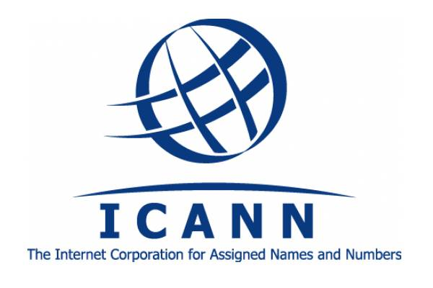
2.3 Non – binding arbitration
Private organization is the only one, who controls the resources valuable to both buyers and sellers traded under certain community
Example: ICANN (Internet Corporation for Assigned Names and Numbers) and its UDRP process (Uniform Domain - Name Dispute - Resolution Policy)

Slide 39
2.4 Binding arbitration
Arbitration is a process where a neutral third party (arbitrator) creates a decision which is final and binding
It is quasi - judicial procedure - the award replaces a court decision
Arbitration is often used to resolve business disputes because it is usually faster than litigation
Arbitral awards are usually easier to be enforced abroad comparing to the court decisions

Slide 40
2.4 Binding arbitration
The result of online arbitration should be binding and ?enforceable?
Every requirement of national and international legal framework has to be followed and respected to reach the full possibility to enforce online award

Slide 41
Advantages and disadvantages of ODR
PROS | CONS
1. Speed and work with information | 1. Obstructions of the process
2. The fourth party | 2. Technological limitations
3. Legality | 3. Due process
4. Erasing distances | 4. Insufficiency of non – verbal communication
5. Asynchronous communication | 5. Inequality of the parties
6. Adaptability of the system | 6. Security of cyberspace and privacy
7. Liberation from emotions and F2F contact | 7. Boundaries caused by lack of F2F communication
8. Quick intercession
9. Saving the costs
10. Use of translation software

Slide 42
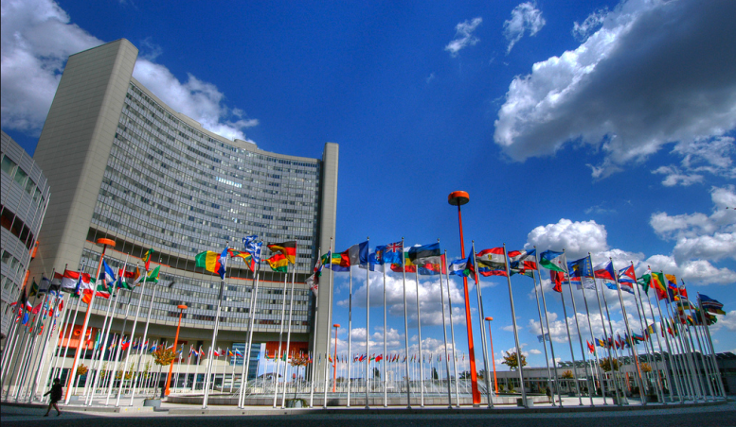
UNCITRAL Working group III.
The core legal body of the United Nations system in the field of international trade law
A legal body with universal membership specializing in commercial law reform worldwide for over 40 years
UNCITRAL's business is the modernization and harmonization of rules on international business

Slide 43
UNCITRAL Working group III.
Model law for online dispute resolution relating to cross-border electronic commerce transactions, including business - to - business (B2B) and business - to - consumer (B2C) transactions
Rules of different ODR providers should be harmonized
http://www.uncitral.org/uncitral/commission/working_groups/3Online_Dispute_Resolution.html

Slide 44
UNCITRAL Working group III.
Scope of application:
low-value
cross-border
e-commerce
Language will be the one employed in the contract
Multi-step process
Negotiation
Facilitation
Arbitration
Enforcement of outcomes through online arbitration process

Slide 45
Draft procedural rules
Preambule
Draft article 1 - Scope of application
Draft article 2 - Definitions
Draft article 3 - Communications
Draft article 4A - Notice
Draft article 4B - Response
Draft article 4C - Counterclaim
Draft article 5 - Negotiation
Draft article 6 - Facilitated settlement
Draft article 7 - Recommendation by a neutral
Draft article 8 - Settlement
Draft article 9 - Appointment of neutral
Draft article 10 - Resignation or replacement of neutral
Draft article 11 - Power of the neutral
Draft article 12 - ODR provider
Draft article 13 - Language of proceedings
Draft article 14 - Representation
Draft article 15 - Exclusion of liability
Draft article 16 - Costs

Slide 46
EU initiative
Statistical background:
1 in 5 consumers in the EU encountered problems when buying goods or services – loss estimated at 0.4% of the EU’s GDP
More than 750 ADR entities in the EU
Diverse not only in different EU states but also within countries
50% of the existing ADR entities are notified to the European Commission by national authorities as meeting the quality criteria set out in the Commission Recommendations
The level of access to dispute resolution is differentiated
No recognized ADR entities (e.g. Slovakia, Slovenia)
Very limited access to ADR entities (e.g. Cyprus, Romania)

Slide 47
EU initiative
Directive on alternative dispute resolution for consumer disputes (ADR)
The directive should ensure that consumers can turn to quality alternative dispute resolution entities for all kinds of contractual disputes
It doesn‘t matter, what they purchased (excluding disputes regarding health and higher education) and whether they purchased it online or offline, domestically or across borders
It does not apply to traders’ complaints against consumers (such as claims for payment) or to trader-to-trader complaints

Slide 48
EU initiative
Regulation on online dispute resolution for consumer disputes (ODR)
The regulation is setting up EU-wide online platform
For the disputes that arise from online transactions
The platform will link all the national alternative dispute resolution entities and will operate in all official EU languages
Establishment of a free, interactive website through which parties can initiate ODR in relation to disputes concerning online transactions (offline transactions are excluded)
National ADR entities will receive the complaint electronically and seek to resolve the dispute through ADR, using the ODR platform exclusively if they wish

Slide 49
EU regulation scheme
CONSUMER DISPUTES IN THE SINGLE MARKET
Submission of a complaint
(ODR Reg. Art. 7)
Complainant accesses platform’s website
Defines information of complaint form
Processing of a complaint
(ODR Reg. Art. 8)
ODR Platform
All ADR entities electronically registered with platform
Information on ADR entities
Complaint form in all EU languages
Put in contact the parties
Proposes 1/+ competent ADR entities
Network of ODR facilitators
Transmission of a complaint
(ODR Reg. Art. 8)
If agreement by parties,
automatic transmission of complaint
ADR Entities
ADR entity apply its own RoP
Dispute resolution within 30 days
(ODR Reg. Art. 9(b) )
Resolution of the consumer dispute

Slide 50
EU initiative
Problems? There are some..
1) Missing presence of online negotiation under ODR platform
2) Misleading reference to the use of ODR platform
3) Language issues
4) Forum shopping

Slide 51
EU initiative
More problems?
5) Unsatisfactory legal basis of ADR and ODR regime in EU
6) General issues relating to the functionality of the ODR platform
7) The absence of evaluation and incentive for the parties to settle dispute
8) Non-existing interconnection of the ODR with the
small claims procedure
Attempt to offer quick and easy solution to the consumers (did it fail?)

Slide 52
(YES?)

Slide 53
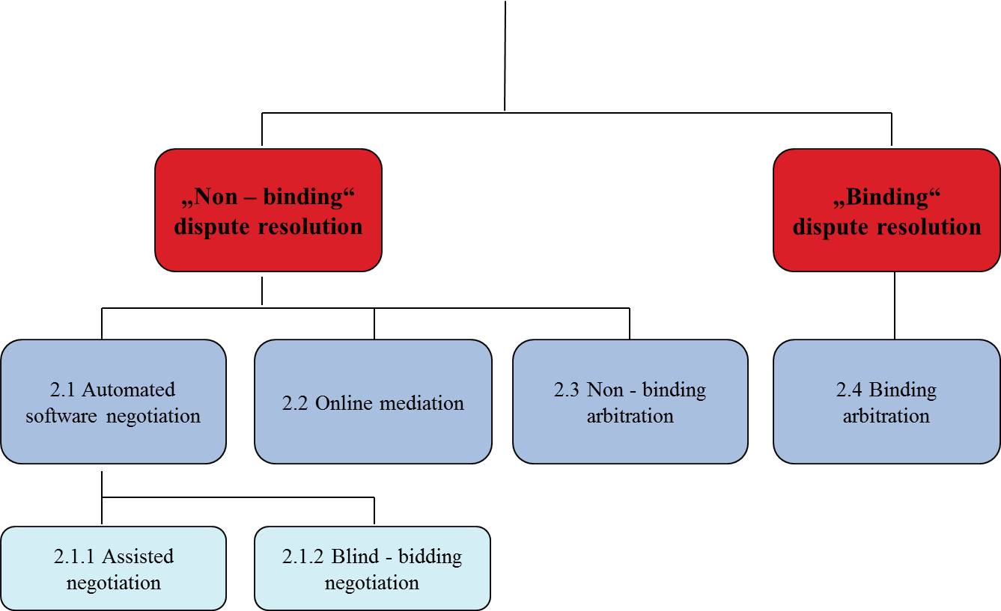
Binding / Non – binding ODR

Slide 54
Binding / Non – binding ODR
The possibility to „enforce“ the outcome of ODR is one of the key factors
Binding ODR
Enforcement by public authorities
Non – binding ODR
Acceptance of the decision by participating parties and enforcement solely by private mechanisms
ODR highly increases access to justice in low - cost (or repetetive) cases

Slide 55
Binding ODR
New York Convention is the most important tool to recognize and enforce binding arbitral award
It is the key to enforce online binding decisions adjudicated in contractual states
Legality of online arbitration
Online arbitration agreement
Online arbitration proceedings
Online arbitration award
Online arbitration enforcement
Appeal and revision

Slide 56
Binding ODR
Problems:
Outdated mechanisms for enforcement of online awards
Traditionalism of some legislations with recognition and enforcement of online arbitral award (e.g. identification of the arbiters, localization of the arbitration, agreeing by parties on the arbitral agreement)
National rules of protecting the consumer
Slowness of using New York Convention mechanisms
Trust by the users into the online tools and binding enforcement mechanisms

Slide 57
Non – binding ODR
Enforcement is secured by private organization using less formalized rules especially in small – value B2C, C2C transactions
Non – binding arbitration is based on the idea of self - regulating the community with no connection to national legislation and enforcement mechanisms
Private organization is the only one, who controls the resources valuable to both buyers and sellers traded under certain community
Only very few online buyers and sellers are willing to go to court to enforce their decisions under national and international rules (especially in low – value cases)

Slide 58
Non – binding ODR
Problems?
The rules are created ad hoc and ODR systems are fragmented, which can lead into decreasing users‘ confidentiality in solving their disputes using non – binding methods
It is impossible to decide the damages of the dispute
Non – binding ODR enforcement mechanisms are fully workable when the transactions are repeating
Convincing online businesses to finance ODR systems, thus to use ODR mechanisms

Slide 59
Binding or Non – binding enforcement of ODR: The outcome?
Binding ODR
International framework with NYC and national rules are the most convenient tool to be used in nonrecurring (single - shot) higher value especially in B2B transactions
Non - binding ODR
Contract binding, does not establish res iudicata
The significant usability mainly in repeated (multiple – shot) B2C, C2C low – value, high - volume cases
1) reputation
2) escrow/chargeback

Slide 60
Icann & Udrp (something in between)
In the beginning, when the party registers the domain name, it agrees to undergo an online dispute settlement if someone files a complaint about his registered domain name in the future
ICANN as the organization securing top – level domain names is the only one responsible for enforcing the rules in this area using UDRP (Uniform Domain-Name Dispute-Resolution Policy)
The enforcement
If the complainant loses, the holder of the domain name remains the owner
If the complainant wins, the domain name is transferred by ICANN to the complainant
The court proceeding are possible, but rarely used. The court however follows previous decision made by UDRP arbitration process.

Slide 62
Stay sober (ODR won‘t save the world)
Modern technologies help with access to justice, but it can‘t be overrated
The dispute can still be decided also without using modern technologies
Full utilization of online communication, online file management, etc. isn‘t absolute condition to decide the case
However all those tools significantly speed up the process and help the parties to solve their case

Slide 63
Future?
Lex informatica – development, existence?
Necessary investment
Possible application not only in e – commerce, but also in other smaller disputes:
Telecommunications, energetics, etc.
ODR tools can be applied in court proceedings

Slide 64
Future of ODR - ejustice
Multi-step process:
1) negotiation
2) mediation
3) binding decision-making process
The courts would manage whole process, transfer available information to the next stages, and ultimately process the court's decision when linking non-binding decision-making to the judicial system
→ the courts would be shielding whole process and offer whole technologiacal environment and tools)

Slide 65
Back to UDRP
What is it?
What it serves for?
Why is it binding (or is it)?

Slide 66
UDRP vs National solution or .eu?
Did you understand how it works?
What is the relationship?
Please discuss..

Slide 67
Thank you for your attention!
Questions?

