Slide 1
How to file a complaint

Slide 2
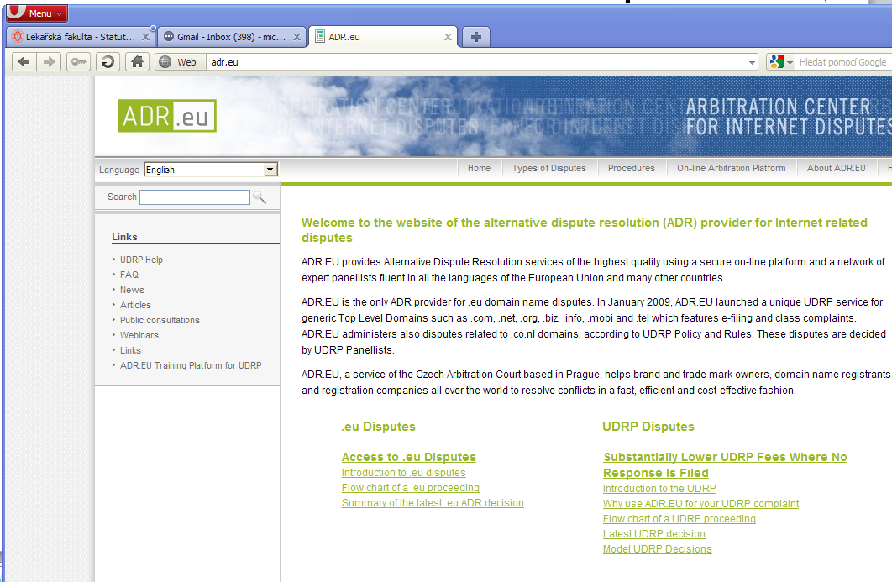

Slide 3
Testing the CAC’s UDRP Platform
We are delighted to present you an easy and flexible possibility how to familiarize yourself with our new UDRP on-line platform.
You can access our Test Platform which is available on: http://udrp.expert4me.com/.
All you need to do is to click onto the on-line platform in the main menu, register your
name and details and then follow the instructions.
If you have any technical difficulties, please contact the UDRP Support Team who you can reach by e-mailing support@expert4me.com.

Slide 4
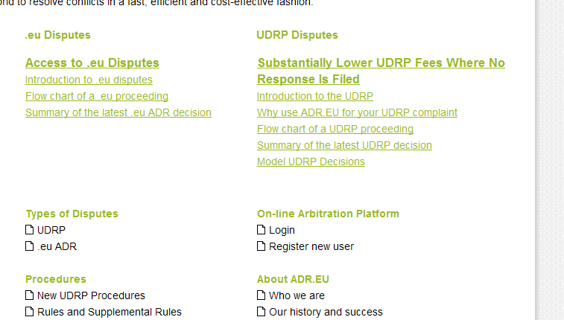
http://udrp.expert4me.com/

Slide 5
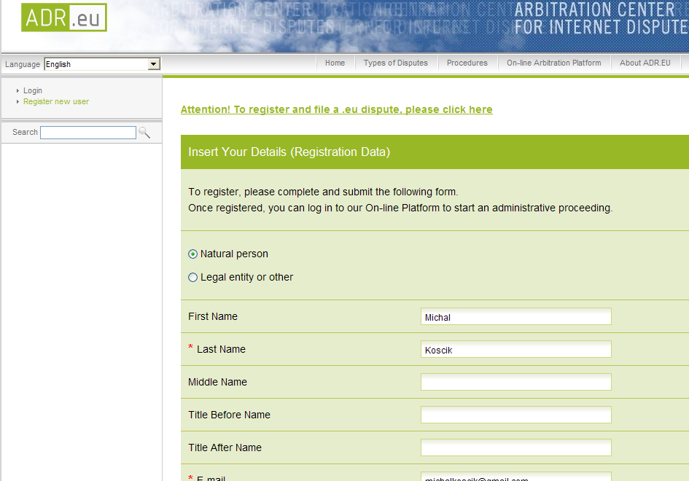
Registration

Slide 6
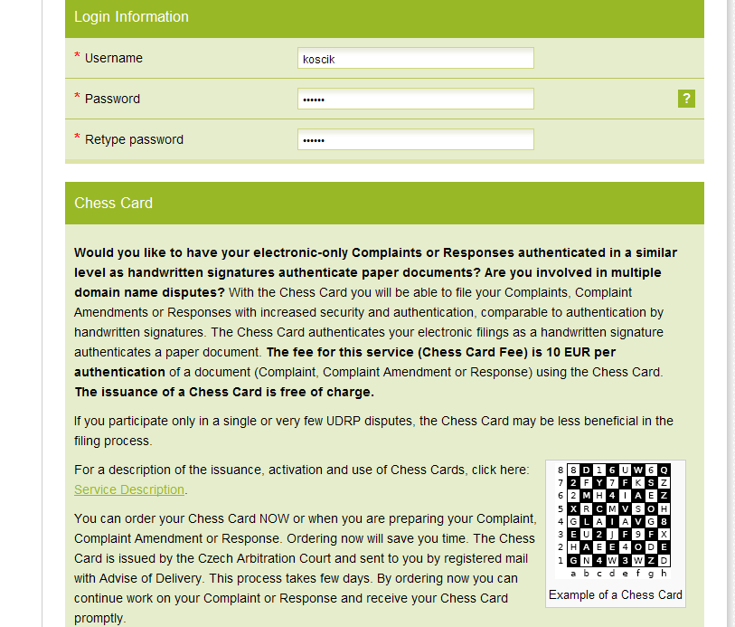
LOGIN

Slide 7
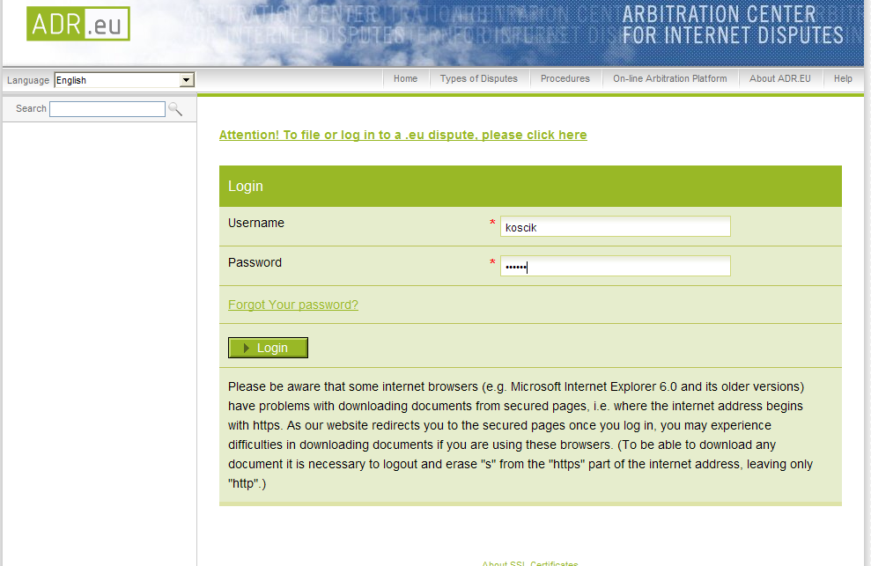

Slide 8
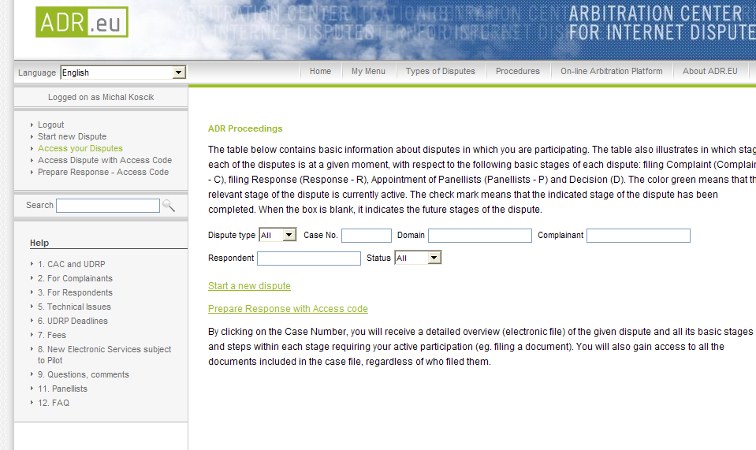

Slide 9
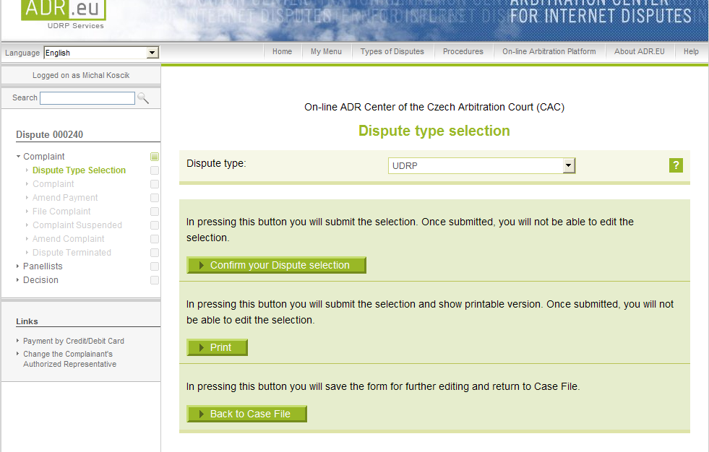

Slide 10
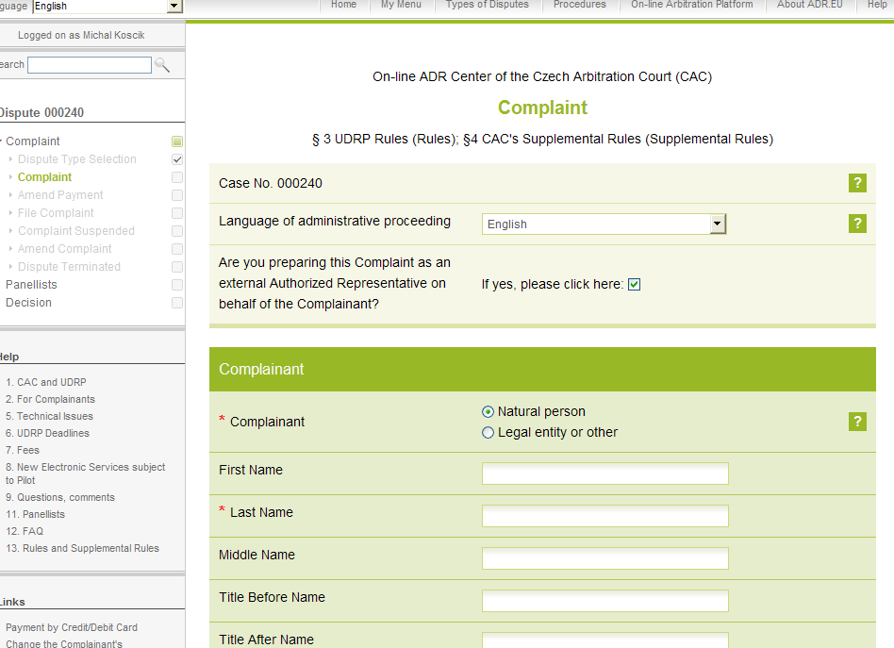

Slide 11
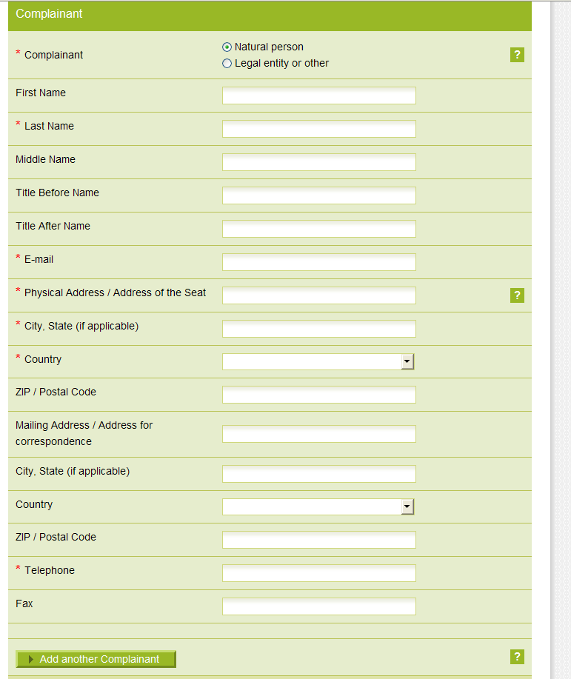

Slide 12
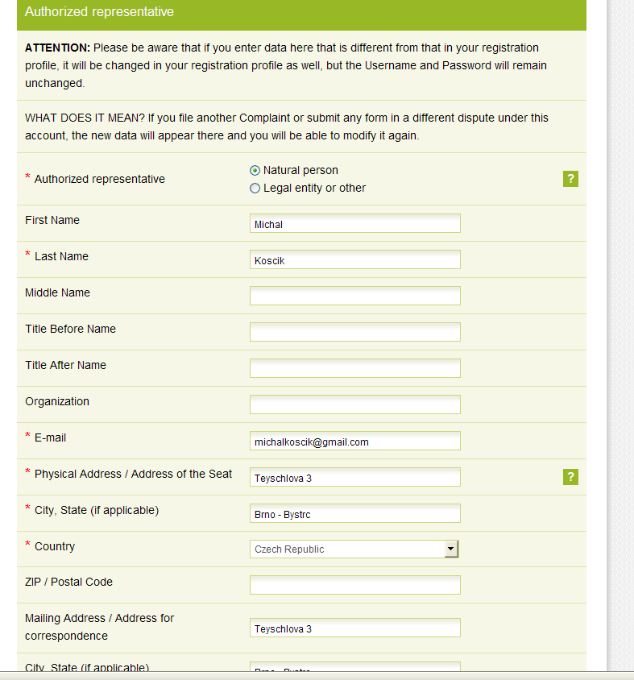

Slide 13
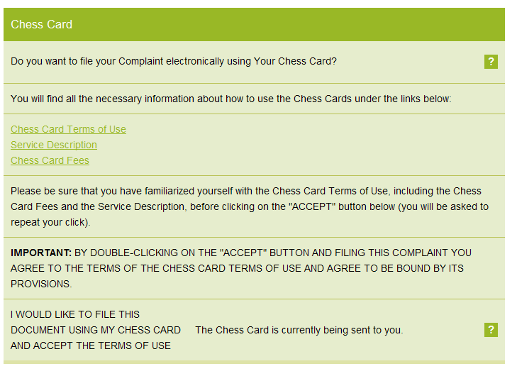

Slide 14
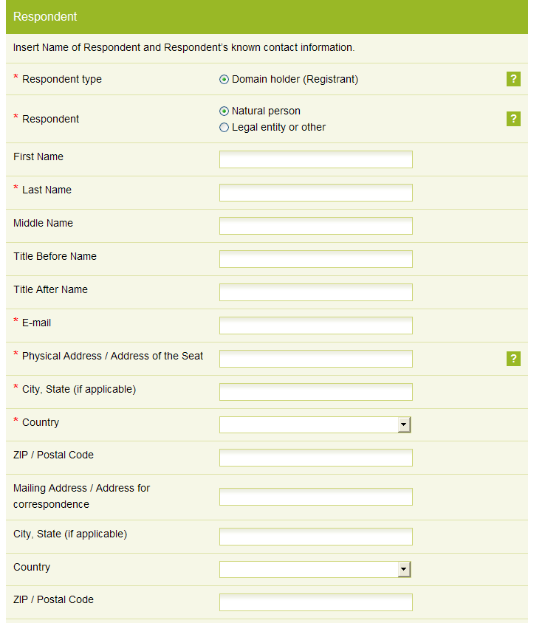

Slide 15
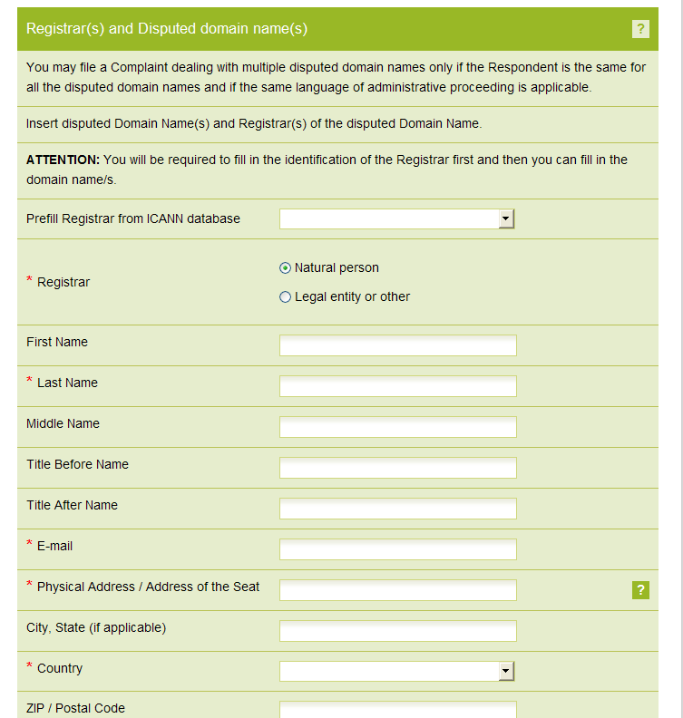

Slide 16
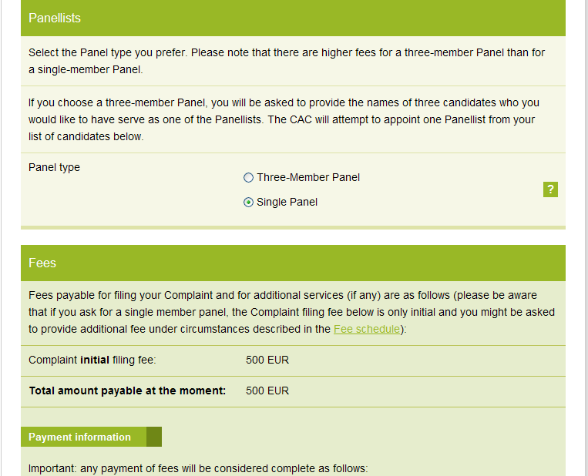

Slide 17
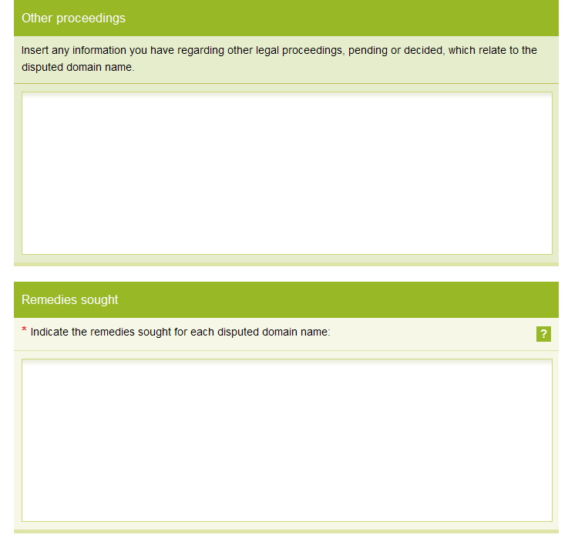
TRANSFER
REVOCATION

Slide 18
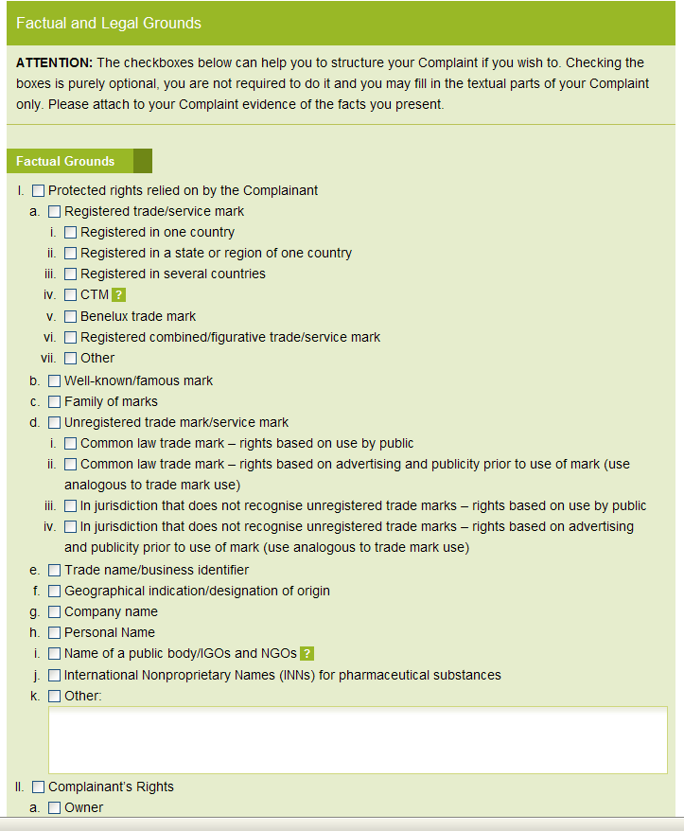

Slide 19
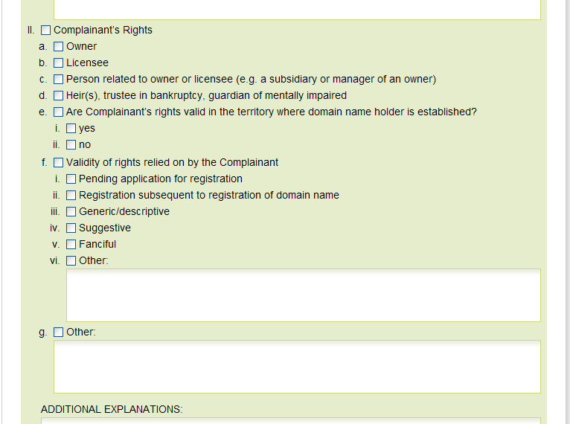

Slide 20
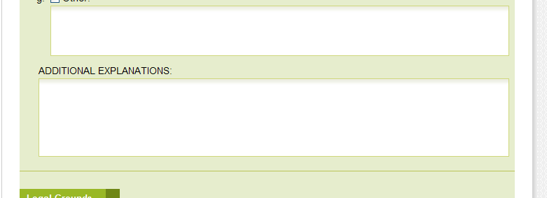
PLEASE FILL !!!

Slide 21
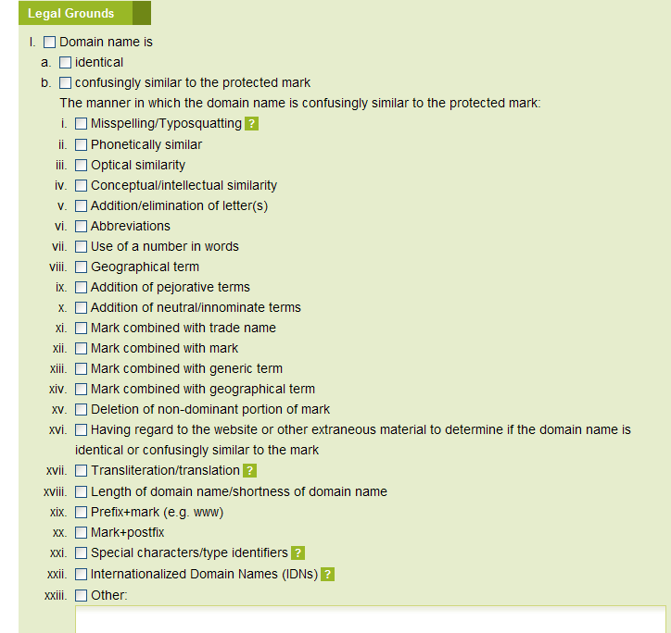

Slide 22
PLEASE FILL !!!

Slide 23
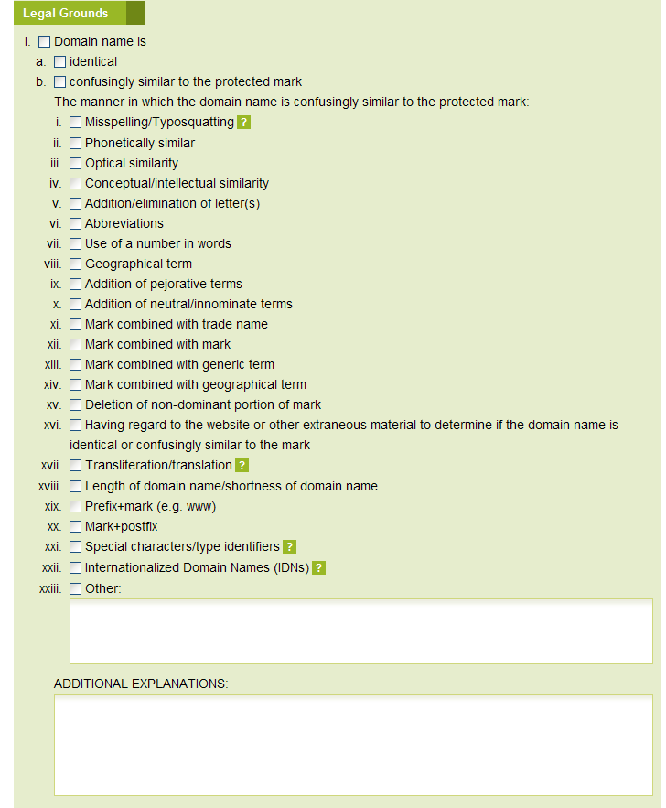
PLEASE FILL !!!

Slide 24
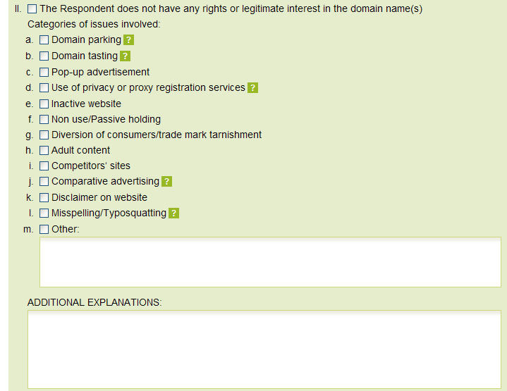

Slide 25
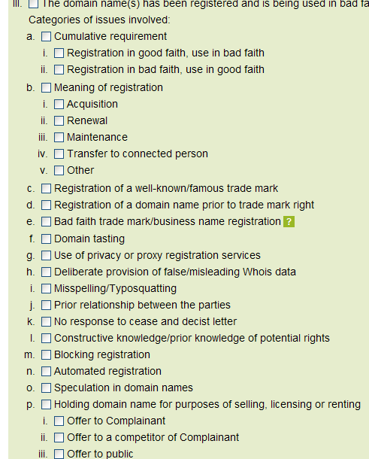

Slide 26
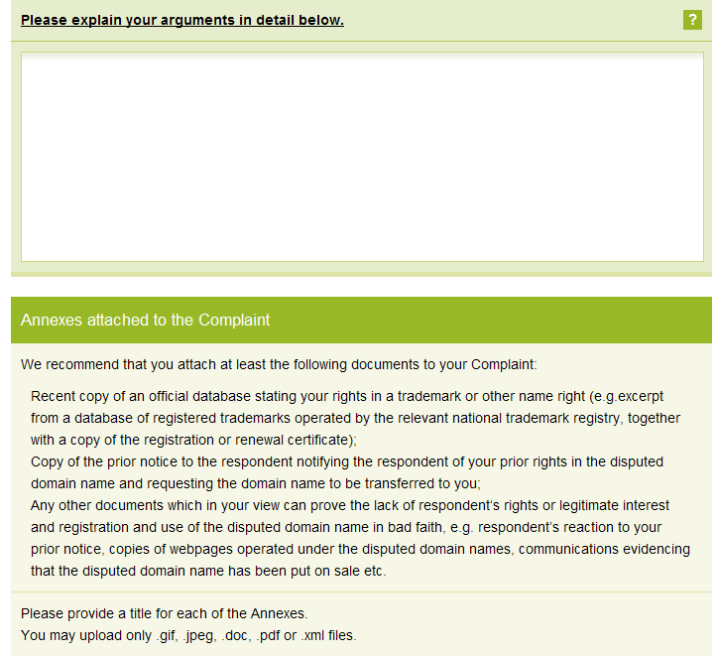

Slide 27
!!!!!!!!!!!!!!!!!
In addition to filing your Complaint with the CAC you must send a copy of your Complaint to the Respondent. You may use the following means according to your discretion:
By fax, with a confirmation of transmission; or
By postal or courier service, with postage pre-paid and return receipt requested; or
By email, provided a record of the transmission is available.

Slide 28
By email, provided a record of the transmission is available
In the CAC form –
Press print !
You will get HTML text
Copy it
Send it to the defendants (all three)
Copy to michalkoscik@gmail.com, loutocky@gmail.com

