Slide 1
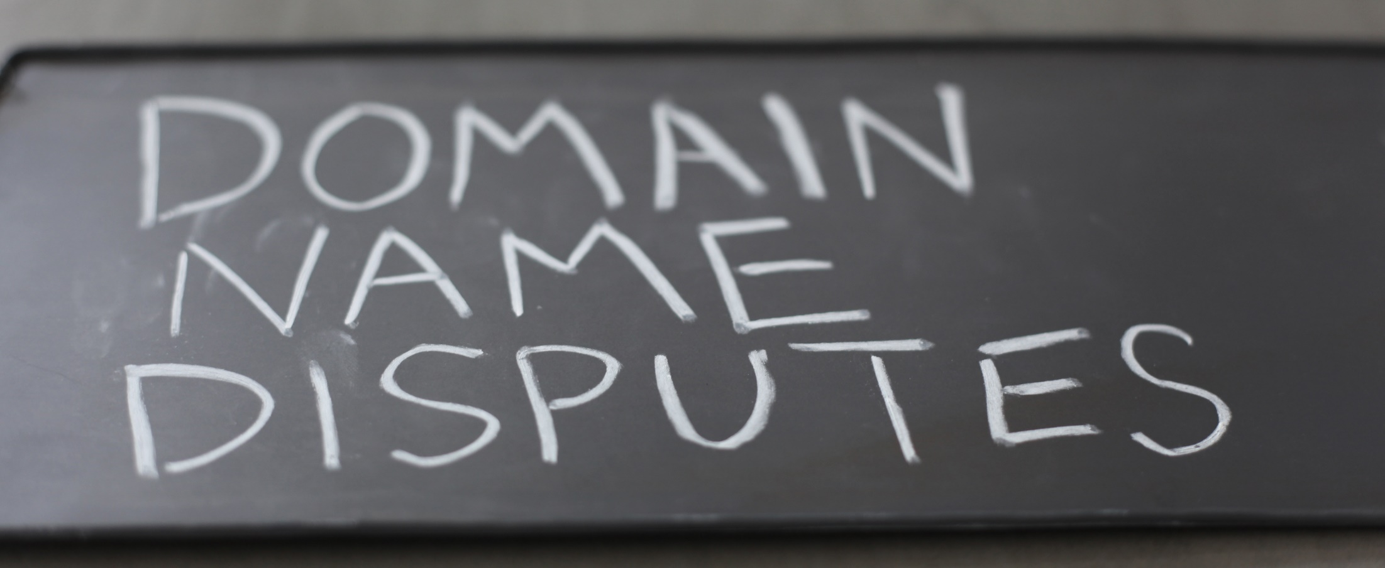
UDRP Case-Law
JUDR. Pavel Loutocký, Ph.D., BA (Hons)

Slide 2
MAIn principle
First comes – first served
The domain name is immediately registered
What if the holder of domain name is not the one who should own it?
Cybersquatting, typosquatting, etc.

Slide 3

Sqautters allowed?

Slide 4
?
#WWYD

Slide 5

Example
Someone registered the domain skoda.com
He does not use this domain and offers it for sale for €200.000
Can the trademark owner claim violation of his rights?
Can the trademark owner claim transfer of the domain name?
What if the owner is based in CZ (GER), administrator is US and squatter Russian?

Slide 6

Icann & Uniform domain-name dispute resoution policy - UDRP (basic principle)
  In the beginning, when the party registers the domain name, it agrees to undergo an online dispute settlement if someone files a complaint about his registered domain name in the future
  ICANN as the organization securing generic top – level domain names is the only one responsible for enforcing the rules in this area using UDRP (Uniform Domain-Name Dispute-Resolution Policy)
  The enforcement
    If the complainant loses, the holder of the domain name remains the owner
    If the complainant wins, the domain name is transferred by ICANN to the complainant (or is cancelled)
    The court proceeding are possible, but rarely used. The court however follows previous decision made by UDRP arbitration process.

Slide 7
ICANN & UDRP
Internet Corporation for Assigned Names and Numbers
Nonprofit organization responsible for the coordination of maintenance and methodology of databases of unique identifiers (domain names) and ensuring the network's stable and secure operation
Management of domain names and IP addresses
ICANN registers top - level generic domain names

Slide 8
ICANN & UDRp
Top - level domains (examples):
  country-code TLD: .cz, .us, .gb, .fr, .de, .at, etc.
  generic TLD: .com, .org, .net, .gov, .int, .edu, .mil,
  .biz, .ceo, .info, .museum, .tel, .travel, etc.
  List of all generic domain names (1532):
  http://data.iana.org/TLD/tlds-alpha-by-domain.txt

Slide 9
ICANN & UDRP
The future of ICANN?
  ICANN was transferred in September 2016 to the global multi-stakeholder community (international character)
  „No one, no government and no organization should control the internet“
  The “control” of the internet by states (which is related with the transfer of ICANN) could change the basic open character of the internet, to change „old customs“ and to make it less hospitable

Slide 10
UDRP
What is it?
What it serves for?
Why is it binding (or is it)?

Slide 11
UDRP
Trademark holder
?
Domain name holder
Registrar
Administrator

Slide 12
UDRP process
„Non – binding“ dispute resolution
„Binding“ dispute resolution
2.1 Automated software negotiation
2.2 Online mediation
2.3 Non - binding arbitration
2.4 Binding arbitration
  Uniform domain name Dispute Resolution Policy (UDRP)
  It is the resolution of the disputes regarding the registration of internet domain names (trademark disputes)
  It applies to:
  all generic TLD (.aero, .asia, .biz, .cat, .com, .coop, .info, .jobs, .mobi, .museum, .name, .net, .org, .pro, .tel and .travel)
  some ccTLDs (Australia, Ireland, etc.) - +- 70 states
2.1.1 Assisted negotiation
2.1.2 Blind - bidding negotiation

Slide 13
UDRP process
  It was launched at 1999 to deal with „The Trademark Dilemma“ (cybersquatting) - disputes arise from abusive registrations of domain names
The rules were drafted in close cooperation with WIPO
All registrars have to follow UDRP (contract)
Disputes are resolved by agreement, court action, or arbitration before a registrar will cancel, suspend, or transfer a domain name
The process is initiated by the holder of trademark - filing a complaint within an approved dispute-resolution service provider

Slide 14
UDRp Process
Disputes are frequently cross – border
Need for speed, accessibility
  Disputes are however not based on trademarks solely – it is the process disengaged from national laws (almost) –bare it in midn and also do not use natinal legislation while filing UDRP complaint

Slide 15
UDRP process
Step - by - step process
  Complainant launches the claim at dispute resolution provider
  Registrant has the opportunity to respond and to decide whether there will be one or three panel members at the process
  Dispute resolution provider assigns panelist(s)
  Panelist(s) render decision based on evidence submitted

Slide 16
UDRP
Response
Panel
Notification
File complaint
Decision
Implementation
Review
0
+3
+1
+20
+5
+14
+3
+10
Commencement
56 days

Slide 17
Authorized providers of UDRP
[ADNDRC] Asian Domain Name Dispute Resolution Centre
[NAF] The National Arbitration Forum
[WIPO] World Intellectual Property Organization
[CAC] The Czech Arbitration Court
[ACDR] Arab Center for Domain Name Dispute Resolution
https://www.icann.org/resources/pages/providers-6d-2012-02-25-en

Slide 18
Specific rules for each provider
UDRP
WIPO Supplemental Rules
NAF Supplemental Rules
ANDRAC Supplemental Rules
CAC Supplemental Rules
ACDR Supplemental Rules

Slide 19
UDRP process
Advantages:
  Fast – the case can be decided within 2 months
  Inexpensive
  Co - existing with local legal systems
  Global solution
  Accessible – decisions are freely available
  Price: http://www.wipo.int/amc/en/domains/fees/

Slide 20
UDRP process
Disadvantages:
  Hard to control (are we getting good decisions?)
  Transparency of panellists
  Inconsistent decisions
  Only transfer (cancellation) of the domain name is decided (not damages)

Slide 21
UDRP process
Problems:
Forum shopping:
  Complainant win percentages:
    WIPO – 82%
    NAF – 83%
    eResolution – 63% (not working any more)
2011
  WIPO – 19.123 cases
  NAF – 16.134 cases
  eResolution – 277 cases

Slide 22
UDRP process
Problems
Case allocation bias:
  One panelist (83% probability to transfer domain name)
    vs
  Three member – panels (60% probability to transfer domain name)
!! 3 member panel is more expansive and there is lower probablity to win the case !! (however it can be part of the tactics !!)

Slide 23
UDRP shielded by court
Storey v. Cello Holdings LLC (american court decision)
The agreement with UDRP is implemented by chains of contracts and it is involuntary
ICANN as the only regulator does not offer any other solution
The decision is contractually binding just between the parties (no rei iudicata)
The parties cannot be prevented from submitting their dispute to the court

Slide 24
UDRP case study in general
Classmates Online, Inc. v. John Zuccarini
Possibility to file additional information (an exception)
No predcedent, but the decisions are following previous ones
„To avoid any misunderstanding that the decision establishes a precedent, we call for caution and recommend to submit complete documentation of the case when filing a complaint.“

Slide 25
UDRP Case study
Donald J. Trump v. Mediaking LLC
The complaint (and the answer) is limited to 5000 words
The panel said, that it has accepted longer complaint, however it only considered the main arguments (not the best argumentation)
X Giga Pty Limited v. Elena Sadkovaya
The complaint had to be shortened and filed again

Slide 26
UDRP case study
Two Way NV/SA v. Moniker Privacy Services, LLC
Usual case (registered trademark X cybersquatting)
however:
The complainant tried to disqualify the panelists (he partly succeeded) because he wanted to have higher probability to win the case
Obvious decision - Panel denied the complaint and made no finding of reverse domain name hijacking – first comes, first served

Slide 27
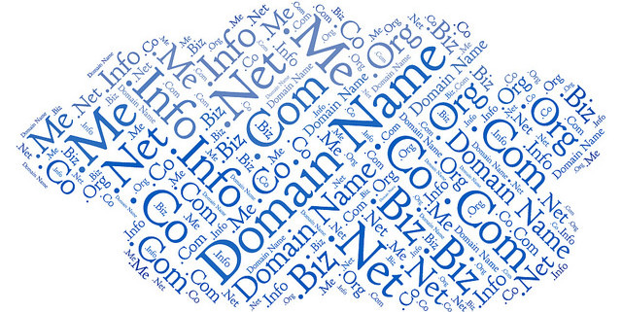
UDRP process

Slide 28

UDRP process

Slide 29
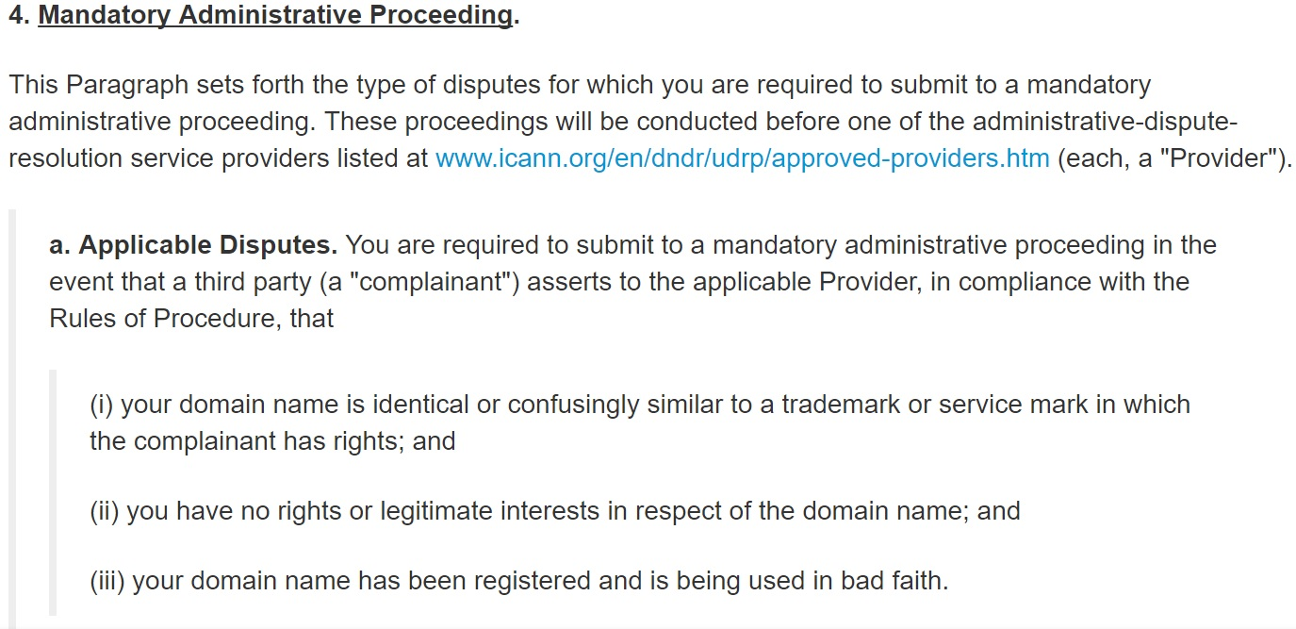
Cumulative condition

Slide 30
UDRP process
Complainant has to prove (all of it):
  Domain name is identical or confusingly similar to a trademark in which complainant has rights
  No rights or legitimate interests in respect of current domain name
  Domain name has been registered and is being used in bad faith

Slide 31

1) Identical or confusingly similar
The test:
comparison between the trademark and the domain name itself to determine likelihood of Internet user confusion.
the relevant trademark would generally need to be recognizable as such within the domain name
the content of website is irrelevant
E.g. guiness.com

Slide 32
1) Identical or confusingly similar
guiness.com = Typosqatting!

Slide 33
Combination of trademark and generic name
Pilsner TM
Audi TM
Apple TM
Pilsnerbeer.com
Audicars.com
Applephones.biz
Is it identical or confusingly similar?
WHAT DO YOU THINK?

Slide 34
AT&T Corp. v. John Zuccarini d/b/a RaveClub Berlin Case No. D2002-0666
A review of the second-level domains
"atttbroadband“
"attbraodband“
"attboradband“
"attbroadban“
"attbrodband“
each domain comprises of the Complainant’s mark AT&T or a slight variation thereof as a prefix and the word "broadband" or a misspelling thereof
that corresponds to a term implying communication and that the public would accordingly associate with the Complainant.

Slide 35
Domain names consisting of a trademark and a negative term
Sucks, blows, stinks

Slide 36
Confusing similarity
Wallmartsucks.com, bridgestonesucks.com
Majority view:
  a trademark and a negative term is confusingly similar, because the domain name contains a trademark and a dictionary word
  For non-commercial use it should be OK
Minority view
  not confusingly similar because Internet users are not likely to associate the trademark holder with a domain name consisting of the trademark and a negative term

Slide 37
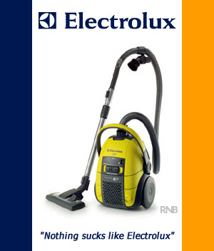
<electroluxsucks.com>

Slide 38

Confusing similarity
It always has to be decided CASE BY CASE

Slide 39
Trademark registered before the registration of domain
Registration of a domain name before a complainant acquires trademark rights in a name does not prevent a finding of identity or confusing similarity.

Slide 40
Registration after the domain name
The UDRP makes no specific reference to the date on which the holder of the trademark or service mark acquired rights.

Slide 41
Registration after the domain name
Generally speaking, when a domain name is registered before a trademark right is established, the registration of the domain name was not in bad faith
BUT!!!! When the respondent is clearly aware of the complainant, and it is clear that the aim of the registration was to take advantage of the confusion, bad faith can be found
garancedore.fr/com
(Mariline Fiori p/k/a Garance Doré v. Private Registrations Aktien Gesellschaft Case No. D2012-1620)
However, in such circumstances it may be difficult to prove bad faith
  Digital Vision, Ltd. v. Advanced Chemill Systems D2001-0827, Denial (it was not registered in bad faith)
  AB Svenska Spel v. Andrey Zacharov D2003-0527,Transfer

Slide 42
Registration after the domain name
Conclusion:
Registration of a domain name before a complainant acquires trademark rights in a name does not prevent a finding of identity or confusing similarity under the UDRP.

Slide 43
Geographical indication = trademark?
Brno.com
Czechrepublic.com
Czech-babes.com
Bayern Munchen

Slide 44
Geographical indication = trademark?
No specific protection to geographical terms under the UDRP.
Can be protected under the UDRP, if the complainant has shown that it has rights in the term and that the term is being used as a trademark.
  FC Bayern München AG v. Peoples Net Services Ltd. D2003-0464, Transfer (<bayernmuenchen.net>)

Slide 45
Geographical indication = trademark?
It has generally proven difficult for the legal authority of a geographical area (which has not otherwise obtained a relevant trademark registration) to show unregistered trademark rights in that geographical term on the basis of secondary meaning.
Cases where local authorities failed
  Porthelsinki.net D2001-0002,
  brisbane.com D2001-0069

Slide 46

TYPOSQATTING

Slide 47
Mispelled IS confusingly simmilar
Wachovia Corporation v. Peter Carrington, WIPO Case No.D2002-0775, <wochovia.com>, Tansfer
Fuji Photo Film U.S.A., Inc. v. LaPorte Holdings, WIPO Case No.D2004-0971, <fuijifilm.com>, Transfer
Express Scripts, Inc. v. Whois Privacy Protection Service, Inc. / Domaindeals, Domain Administrator, WIPO Case No.D2008-1302, <expresscripts.com>, Transfer

Slide 48
2) Legitimate interest
What is legitimate interest?
  Bona fide offering of goods or services
  Commonly known as domain
  Legitimate noncommercial or fair use of the domain name
  without intent for commercial gain to misleadingly divert consumers
  or to tarnish the trademark or service mark at issue.
  Article 4(c) of the rules

Slide 49
Who has to prove legitimate interest?
Complainant bears the "general burden of proof" ….. burden shifts to the Respondent once Complainant makes a prima facie showing that the Respondent lacks rights or legitimate interests.
Neusiedler Aktiengesellschaft v. Kulkarni, WIPO Case No. D2000-1769;
Dow Jones & Company and Dow Jones LP v. The Hephzibah Intro-Net Project Limited, WIPO Case No. D2000-0704.

Slide 50
legitimate interests of reseller/distributor
Car parts

Slide 51
Mercedesshop.com
discussion forum where mechanics and owners of Complainant's products discuss
also offers genuine Mercedes parts and accessories for sale,
were obtained through fully authorized channels of distribution. Respondent also offers clearly identified quality, re-built, and used parts.
disclaimer at Respondent's web site of no affiliation between Complainant and Respondent.

Slide 52
Mercedesshop.com
It is exceedingly unlikely that any user seeking to find Complainant <mercedes.com> would enter <mercedesshop.com>.
Moreover, there is a clear disclaimer at Respondent's web site of any affiliation between Complainant and Respondent.
DaimlerChrysler A.G. v. Donald Drummonds, WIPO Case No.D2001-0160, Not transferred

Slide 53
discount-marlboro-cigarettes.com
Discount cigarettes
Respondent’s website is likely to mislead users of internet into believing the site is operated or endorsed by or affiliated with Complainant.
Create a strong impression that the site is an official site of Complainant
-> Transfer

Slide 54

Generic words in generic domains
Apple.net
Puma.com
Jaguar.com
Husky.com

Slide 55
Lack of legitimate interests in generic words
What has to be considered?:
The respondent fails to show one of the three circumstances under Paragraph 4(c) of the Policy,
The respondent may lack a legitimate interest in the domain name

Slide 56
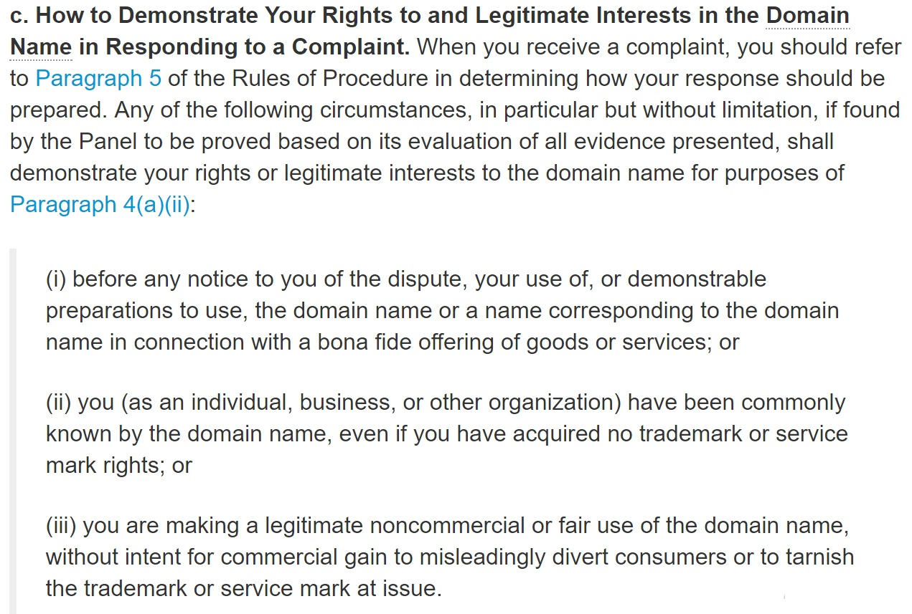
Lack of legitimate interests in generic words

Slide 57
Generic words and legitimate interests
  Back to the case of APPLE:
  respondent may well have a right to a domain name "apple" if it uses it for a genuine site for apples but not if the site is aimed at selling computers or MP3 players (or other similar goods compairing to the products of Apple)

Slide 58
3) Bad faith
What is bad faith?
Article 4 (b) of the rules

Slide 59
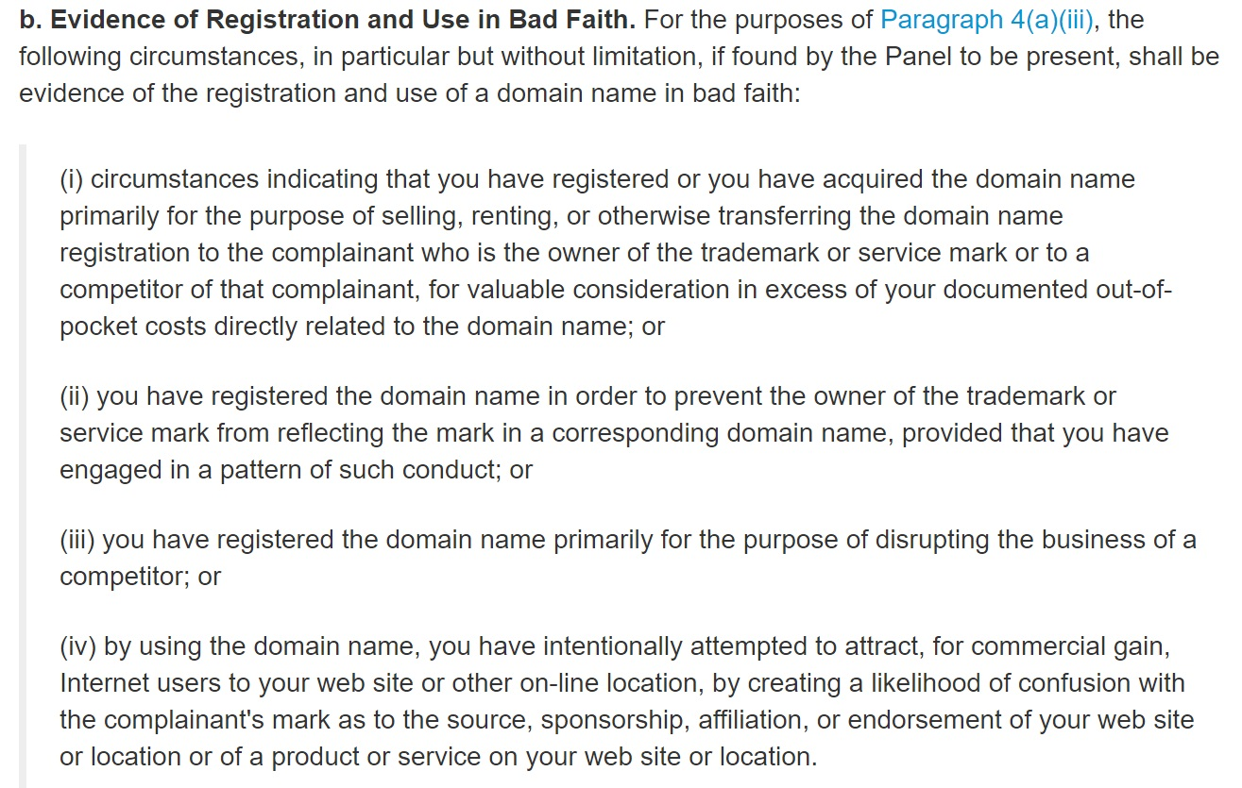
3) Bad faith

Slide 60
Bad faith without any active use
The lack of active use of the domain name does not as such prevent a finding of bad faith.
The panel must examine all the circumstances of the case to determine whether respondent is acting in bad faith
Panels may draw inferences about whether the domain name was used in bad faith given the circumstances surrounding registration, and vice versa.

Slide 61
Presence of disclaimer
Eg. domain bmw.com
Wesite states
  this domain is not associated to BMW
  this domain is for sale
What do you think? Is it OK?

Slide 62

Presence of disclaimer
The existence of a disclaimer cannot cure bad faith, when bad faith has been established by other factors.
A disclaimer can also show that the respondent had prior knowledge of the complainant’s trademark.

Slide 63
Domain name decision structured search
http://www.wipo.int/amc/en/domains/search/legalindex.jsp#15050

Slide 64
MUST READ !
WIPO Overview of WIPO Panel Views on Selected UDRP Questions, Third Edition
(“WIPO Jurisprudential Overview 3.0”)
http://www.wipo.int/amc/en/domains/search/overview3.0/

Slide 65
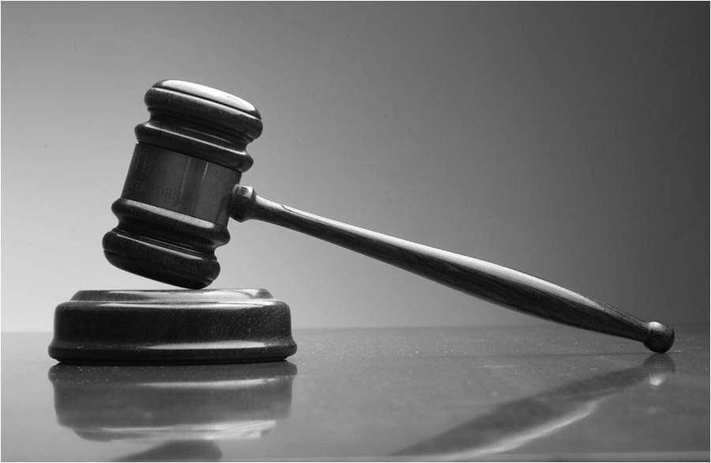
Thank you for your attention!
Questions?

