Slide 1
Selected Problems of Czech Criminal Law
Defense in Criminal Proceedings

Slide 2
Anglo-American vs. Continental System
Different approaches
  depends on the character of the criminal proceedings
  inquisitorial v. adversary
  Similarities given by the nature of the criminal defense
  e.g. the standard of proof
  presumption of innocence

Slide 3
Anglo-American System
Thorough equality of arms
  no preparatory proceedings, the truth comes out of the clash of the parties’ statements and evidence (eristic model)
  Jury system
  makes the trial more unpredictable
  the prosecution is more willing to negotiate
  System of appeal in favour of the defendant
  So-called „two cases approach“
  tendecy to accept plea bargain if the defense has no case

Slide 4
Continental system
Formal equality of arms in the trial phase
  defense plays more of a reactive and corrective role
  strong role of the preparatory proceedings
  no equality of arms outside of court
Professional judge system
  “professional deformation”
  better foreseeability for the prosecutor
Twofold system of appeal
  prohibition of reformationis in peius
  right of the prosecutor to appeal to defendant‘s detriment

Slide 5
Defense in the Criminal Proceeding
Important part of the right to a fair trial
  basic components (art. 6 par. 1 of CPHR) + few “bonuses” (art. 6 par. 2 and 3 of CPHR)
Ensuring a possibly effective chance for the defendant to influence the course of the proceedings in his/hers favour
Division
  defense in the material sense
  defense in the formal sense

Slide 6
Defense in the material sense
Giving the defendant legal instruments to oppose the prosecution
  right to make statements
  right to collect and present evidence
  right to comment evidence
  right to propose certain procedures
  right for legal remedies [to appeal etc.]
  right to translation and interpretation
Right to remain silent

Slide 7
Defense strategies and tactics
Defense strategies
  preventing finding of quilt strategy
  milder verdict regarding guilt
  milder verdict regarding punishment
Defense tactics
  facts based tactic
  material law based tactic
  procedural law based tactic
  „passive“ tactic (remaining silent and uncooperative)

Slide 8
Nemo tenetur se ipsum accusare
the defendant as a source of evidence vs. as a subject of the procedure
  not only what he/she remembers, but also fingerprints, DNA, scars, bruises etc.
  the law enforcement wants this info
  the defendant might not want to surrender it
no one can be forced to attribute to his/hers own conviction
  ECHR Jalloh v. Germany
  limits: active participation
  the defendant may be forced to brook investigatorial procedures passively

Slide 9
Right to lie?
In most continental systems immunity from perjury
But not immunity from false accusation
What about slander, libel, hatespeech or other verbal delicts?
  ECHR Brandstetter v. Austria
In most systems crime of obstruction of justice
  forging, destroying, altering etc. evidence, abbeting to commit perjury etc.

Slide 10
Defense in the formal sense
Right to be legally represented
  right to choose one’s own attorney [always]
  obligatory representation by an attorney in certain cases
  right to be legally represented free of charge in certain cases
Purpose – to have a legal professional at one’s side
  counseling, recommendations, acting on behalf of the defendant

Slide 11
Obligatory legal representation
Obligation to be legally represented from preparatory proceedings on
  in cases of deprivation of liberty (custody, prison etc.)
  diminished legal capacity
  proceedings in absentia
  in the plea bargaing negotiations
  If the judge or prosecutor in the preparatory proceedings deems it necessary
  if the charged crime‘s statutory maximum exceeds 5 years
  in a procedure against a juvenile (never for legal entity)
  + special cases from the start of the trial or in execution
  e. g. trial after fast track preparatory proceedings

Slide 12
Defense Attorney and the Law Enforcement
Rights
  to be present during investigation actions
  to get access to the file
  to get access to his/hers client [e.g. in custody] 24/7 without the presence of another person
Obligations
  obligation to be present during the trial
  obligation to follow the instruction of the law enforcement and the court

Slide 13
Defense Attorney and the Defendant
Rights
  to be instructed
  to be compensated for his work
Obligations
  obligation to professionally represent
  obligation to act only in client‘s favour
  obligation to follow the instructions
  obligation to give counsels and to inform the client
  obligation to respect the attorney-client privilege

Slide 14
Defense Attorney and the Bar Association
Rights
  to legally represent as a defense attorney [so called “defense monopole”]
Obligations
  to keep the dignity of the estate untouched
  to wear the estate’s robes
  to be polite to the law enforcement
  to express himself/herself moderately and up to the point

Slide 15
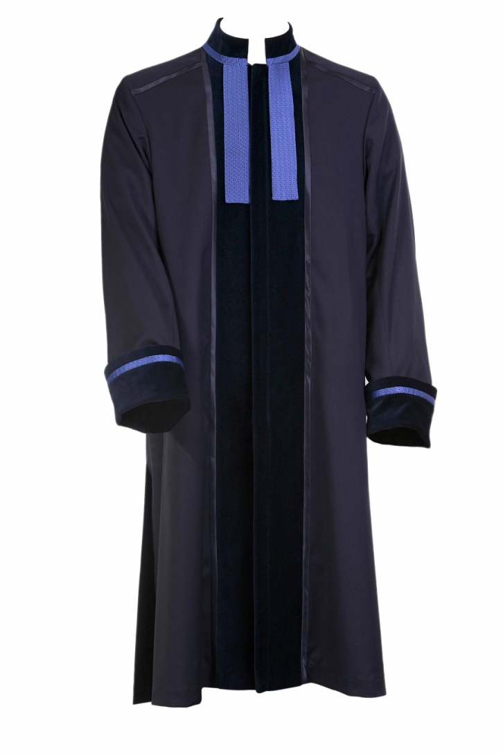
Defense Attorney’s Robe

Slide 16
Who may become a defense attorney
attorney enrolled with the Czech Bar Association
  „long“ graduate study (5 years, master‘s degree in law)
  at least 3 year of praxis as an attorney‘s trainee
  successful passing of a bar exam
  mandatory insurance
  swearing an oath
trainee attorney
  finished legal education
  enrolled as a trainee with the Bar
  employee of a specific attorney (supervisor)
  only cases which are in a jurisdiction of a district court in the first instance

Slide 17
Limits of the Criminal Defense
Defense attorney must
  act always in accordance with the law and the estate’s regulation
  consult the case with the client and give his/hers best opinion
  respect his/hers client’s instruction even if they are in discordance with the attorney’s best opinion
  continue the representation until one of prescribed conditions are met

Slide 18
Limits of the Criminal Defense
Defense attorney must not
  truth-examine client’s statements and pieces of evidence
  lie or present forged piece of evidence
  follow an illegal instruction
  secure the evidence himself/herself
  run personal errands for the client
  restrain from the thwarting of a planned offence or offence in progress
  report known already committed crimes

Slide 19
Obstruction of justice – sec. 347a of CC
  „(1) Who for the purpouses of iniciation of court proceedings, international judicial proceedings or criminal proceedings or in the course of such proceedings presents tangible or written piece of evidence, which has a substantial importance for the decision, while knowing that it has been forged or altered, with an intent for it to be used as genuine one, or who forges or alters such a piece of evidence with intent of it being used as a genuine one, will be punished up to two yers of imprisonment.
  (2) Who on his own or via somebody else provides, offers or promises a benefit to another person or for another person for the purpouse of committing a criminal act of false accusation, perjury and false expert‘s opinion or false interpretation, will be punished by up to three years of imprisonment.“…

Slide 20
Thank you for your attention!
JUDr. Jan Provazník, Ph.D.
Assistant Professor
Department of Criminal Law
Office: room no. 226
Consultation hours: Wednesdays 10:00 - 11:00
E:mail: jan.provaznik@law.muni.cz

