Slide 1
EEA LAW
INTERNATIONAL REGULATION AND SUPERVISION

Slide 2
Financial Stability - InternationalLy
Videos
Regulation
https://www.youtube.com/watch?v=psahnlcr-C0
https://www.youtube.com/watch?v=ryOjSsPxvL8
Payment system
https://www.youtube.com/watch?v=RYncnd5gXaM

Slide 3
Regulation/Supervision/Control/
Surveillance
Regulation – setup of conditions and rules of business in the relevant section of the regulation. These rules can be embodied not only in legal standards and statutory instruments of national law, but also in European and international law
Control It is a generic term that includes Supervision and Surveillance.
Supervision means control and compliance with rules of activities including possible sanctions for not complying inference rules and not by the state but the institution on which this power is transferred
Surveillance– control performed by state authorities
For Financial Market is used term Supervision

Slide 4
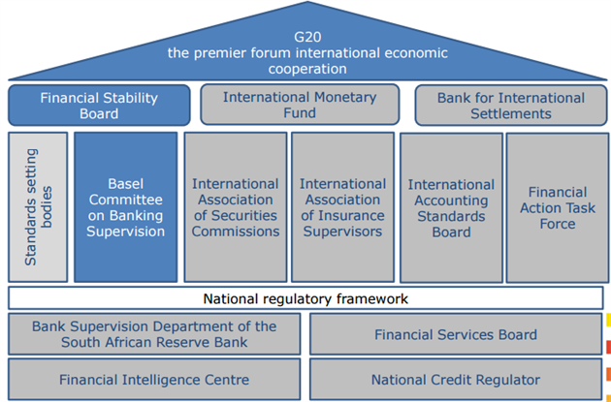
International Supervision

Slide 5
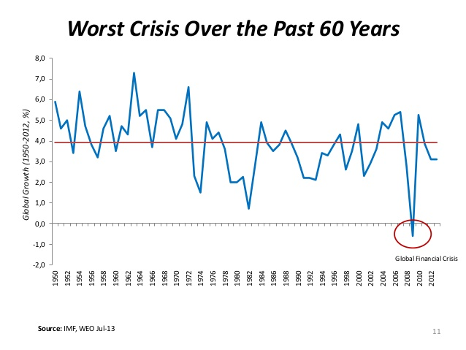
Financial crisis 2007/2008

Slide 6
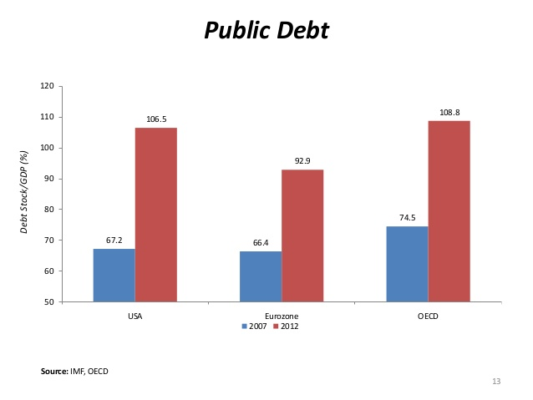

Slide 7
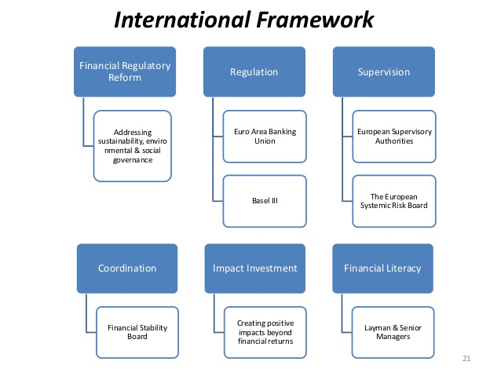

Slide 8
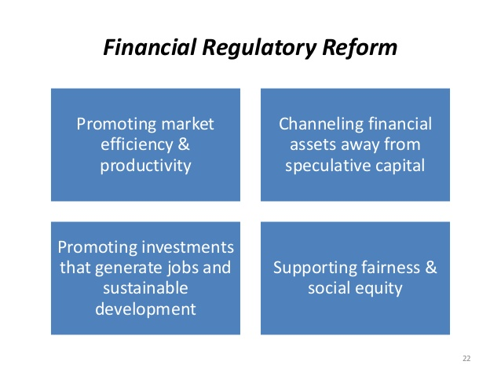

Slide 9
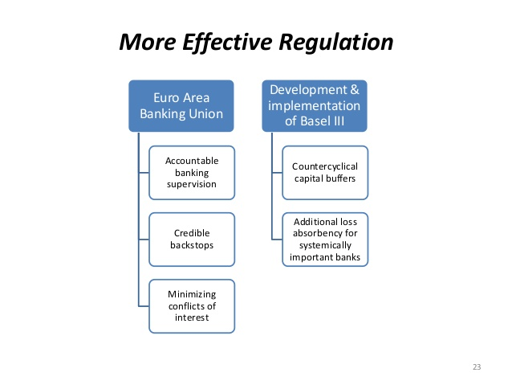

Slide 10
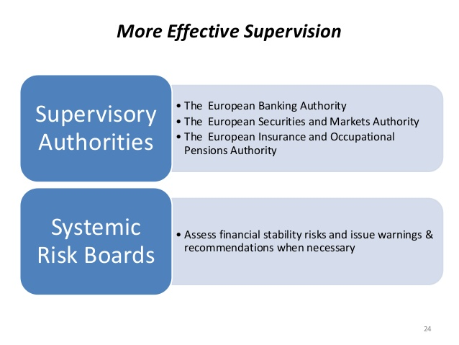

Slide 11
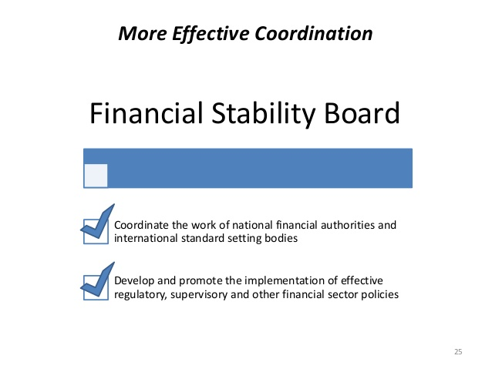

Slide 12
International Supervision
System of. „Core principles“
  Basel Committee on Banking Supervision (BCBS) http://www.bis.org/bcbs/about.htm?m=3%7C14%7C573
  and Key principles for effective banking regulation, Financial stability institute
    + Financial Stability Board - monitors and makes recommendations regarding the global financial system. Promotes international financial stability
    International Association of Insurance Supervisors and (IAIS) Key principles of insurance
    The International Organization of Securities Commissions (IOSCO) and Objectives and Principles for the capital markets and their regulation
    across the spectrum
  Financially-action committee against money laundering (FATF) and its own 40 recommendations

Slide 13
BCBS aND FSB -> G-SIB
Global systemically important banks
http://www.financialstabilityboard.org/wp-content/uploads/r_141106b.pdf
- total loss-absorbing capacity (TLAC) – Rule for the capital adequacy– It helps build higher capital reserves for the purpose of readiness to respond to crisis situations.
? OVERKILL ? For GSIB, which are also EU important banks because of robust MREL (Minimum Requirement for own funds and Eligible Liabilities from 2019). MREL is same principle but differently made up.

Slide 14
Reasons for Higher standards of regulation and Supervision
SYSTEMIC REGULATION and SUPERVISION – systemic risk,
CONSUMER PROTECTION - market abuse risk,
PRUDENTIAL REGULATION and SUPERVISION - prudential regulation of financial institutions and supervision
abuse of dominant position
information asymmetries
These market failures can be associated with more reasons, and it is
criminal law risk, especially in terms of money laundering

Slide 15
European regulation and supervision
Primary sources (TFEU)
Secondary sources
  Regulations
  Directions
Decision of ECJ

Slide 16
Main Areas of Harmonisation
Providing of financial services
Financial market regulation and supervision
Monetary regulation (union)

Slide 17
Supervision of financial conglomerates
Large financial groups and conglomerates are a permanent fixture in the financial landscape and require regulatory attention
System of prudential supervision in the European Union is based on a principle so called. Home country, the supervision of internationally active financial institutions is provided by the supervisory authority of the home country.
- It is a country of registration / license of „parent“ company (financial institution), compared to subsidiaries of this parent company operating in other states – host countries
European passport for financial institutions

Slide 18
supervisory colleges
effective tool for cross-border supervision
Existed since 80ties of 20th century ad hoc
A supervisory college is essentially a permanent, though flexible, structure comprised of an international bank’s “home” and “host” supervisor
Main role came up with EU - CRD III Direction
In practice, colleges are a mechanism for the exchange of information between home and host authorities, for the planning and performance of key supervisory tasks in a coordinated manner or jointly, including all aspects of ongoing supervision, and also for the preparation for and the handling of emergency situations.
The EU law envisages the establishment of colleges of supervisors for EEA banks with subsidiaries or significant branches in other EEA countries. They may include supervisors in non-EEA countries, where relevant.
One of the fundamental tasks for supervisory authorities as members of colleges is reaching joint decisions on the risk-based capital adequacy of cross-border groups and their EEA subsidiaries.

Slide 19
supervisory colleges II
Dispute settlement within a college - or ESA (European Supervisory Authorities) and the Joint Committee Suropean supervisors
When one national supervisory authority disagrees with the actions of another supervisory authority, than enters into solving this "dispute" ESA, which sets a deadline for mediation and acts as intermediary. If no agreement is reached, the ESA decides towards supervisory authority with the obligation to do something or to refrain from some action.
However, if even then a national supervisor does not follow the decision, decisions may be taken directly aiming for the financial institution

Slide 20
MAcRO supervision: ESRB - Frankfurt
Consists of 5 units: General Board; Steering Committee; Advisory Technical Committee; Advisory Scientific Committee; Secretariat
The ESRB is responsible for the macroprudential oversight of the EU financial system and the prevention and mitigation of systemic risk.
In pursuit of its macroprudential mandate, the ESRB monitors and assesses systemic risks and, where appropriate, issues warnings and recommendations.
Not legaly binding warnings and recommendations (act or explain) and „naming and shaming“,
OECD uses naming and for indentifying tax edens or in fight against money laundering. …“Name and shame” can work for money laundering. OECD

Slide 21
MIcRO – ESA´s
Board of appeal
Joint Committee
EBA – EIOPA - ESMA

Slide 22
EU agencies
  European Systemic Risk Board, ESRB - Problem of not found risks or false warnings -> reputation goes low.
  CEBS replaced by European Banking Authority, (EBA)
  CESR replaced by European Securities and Markets Authority (ESMA)
  CEIOPS replaced by European Insurance and Occupational Pensions Authority (EIOPA)

Slide 23
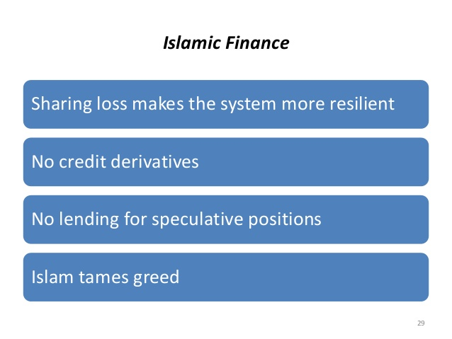
Alternative model for Financial systém…?

