Slide 1
Law of Succession
Concept and Principle

Slide 2
Concept of Law of Succession
Law of succession serves primarily to identify those who will succeed in the legal position of the deceased (P. Bonfante)
Law of succession – a set of rules governing the transition of the property of a deceased individual to other subjects (E. Tilsch)
Succession – a transfer of the property rights and obligations of the deceased citizen, that was not determined at the moment of death, to his / her legal successor (Hromada a kol., Právnický slovník, Orbis: Praha, 1966.)

Slide 3
LAW OF SUCCESSION
PRINCIPLE

Slide 4
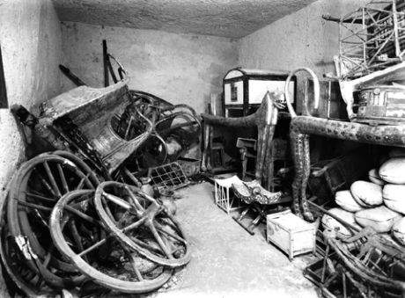
The principle of preserving values
Foto Harry Burton
(1879-1940)

Slide 5
The principle of preserving values
After whom to inherit
What to inherit (movable x real estate from beginning)
Premises:
Privat ownership of individual person
The relationship between the person and his property finish with the death
  Primitive religions – property was destroyed together with the defunct
  „taboo“ – the thing belongs to the deceased even after his death, a disposition with it is forbidden
  Gradual retreat - replacement for symbolic things, symbolic redemption from the dead, etc.
  Does it matter today?

Slide 6
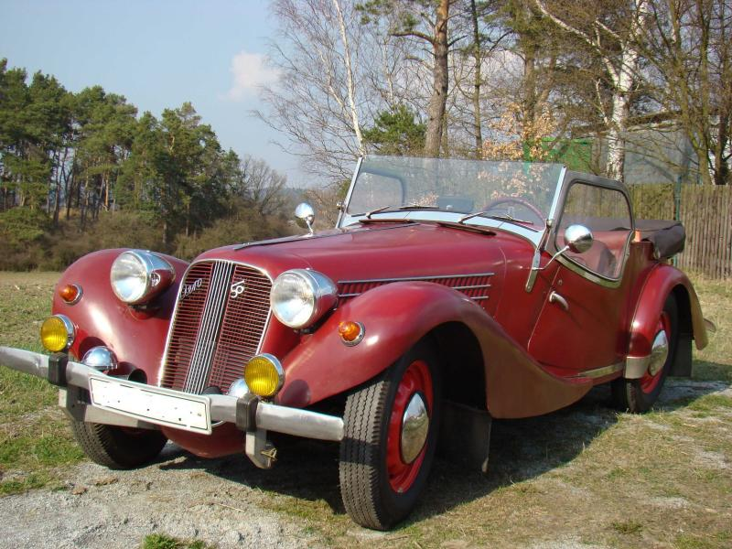
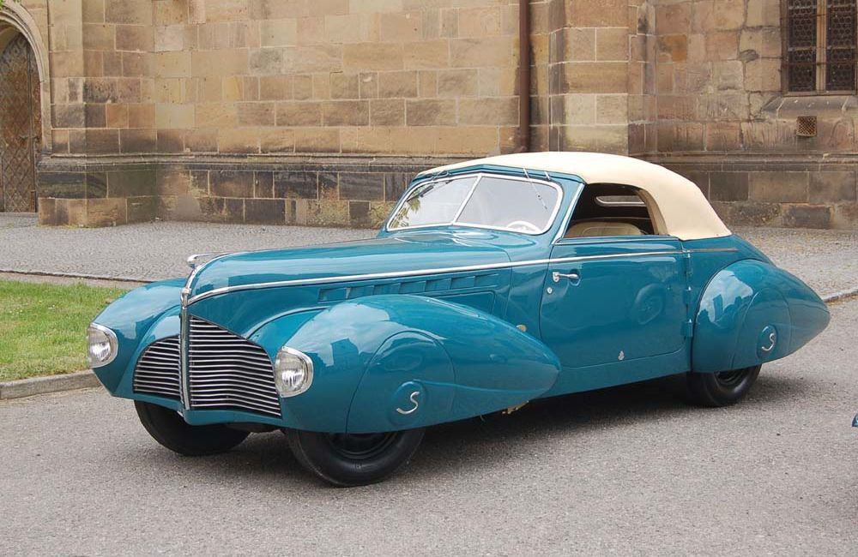
The principle of preserving values
Today:
Important mostly at real estate
But also: industrial enterprises and factories, copyright, etc.
pictures: www.mojeauto.cz a http://auta5p.eu
Meaning/importance(?): this principle manifests the unity of mankind in the future, the solidarity of generations about themselves - it allows the continuation of quality of cultural level and the pursuit of goals that go beyond one human life

Slide 7
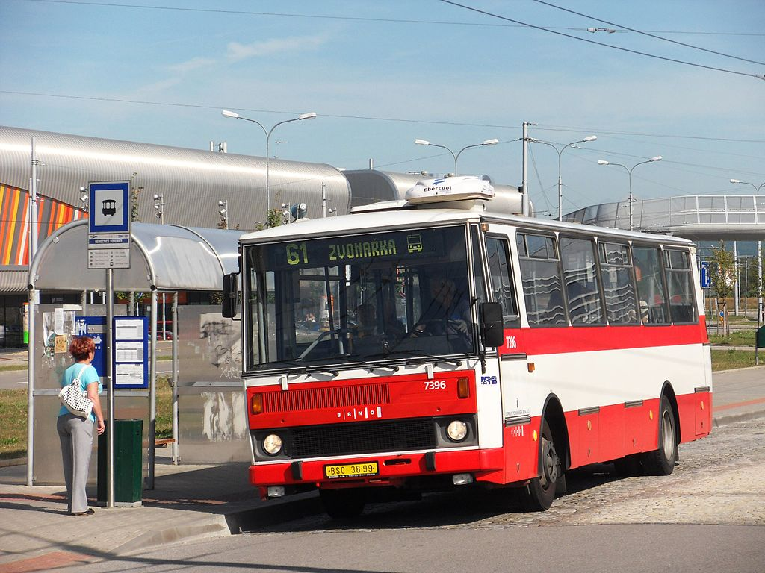
The principle of the transition to an individual person
Privat ownership of decendent x what after the death?
  transition to an individual person
  transition to society as a whole – Bentham, St. Just, St. Simon
  Restriction of succession in favor of society as a whole
Zdroj: www.wikipedie.cz

Slide 8
The principle of the transition to an individual person
Protagonists
Oponents
Motivation for productive activity
It supports the effort to preserve for the next generation
Leaving would reduce productivity and start tendency to spend all income
„Instead of general well-being, general poverty would be“ (Glasson, dle Tilsche)
Maintaining inequality in society
Profit without working
Idea of abolishment of law of succession (Bakunin) x Karel Marx on 4th General Congress of the International Workingmen's Association (IWA) in Basel, 1869 in opposition to this idea – inheritance law is the consequence, not the cause of social relations

Slide 9
The principle of the transition to an individual person
  Restriction of succession in favor of society as a whole
  Restriction of freedom of disposition
  Restriction of intestacy
  Qualitative restrictions- property that can be disposed of (for example: only movable property)
  Quantitative restrictions – i.e. the value at which it is available
Was partly applied in law in years 1948-1989 (not all)

Slide 10
The Principle of freedom of disposition
Is succession on indiviudal person x Who may be it?
Principle of coercion (objectiv) – Solus deus facere potest heredem, non homo
  Primitiv society, equable kind of life
  Also in Middle ages
Principle of freedom (subjectiv)- UTI LEGASSIT SUPER PECUNIE TUTELAVE SUAE REI ITA IUS ESTO (LDT V.3)
  More developed society (monetary system and credit)
  It can be said that it is a manifestation of ius disponendi

Slide 11
The Principle of freedom of disposition
Principle of coercion
Principle of freedom
Pro: It strengthens family ties with equal access to everyone at the same level of kinship /x in history prefered first-born heirs, male descendant etc./, can mitigate unfair behavior in life /descedent in favour x not in favour/
Con: weakening the authority of the head of the family, forces co-ownership, or to disperse property (pauperisation of czech aristokracy in 14th century), may lead to an attempt to transfer assets inter vivos
Pro: it strengthens the sense of responsibility and care for care, ensures unity of property and prevents its fragmentation, allows for better continuity of work and solution of complicated property conditions
Con: unequal position of the heirs, perpetuation of property inequality, the possibility of the testator arbitrarily, the heir may be unduly burdened, to limit inheritance (Trust etc.)

Slide 12
The Principle of freedom of disposition
Limits of the principle
Disposition limited to a number of future generations (Substitution in Trust x Trust)
The need to respect the rights of forced heirs
“la réserve héréditaire” (influence of Code Civil) – the testament is available only for a certain part of the property (in ABGB at prodigal), the rest is for the legal heirs
Forced heirs – compulsory part for forced heirs, the rest can be disposed of
Determining the heir by a third person – such as a family council, or the state - it is not possible, even if the testator pronounced it by himself

Slide 13
The principle of equality
The principle of equality
  All potential heirs have equal position x aristocratic principle (first-born heirs, male descendant etc.)
  Typical for intestacy x it is also important for testacy (the intestacy is on its background and it also looks like it will be tested)
  could be contrary to the principle of preserving values – therefore it is regulated by principle of freedom of disposition

Slide 14
Principle of universal succession
Inheritance is univesitas - roman law
  x old german law tradition - the inheriting asset is held in the whole by the person of the deceased and his death is disintegrated – there are different regimes of different assets (movable x real estate – e.g. England, "feminine" x "male" things - Magdeburg law)
Plurality of heirs – each of them receives only a certain part of asset, it is not possible to inherit a specific thing (heres ex re certa)
Debts – full responsibility of heir (classical roman law) x responsibility for debts limited by the value of the estate (german and english tradition, also justinian roman law)

Slide 15
The principle of freedom of heir acquisition and the principle of official ingerence at acquisition
The principle of freedom of heir acquisition
  Archaic law – heir ipso iure – the heir did not have to manifest, he became the heir at the moment of death of the deceased person
  Roman law – principly of addition – the heir (voluntarii) must decide whether to inherit the inheritance ( x heredes necessarii)
  BGB, ZBG – acquisition ipso iure (tradition + law implies a more typical situation - that is, that the heirs accept, not that they reject the inheritance)
  ABGB (§ 799, 823)– the addition principle
  NOZ – acquisition ispo iure
the principle of official ingerence at acquisition (ABGB, ZGB)
  Defunctus die – the heir accept the inheritance – the court shall confirm and the estate shall be surrendered by the heir
  Every estate must be heard by the court

Slide 16
Thanks for your attention
JUDR. P. Salák jr., Ph.D.

