Slide 1
LEGACY doc. JUDr. P. Salák jr., Ph.D.

Slide 2
WHAT IS LEGACY?
Gift of personal property through a will by the writer of the will (the 'testator') to an individual or organization (the 'legatee').
is the institute of law of succession consisting of unilateral legal action in the case of death, by which the testator gives a certain property advantage to the recipient of the estate.
Heir
  universal succession – liability for debts
Legatee
  singular succession AFTER universal succession
  he doesn‘t participe in inheritance procedure
  Legacy is a debt on the inheritance

Slide 3
Legacy in Roman law
LEGATUM
FIDEICOMMISSUM (Trust)
-based on ius civile
-only as a part of testament
(only the Roman citizens may be the legatees)
-very formal
-four types (2 basic, 2 supplementary)
Per vidicationem
Per praeceptionem
Per damnationem
Sinendi modo
Absolutely informal
not proteceted by ius civile
Protection by „morality“
May exist withoout will (fideicommissum ab intestato)
Change at Augustus time
Beginning of protection x also beginning of formalization and limitation (Flavius)
Justinian – the type which will be more profitable for the legatee, will be used, regardless of the words that the testator used

Slide 4
FIDEICOMMISSUM
CODICILLI
fideicommissum in the letter – as supplement of testament or ab intestato
Codiciar clause - at the end of testment „if this testament will be invalid due to lack of form, but the form would be sufficient for codicil, let it be a codicil“
FIDEICOMMISSUM HEREDITATIS
the heir has the obligation to issue the whole testator´s estate to the trustee
He has the obligation to pay all debts
Limitation by SC Trebelianum and SC Pegasianum
the heirs keep religious rights (sacra privata, iura sepulchrum)
FIDEICOMMISSARY SUBSTITUTION
the heir must, after a certain period of time, hand over testator´s estate to another person - who is not an heir (semel heres, semper heres), but trustee
FIDEICOMMISSUM FAMILIAE RELICTUM
The order of the testator that some esate (typically farmhouse, or manor) must remain in the family

Slide 5
LEGACY TODAY
German legal tradition
– different between the heir and legatee like in roman law
France
System of „reserve“ – difference is not so strong
Hungary
Only terminologically different, the legatee also has responsability for debts (but limited)
Czech republic (1964-2012) and Slovakia (1964-today)
-non existing regulation of legacy – the heir has the whole estate, a part, or a certain thing (car) - he is an heir and has (limited) liability for debts

Slide 6
LEGATUM today
Terminological
– in ABGB „Vermächtnis“ x legatee is „Legatar“
Legacy today is a mix of legatum and fideicommissum
It is formal (mostly the same form, like the will)
X not only in testament – may be also in codicil (F. ab intestato)
Not limited (most codes) x limitation by Falcidian portion (CZ CC 2012)

Slide 7
FIDEICOMMISSSUM today
CODICILLI - codicil (dovětek)
SUBSTITUTIO FIDEICOMMISSARIA
Substitution in trust - only terminology (in fact the second one is not a trustee, but also an heir)
No „substitution“ but „institution“
FIDEICOMMISSUM HEREDITATIS
In Roman law limited for 4 generations x in Middle Ages without limitations
Middle Ages „Fideikomiss“ – inspiration from Spain and Italy, from 17th century until 1924
CzCC 2012 – sec. 1448 „Trust“ – inspiration in CC Quebec

Slide 8
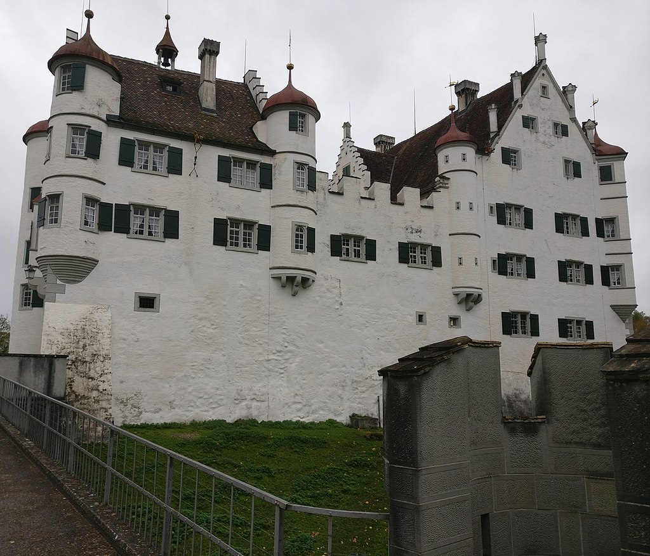
Altenklingen (Switzerland) – trust from 1595
https://en.wikipedia.org/wiki/Altenklingen_Castle

Slide 9
Thank you for attention
P. Salák jr.

