Slide 1
EXTRAORDINARY
TESTAMENTS
SPANISH LAW
LAW OF SUCCESION
Pablo Colomina urios

Slide 2

Testament in imminent danger of death
  If the testator is in imminent danger of death can be granted (art. 700 C.C.):
  - before five suitable witnesses
  - without a Notary = is impossible
  The state of danger is essential for the validity of the will,
  -is not Enough the serious
  -disease requires urgent, immediate and extreme situation of proximity to death.

Slide 3
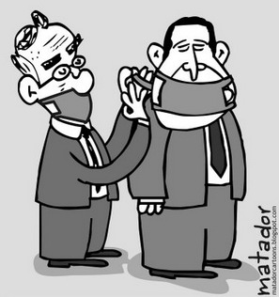

Testament in case of epidemic art. 701 c.c.
can be granted before 3 witnesses over 16 years
without the need of notary
The CC does not require the testator to suffer epidemic disease.
It is enough that it is in the affected place.

Slide 4
FORM:
Art. 702 C.C.: They must be written, if possible.
If it is not possible the will is valid even if the witnesses do not know how to write, keep in their memory until their elevation to public deed by the notary.
EXPIRATION DATE:
at 3 months since the testator came out of the danger of death
or
stopped the epidemic Art. 703 C. C.

Slide 5
especial
TESTAMENTS
LAW OF SUCCESION
Pablo Colomina urios

Slide 6


Forms of the Military Testament:
- Open: In writing before an officer with rank of captain and two suitable witnesses.
If the testator is injured before the captain or physician who assists you.
- Closed: Before a war Commissioner (art. 717 C.C.).
- Extraordinary situations: art. 720 C.C. , battle, assault, combat...
Before two witnesses who must formalize it before the auditor of War (in 3 months).
- Inefficacy Art. 719 C.C. :----------} 4 months end of campaign.

Slide 7
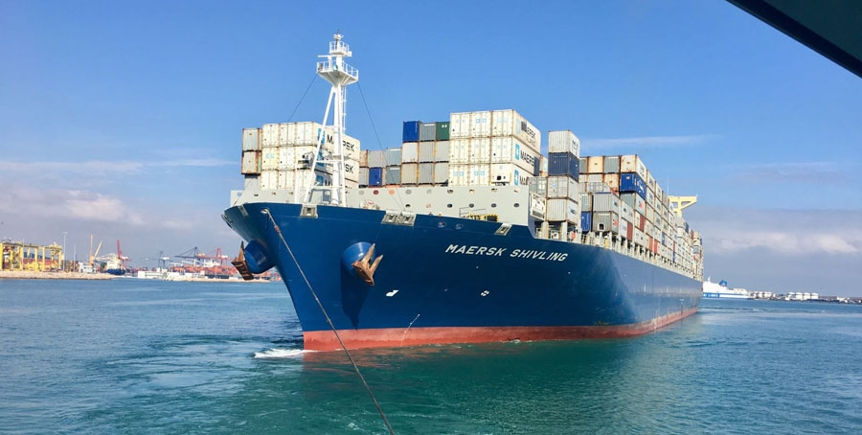
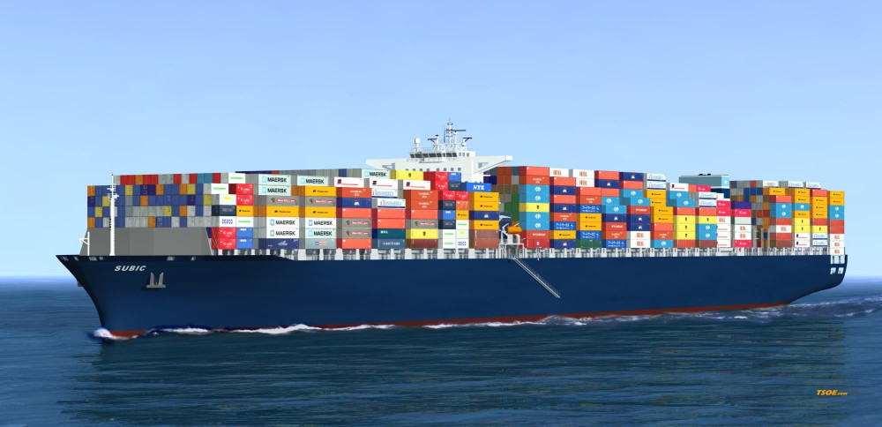
MARITIME TESTAMENT
- Granted by those who are aboard on a maritime voyage, art. 722 C.C.
The journey begins at the time of embarkation.
- Requirements:
Warship: Before the accountant and two suitable witnesses.
Merchant ship: Before the captain and two suitable witnesses.
-Witnesses, chosen among the passengers (art. 722 C.C.).
- Expiry maritime will: 4 months from end trip.

