Slide 1
EEA LAW VIII.
SAFETY NET OF THE FINANCIAL SYSTEM
DGS (Deposit Guarantee Schemes)

Slide 2
Legal BASIS
Directive 2014/49 / EU of the European Parliament and of the Council of 16 April 2014 on deposit-guarantee schemes (Deposit Guarantee Scheme Directive)
entered into force in June 2014 and repealed the previously in force Directive 94/19 / EC of 1994, which was amended in 2009 in response to the financial crisis.
The time limit for transposition of the DSGS Directive for Member States was 1 year.
Legal basis for the DSGS Directive can be found in Article 114 of the Treaty on the Functioning of the European Union „TFEU“), thus a common basis for internal market legislation.

Slide 3
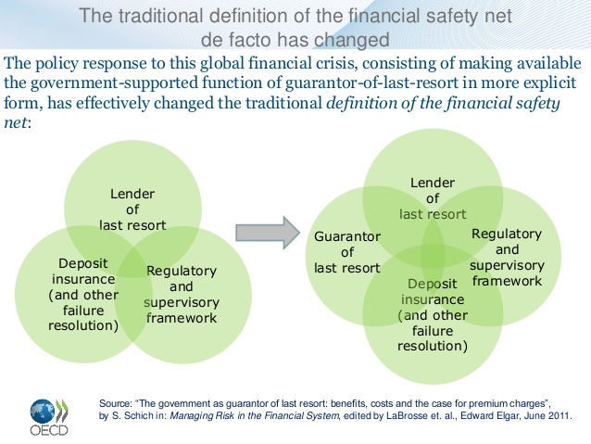
III. Pillar of banking union
FINANCIAL SAFETY NET
Apart from harmonization through a directive, no common system (pan-European) is expected.
DGSD IT IS PART of the FINANCIAL SAFETY NET

Slide 4
What and Who is protected
All credit institutions are compulsorily members of the deposit insurance system and the principle is to pay out any anticipated type of deposits of all clients - depositors of credit institutions, in the event of liquidation or bankruptcy of the credit institution, when deposits are no longer available.
The protected amount of deposits is set at EUR 100,000 per depositor (both natural and legal person) from the insurance scheme of which the credit institution is a member.
Originally, under the 1994 Directive, the amount of insured deposits per person was increased to EUR 50,000 at the level of EUR 20,000 and subsequently to the current value.
Other protected deposits are SME (small and medium-sized enterprise pension schemes, deposits from public authorities with a budget of up to € 500,000, deposits in excess of € 100,000 for certain housing and social purposes, as specified in more detail below

Slide 5
Who is financing it?
funds to the guarantee fund go from credit institutions in a financial amount depending on the risk profile and other decisive factors for specific institutions. The greater the risks a credit institution incurs, the more funds must be paid into the systém.

Slide 6
How does it work
Deposits are paid out to depositors within 20 working days with the possibility of extension by 10 working days, but until 2024 this period is gradually shortened to 7 days.
Originally, the period was 3 months with the possibility of extension by up to another 6 months

Slide 7
Goals
The amount accumulated in each Member State's insurance scheme (DGSD) should reach 0.8% of insured deposits by 2025. Deposit Guarantee Schemes shall undergo stress tests at least every three years to verify their functioning.
Furthermore, deposit-guarantee schemes, subject to strict conditions, can also be a source of resolution funding under the second pillar of banking union.

Slide 8
Exeptions
In Norway its 3x times higher guarantee
(they haven't adopted the directive for many years)
Why?
Ensuring the protection of private finances x protection of the rich ones

Slide 9
DGSD news
The DGSD no longer applies to any public authority's automatic non-insurance of municipal deposits.
The second novelty, on the other hand, is the insurance of temporarily high deposits over EUR 100,000 up to twice in specified cases in compliance with the set conditions, exclusively at the request of the person. *
As for municipalities - only "small" municipalities that do not have tax revenues higher than EUR 500,000 can be newly insured. (Insurance will arise only at the request of the municipality within the administrative procedure, when the municipality requests a financial institution)
*
Temporarily high deposits are insured, which affect specific income such as the sale of private real estate used for housing, divorce settlement, income from insurance benefits from accident, illness, disability or death, inheritance, one-off pension benefit, severance pay, compensation for damage caused criminal offense, etc. The condition is that this specific financial amount is not credited earlier than 3 months before the decisive day - the day when the competent authority (could be Central bank or specialised authority) notifies the bankruptcy of the given financial institution (this ensures the exceptionality and short-term nature of the amount so credited).

Slide 10
Securities Dealers Guarantee Fund
Directive 97/9/EC of the European Parliament and of the Council of 3 March 1997 on investor-compensation schemes

Slide 11
Purpose
The purpose of this fund is to create a guarantee system from which compensation is paid to the customers of a securities trader (hereinafter referred to as the "trader") who is unable to meet its obligations to its customers.
the trader pays an annual contribution to the fund in the amount of 2% of the volume of received fees and commissions for provided investment services for the last year
The minimum contribution of the trader in the Czech republic is CZK 10,000

Slide 12
How much and to whom
Compensation to the trader's customer in the event that the trader is unable to meet its obligations for reasons directly related to his financial situation is provided in the amount of 90% of his customer assets, but may reach a maximum crown amount of the equivalent of EUR 20,000 per customer per trader.
In the event that the fund's resources are not sufficient to pay compensation to customers of bankrupted traders, the fund must obtain the necessary funds only on the financial market

Slide 13
Future…
The 7-day limit for the payment of compensation, which is expected until 2024, is excessive. The CNB also does not agree with such a shortened period
A common pan-European fund and system?

