Slide 1
Tax Law Drafting Principles
Michal Radvan

Slide 2
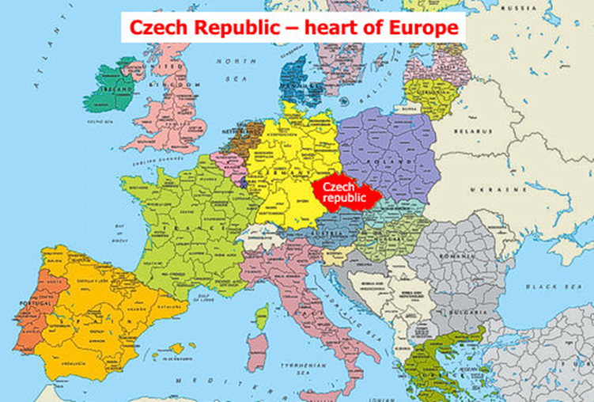
Masaryk University, Brno
Brno
the second largest city in the Czech Republic
centre of Czech judiciary
13 tertiary education institutions, 90,000 students
Masaryk University
founded in 1919
10 faculties
Faculty of Law
3 000 students
200 staf

Slide 3
Specific Method of Tax Law Regulation
essentially a modified version of the administrative law method
a lower level of applying sub-statutory regulations in tax law – nullum tributum sine lege
economic instruments to affect recipients
private law elements (such as the options of lump-sum tax, postponing taxes, payment calendars, etc.)
certain administrative activities are delegated to private law entities (withholding taxes)
self-application – the taxpayer applies tax law norms to itself by determining the tax base using its knowledge, uses the relevant tax rate for itself, and applies the corrective elements
the mandatory nature is moderated in certain instances with an element of choice (lump-sum personal income tax, voluntary VAT payer, method of depreciation, lump-sum expenditures for income taxes, etc.)

Slide 4
Results
The tax law regulation must fulfill very strict quality requirements, respecting the terminology used in other branches of law.
The legislator should be receptive to the economic aspects of private and business life.
The regulation should be not only perfect but easy to understand and apply, i.e., cheap for both taxpayers and tax administrators.

Slide 5
Tax Law Drafting Principles
an important role in the process of tax law drafting and application
principles consider both the public interest and tax subjects' individual interests or interests of other tax law addressees
principles allow the postulates of a rational tax system's functioning to be formulated
legislator should respect: basic legal principles given by the Constitution, principles generally valid for (continental) legal culture and the democratic rule of law

Slide 6
Basic Principles
applied by most of the constitutions worldwide
nullum tributum sine lege
lex retro non agit – principle of non-retroactivity
the prohibition of taxation of facts that occurred in the past, i.e., the obligation arising during the effectiveness of a particular regulation is governed by this regulation until its fulfillment
might be broken only if the new regulation is advantageous for the obligated tax subject
priority of international and EU Law
especially the indirect taxes are widely harmonized

Slide 7
Self-application Principles I
tax provisions should be included in separate legal acts
it is necessary to follow a uniform terminology in law
it is inappropriate to impose an unorthodox tax or tax components
super gross wage as a tax base: income from dependent activity increased by sums of social security and health contributions paid by the employer (34 %, later 33.8 % of the gross income)
tax bonus: tax preferences for children as the tax reduction; tax reduction up to zero tax and tax bonus to be paid back: some taxpayers not only do not pay the tax, but they get tax from the State
understandable and unambiguous form; no need to apply any of the contradictory principles in dubio pro libertate (in dubio mitius) and in dubio pro fisco

Slide 8
Self-application Principles II
tax duties should be formulated briefly and clearly; they should consider the level of legal and economic knowledge of the taxpayers
the title of the legislative instrument must clearly suggest that it concerns tax matters
the tax on acquisition of immovable property (where the object of taxation was the acquisition of immovable property) was to be paid by the seller and not the acquirer (buyer)
adequate vacatio legis
the amendments to many Czech tax acts effective from the beginning of the tax year 2021 were published only on 31 December 2020

Slide 9
Principle of (Tax) Justice I
a horizontal tax justice – the same objects of taxation should be taxed equally (e.g., income, property, or consumption of different persons should be taxed equally regardless of the nature of these persons, their legal status, etc.)
a vertical tax justice – an entity with higher incomes, higher valued assets, or higher consumption should pay a higher tax, but not in the sense that the tax rate will increase highly progressively with increasing tax base; the tax rate should remain the same or be progressive proportionally
the principle of proportionality
the principle of endurance – the tax must not be of a liquidating nature / the tax does not have a choking effect (secured by corrective components – exemptions, relieves, etc., or deferral and waiver of the tax by administrative means

Slide 10
Principle of (Tax) Justice II
no double taxation, especially in the interstate tax system
super gross wage: social security might be seen as a tax sensu lato and being taxed by the income tax, it means the breach of the principle
it is necessary to protect the interests of the majority from the intrusion of different lobbies' interests
Czech Income Taxes Act includes some 400 corrective components (exemptions, tax reductions, etc.) – Christmas tree strategy: the bill sent to the Parliament should have only minimum corrective components (a tree) while the MPs are expected to add a lot of additional ones (to hang decorations on a Christmas tree)

Slide 11
Economic Nature
the primal sense of taxation is the fiscal effect for pubic budgets; often broken as taxes might have reduction and stimulation functions, too
tax law drafters should respect the economic rules of a chosen economy model (the principle of an open market economy, short-term and long-term consequences of tax law regulation, legal regulation of related sections of public financial activities, impact of fluctuations in the value of money on the stability of tax law, continuity of changes in the amount of taxes)
fixed tax rates and fixed corrective components (tax reductions); it is necessary to ensure regular amendments

Slide 12
Professionality
proposals of the acts should be consulted
with stakeholders, discussed by the professional committees
adequate explanatory report to the act
the explanatory reports are often somewhat misleading, especially regarding the reason for changes in tax regulation (excise taxes states that the reason to increase the tax rates is the regulative function of the tax and the fiscal function of the excise taxes is being suppressed; SARS-CoV-2 virus and Covid-19 pandemic)
amendments by the members of the Parliament seem to be breaking many of tax law drafting principles
no explanatory report
tax bills might be voted under so-called close rules, i.e., “yes or no vote” without the possibility of introducing amendments
Christmas tree legislation

Slide 13
Procedures
EXPERTS
act is prepared by the experts at the Ministry of Finance: legislators and tax experts
internal comment procedure within the Ministry
external comment procedure with other ministries and stakeholders
bill is discussed at the specialized commissions of the Legislative Council of the Government incl. the commission for financial/tax law, and at the Legislative Council of the Government
NON-EXPERTS
bill is accepted by the Government
Parliament (no duty to explain the amendments or change the explanatory report, never discussed with the Ministry of Finance or any other experts)

Slide 14
Bad Practice Example
the act amending the tax law acts for the taxable period of 2021
the bill was prepared by the Ministry of Finance and accepted by the Government
as a Parliament member, the prime minister has prepared his own amendment to this act canceling the super gross wage as the partial personal income tax base from incomes from dependent activities
(the concept of the super gross wage was criticized for many years by many experts)
I do not believe that the super gross wage should have been abolished this way and during the fiscal crises caused by the Covid-19 pandemic
as the prime minister´s proposal means a lower level of taxation, it was accepted
these changes mean the additional loss of public budget revenues in the order of tens of billions of CZK

Slide 15
Conclusions
tax law drafting principles are generally followed (not only) in the Czech Republic
however, several cases are showing that this statement cannot be applied in all situations
the principles' breach is not caused by the lack of the principles or their unclarity
To achieve a good quality of tax law, it seems to be enough to follow the principles, especially by the politicians.

Slide 17
Study / Teach at Masaryk Law School
exchange student
SOC courses for incoming students, incl. Work on Diploma Theses (30 ECTS)
master-level courses for all students
https://erasmus.law.muni.cz/content/en/exchange-students/courses-in-foreign-languages/
PhD student
Comparative Constitutional Law
Comparative Corporate, Foundation and Trust Law
Legal Theory and Public Affairs
Intellectual Property Law
Law of Information and Communication Technologies
www.phd.law.muni.cz
visiting professors’ short intensive specialist courses
5 x 100 minute seminars – practical and interactive
https://www.law.muni.cz/content/cs/o-fakulte/organizacni-struktura/oddeleni-a-centra/oddeleni-pro-zahranicni-vztahy/zahranicni-vyucujici/

