Slide 1
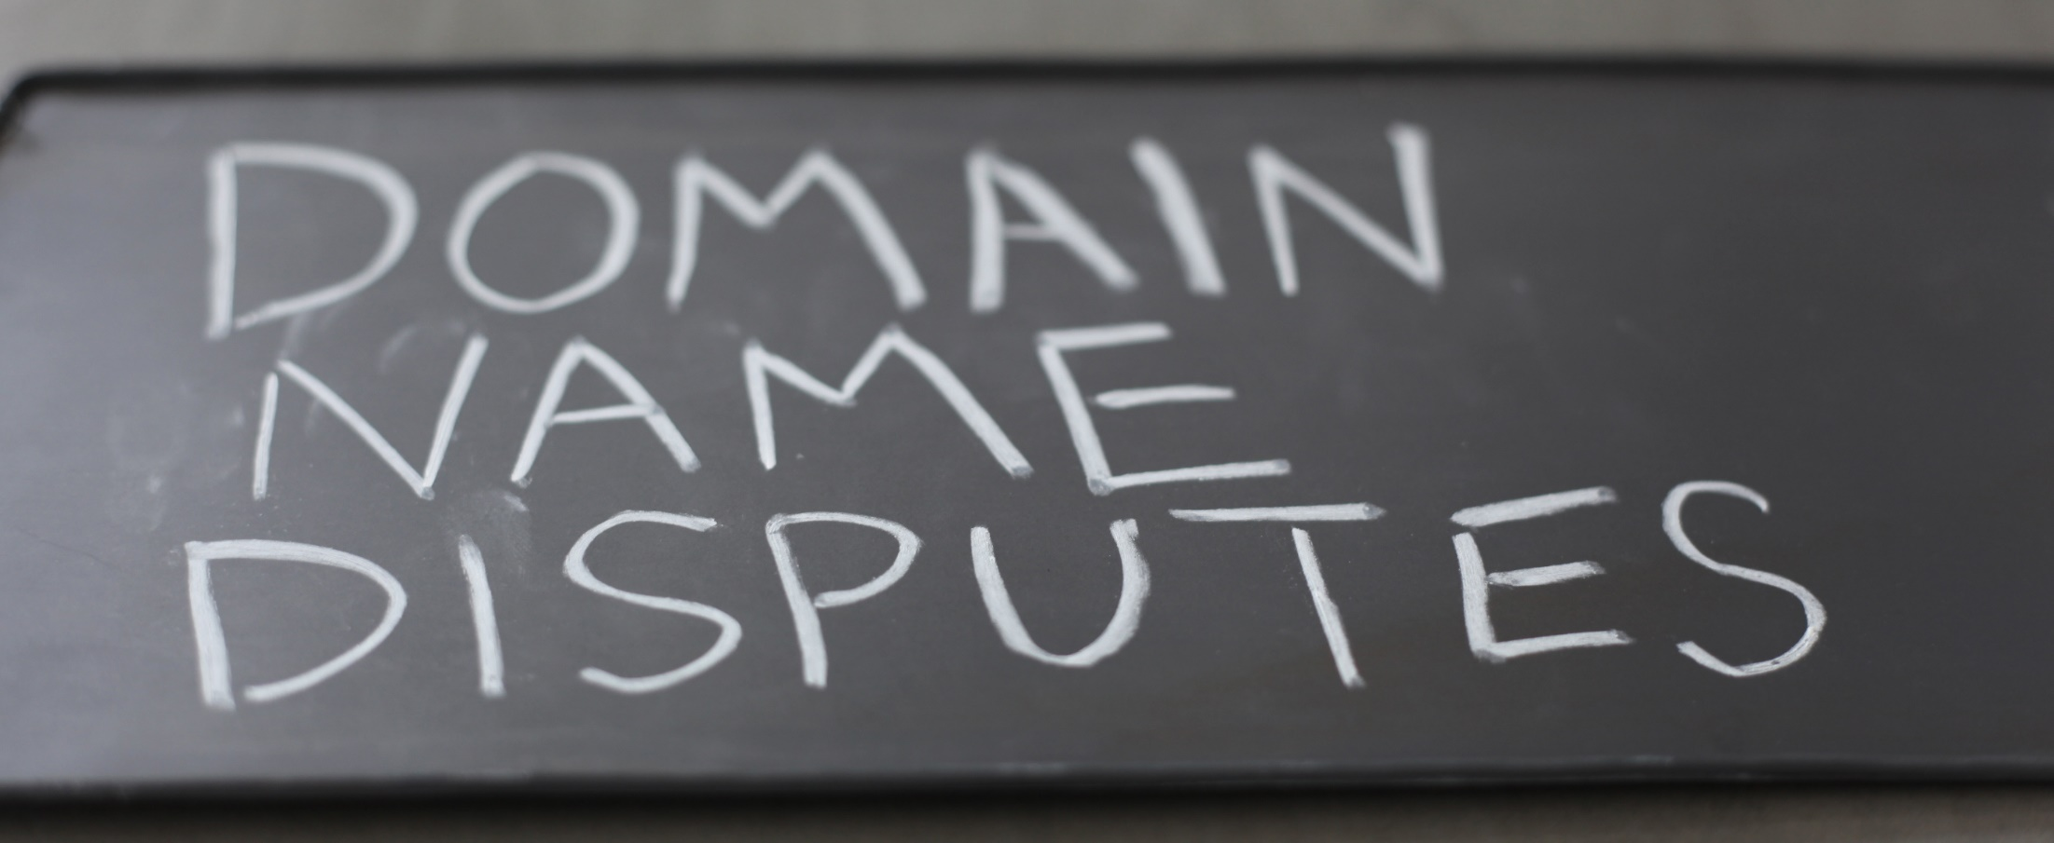
Procedural elements
JUDr. Pavel Loutocký, Ph.D., BA (Hons)

Slide 2
MAIn principle
First comes – first served
The domain name is immediately registered
What if the holder of domain name is not the one who should own it?
Cybersquatting, typosquatting, etc.

Slide 3

UDRP
Response
Panel
Notification
File complaint
Decision
Implementation
Review
0
+3
+1
+20
+5
+14
+3
+10
Commencement
56 days

Slide 4
UDRP process
Criticism
Froomkin says, that such a short terms are in contradition with public order
On the other hand some of the terms can be prolonged

Slide 5
UDRP process
Advantages:
  Fast – the case can be decided within 2 months
  Inexpensive
  Co - existing with local legal systems
  Global solution
  Law accessible – decisions are freely available
  Price: http://www.wipo.int/amc/en/domains/fees/

Slide 6
UDRP process
Disadvantages:
  Hard to control (are we getting good decisions?)
  Transparency of panellists
  Inconsistent decisions
  Only transfer (cancellation) of the domain name is decided (not damages)

Slide 7
UDRP shielded by court
Storey v. Cello Holdings LLC (american court decision)
The agreement with UDRP is implemented by chains of contracts and it is involuntary
ICANN as the only regulator does not offer any other solution
The decision is contractually binding just between the parties (no rei iudicata)
The parties cannot be prevented from submitting their dispute to the court

Slide 8
UDRP case study in general
Classmates Online, Inc. v. John Zuccarini
Possibility to file additional information (an exception)
„To avoid any misunderstanding that the decision establishes a precedent, we call for caution and recommend to submit complete documentation of the case when filing a complaint.“

Slide 9
UDRP proces - cons
Problems:
Forum shopping:
  Complainant win percentages:
    WIPO – 82%
    NAF – 83%
    eResolution – 63% (not working any more)
2011
  WIPO – 19.123 cases
  NAF – 16.134 cases
  eResolution – 277 cases

Slide 10
UDRP proces - cons
Problems
Case allocation bias:
  One panelist (83% probability to transfer domain name)
    vs
  Three member – panels (60% probability to transfer domain name)
!! 3 member panel is more expansive and there is lower probablity to win the case !! (however it can be part of the tactics !!)
3 member panel decides only 10% of cases

Slide 11
UDRP proces - cons
Also choosing one or three member panel is problem:
One panelist – decided by ODR provider
Three members
  each party proposes three members from defined list of panelists; provider chooses one from each list
  Third panelist is chosen from 5 panelists list where each party crosses out 2 panelists (the last one remains)
The parties thus cannot influence who will be member of one member panel
UDRP contain rules how to exlude panelist…
HOWEVER – usualy the panelists are lawyers who are specialists in trademarks, thus they prefer trademark protection

Slide 12
UDRP proces - cons
Flexibility of the rules
It is OK that the rules are not covering only trademarks
The problem is with spreading it wider – e.g. in geographical indications
.zulu (new gTLD) is considered as geographical indication (but it is language)
Really bad decisions:
  Domain name bodacious-tats.com was found as confusingly similar to trademark „Tata & Sons“

Slide 13
Some Procedural issues
There is not only UDRP itself
There are also Rules for UDRP
https://www.icann.org/resources/pages/udrp-rules-2015-03-11-en
UDRP - substantive rules (mainly)
Rules for UDRP – procedural rules

Slide 14
Some Procedural issues
Do you need a lawyer?
(And who is the lawyer?)

Slide 15
Some Procedural issues
No..
There is not such a demand
However it could be helpful..

Slide 16
Some Procedural issues
Who carries a burden of proof?

Slide 17
Some Procedural issues
the Complainant..
the Complainant is required to substantiate its claims beyond mere allegations
a fact is considered established when it is more likely than not that the fact is true
Neusiedler Aktiengesellschaft v. Kulkarni, WIPO Case No. D2000-1769;
Dow Jones & Company and Dow Jones LP v. The Hephzibah Intro-Net Project Limited, WIPO Case No. D2000-0704.

Slide 18
Some Procedural issues
Are there in-person hearings?

Slide 19
Some Procedural issues
Paragraph 13 of the Rules - there shall be no in-person hearings (including hearings by teleconference, videoconference and web conference)
…unless the Administrative Panel determines, only as an exceptional matter, that such a hearing is necessary
no in-person hearing has been held in any WIPO proceeding to date!

Slide 20
Some Procedural issues
Is UDRP confidetial?

Slide 21
Some Procedural issues
Paragraph 16 of the Rules
The provider publishes the following case-related information on its web site:
  the domain name(s) in issue,
  the date of formal commencement of the proceeding,
  the case number assigned by that provider.
Unless the Panel has decided to hide certain portions of its findings, it publishes in full on its web site all decisions rendered under the UDRP.

Slide 22
Some Procedural issues
What language of the Complaint?

Slide 23
Some Procedural issues
Paragraph 11
the Complaint must be submitted in the same language as the domain name registration agreement
Unless agreed otherwise
Attachments to the Complaint may be in their original language (could be ordered to translate it)
The final authority to determine the language of the proceeding lies with the Administrative Panel.

Slide 24
Some Procedural issues
Problem:
Ets Leobert, SARL v. Jeonngon Weo
  Agreement in Korean language
  Panel decided to have the proceedings in two languages (to improve comfort of the parties – it was however not agreed)
LEGO Juris A/S v. Linecom
  Agreement in Korean language
  Complaint of LEGO in English and then whole proceedings in English (without agreement)
  The argument of panel was, that the domain name consisted of English words (mindstormslego.com)
  At least there could be bilingual process as it happened in previous case…

Slide 25
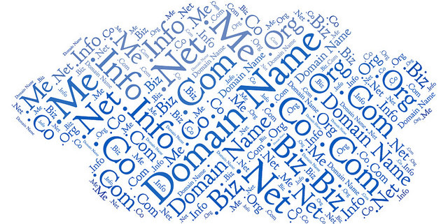
UDRP process

Slide 26

UDRP process

Slide 27
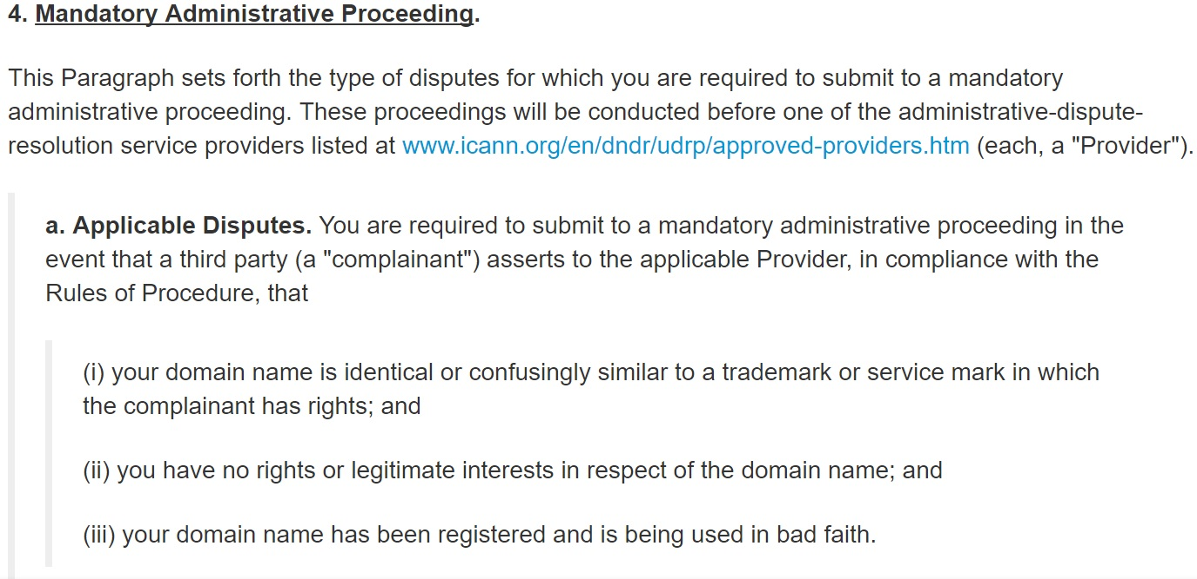
Cumulative condition

Slide 28
UDRP process
Complainant has to prove:
  Domain name is identical or confusingly similar to a trademark in which complainant has rights
  No rights or legitimate interests in respect of current domain name
  Domain name has been registered and is being used in bad faith

Slide 29

1) Identical or confusingly similar
The test:
comparison between the trademark and the domain name itself to determine likelihood of Internet user confusion.
the relevant trademark would generally need to be recognizable as such within the domain name
the content of website is irrelevant
E.g. guiness.com

Slide 30
Mispelled IS confusingly simmilar
Wachovia Corporation v. Peter Carrington, WIPO Case No.D2002-0775, <wochovia.com>, Tansfer
Fuji Photo Film U.S.A., Inc. v. LaPorte Holdings, WIPO Case No.D2004-0971, <fuijifilm.com>, Transfer
Express Scripts, Inc. v. Whois Privacy Protection Service, Inc. / Domaindeals, Domain Administrator, WIPO Case No.D2008-1302, <expresscripts.com>, Transfer

Slide 31
2) Legitimate interest
What is legitimate interest?
  Bona fide offering of goods or services
  Commonly known as domain
  Legitimate noncommercial or fair use of the domain name
  without intent for commercial gain to misleadingly divert consumers
  or to tarnish the trademark or service mark at issue.
  Article 4(c) of the rules
  See e.g. DaimlerChrysler A.G. v. Donald Drummonds, WIPO Case No.D2001-0160, Not transferred

Slide 32
3) Bad faith
What is bad faith?
  Attempt to sell, lease, etc. the domain (cybersqatting)
  Disrupt competitor‘s business
  Attract (for commercial gain) the visitors to the site via confusion
Article 4 (b) of the rules

Slide 33
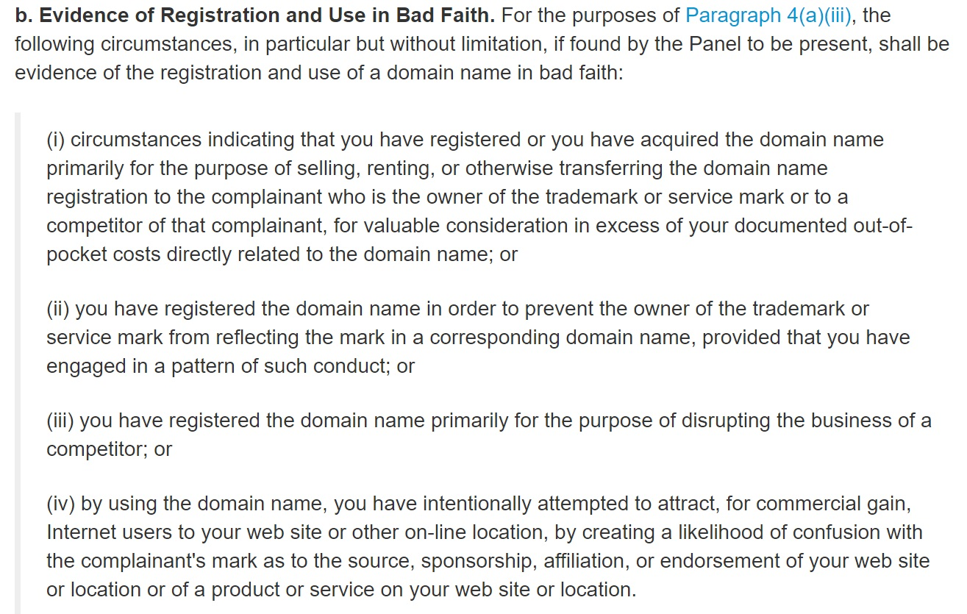
3) Bad faith

Slide 34
MUST READ !
WIPO Overview of WIPO Panel Views on Selected UDRP Questions, Third Edition
(“WIPO Jurisprudential Overview 3.0”)
http://www.wipo.int/amc/en/domains/search/overview3.0/
WIPO Guide to the Uniform Domain Name Dispute Resolution Policy (UDRP)
http://www.wipo.int/amc/en/domains/guide/

Slide 35
Future
1th October 2016 – expiration of the agreement between IANA and National Telecommunications and Information Administration (Part of US Ministry of Commerce)
Control of ICANN completely out of US gouvernement
More complicated control of the decision making authorities and possible loss of transparency and quality of the process

Slide 36
The rules - ccTLDs
National authorities (does not have to be governemental)
Contract with ICANN
In Czech Republic – CZ.NIC
https://www.nic.cz/page/314/pravidla-a-postupy/

Slide 37

The rules - .EU
Not an arbitration clause! (again)
Competence of arbitration courts enacted by regulation 874/2004/EC
https://eurid.eu/en/

Slide 38
The rules - .EU
Set of eu regulations:
http://ec.europa.eu/ipg/basics/urls/doteu_en.htm

Slide 39
Legal Framework in EU
Regulations
  733/2002/EC; 874/2004/EC; 1654/2005/EC; 1255/2007; 560/2009
  http://ec.europa.eu/ipg/basics/urls/doteu_en.htm
Including
  .eu domain name registration rules
  Domain Name Registration Terms and Conditions
  Sunrise period Rules for .eu domains
  .eu Domain Dispute Resolution Rules (ADR Rules)
Rules of Procedure of the ADR provider (adr.eu - based in Prague!)

Slide 40
Domains .eu
boost e-commerce in the EU
create a clearly identifiable link between the domain name holder and the EU
EURid administrator

Slide 41
Authorised users
entrepreneurs with their registered office or place of business within the EU
organisations established in the EU
natural persons permanently resident in the EU

Slide 42
Domain name disputes in .eu
Litigation against speculators
Active legitimation: trade mark owner
Passive legitimation: Domain holder
Disputes against the domain administrator
Active legitimation: Domain name registrant
Passive legitimation: Domain administrator

Slide 43
Disputes against speculators
Article 21 of Commission Regulation (EC) No 874/2004 of 28 April 2004 laying down public policy rules concerning the implementation and functions of the .eu Top Level Domain and the principles governing registration
A registered domain name shall be subject to revocation, using an appropriate extra-judicial or judicial procedure, where that name is identical or confusingly similar to a name in respect of which a right is recognised or established by national and/or Community law, such as the rights mentioned in Article 10(1), and where it:
has been registered by its holder without rights or legitimate interest in the name; or
has been registered or is being used in bad faith.

Slide 44
Legitimate interest
X
Bad Faith
Article 21/2,3
https://eur-lex.europa.eu/legal-content/en/ALL/?uri=celex:32004R0874

Slide 45

Domain name disputes .CZ

Slide 46
Legal background
Primarily rules (binding between the parties)
https://www.nic.cz/page/314/pravidla-a-postupy/
The possibility of appealing to the courts afterwards:
  Usnesení Nejvyššího soudu ČR ze dne 26. ledna 2010, sp.zn. 29 Cdo 3580/2009
  Rozsudek Nejvyššího soudu ČR ze dne 17. prosince 2013. sp.zn. 23 Cdo 3895/2011

Slide 47
ANNEX 3: RULES FOR ALTERNATIVE DISPUTE RESOLUTION (Article 3)
The Holder agrees to submit to dispute resolution in accordance with these ADR Rules and the Regulations, in the event that the Complainant files a claim with the Administrator claiming that the Holder's Domain Name is identical or confusingly similar with the Protected Designation to which the Complainant has rights, if at the same time:
3. 1.1. such Domain Name has been registered or acquired without the Holder having rights to the Domain Name or Protected Marking pursuant to Section 3.3; or
3.1.2. such Domain Name has been registered, acquired or used in bad faith.

Slide 48
Czech court decisions
Suzuki.cz (sp. zn. 23 Cdo 3895/2011)
Globtour.cz (sp. zn. 23 Cdo 3407/2010)
Ceskapojistovna.cz (dostupné zde: http://www.itpravo.cz/index.shtml?x=218427)
And many more
https://ictjudikatura.law.muni.cz/wiki/Kategorie:Dom%C3%A9nov%C3%A1_jm%C3%A9na

Slide 49
http://www.adr.eu/

Slide 50
UDRP vs National solution or .eu?
Did you understand how it works?
What is the relationship?
Please discuss..

Slide 51
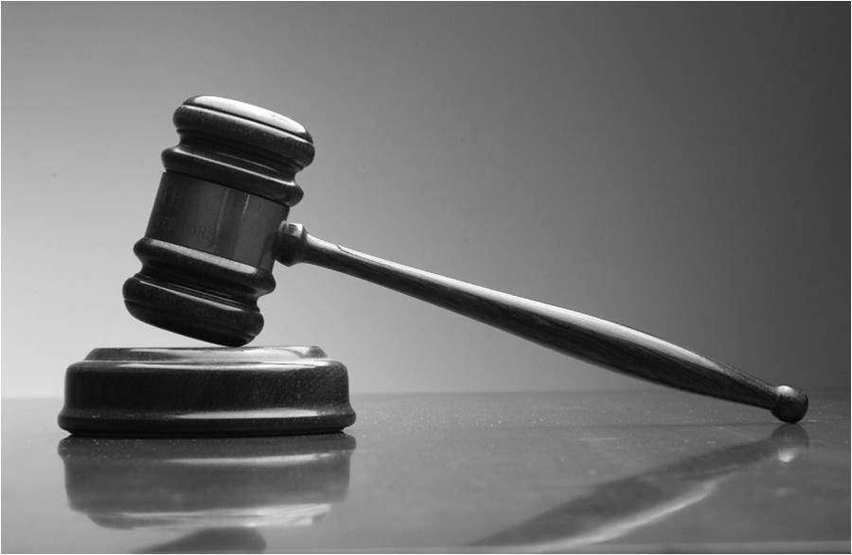
Thank you for your attention!
Questions?

