Slide 1
Representative Democracy and Direct Democracy

Slide 2
Direct or Representative? Topics.
Is Representative Democracy in Crisis? (Blokker)
But What Actually is „Representative Democracy“? (3 stages, basic principles).
Pros
Cons
What values might be better served by the respective forms of democracy?
Philosophical and Political Context

Slide 3
To be represented… What does it mean? (Hana Pitkin)
Symbolic representation

Slide 4
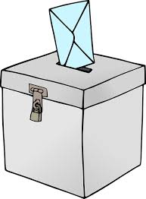
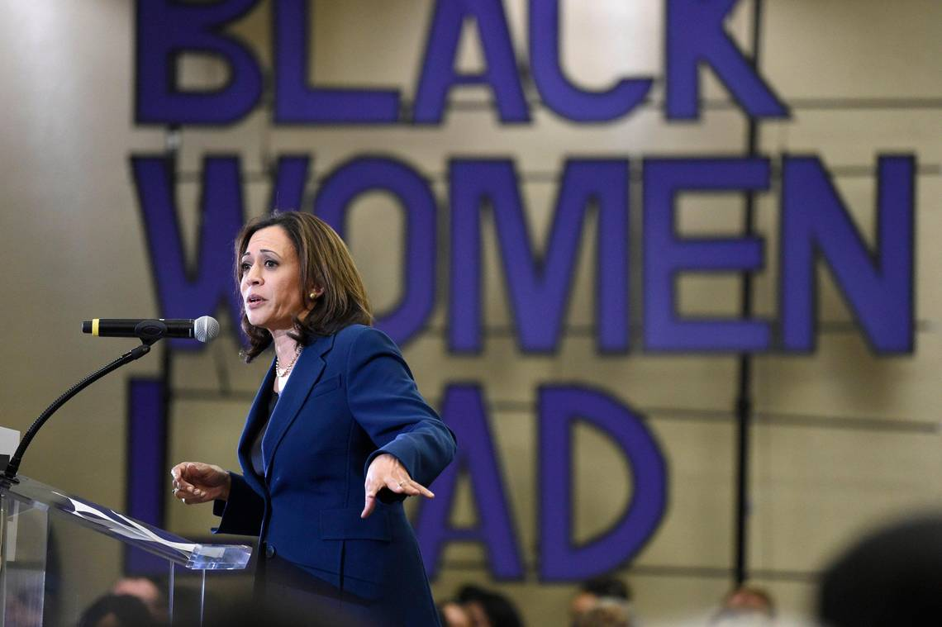
Formal representation (legal-formal link)
Descriptive representation (see also quotas, redistricting)

Slide 5
Substantive representation
The actual interests of the represented are spoken for.
Who is the judge of this?
Does Bono speak for Africa? „I represent a lot of people [in Africa] who have no voice at all... They haven't asked me to represent them. It's cheeky but I hope they're glad I do. The world is more malleable than you think.“
Link between substantive und descriptive representation?

Slide 6
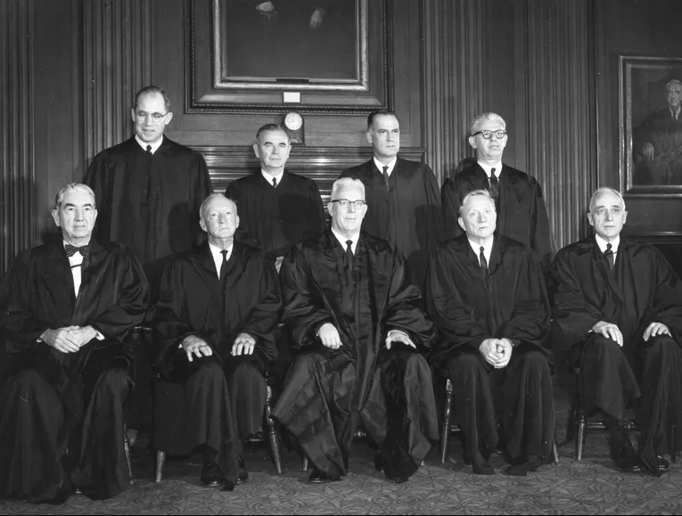
Representative institutions?

Slide 7
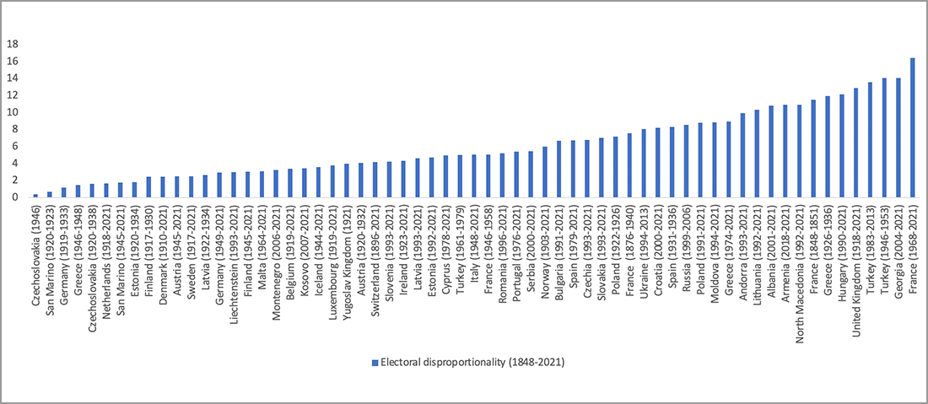
Representation and proportionality

Slide 8
Principles (or Benchmarks?) of Representative Democracy
Election of Representatives in Regular Intervals
Partial Independence of the Representatives
Freedom of Public Opinion
Making Decisions after „Trial by Discussion“

Slide 9
Evolution of Representation
Parlamentarism (Notables, Deliberation)
Party Democracy (Stable Party Electorates, Party Discipline)
Audience Democracy (Media Experts, Less stability, Social Stratification Less Important, Fluidity)

Slide 15
Reaction paper reflections
Responsiveness of government (even of oligarchs); Calls for direct democracy as an intuitive response to perceived exclusion and illegitimacy? Democray, equality and non-domination.
Bildungsstaat: „Contemporary liberal democracy is essentially an ideology of Bildungsstaat, the Enlightenment educatory state. The people had to be educated into democracy and into civic public sphere. Otherwise, parliamentarism had no sense. This original doctrine entailed colonialism and was accompanied with large-scale violence. Therefore, it was partly forgotten and replaced by the Schumpeterian “democracy” of self-interested consumers. But this is not a better alternative, which in the current decades increasingly produces the scandal of “populism.” Bewildered “democrats” stare at “populists” as their unrecognized shadow: democracy minus Bildung.“ (Artemy Magun)

Slide 16
Reaction paper reflections
Zygmunt Baumann and his „echo chamber“
Supply and demand, how are preferences born and who creates whom? Representation as separation of powers.
How much should be the representative bound by wishes of the represented? Listen and obey? Guide and reflect?

