Slide 1
1. Administrative Procedural Law
2. Legal Guarantees in Public Administration
3. Ombudsman. Public Administration control. Judicial Review
JUDr. Lukáš Potěšil, Ph.D.
Department of Administrative Studies and Administrative Law, Faculty of Law, Masaryk university, Brno, Czech Republic
Lukas.Potesil@law.muni.cz

Slide 2
Introduction
Prepare your answer to the following questions:
Why do we have public administration? Is it good/bad thing, helps/is harmful, …
What is (is there any) a connection between public administration and administrative law?
Do we need any procedural norms in administrative law? Who is the addressee?
Why is important to control public administration?

Slide 3
System of (Czech) Administrative Law
Administrative Law („Správní právo“)
is the biggest (and also very important – yes? Really, it is!) branch/part of law/legal system (of each „legal“/“administrative“ state); part of public law
regulates relations in Public Administration a) its organization (at different levels) and b) its functions/activities; public administration is based on (intentional) activity
its funcion in the society;
to gain public goals and
to protect public interest
represents a possibility of using public power; protects public interest; examples of superiority

Slide 4
System of (Czech) Administrative Law
One possible division:
Administrative Law
General part
What is common: general rules, institutes, organization, sources of legal regulation, forms of activity, liability, control of public administration, etc., also different procedural aspects of conducting public administration
Special part
Legal regulation of different „branches“ of public administration and administrative law – „building law“, „health care law“, „school law“, „cultural law“, „police law“, „refugee law“, „ius gentium“, law of electronic communication, expropriation, etc (about houndreds of laws and other norms, also law of the EU)

Slide 5
System of (Czech) Administrative Law
Second possible division:
Administrative Law
Organizational Administrative Law
Procedural Administrative Law
Substantive Administrative Law
Administrative Punishment Law/Criminal Administrative Law
„Who“ – legal regulation of organization of public administration – state administration (central, regional, local), self government, …
„How“ – different procedural aspects of administrative law, procedural forms of activity, also (subsequent) judicial control – administrative justice
„What“ – rights and duties at different branches of public administration
„What will happen if the regulation is violated“; it contains all features of organization, procedural and substantive administrative law

Slide 6
Administrative Procedural Law
Procedural part of Administrative Law (different proceedures that can be found in public administration) – protection of rights
Code od Administrative Procedure (act nr. 500/2004 Coll.)
Code of Administrative Justice (act nr. 150/2002 Coll.)

Slide 7
Legal Guarantess in Public Administration
Principle of legality (Constitution, Charter of Fundamental Rights and Freedoms, Code of Administrative Procedure, …)
Legal guarantees: different measures that enables and ensures legality in public administration
Control (in public administration – internal and external), Code of Control (act nr. 255/2012 Coll.), external control by: courts, ombudsman, people (petition), independent administrative bodies, Parliament
Right to information (FOIA – act nr. 106/1999 Coll.)
Control of administrative acts
Responsibility (act. nr. 82/1998 Coll. for damages), administrative offences (act nr. 250/2016 Coll.)

Slide 8
…and now selected issues
In general…
Forms of activity and protection of rights
Remedies
Administrative Justice
ombudsman

Slide 9
System of Czech Public Administration
Art. 1 section 1 of act nr. 500/2004 Coll., Code of Administrative Procedure
„Tento zákon upravuje postup orgánů moci výkonné, orgánů územních samosprávných celků a jiných orgánů, právnických a fyzických osob, pokud vykonávají působnost v oblasti veřejné správy (dále jen "správní orgán").“
„This Act regulates the procedure of executive bodies, bodies of territorial self-governing units and other bodies, legal and natural persons, if they exercise competence in the field of public administration (hereinafter referred to as "administrative body").“
Public administration is a system of different administrative bodies and it functions and forms

Slide 10
System of Czech Public Administration
Art. 9 of act nr. 500/2004 Coll., Code of Administrative Procedure
„Správní řízení je postup správního orgánu, jehož účelem je vydání rozhodnutí, jímž se v určité věci zakládají, mění nebo ruší práva anebo povinnosti jmenovitě určené osoby nebo jímž se v určité věci prohlašuje, že taková osoba práva nebo povinnosti má anebo nemá.“
„Administrative procedure is procedure performed by the administrative body aimed at issuing a decision establishing, modifying or abolishing the rights or obligations of a nominated person in a particular case or declaring that a person has or does not have rights or obligations in a particular case.“

Slide 11
System of Czech Public Administration
State administration
Self government
Public administration
State administration belongs to the state; important part of public adminstration, different task of the state are perfomed by the state and its bodies („direct state administration“), but also „indirectly“ by other bodies that are not part of the state administration („indirect/transfered state administration“) – under a law are bodies of territorial unites entitled (and also obliged) to perform state administration instead of the state and its bodies („mixed model of state administration“) – specific „representation“ – they perform the state administration, but in origin, are not part of this body
Self government includes local, regional and also „university/interest and professional“ self-government

Slide 12
How we can know if the state is democratic and legal?
Adolf Merkl (Austrian scientist) wrote in the 30´s that such state recognizes:
Principle of legality, rule of law
Existence of self – government and
Judicial control of public administration – administrative justice
Example: In the Czechoslovakia these roots were distroyed from 1948 to 1989
So, thanks to this heritage, we should be aware and be carefoul, if someone will try to limit it (due also „economic“ reasons)

Slide 13
System of Czech Public Administration
Self government (based in Constitution, European Charter of Local Government) – is protected, „prepares the politicians for the national/state level“
14 regions (all perform also state administration)
+/- 6254 municipalites (cca 30 cities with specific regime – division between part of such cities and the city itself); all of them perform (of course) self government and the state administration (but in different scope – three cathegories of the municipalites, only for the tasks of STATE administration)

Slide 14
System of Czech Public Administration

Slide 15
System of Czech Public Administration
Government and ministries (14) (and other central administrative bodies – 17: 1. Czech Statistical Office, 2. Czech Office for Surveying, Mapping and Cadastre, 3. Czech Mining Authority, 4. Industrial Property Office, 5. Office for the Protection of Competition, 6. Administration of State Material Reserves, 7. State Office for Nuclear Safety, 8. National Security Authority, 9. Energy Regulatory Office, 10. Office of the Government of the Czech Republic, 11. Czech Telecommunication Office, 12. Office for Personal Data Protection, 13. The Council for Radio and Television Broadcasting, 14. Office for the Supervision of the Management of Political Parties and Political Movements; 15. Office for Access to Transport Infrastructure, 16. National Office for Cyber and Information Security, 17. National Sports Agency and „independent“ bodies as Czech National Bank or Supreme Control Office
State administrative bodies with the whole state/national scope: National Heritage Institute, Czech Social Security Administration, Labor Office, State Labor Inspection Office, Civil Aviation Office, General Financial Directorate, Specialized Tax Office, Railway Authority, Office for International Legal Protection of Children, State Institute for Drug Control, National Accreditation Office
Local Specialized bodies: Tax offices (14), regional sanitary stations (14), regional military headquarters (14), district social security administration (84), district mining offices (8), cadastral offices, inspectorates (84)
Indirect state administration perfomed by the bodies of regions and municipalites

Slide 16
System of Czech Public Administration
Art. 1 section 1 of law nr. 500/2004 Coll., Code of Administrative Procedure
„This Act regulates the procedure of executive bodies, bodies of territorial self-governing units and other bodies, legal and natural persons, if they exercise competence in the field of public administration (hereinafter referred to as "administrative body").“
Executive body – ministries and central administrative bodies - act nr. 2/1969 Coll. (the procedural result is: remonstrance)
Bodies of territorial self-government units – 14 regional offices and cca 6254 municipalities offices (but not only the offices)
Other bodies
Legal and natural persons – universities (disciplinary committee), chamber of attorneys, chamber of „doctors“, etc. (about 10 chambers with the right to self government)

Slide 17
Activity of Public Administration
Public administration as activity of administrative bodies is represented by the system of forms („formy činnosti“, „formy działania“, „Handlungsformen“)
Variety of forms – a lot of task and duties of public adminstration in the 21st century
In general are mostly regulated (by the procedural aspects) by the act nr. 500/2004 Coll. – Code of Administrative Procedure (CAP) – the principle of legality

Slide 18
Activity of Public Administration
Form(s) of activity:
Outcome/result of public administration activity; several forms (due to complexity of public tasks and goals)
Shows in which ways/forms is the public administration realized and applicated
Presents scope of administrative and (later) judicial protection.
Normative approach to the forms: which forms has the public administration permited/allowed and „prescribed“ to fulfill its tasks (principle of legality), helps the public administration
Instrumental approach: the system of forms protects the individual rights, another than prescribed form can´t be applied/used
If we think about simplification we must not forget that people would have right to defense against illegal administrative acts

Slide 19
Forms of Public Administration Activity in the Czech Republic and Protection of the Rights of Individuals
System of forms of public administration activity
Approaches to the system of forms
Forms of public administration activity and judicial protection

Slide 20
Normative vs. instrumental approach to the forms of public administration acitivity
Form(s) of activity:
Outcome/result of public administration activity; several forms (due to complexity of public tasks and goals)
shows in which ways/forms is the public administration realized and applicated
Presents scope of administrative and judicial protection.
Normative approach to the forms: which forms has the public administration permited/allowed and „prescribed“ to fulfill its tasks (principle of legality), helps the public administration
Instrumental approach: the system of forms protects the individual rights, another than prescribed form can´t be applied/used

Slide 21
Activity of Public Administration
Forms of public administration activity |  | Where in the Code of Administrative Procedure (CAP) it is provided for/regulated | Form of protection under the CAP
Administrative act | normative administrative act | not provided for; however, the CAP shall be applied at least in the scope of its principles contained in Part one (Sections 2 to 8 CAP) | no provision
 | individual administrative act | 1) administrative decisions – Parts two and three (Section 9 to 153 CAP) 2) so-called other acts – Part four (Sections 154 to 158 CAP) | Ad 1) remedial measures (ordinary and extraordinary, Sections 81 to 100 CAP) 2) interlocutory revision and the form of so-called review proceedings (Section 156 CAP)
 | mixed administrative act | measure of a general nature – Part six (Sections 171 to 174 CAP) | form of so-called review procedure (Section 174 par. 1 CAP)
Public law contract |  | Part five (Sections 159 to 170 CAP) | form of so-called review procedure (Section 165 CAP)
Factual act and immediate intervention |  | no provision; however, the CAP shall be applied at least in the scope of its principles contained in Part one (Sections 2 to 8 CAP) | no provision
21

Slide 22
General rules/principles of public administration activity
In Constitution (act nr. 1/1993 Coll. – principle of legality, legal basis for the establishment of authorities, order of the government – government regulation), Charter of Fundamental Rights and Freedoms (nr. 2/1993 Coll.) – right for a fair trial (art. 36 sec. 1) and judicial protecion (art. 36 sec. 2)
Art. 6 European Convention on Protection of Rights and Freedoms – is applicable also to the administrative procedure? – existence of judicial protection
Art. 2 – 8 CAP (principles of good administration): legality, proportionality, protection of good will, legitimate expectations, public service, alternative solutions, speed and economy, minimalization of interventions, equality, cooperation – binding for the administrative bodies
Soft law: Rec (2007) 7 on good governance

Slide 23
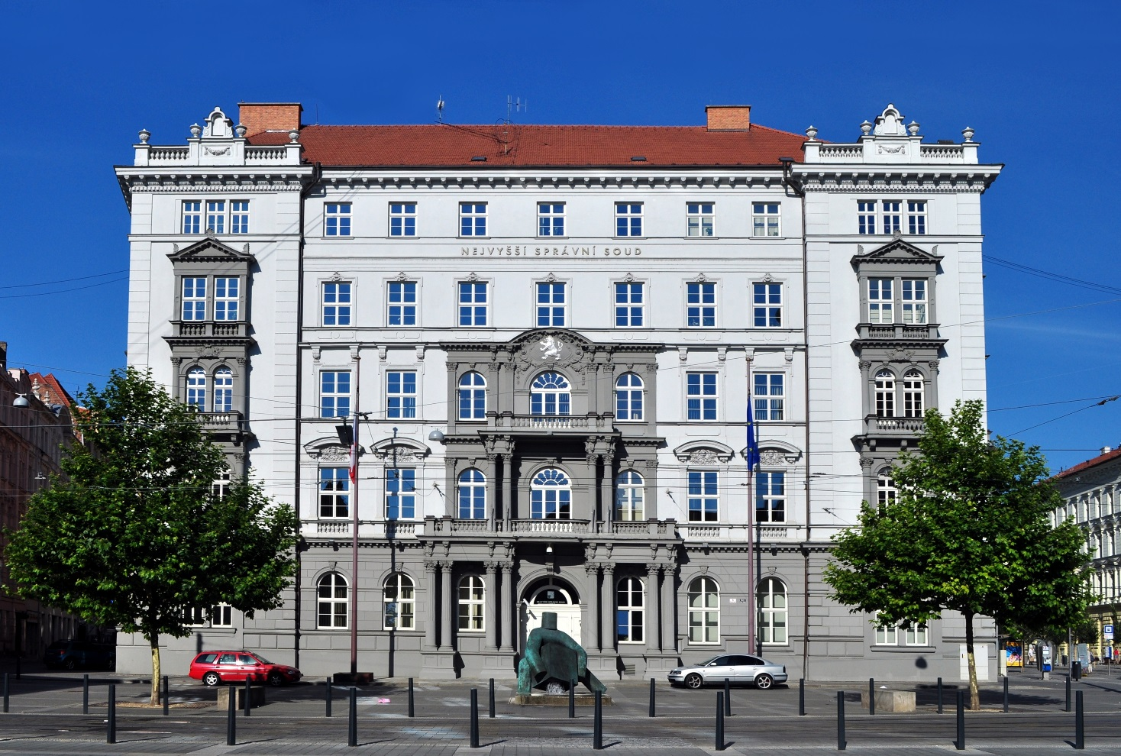
General rules/principles of public administration activity
Case law of the administrative courts (8 regional and Supreme Administrative Court) – also sources of principles, subsequent control

Slide 24
Legal regulation of administrative procedure
In general is in the CAP (art. 1 sec. 2) „This Act or its individual provisions shall apply unless a special Act provides otherwise.“, so CAP:
as lex generalis (about 300 laws in position of lex specialis), we can find bigger or lower „deviations“, special legal regulation (problems of knowledge)
about 180 provisions, in effect since 2006
can be excluded by lex specialis – art. 177 sec. 1 CAP (reqirements for the lex specialis about the principles and content itselfs) – OK, but the CAP shall apply in the scope of principles of good aministration (art. 2 – 8 CAP) – so the CAP will apply, even it is excluded
It is not possible to perform public administration and do not apply CAP

Slide 25
Legal regulation of administrative procedure
1867 and 1876 in Austrian Empire – Code of Administrative Justice (Act Nr. 36/1876 Coll.) – this act was in effect (with some changes) till 1952!
Act Nr. 3/1918 Coll. – Code of Administrative Justice; „only“ Supreme Administrative Court with the the cassation action/complaint (against administrative decision), but continuing Austrian procedural regulation
Lack of procedural norms it the sphere of public administration – big place for the case law
Adoption of the Code of Administrative Procedure (in 1928) was strongly influenced by the case law of the Austrian/Czeschoslovakian (Supreme) Administrative Court

Slide 26
Legal regulation of administrative procedure
CAP in the Czech history:
8/1928 Coll. – 137 provisions, „only“ administrative procedure
20/1955 Coll. – 53 provisions, „only“ administrative procedure
91/1960 Coll. – just 36 provisions, „only“ administrative procedure
Act. nr. 71/1967 Coll. – 86 provisions, mostly administrative procedure, still in effect in Slovakia (common CAP for the CZ and SK)
Act nr. 500/2004 Coll. – 184 provisions, mostly administrative procedure (art. 9 – 153),
Shortening or lengthening of legal regulation as a measure, how to simplify administrative procedure?

Slide 27
Legal regulation of administrative procedure
Art. 9 of act nr. 500/2004 Coll., Code of Administrative Procedure
„Administrative procedure is procedure perfomed by administrative body aimed at issuing a decision establishing, modifying or abolishing the rights or obligations of a nominated person in a particular case or declaring that a person has or does not have rights or obligations in a particular case.“
Procedure (based on cooperation with participants)
Perfomed by administrative body (has public power)
In the sphere of public administration (not all things are made by administrative bodies)
(Administrative) decision is product (and also under the control of courts)
Twice concrete – rights and duties and addressee
Provisions 9 – 153 CAP

Slide 28
Czech Administrative Procedure from the perspective of general rules of proceedings
Administrative procedure:
is one (not the only one) of the procedural forms, that are regulated by/ can be found in CAP, CAP ≠ administrative procedure, but CAP ≥ administrative procedure
is important part of public administration – the decision enables/permits/constitues new right (to study, to build, to do business, to drive, grant social benefit, authorozation, …), but also constitues duties (to pay a fine); sometimes is the decision the first thing, sometimes it follows what happened (administrative offence)
is performed by hundreds/thousands of different administrative bodies and in different situations (azylum, permision for foreigners, …)
some provisions are still the same, some of them differs (lex specialis) in different cases/examples

Slide 29
Czech Administrative Procedure from the perspective of general rules of proceedings
Administrative procedure:
needs to have its participants, who have different rights and duties among the procedure; these are also addressee of the final decision
If started, the only way how to terminate it is the decision (or public law contract), if not – administrative silence/innactivity
Usually takes some (reasonable) time, but the participant wants to have decision immediately or „never“ (sanctions) – different attitude of participants (cooperation x obstacles)
Can be controled by the superior administrative body and later by the administrative courts

Slide 30
Czech Administrative Procedure from the perspective of general rules of proceedings
Administrative procedure:
is terminated by a decision and the decision is issued in administrative proceedings
is a legal relationship (procedural nature, unequal position, superiority of the administrative body), has entities (administrative body and participants), object (why, for what purpose - issuing a decision on rights and obligations) and content (procedural rights and obligations)

Slide 31
Czech Administrative Procedure from the perspective of general rules of proceedings
Administrative procedure:
the 'master of the proceedings' is the competent administrative bod - the participants have the right to propose and demand… but they may not be
complied with (but justify why – in reasoning)
time limit for issuing a decision (Art. 71) x administrative silence (Art. 80), in some cases the time limits initiating proceedings and issuing decision/termination of proceedings
gaining of documents from other (affected) administrative bodies, as well as the participants (may propose), ascertaining the facts things
activities of the administrative body before, during and after the proceedings

Slide 32
Czech Administrative Procedure from the perspective of general rules of proceedings
Administrative procedure:
participants - those whose rights or ditues are to be decided (established, changed, canceled or confirmed)
min. 1 participant, special laws may include a broader/narrower definition,
in case of doubt – is better to consider person as a participant (risk of „forgotten participants“)
the responsibility for the proper delimitation of the participants lies with the administrative body, the need to check the circle of participants
more than 30 participants (simplified procedure Art. 144)

Slide 33
Czech Administrative Procedure from the perspective of general rules of proceedings
Administrative procedure:
participants
1. main, strong or unforgettable participants – Art. 27 sec. 1 CAP (persons whose rights or duties are directly decided)
2. weaker participants – Art. 27 sec. 2 CAP, those whose rights or duties can be directly affected by the decision (somehow this will have a negative effect on their legal sphere)
3. participants under a special law (lex specialis) – Art. 27 sec. 3 CAP
4. the participant in case of doubt – Art. 28

Slide 34
Czech Administrative Procedure from the perspective of general rules of proceedings
Administrative procedure:
participants and theire rights
make proposals/demands/objections * concentration
to comment, explanate
to be familiarized with the documents before issuing a decision, if not: significant procedural error
Access to the files

Slide 35
Czech Administrative Procedure from the perspective of general rules of proceedings
Administrative procedure:
the proceedings are conducted by the relevant administrative body and in particular the so-called authorized official person
written form is dominating, but also oral hearings (orally to the protocol)
the file is established and maintained in each case – right to access to the files

Slide 36
Czech Administrative Procedure from the perspective of general rules of proceedings
Administrative procedure: ways of delivering the documents
on site (vis-à-vis the present)
to data box or otherwise electronically (e-mail)
written (by post)
hybrid

Slide 37
Czech Administrative Procedure from the perspective of general rules of proceedings
Administrative procedure:
Pre - litigation procedure
acceptance of initiatives for initiation of proceedings ex officio
postponement of the case
explanation
provision (ensurance) of evidence
preliminary information
initiation of proceedings
upon request and ex officio
oral hearing
documents for issuing the decision

Slide 38
Czech Administrative Procedure from the perspective of general rules of proceedings
Administrative decision:
Statement
Justifications/reasoning
Information about remedies
It follows the initiation of the proceedings (application / notice of initiation) and the subject of the proceedings (it is not possible to decide on something else)
Specifying the rules of conduct for a given case and circumstances (act of application of law)
Creates decision-making practice – binding in the future

Slide 39
Czech Administrative Procedure from the perspective of general rules of proceedings
Administrative decision:
Statement
Justifications/reasoning
Information about remedies
It follows the initiation of the proceedings (application / notice of initiation) and the subject of the proceedings (it is not possible to decide on something else)
Specifying the rules of conduct for a given case and circumstances (act of application of law)
Creates decision-making practice – binding in the future

Slide 40
Czech Administrative Procedure from the perspective of general rules of proceedings
Administrative decision:
the decision itself is only that part of it which is truly 'capable of curtailing its addressee's rights and which is manifested by the' power of law 'if the decision becomes final. In the operative part of the decision, the administrative authority authoritatively establishes, modifies, or cancels or declares authoritative subjective authority of the participant. (High Court in Prague, 13. 8. 1996, nr. 6 A 154/94)
interim and partial decision, subject to binding opinion, order (, „document“

Slide 41
Principle of Two Instances
Common principle of the Administrative Law
not expressly stated in the legislation – non written down exactly
X - Admitted by the practice a jurisprudence
X - Existence of ordinary remedies – their admissibility – existence of this principle
! - BUT has no nature as BASIC/FUNDAMENTAL principle, only standard/normal principle
THEREFORE:
Absolute exclusion of this principle
Relative exclusion of this principle

Slide 42
Principle of Two Instances
Absolute exclusion of the principle
no ordinary remedies
legal force
Independent administrative bodies (no superior body)
No administrative review – due to the independence
Instead of administrative review – straight judicial review
Relative exclusion of the principle
Remonstrance
? Is it a special, but independent ordinary remedy, or only a special type/kind of an administrative appeal?
Whose decision are controlled in remonstrance proceedings?
Who decides on remonstrance?

Slide 43
Remedies
WHY REMEDIES IN ADMINISTRATIVE PROCEDURE? NEED OF REMEDIES?
Normative approach: how to protect legality and public interests in administrative procedure, to ensure legality of administrative acts itself (law)
Instrumental approach: system of remedies that helps aggrieved parties (participants) against unlawful and unjust decisions (right)
YES, we need them, but … (is not so much remedial measures? More remedies = more rights??? How to use this system …

Slide 44
Remedies
Are remedial measures in administrative procedure more „normative“ or „instrumental“?
Ordinary remedies – more instrumental
(Appeal - Sec. 81 – 93 CAP, and/or Remonstrance - Sec. 152), right to administrative appeal, the decision is not in legal force, principle of two instances, condition for acces to Administrative Justice
Extraordinay remedies – more normative
(Review procedure – Sec. 94 – 99, and Renewal procedure – Sec. 100), more ex officio, scope of legality (q. iuris et facti) problems with legal force, problems with time limits and concurrence with Administrative Justice

Slide 45
Remonstrance
Use by the aggrieved participants against decision that was made by the „CAB“ in the first instance/level
„CAB“
      central bodies (on the top of the hierarchy)
      no superior bodies
      preparation of the legislation
      conceptual task, analysis, advices
      ministries, other …
Should or shouldn´t the „CAB“ participate in the administrative decision making process and should or shouldn´t make an individual decisions?

Slide 46
Remonstrance
„CAB“ in the administrative proceedings
Represents the second/final instance
  with accordance to the principle of two instances
  final instance – final decision, end of the procedure
  instrument for control
Represents the first instance – the administrative proceeedings begins at this stage/level
  In respect to the principle of two instance – who will then decide in the second instance?
  No superior administrative body REMONSTRANCE

Slide 47
Remonstrance
By the head of the „CAB“ who made first instance/level decision
? internal or external control?
? Impartiality – control of decision that was made by „his/her“ office, „his/her colleagues“, …
Legal requirement: estabilishing the „independent“ remonstrance commitee
! decision on remonstrace is made by the head, not by the commitee!
Issues not decision on remonstrance, but „only“ recommendation/advices
Recommendation is not binding, but in practice is mostly respected – WHY?
5 members; „experts“
? Who is an expert? – no legal reqiurements
Are appointed by the head of the „CAB“
? Are these „experts“ impartial?

Slide 48
Extraordinary remedies
problems with legal force (is relative or absolute?) and rights
problems with time limits
concurrence with Administrative Justice
purpose of this measures
the need of legailty x gained rights in good faith
Ex officio (initiative from parties)
Do we really need them? Can the society and Public Administration exist and function without them?

Slide 49
Extraordinary remedies
Review procedure – instrument of connectivity in CAP, is used in other procedural forms
Retroactivity in favor – bound by the the date of issue, no later changes, even in favour …
Is it effective?

Slide 50
Administrative Justice in the Czech Republic
„changes and expectations“ in Administrative Justice (not only) on the example of the Czech Republic
Purpose of the Administrative Justice and its history and development
Todays situation and legal regulation
Possible changes and expectations in future
http://nssoud.cz/Uvod/art/1

Slide 51
Administrative Justice in the Czech Republic
Why do we have the Administrative Justice?
To protect rights of individuals and thus to control state/public administration
More protection or more control?
Control as a result of protecion – Administrative Justice may control only such cases where the action was taken (no ex officio)
Protection is not possible in all cases, but only in which the legal regulation enables it (reasons for actions are very wide)

Slide 52
Administrative Justice in the Czech Republic
NSS (sp. zn. 8 As 47/2005, 1764/2009 Coll., NSS) Administrative Justice and „Code of Administrative Justice is by its nature a „defensive„ act. It is not a "control" standard that would allow anyone to initiate, by bringing an action in the administrative justice, to control any act of the public administration. It is only intended to ensure legal protection in cases where public administration enters into the legal sphere of natural or legal persons. The limitation criterion for prominence is the alleged interference with public subjective rights. Not all the activity (or any misconduct) of public administration is subjected to judicial control …., but only when the activity of the administration exceeds their public subjective rights. "

Slide 53
Administrative Justice in the Czech Republic
External products of Administrative Justice – the ruling/court's decision – is still an individual decision or the law for other cases?

Slide 54
Administrative Justice in the Czech Republic
1867 and 1876 in Austrian Empire – Code of Administrative Justice (Act Nr. 36/1876 Coll.)
Act Nr. 3/1918 Coll. – Code of Administrative Justice; „only“ Supreme Administrative Court and the cassation complaint (against administrative decision)
Adoption of the Code of Administrative Procedure (in 1928) was strongly influenced by the case law of the Austrian/Czeschoslovakian (Supreme) Administrative Court
To cover the Loopholes in legal regulation

Slide 55
Administrative Justice in the Czech Republic
Restoration in 1992 (to 2003), with lack of Supreme Administrative Court – 8 regional administrative courts and 2 High Courts in administrative matters
Different/inconsistent court rulings

Slide 56
Administrative Justice in the Czech Republic
New system (since 1. 1. 2003, Act Nr. 150/2002 Coll., Code of Administrative Justice)
Regional courts and Supreme Administrative Court
Possibility to take an action againt: decision, inactivity, factual acts, act of general measure (since 2005), … wide scope of judicial protection
Unacceptability of cassation complaint (since 2005) in the matters of international protection (azylum sphere)

Slide 57
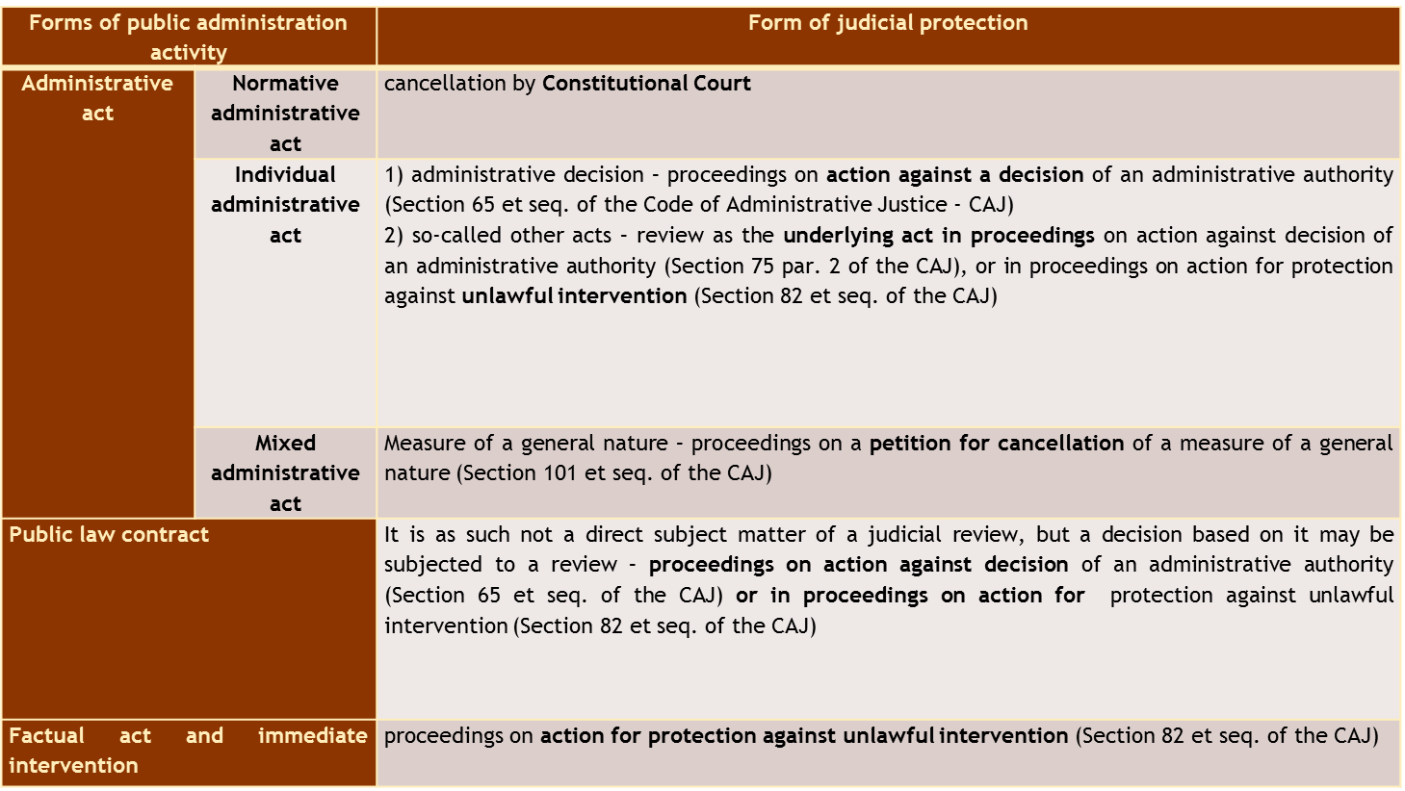
Administrative Justice in the Czech Republic
Administrative Justice in the Czech Republic
Define footer - Name of the presentation / Your name / Unit, Office
57

Slide 58
Administrative Justice in the Czech Republic
Creation and transforming the law, even the legal regulation contains the rule (against the law), power to rewrite the legal regulation – no loopholes
The Parliament usually agrees (only in small amout of cases was adpoted legal regulation that is different than the case law – 3 cases)
Purpose of Administrative Justice – ex post control or direct decision making proces?
Define footer - Name of the presentation / Your name / Unit, Office
58

Slide 59
Administrative Justice in the Czech Republic
Expectations:
Specialization?
Control or direct decision making in the case?
Scope of review? Unacceptability of cassation complaint
Define footer - Name of the presentation / Your name / Unit, Office
59

Slide 60
Ombudsman
Estabilished in 2000, Act nr. 349/1999 Coll., seated in Brno
„Public Defender of Rights“
https://www.ochrance.cz/en/

Slide 61
Ombudsman
Protects people against the conduct of authorities and other institutions if the conduct is against the law, does not correspond to the principles of a democratic legal state and the principles of good administration, or the authorities are inactive.
He/she also carries out preventive systematic visits to places where people are restricted in their freedom and seeks to ensure that their rights are respected. The Defender also contributes to promotion of the right to equal treatment and protection against discrimination and also systematically deals with the rights of the people with disabilities.

