Slide 1
Tort Law Lukáš Hadamčík

Slide 2
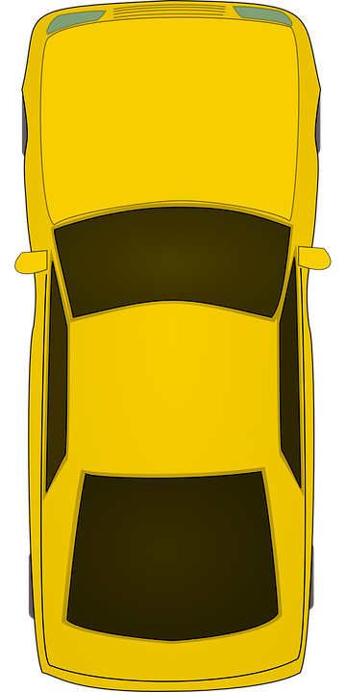
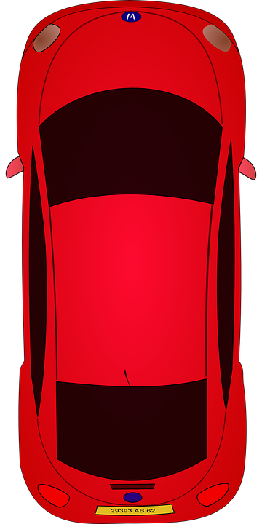
Free
Paid

Slide 3
System of Tort Law
zero point
neminem laedere (not to harm anyone)
everyone is liable for everything
casum sentit dominus (coincidence affects the owner)
no-one is liable for anything

Slide 4
Meaning of Tort Law
only non-contractual liability
Book four Title III – Obligations arising from torts
but! sc. 2913 – Breach of contractual duty
(1) If a party breaches a contractual duty, such a party shall provide compensation for the resulting damage to the other party or the person who was evidently intended to benefit from the fulfilment of the stipulated duty.

Slide 5
Basic Elements of Liability for Damage
delict – breach of statute or good morals
damage
causal relationship
fault

Slide 6
General Clauses of Tort Liability
breach of good moral sc. 2909
A tortfeasor who causes harm to a victim by an intentional breach of good morals has the duty to provide compensation for it; however, if the tortfeasor was exercising his right, he has the duty to provide compensation for the damage only if his main purpose was to harm another.
culpable violation of absolute right sc. 2910
life, body, health, freedom, property, etc.
culpable violation of a protective law sc. 2910
A tortfeasor who is at fault for breaching a statutory duty, thereby interfering with an absolute right of the victim, shall provide compensation to the victim for the harm caused. A tortfeasor also becomes obliged to provide compensation if he interferes with another right of the victim by a culpable breach of a statutory duty enacted to protect such a right.

Slide 7
Is the statutory duty enacted to protect the right of owner of the red car to be first in the car park?
Free
Paid

Slide 8
Free
Paid

Slide 9
Civil Delict
objective criterion
prohibitions and commands in the whole law system
prevention – sc. 2900
If required by the circumstances of the case or the usages of private life, everyone has the duty to act so as to prevent unreasonable harm to freedom, harm to life, bodily harm or harm to the property of another.

Slide 10
Defences and Exception Clauses
using a right
fulfill a legal duty
victim´s consent
voluntary assumption of risk
self-help sc. 14
necessity sc. 2906
self-defence sc. 2905

Slide 11
Necessity
Sc. 2906 A person who protects himself or another from an imminent risk of harm does not have the duty to provide compensation for the resulting harm if, given the circumstances, the danger could not have been prevented otherwise, or if he does not cause a consequence which is evidently equally serious as, or even more serious than, the imminent harm, unless the property would have decayed in any case even without the act made under necessity. This does not apply if the actor was at fault for inducing the risk.
Sc. 2907 In assessing whether or not someone acted in self-defence or under necessity, account is taken of justifiable excitement of mind of the person who prevented the attack or another danger.
Sc. 2908 A person who prevented imminent harm is also entitled to the reimbursement of reasonably incurred costs and compensation for the harm suffered in doing so against the person in whose interest he acted, but only to the extent appropriate to the harm which he prevented.

Slide 12
Sc. 3014 If a person in difficulties sacrifices a thing in order to prevent greater damage, each of the persons benefiting from the situation shall provide the victim with a proportionate compensation.
A person who protects himself or another from an imminent risk of harm does not have the duty to provide compensation for the resulting harm if, given the circumstances, the danger could not have been prevented otherwise, or if he does not cause a consequence which is evidently equally serious as, or even more serious than, the imminent harm, unless the property would have decayed in any case even without the act made under necessity. This does not apply if the actor was at fault for inducing the risk.

Slide 13
Self-defence sc. 2905
A person who protects himself or another from an imminent or ongoing unlawful attack and, in doing so, causes harm to the attacker, has no duty to provide compensation for such harm. This does not apply if it is clear that, given the circumstances, the attacked person is under the threat of incurring only negligible harm, or the defence is manifestly excessive, especially given the gravity of the harm caused to the attacker by preventing the attack.

Slide 14
Fault
subjective criterion
examined aspects – knowledge and will
dolus directus – direct intent
dolus eventualis – indirect intent
culpa lata – wilful negligence
culpa levis – unwilful negligence
Presumption of negligence
Sc. 2911 If a tortfeasor causes damage to the victim by breaching a statutory duty, he is presumed to have caused the damage through negligence.

Slide 15
Concepts of Liability
liability based on fault
no-fault liability (strict liability)
sc. 2895 - A tortfeasor has the duty to pay damage regardless of his fault in cases specifically provided by a statute.
ex. - Damage resulting from operating activities, Damage caused by a particularly hazardous operation, Damage caused by the operation of a means of transport

Slide 16
Causation
causal connection between the tortfeasor´s conduct and the damage
doctrine condictio sine qua non – theory of consequence
but-for test
A
B
A
B

Slide 17
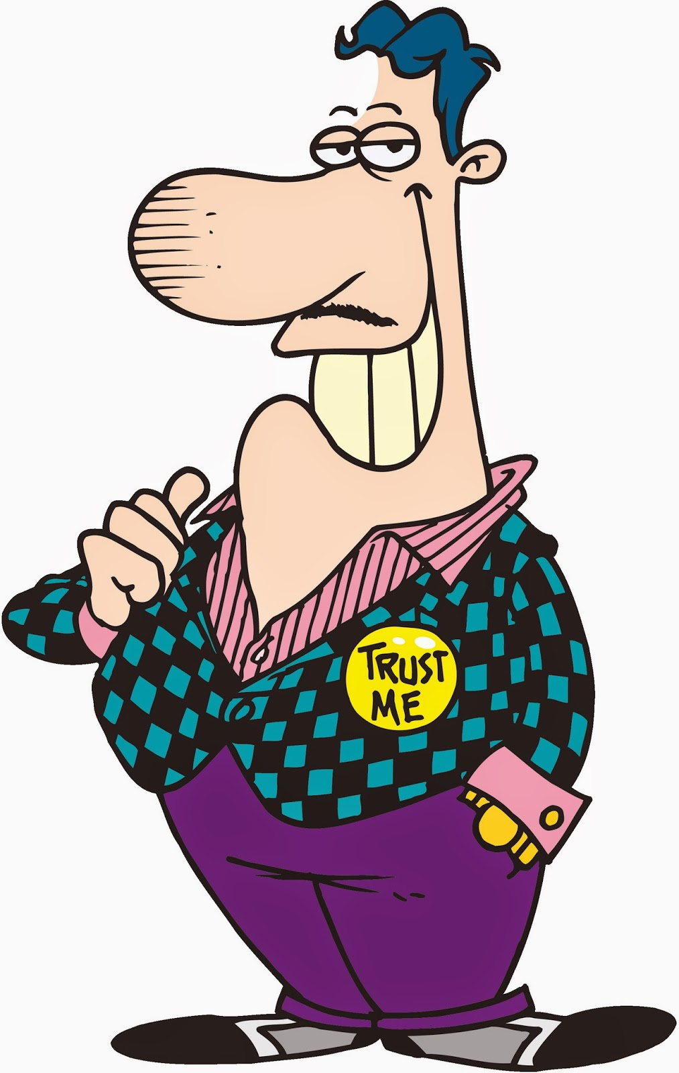
2018
2021
40 000 €
35 000 €
5 000 € ?
Tato fotka od autora Neznámý autor s licencí CC BY-NC

Slide 18
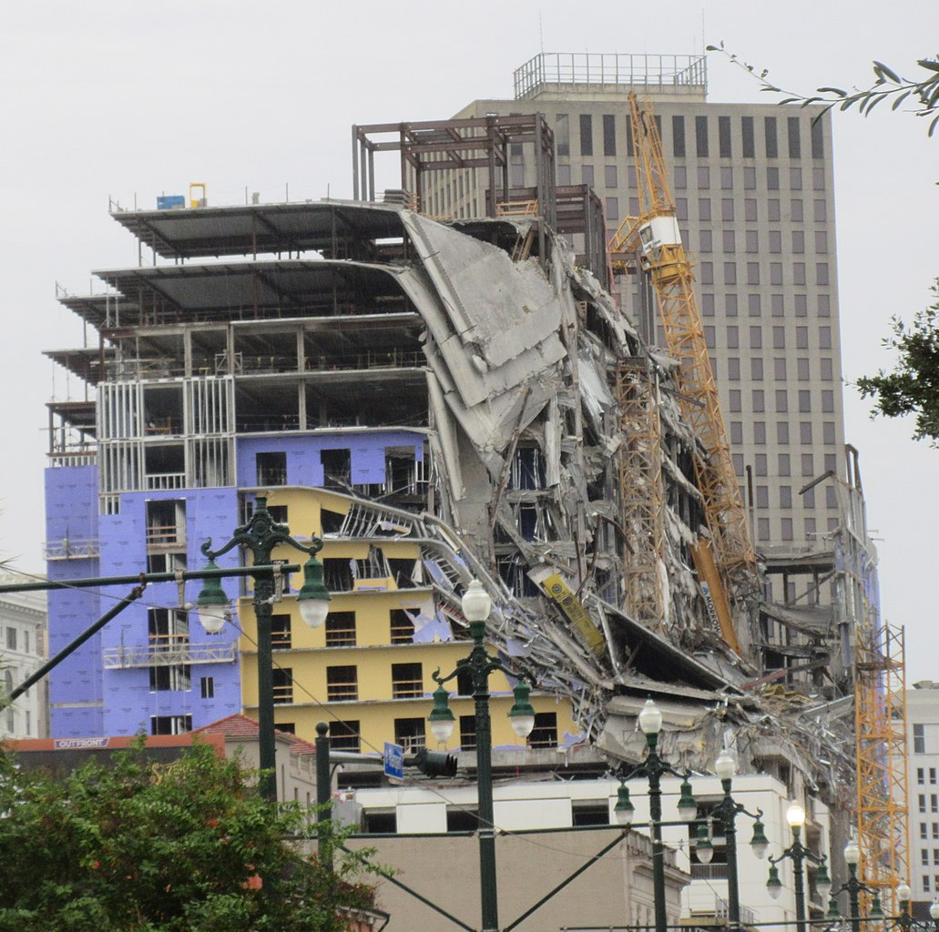
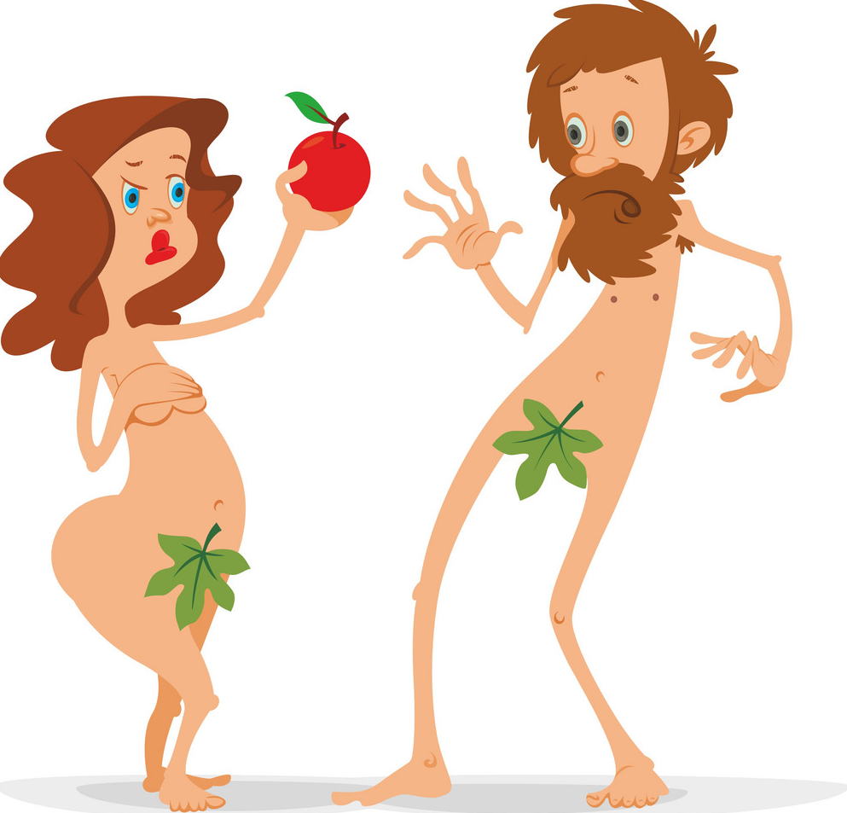

Slide 19
Concept of Adequate causation
Action is a relevant cause only if it is not just under particularly exceptional and extremely unlikely circumstances, but generally, suitable to produce a certain result.

Slide 20
Material Damage
forms
damnum emergens – actual damage
lucrum cesans – lost profit
differential hypothesis
what would the victim have, if the damage hadn´t happen
expressible in the money

Slide 21
Compensation of Material Damage
sc. 2951 - Damage is compensated by the restoration to the original state. If this is not reasonably possible, or if so requested by the victim, damage is payable in money.
restoration to the original state
in money
choice of victim

Slide 22
Reduction of Compensation sc. 2953
(1) For reasons deserving special consideration, a court shall proportionately reduce the compensation of damage. In doing so, the court shall in particular take into account how the damage occurred, the personal and property situation of the individual who caused and is liable for the damage, as well as the circumstances of the victim. Compensation may not be reduced if the damage was caused intentionally.
(2) Subsection (1) does not apply if the damage was caused by a person who offered to provide professional performance as a member of a particular vocation or occupation, or by a breach of professional care.

Slide 23
Non-Material Damage
isn´t quantifiable in money
sc. 2894 subsc. 2 - If the duty to provide compensation to another for non-pecuniary harm has not been expressly stipulated, it affects the tortfeasor only where specifically provided by a statute. In such cases, the duty to provide compensation for non-pecuniary harm by providing satisfaction is assessed by analogy under the provisions on the duty to provide compensation for damage.
general clause sc. 2956
other clauses – sc. 2969 par. 2, sc. 2971 and others

Slide 24
Appropriate Satisfaction
sc. 2951 subsc. 2 - Non-pecuniary harm is compensated by appropriate satisfaction. Satisfaction must be provided in money unless real and sufficiently effective satisfaction for the harm incurred can provide for satisfaction otherwise.
moral – apologize
in money

Slide 25
Compensation for Bodily Harm and Death
Sc. 2958 - In the case of bodily harm, the tortfeasor shall compensate the victim for such harm in money, fully compensating for the pain and other non-pecuniary harm suffered; if the bodily harm resulted in an impediment to a better future for the victim, the tortfeasor shall also compensate him for the deteriorated social position. Where the amount of compensation cannot be determined in this manner, it is determined according to the principles of decency.

Slide 26
Compensation for Bodily Harm and Death
Sc. 2958 In the case of bodily harm, the tortfeasor shall compensate the victim for such harm in money, fully compensating for the pain and other non-pecuniary harm suffered; if the bodily harm resulted in an impediment to a better future for the victim, the tortfeasor shall also compensate him for the deteriorated social position. Where the amount of compensation cannot be determined in this manner, it is determined according to the principles of decency.
reparation money
compensation for deteriorated social position
the weaking of the social capacity of a person
impediment to a better future
other non pecuniary harm
Method of The Supreme Court of Justice
http://www.nsoud.cz/Judikatura/ns_web.nsf/Edit/Rozhodovacicinnost~Metodikak%3F2958o.z.?Open&area=Rozhodovac%C3%AD%20%C4%8Dinnost&grp=Metodika%20k%20%C2%A7%202958%20o.z.&lng=

Slide 27
Reparation Money (Pain)
Example – pulling out an eye
B S057 = 200 points
1 point = average wage in CZR in the previous year / 100
1 point in 2021 = 356,11 Kč (13,78 €)
71 222 Kč (2 756 €)

Slide 28
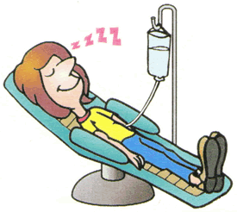
Impediment to a Better Future
Starting question: What is the price for destroyed life?
= average wage in CZR in the previous year * 400
in 2021
14 244 400 Kč (551 254 €)
can be modified by:
Age of the victim
Lost of career
Intentional harm
maximal modification
= double
28 488 800 Kč (1 102 508 €)

Slide 29
Considered Life Activities
Learning and application of knowledge
General tasks and requirements
Communication
Mobility
Self care
Home life
Interpersonal negotiations and relationships
The main areas of life (upbringing, job)
Community, social and civic life
Weighted average in every category
Complex weighted average
Worse life by 1 %
1 % * 14 244 400 Kč (551 254 €)
= 142 444 Kč (5 512,54 €)

Slide 30
If the victim dies
Sc. 2959 In the case of killing or particularly serious bodily harm, the tortfeasor shall compensate the spouse, parent, child or other close person for the mental suffering in money, fully compensating their suffering. Where the amount of compensation cannot be determined in this manner, it is determined according to the principles of decency.
spouse, parent, child or other close person
= average wage in CZR in the previous year * 20
in 2021 = 712 220 Kč (27 563 €)

Slide 31
What about the victim claims?
If the victim dies immediately, his claims terminate.
If the victim survive for a while, he has to bring an action against tortfeasor. Then his claims are part of heritage.
Sc. 1475 § 2 A decedent’s estate consists of the entire assets and liabilities of a decedent except for the rights and duties exclusively bound to him personally, unless they have been acknowledged or enforced as a debt before a public body.
Serious harm
Kill
1 102 508 €
>
27 563 €

Slide 32
Voluntary Homework
How is reparation money and deteriorated social position calculate in your country?
Where is it regulated?
What will happen to this claims if the victim dies?

Slide 33
Thank you!

