Slide 1

Marketing for Lawyers
Customer services offered by lawyers
Romana Buzková
Romana.Buzkova@law.muni.cz

Slide 2

Content
Services, global brands
Successful examples
Services marketing
Customer service
Services in legal context

Slide 3
What is a service?
Any act or performance that one party can offer to another that is essentially intangible and does not result in the ownership of anything. Its production may or may not be tied to a physical product (Kotler, 1987).
Service-based business x product-based business.

Slide 4
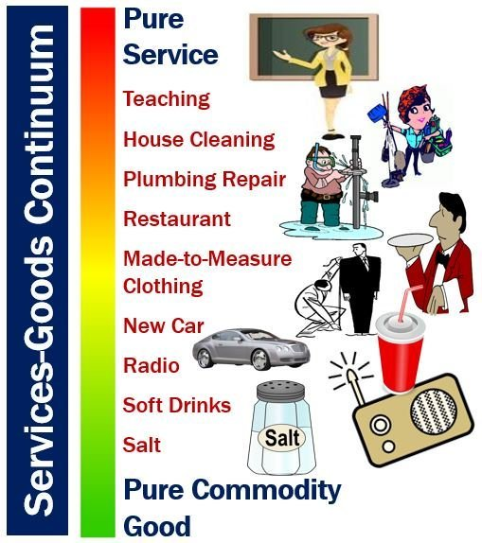
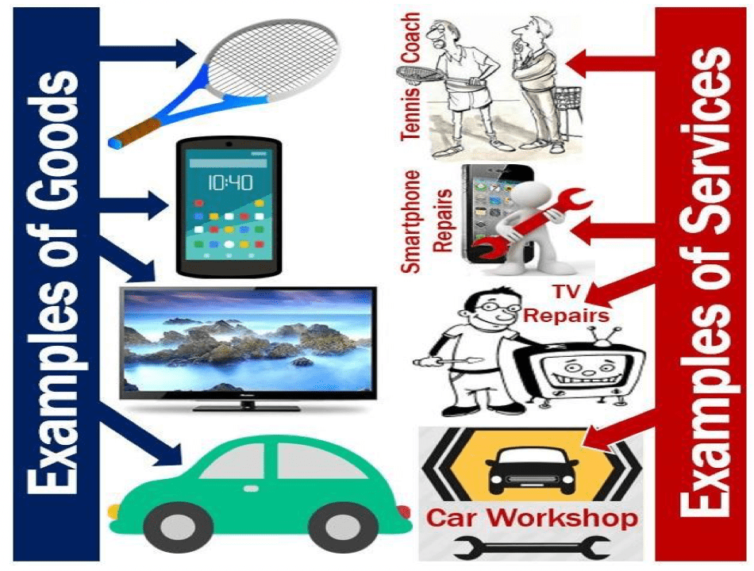
Service x product

Slide 5
Some examples of services
Accounting
Advertising
Banking and financial services
Communications
Consulting
Education and training
Health care
Leasing
Legal services
Maintenance and repair
Management and catering
Publishing
Transportation

Slide 6
Why is it important?
Services play an important role in today's world of business – we live in a service economy.
Services sector is the largest sector in the world.
Today, over two-thirds of GDP and four-fifths of employment in the OECD countries are in the services sector.

Slide 7
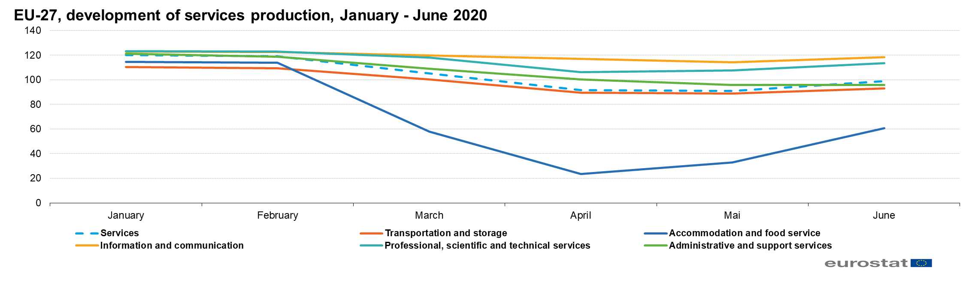
Coronavirus impact

Slide 8




Examples

Slide 9

Best global brands
Which companies do you think that belong to top 3 in the world?
  …
  …
  …
https://www.interbrand.com/best-global-brands/

Slide 10






Do you know any Czech companies/brands?

Slide 11


RegioJet (successful example from Brno ☺)
https://www.regiojet.com/

Slide 12
Task 1
Find a (successful) example from your country.
Prepare a short description of the company and its services.
What makes it special? Why do you like it?
Is there anything you do not like?
Do you have any recommendations for improvement?
How would you describe the marketing strategy of this company?
Marketing for Lawyers

Slide 13
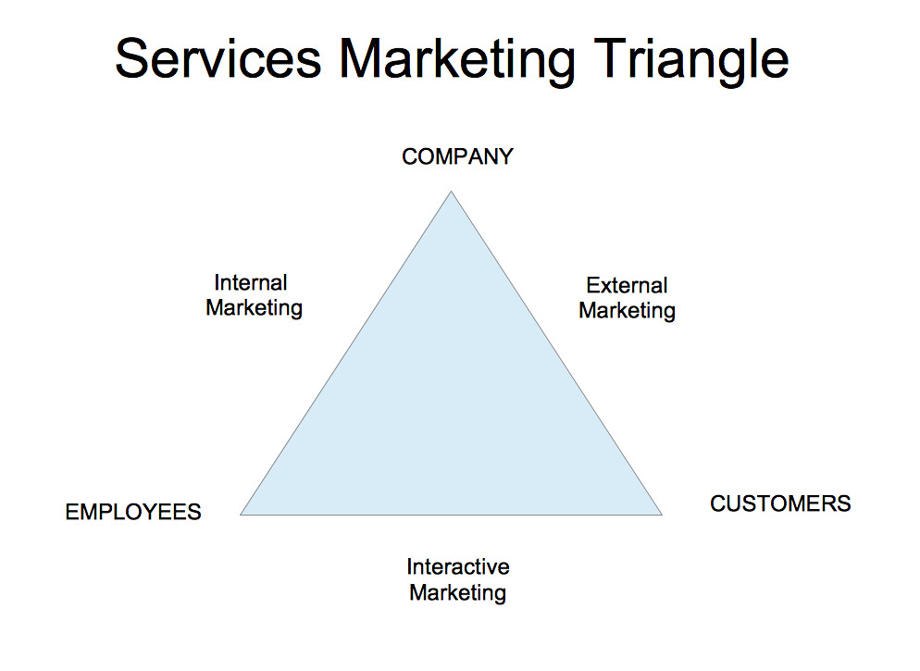
Services marketing
Internal marketing
  Enabling the promise
  Vertical & horizontal communications
External marketing
  Setting the promise
  Advertising, sales promotion, direct marketing,
  public relations
Interactive marketing
  Delivering the promise
  Personal selling, customer service center,
  service encounters, servicescapes
Marketing for Lawyers

Slide 14
Customer service
Everything what a company does for satisfaction of its customers.
Helps to gain higher profit from sold products.
Customer services can be also an important competitive advantage.
Why customer service matters: https://www.youtube.com/watch?v=nxtaMdu55Ug

Slide 15
Customer service
May be provided by a person or by automated means.
Understanding of customers’ needs and wishes.
Influences emotional experiences from purchase and helps to increase the satisfaction of customers.
Generates income and revenue.

Slide 16
Customer service
Takes place before, during and after the purchase.
Examples of customer services:
  Providing sufficient information about the company and its products
  Payment options
  Transport and packaging of products according to customers' preferences
  Maintenance services
  Free phone connection
  Online helpdesk
  Others

Slide 17
How to offer customer service
Know your product (do not leave a customer with an unanswered question).
Body language/communication (smile, keep an eye contact, be polite).
Anticipate customers’ needs (go the extra mile).

Slide 18
Customer service offered by lawyers
What consumers (clients) want from customer service:
  Understanding and solving the problem
  Polite and friendly staff
  Frequent communication, responsiveness to phone calls and emails
  Same treatment for all clients
  Clear communication
  Transparency in pricing
  Going beyond their expectations

Slide 19
Task 2
Think about any kind of service that can be provided in addition to standard legal services.
Try to find a legal office from your country which in your opinion provides good customer service.
Example: http://www.pravovrousce.cz/law_in_drape.html
Please send me both tasks via email till the end of this week ☺

Slide 20
References
https://marketbusinessnews.com/financial-glossary/services/
https://www.martindale-avvo.com/blog/what-is-customer-service/
Kotler, Philip. Marketing Management: Analysis, Planning, Implementation, and Control. Prentice Hall (1997).
Lovelock, Christopher; Wirtz Jochen. Services Marketing: Global Edition. Pearson (2012).
Marketing for Lawyers

