Slide 1


BASICS OF THE EU ENVIRONMENTAL LAW
ACCESS TO ENVIRONMENTAL INFORMATION, PARTICIPATION OF PUBLIC IN ENVIRONMENTAL DECISION-MAKING AND ACCESS TO JUSTICE - THE 3 PILLARS OF AARHUS CONVENTION.
14 March 2022
JUDr. Vojtěch Vomáčka, Ph.D., LL.M.

Slide 2
Last lecture summary - Harmonization of environmental requirements
1) Correct transposition + application + information
2) Obligation to refrain from any measure which could jeopardise the attainment of the Union's objectives
3) Implementation and the enforcement: member states, problems of EU control: remote, burden of proof
4) The role of national courts and the role of CJEU.
CJEU: interpretation, systematic failures, financial sanctions
national courts: a) consistent interpretation, b) conflict: annulment, non-application (exemptions), direct effect?, c) state liability

Slide 3
Today
Public participation in general
The Aarhus Convention
Three pillars at the EU level
Three pillars at the national level

Slide 4
Public participation?
Environmental democracy
Affected and close to the source
Fundamental rights
(to be able to assert this rights, citizens must participate)
Helping hand
    to further the accountability of and transparency
to strengthen public support for decisions
to promote environmental education
Negatives?
„Only“ procedural rights
Wide scope
Free or almost free of charge
Not necessarily protection of environment – personal interests

Slide 5

Public participation? How?
Petition
Demonstration
Referendum
Access to information
Participation in proceedings
Judicial Protection

Slide 6

Access to justice in Environmental Matters: Sources (Layers)
National Law
Specific Acts (EIA, IED)
Constitutional Law + judicial process
Specific Directives (EIA, IED)
Art. 47 EU Charter
Everyone whose rights and freedoms guaranteed by the law of the Union are violated has the right to an effective remedy... (fair and public hearing within a reasonable time + legal aid)
EU Law
The Aarhus Convention
Pillar III: Access to justice
European Charter of Human Rights
Art. 6 (procedural – access to justice)
Art. 2 (protection of life)
Art. 8 (protection of private and family life)
Art. 1 of Protocol No. 1 (protection of property)
International Law
6

Slide 7
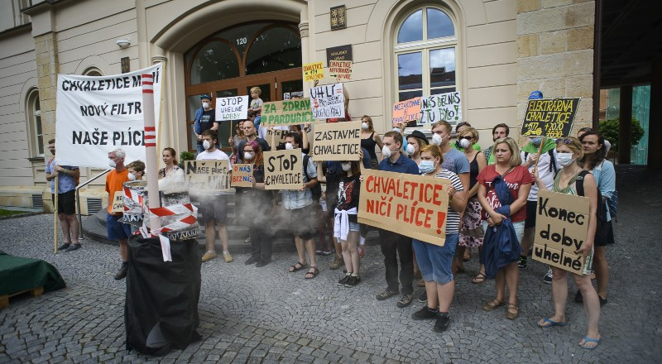
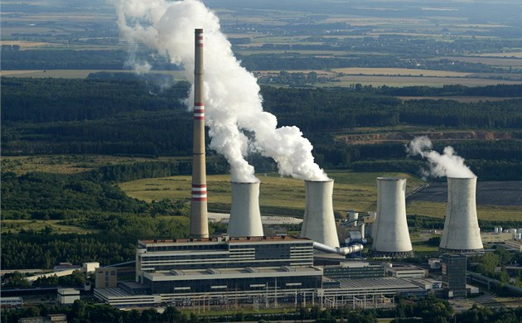
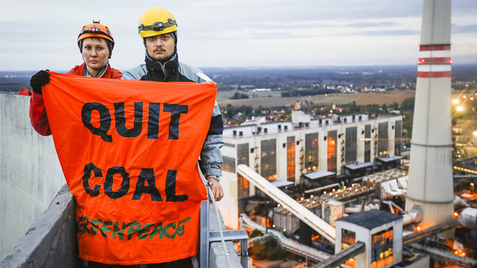
Effective public participation?

Slide 8

Public participation? Balancing the system
C-115/09 Bund für Umwelt und Naturschutz Deutschland, Landesverband Nordrhein-Westfalen eVvBezirksregierung Arnsberg Trianel Kohlekraftwerk Lünen
The German system of judicial review
involves a “careful and detailed” scrutiny of administrative decisions,
admissibility criteria are such that few are able to access this system, particularly groups bringing actions alleging environmental harm.

Slide 9
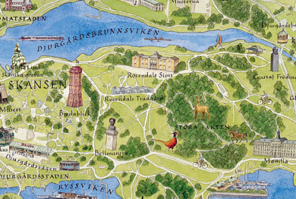
The Aarhus Convention – NATIONAL level
Various restrictions:
C-263/08 (Djurgården-Lilla Värtans)
– only NGOs with environmental objectives
- active for 3 years
    - 2.000 members

Slide 10
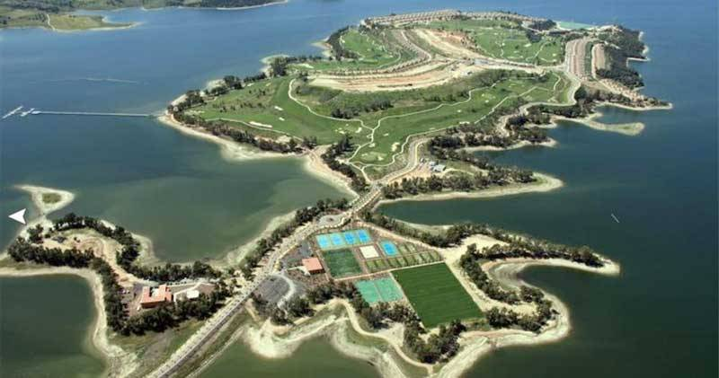
Public participation? Balancing the system
Marina Isla de Valdecañas

Slide 11
Public participation? Balancing the system
Marina Isla de Valdecañas
The tourist resort in the province of Caceres, which comprises hotels, 200 luxury villas, a golf course and a marina.
It was declared illegal by a Spanish Supreme Court ruling of 6 February 2014. The resort is located within a Natura 2000 protected area.
The ruling comes after almost a decade of court proceedings, and at this stage the resort is already close to completion.

Slide 12
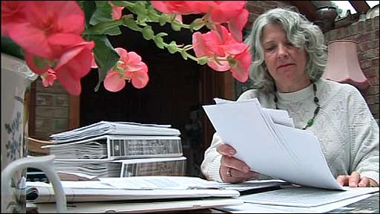
Public participation? Balancing the system
Various restrictions:
Costs of the proceedings? Costs follow the event rule?
Lilian Pallikaropoulos from Rugby – £ 90.000
Maximum, legal aid, moderation, C-260/11 (Edwards)

Slide 13
Sources of legal regulation: International level
Principle l of the Stockholm Declaration on the Human Environment (1972)
Principle 10 of the Rio Declaration on Environment and Development
UN General Assembly resolutions (1982) on the World Charter for Nature and (1990) on the need to ensure a healthy environment for the well-being of individuals
Customary international law?
Human Right treaties
The Aarhus Convention

Slide 14

The Convention on Access to Information, Public Participation in Decision-making and Access to Justice in Environmental Matters
https://www.youtube.com/watch?v=uyhE9v2UnEQ
https://www.youtube.com/watch?v=2UvwbKCjmjA

Slide 15
The Aarhus Convention
the most ambitious venture in environmental democracy undertaken under the auspices of the United Nations (Kofi Annan)
the world’s foremost international instrument that links environmental and human rights
a unique international treaty regime, combining notions from environmental as well as human rights law
Almost mature, yet not always respected*
* by Austria, Bulgaria, Czechia, Romania, Slovakia, Spain, United Kingdom, Croatia, Germany, Lithuania and the European Union
Notes:
The adoption of the Aarhus Convention was heralded as a major breakthrough in international law. The then UN Secretary General Kofi Annan described it as “the most ambitious venture in environmental democracy undertaken under the auspices of the United Nations”.

Slide 16
Development
Before the 1990’s international law did not pay much attention to domestic procedures - domestic law- and policy-making only
Principle l of the Stockholm Declaration on the Human Environment (1972) – Both aspects of man's environment, the natural and the man-made, are essential to his well-being and to the enjoyment of basic human rights the right to life itself.
UN General Assembly resolutions (1982) on the World Charter for Nature and (1990) on the need to ensure a healthy environment for the well-being of individuals
Customary international law?
Human Right treaties – access to justice and effective remedies
The EU:
The EIA Directive (85/337/EEC), Directive on the freedom of access to information on the environment (90/313/EEC ), The Habitats Directive (92/43/EEC),
CJEU: elements of individual rights to rely on environmental laws before courts, e.g. with respect to environmental quality standards (C-59/89, Commission v Germany; C-361/88, Commission v Germany; and C-64/90, Commission v France).
Notes:
With the exception of international human rights law, before the 1990’s international law did not pay much attention to domestic procedures for decisions-making, citizens’ access to documents or citizens’ access to court. Today, it may appear surprising that at that time only few multilateral environmental agreements addressed the engagement of members of the public in environmental matters at all; accordingly these matters remained essentially for domestic law- and policy-making only.
The EU was a different case. Not only it adopted some pieces of legislation, in particular Directive 85/337/EEC on the assessment of the effects of certain public and private projects on the environment, and Directive 90/313/EEC on the freedom of access to information on the environment, which oblige the Member States to promote access to information and some degree of public participation in decision-making. The European Court of Justice had also highlighted elements of individual rights to rely on environmental laws before courts, e.g. with respect to environmental quality standards. (C-59/89, Commission v Germany; C-361/88, Commission v Germany; and C-64/90, Commission v France.)

Slide 17
United Nations Framework Convention on Climate Change (1992, 197 Parties):
Art. 6 (a) Promote and facilitate at the national and, as appropriate, subregional and regional levels, and in accordance with national laws and regulations, and within their respective capacities:
(ii) public access to information on climate change and its effects;
(iii) public participation in addressing climate change and its effects and developing adequate responses;
Convention on Environmental Impact Assessment in a Transboundary Context (Espoo Convention, 1991, 45 Parties):
    Art. 2(2): Each Party shall take the necessary legal, administrative or other measures to implement the provisions of this Convention, including (...) the establishment of an environmental impact assessment procedure that permits public participation.
    Art. 2(6): The Party of origin shall provide, in accordance with the provisions of this Convention, an opportunity to the public in the areas likely to be affected to participate in relevant environmental impact assessment procedures regarding proposed activities and shall ensure that the opportunity provided to the public of the affected Party is equivalent to that provided to the public of the Party of origin.
    Art. 3(8): 8. The concerned Parties shall ensure that the public of the affected Party in the areas likely to be affected be informed of, and be provided with possibilities for making comments or objections on, the proposed activity, and for the transmittal of these comments or objections to the competent authority of the Party of origin, either directly to this authority or, where appropriate, through the Party of origin.
    Art. 4 (2): ... The concerned Parties shall arrange for distribution of the documentation to the authorities and the public of the affected Party in the areas likely to be affected...
    Declaration of France: The Convention implies that it is the responsibility of each Party to ensure the public distribution within its territory of the environmental impact assessment documentation, inform the public and collect its comments, except where different bilateral arrangements apply

Slide 18
The Aarhus Convention: Development
Principle 10 of the 1992 Rio Declaration on Environment and Development (UN Doc. A/Conf.151/26):
Environmental issues are best handled with the participation of all concerned citizens, at the relevant level. At the national level, each individual shall have appropriate access to information concerning the environment that is held by public authorities, including information on hazardous materials and activities in their communities, and the opportunity to participate in decision-making processes. States shall facilitate and encourage public awareness and participation by making information widely available. Effective access to judicial and administrative proceedings, including redress and remedy, shall be provided.”
Agenda 21: “One of the fundamental prerequisites for the achievement of sustainable development is broad public participation in decision-making
Political changes in Europe in the beginning of the 1990’s influenced the perception of what are international and national legal issues. New matters, such as civic society, democratisation, environmental human rights and globalisation, transcended state borders, entered the international arena, and expanded into international discourse, law, and policy-making in a way that had previously not been possible.
Notes:
While international human rights law and EU law was important for the Aarhus Convention, it would not have come into being were it not for two important circumstances.
The first is the outcome of the 1992 UN Conference on Environment and Development in Rio de Janeiro 1992. More specifically, through the Rio Declaration on Environment and Development, Principle 10 (United Nations Declaration on Environment and Development; UN Doc. A/Conf.151/26.), it was agreed at the conference that:
“Environmental issues are best handled with the participation of all concerned citizens, at the relevant level. At the national level, each individual shall have appropriate access to information concerning the environment that is held by public authorities, including information on hazardous materials and activities in their communities, and the opportunity to participate in decision-making processes. States shall facilitate and encourage public awareness and participation by making information widely available. Effective access to judicial and administrative proceedings, including redress and remedy, shall be provided.”
Principle 10 nicely frames what was to become the Aarhus Convention; it highlights access to information, public participation in decision-making, and effective access to judicial and administrative proceeding, including redress and remedy, ie access to justice.

Slide 19
The Aarhus Convention: Negotiations
1995: The Third “Environment for Europe” Ministerial Conference endorsed the UNECE Guidelines on Access to Environmental Information and Public Participation in Environmental Decision-making, which drew on and developed Principle 10. The Ministerial Conference also decided to consider the drafting of a convention.
1996: The UNECE Committee on Environmental Policy established the mandate for an ad hoc working group to conduct the negotiations for a new instrument.
June 1996 - March 1998: Over ten sessions of the working group. The NGOs engaged (‘friends of the secretariat’). The EU (EC) did not have a negotiating mandate, but increasing EU coordination and presentation of a single EU position. The US and Canada opted out of the negotiations at an early stage. Russia and Turkey played an active role, with many of their textual proposals being accommodated by the other negotiating parties, but did not sign or accede to the Convention.
25 June 1998 (Aarhus, Denmark): The Convention was adopted within the framework of the Fourth Ministerial ‘Environment for Europe’ conference.
30 October 2001: The Convention entered into force.
Since 2012, all EU Member States and the EU itself are parties to the Aarhus Convention.
4 March 2018: Escazú (Costa Rica) - Regional Agreement on Access to Information, Public Participation and Justice in Environmental Matters in Latin America and the Caribbean
Notes:
Soon after the Rio Conference, in 1995, the Third “Environment for Europe” Ministerial Conference endorsed the UNECE Guidelines on Access to Environmental Information and Public Participation in Environmental Decision-making, which drew on and developed Principle 10. The Ministerial Conference also decided to consider the drafting of a convention.
In January 1996, the UNECE Committee on Environmental Policy established the mandate for an ad hoc working group to conduct the negotiations for a new instrument, to be chaired by Willem Kakebeeke, a senior official from the Netherlands. The negotiations took place from June 1996 to March 1998 over ten sessions of the working group. For most of the negotiating period, the EU (then called the European Community) did not have a negotiating mandate and its Member States intervened directly in the negotiations, often with divergent positions. Towards the conclusion of the negotiations (and even more subsequently), there was increasing EU coordination and presentation of a single EU position. The US and Canada opted out of the negotiations at an early stage. Russia and Turkey played an active role, with many of their textual proposals being accommodated by the other negotiating parties, but did not sign or accede to the Convention.
The level and depth of NGO engagement in the negotiations, while following a tradition established in the ‘Environment for Europe’ process, was unprecedented in the context of the formulation of an international environmental treaty and possibly any legally binding treaty. Even before the formal negotiations began, NGOs were represented in a small ‘friends of the secretariat’ group that assisted the secretariat with preparing draft elements for the Convention text. Thereafter, environmental NGOs were able to be involved not just in the plenary but in every small drafting group. As the NGOs had the relevant experience and would end up being, on behalf of the public, the main ‘clients’ of the Convention, their active participation was not only justified from a principle standpoint but contributed materially to the relevance and robustness of the text.
The Convention was adopted on 25 June 1998 in Aarhus, Denmark, within the framework of the Fourth Ministerial ‘Environment for Europe’ conference. The same day, it was signed at the Conference by 35 States and the European Community, with four more States signing in December 1998 before the Convention was no longer open for signature.

Slide 20
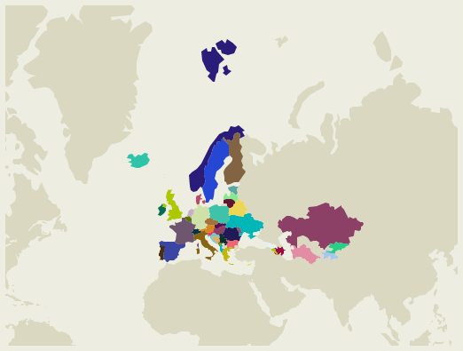
The Aarhus Convention on Access to Information, Public Participation in Decision-making and Access to Justice in Environmental Matters

Slide 21
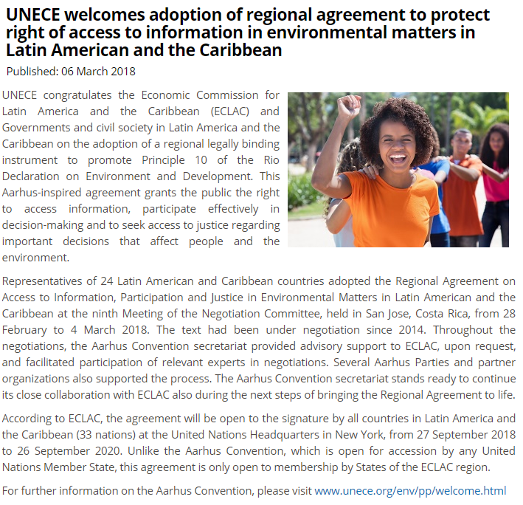

Slide 22
The Aarhus Convention on Access to Information, Public Participation in Decision-making and Access to Justice in Environmental Matters
Adopted on 25 June 1998 in the Danish city of Aarhus (Århus)
Entered into force in 2001
All Member States and EU are parties
Links environmental rights and human rights
Acknowledges that we owe an obligation to future generations
Establishes that sustainable development can be achieved only through the involvement of all stakeholders
Links government accountability and environmental protection
Focuses on interactions between the public and public authorities in a democratic context.

Slide 23
The Aarhus Convention on Access to Information, Public Participation in Decision-making and Access to Justice in Environmental Matters
Rights-based approach
A 'floor', not a 'ceiling'‚
Non-discrimination
Definition of public authorities
Non-compliance mechanism
    Meeting of the Parties
Bureau
Working Group of the Parties
Compliance Committee
GMO amendment

Slide 24
The Aarhus Convention on Access to Information, Public Participation in Decision-making and Access to Justice in Environmental Matters
“The public” means one or more natural or legal persons, and, in accordance with national legislation or practice, their associations, organizations or groups;
“The public concerned” means the public affected or likely to be affected by, or having an interest in, the environmental decision-making; for the purposes of this definition, non-governmental organizations promoting environmental protection and meeting any requirements under national law shall be deemed to have an interest.
https://www.unece.org/fileadmin/DAM/env/pp/documents/cep43e.pdf

Slide 25
The three-pillar structure
Access to information Public participation in decision-making Access to justice
public
passive obligation
active obligation
public concerned
Annex I and other activities with significant effects
plans and programmes
general legal regulation
public (concerned)
denied information
decisions from
pillar II
violation of (other) provisions of the national law relating to the environment

Slide 26
The three-pillar structure
Access to information (Art. 4 – 5)
a “passive” obligation - the environmental information possessed by public authorities should be provided to members of the public on request “as soon as possible” and at the latest within a month. Requests for information can only be refused if any of the listed grounds for refusal apply. Even when they do, the grounds for refusal shall be interpreted “in a restrictive way, taking into account the public interest served by disclosure and taking into account whether the information requested relates to emissions into the environment. Any refusal must be reasoned and in writing.
an “active” obligation - the Parties must actively ensure that public authorities possess and update relevant environmental information, and that mandatory systems are established, providing for an adequate flow of information. Electronic databases shall be publicly accessible and the Parties are to set up nationwide systems of pollution inventories and registers. This part has been further developed through the 2003 Kiev Protocol on Pollution Release and Transfer Registers.
Notes:
Two obligations: a “passive” obligation, which means that the Parties must ensure that public authorities make available the environmental information they possess. The presumption is that the environmental information possessed by public authorities should be provided to members of the public on request “as soon as possible” and at the latest within a month. Requests for information can only be refused if any of the listed grounds for refusal apply. Even when they do, the grounds for refusal shall be interpreted “in a restrictive way, taking into account the public interest served by disclosure and taking into account whether the information requested relates to emissions into the environment” (Art 4(4)). Any refusal must be reasoned and in writing (Art 4(7)).
Second, the Parties must actively ensure that public authorities possess and update relevant environmental information, and that mandatory systems are established, providing for an adequate flow of information. Electronic databases shall be publicly accessible and the Parties are to set up nationwide systems of pollution inventories and registers. This part has been further developed through the 2003 Kiev Protocol on Pollution Release and Transfer Registers.

Slide 27
The three-pillar structure
II. Public participation - three categories of decision-making (Art. 6 – 8)
Decision-making concerning specific activities listed in Annex I and other activities which may have a significant effect on the environment.
Annex I:
Energy sector
Production and processing of metals
Mineral industry
Chemical industry
Waste management:
Waste-water treatment plants
Industrial plants
Construction of railways, motorways, express roads, roads
Inland waterways, trading ports, piers
Groundwater abstraction or artificial groundwater recharge schemes
...
20. Any activity not covered by paragraphs 1-19 above where public participation is provided for under an environmental impact assessment procedure in accordance with national legislation.
Notes:
The Convention provides for public participation with respect to three categories of decision-making.
First, most detailed provisions apply to decision-making concerning specific, listed activities and to other activities which may have a significant effect on the environment. For all these activities, the Parties must ensure:
Early information and notification about the decision-making procedure, in an effective, adequate and timely manner;
Reasonable time-frames to prepare and participate effectively;
Early and effective public participation when all options are open;
That all relevant information is made available at the time of the public participation procedure;
That the public is allowed to submit comments, information, analyses or opinions in writing or at public hearings;
That due account is taken of the outcome of public participation; and
Publicly accessible decisions with reasons and considerations (Art 6).

Slide 28
The three-pillar structure
II. Public participation - three categories of decision-making
Decision-making concerning specific activities listed in Annex I and other activities which may have a significant effect on the environment.
The Parties must ensure:
Early information and notification about the decision-making procedure, in an effective, adequate and timely manner;
Reasonable time-frames to prepare and participate effectively;
Early and effective public participation when all options are open;
All relevant information is made available at the time of the public participation procedure;
The public is allowed to submit comments, information, analyses or opinions in writing or at public hearings;
Due account is taken of the outcome of public participation;
Publicly accessible decisions with reasons and consideration.
Notes:
The Convention provides for public participation with respect to three categories of decision-making.
First, most detailed provisions apply to decision-making concerning specific, listed activities and to other activities which may have a significant effect on the environment. For all these activities, the Parties must ensure:
Early information and notification about the decision-making procedure, in an effective, adequate and timely manner;
Reasonable time-frames to prepare and participate effectively;
Early and effective public participation when all options are open;
That all relevant information is made available at the time of the public participation procedure;
That the public is allowed to submit comments, information, analyses or opinions in writing or at public hearings;
That due account is taken of the outcome of public participation; and
Publicly accessible decisions with reasons and considerations (Art 6).

Slide 29
The three-pillar structure
II. Public participation - three categories of decision-making
b) Decision-making concerning plans and programmes.
Practical or other provisions shall be made for public participation during preparations of plans and programmes relating to the environment;
This should be provided in a transparent and fair framework with necessary information;
Reasonable time-frames must be ensured to prepare and participate effectively;
Early and effective public participation must be provided when all options are open; and
Due account shall be taken of the outcome of public participation
The Parties must endeavour to provide for public participation when preparing policies relating to the environment (Art 7).
Notes:
Second, rather similar, although to some extent less detailed, requirements for public participation apply to decision-making concerning plans and programmes. Thus:
Practical or other provisions shall be made for public participation during preparations of plans and programmes relating to the environment;
This should be provided in a transparent and fair framework with necessary information;
Reasonable time-frames must be ensured to prepare and participate effectively;
Early and effective public participation must be provided when all options are open; and
Due account shall be taken of the outcome of public participation
The Parties must endeavour to provide for public participation when preparing policies relating to the environment (Art 7).

Slide 30
The three-pillar structure
II. Public participation - three categories of decision-making
c) Executive regulations and generally applicable legal instruments
The Parties are obliged to strive to promote effective public participation, at an appropriate stage. To this end, certain requirements are set out (Art 8):
Time-frames sufficient for effective participation should be fixed;
Draft rules should be published or otherwise made publicly available; and
The public should be given the opportunity to comment, directly or through representative consultative bodies.
  The result of the public participation shall be taken into account as far as possible.
In addition, the 2nd Meeting of Parties (MoP) decided to amend the Convention in order to provide for public participation with respect to deliberate release into the environment and the placing on the market of genetically modified organisms.
Notes:
Third, as far as executive regulations and generally applicable legal instruments are concerned, the Parties are obliged to strive to promote effective public participation, at an appropriate stage. To this end, certain requirements are set out (Art 8).
In addition, the 2nd Meeting of Parties (MoP) decided to amend the Convention in order to provide for public participation with respect to deliberate release into the environment and the placing on the market of genetically modified organisms.

Slide 31
The three-pillar structure
III. Access to justice (Art. 9)
Denied information
Anyone who is denied access to environmental information shall have access to a review procedure before a court of law or another independent and impartial body established by law.
Standing should be granted to anyone whose request has been ignored, wrongfully refused or otherwise not dealt with in accordance with the Convention. In certain cases, the Parties should also provide for expeditious procedures for reconsideration by a public authority.
Decision-making concerning specific activities
access to court or another independent and impartial body of law should also be granted with respect to decision-making concerning specific activities for members of the public concerned who either have a sufficient interest or, where so required in national law, maintain impairment of a right.
These criteria should be determined in accordance with national law and consistently with the objective of giving the public concerned wide access to justice. To this effect, environmental NGOs are deemed to have a sufficient interest to be granted standing.
This right to access to justice pertains to challenging the substantive as well as procedural legality of any decision, act or omission concerning specific activities
Notes:
The last “pillar” of the Convention focuses on access to justice. Here too, the Convention distinguishes between three categories of decisions, acts and omissions.
First, anyone who is denied access to environmental information shall have access to a review procedure before a court of law or another independent and impartial body established by law. For these cases, standing should be granted to anyone whose request has been ignored, wrongfully refused or otherwise not dealt with in accordance with the Convention. In certain cases, the Parties should also provide for expeditious procedures for reconsideration by a public authority (Art 9(1)).
Second, access to court or another independent and impartial body of law should also be granted with respect to decision-making concerning specific activities for members of the public concerned who either have a sufficient interest or, where so required in national law, maintain impairment of a right. These criteria should be determined in accordance with national law and consistently with the objective of giving the public concerned wide access to justice. To this effect, environmental NGOs are deemed to have a sufficient interest to be granted standing. This right to access to justice pertains to challenging the substantive as well as procedural legality of any decision, act or omission concerning specific activities (Art 9(2)).
Finally, each Party shall ensure access to administrative or judicial procedures to members of the public, meeting the criteria in national law, “if any”, to challenge other acts and omissions by private persons and public authorities “which contravene provisions of its national law relating to the environment” (Art 9(3)). In this regard, the Committee has concluded that for EU Member States applicable European Union law relating to the environment should also be considered to be part of the domestic, “national law”.

Slide 32
The three-pillar structure
III. Access to justice (Art. 9)
c) Violation of provisions of the national law relating to the environment
Access to administrative or judicial procedures to members of the public, meeting the criteria in national law, “if any”, to challenge other acts and omissions by private persons and public authorities “which contravene provisions of its national law relating to the environment” (Art 9(3)).
EU law relating to the environment should also be considered to be part of the domestic, “national law”.
Contrary to the first and the second categories, it may suffice to ensure access to administrative review procedures to challenge acts and omissions in the third category.
Access to justice must not be pro forma only. Therefore, all procedures referred to above under the three categories, including any administrative procedure, must provide “adequate and effective remedies, including injunctive relief as appropriate, and be fair, equitable, timely and not prohibitively expensive”
Notes:
Finally, each Party shall ensure access to administrative or judicial procedures to members of the public, meeting the criteria in national law, “if any”, to challenge other acts and omissions by private persons and public authorities “which contravene provisions of its national law relating to the environment” (Art 9(3)). In this regard, the Committee has concluded that for EU Member States applicable European Union law relating to the environment should also be considered to be part of the domestic, “national law”.

Slide 33
The Aarhus Convention and the EU law
The Aarhus Convention
Art. 216 (2) TFEU
EU
1 + 2 + 3
Member State
1 + 2 + 3
1 + (2) + (3)

Slide 34
The Aarhus Convention implemented by EU law
Directive 2003/4/EC of the European Parliament and of the Council of 28 January 2003 on public access to environmental information
Directive 2003/35/EC of the European Parliament and of the Council of 26 May 2003 providing for public participation in respect of the drawing up of certain plans and programmes relating to the environment and amending with regard to public participation and access to justice Council Directives 85/337/EEC and 96/61/EC
+ number of other environmental directives
Proposal for a Directive of the European Parliament and of the Council on access to justice
Regulation (EC) N° 1367/2006 of the European Parliament and of the Council on the application of the provisions of the Aarhus Convention on Access to Information, Public Participation in Decision-making and Access to Justice in Environmental Matters to Community institutions and bodies
(information - extends Regulation (EC) No 1049/2001)

Slide 35

The Aarhus Convention
Binding nature? Direct application?
C-240/09 (Slovak Brown Bears): As far as possible

Slide 36
The Aarhus Convention – EU level
Information (also Art. 15 TFEU, Art. 42 Charter)
Wide definiton of information (up-to-date, accurate and comparable)
Active (treaties, report on the state of the environment, …/passive)
Exceptions (concerning possible infringements, adversely affect the protection of the environment)
- wider than AC!

Slide 37
The Aarhus Convention – EU level
Public participation concerning plans and programmes relating to the environment (EIA, IPPC)
Partnership, consultation (EAP, Green books)
Internal review of administrative acts (Any NGO which meets the criteria – independence, objective of promoting environmental protection, active for 2 years)
The non-governmental organisation which made the request for internal review may institute proceedings before the Court of Justice

Slide 38
The Aarhus Convention – EU level
Public participation – problems: narrow scope of acts:
‘administrative act’ means any measure of individual scope under environmental law, taken by a Community institution or body, and having legally binding and external effects;
Wide exceptions from administrative acts and administrative omissions in Art. 2 (2).:
2. Administrative acts and administrative omissions shall not include measures taken or omissions by a Community institution or body in its capacity as an administrative review body, such as under:
(a) Articles 81, 82, 86 and 87 of the Treaty (competition rules);
(b) Articles 226 and 228 of the Treaty (infringement proceedings);
(c) Article 195 of the Treaty (Ombudsman proceedings);
(d) Article 280 of the Treaty (OLAF proceedings).
This provision provides illustrative list of exceptions (“such as”) and goes far beyond Art. 2 (2) of Aarhus (which applies only to decisions of court)

Slide 39
The Aarhus Convention – EU level
Access to justice – major problem: requirement of impairment of rights
C 401/12 P to C 403/12 P:
Setting aside a ruling of the General Court it uphelds the validity of EC regulation No 1367/2006 t hat strictly confines access to justice to administrative acts of only individual (!) scope.
There is now a specific “Aarhus gap”. The Court of Justice does not bridge the gap by a strong interpretation in the light of Aarhus.
Result: EU before the Aarhus Convention Compliance Committee

Slide 40
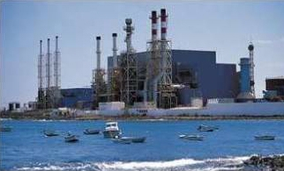
The Aarhus Convention – EU level
Access to justice – major problem: requirement of impairment of rights
Acces to justice
- scope of review
- individual concern - strictly individual economic interests 25/62 (Plaumann).
T-585/93 (Greenpeace): NGOs + locals
T-142/03 (waste management in Belgium)
Only the Commission turns out
to be personaly affected
What about the Charter ? (Art. 42, 47)

Slide 41
The Aarhus Convention – NATIONAL level
Access to information:
- generally wide and non problematic (Aarhus + EU + CJEU case law + national law)
one comperhensive system or 1 general and 1 specific for environmental information
role of national courts
„Any other natural or legal persons having public responsibilities or functions, or providing public services, in relation to the environment…“

Slide 42
The Aarhus Convention – NATIONAL level
Access to information:
- generally wide and non problematic (Aarhus + EU + CJEU case law + national law)
one comperhensive system or 1 general and 1 specific for environmental information
role of national courts
„Any other natural or legal persons having public responsibilities or functions, or providing public services, in relation to the environment…“

Slide 43
The Aarhus Convention – NATIONAL level
Participation in proceedings
EU: only EIA, IPPC (IED) – not all activities listed in AC
National law: specific conditions (in accordance with national legislation or practice)
For example participation fees
- not regulated by AC or EU law
- C-216/05 (Ireland)

Slide 44
Public participation provisions under the EU environmental law
1) Directives explicitly implementing the Aarhus Convention (decision-making)
EIA Directive – environmental impact assessment (construction and other activities)
IED Directive – industiral emmissions (permits for industrial activities)
Seveso III Directive - major accident hazards
2) Directives implementing the Aarhus Convention according to the CJEU (decision-making)
The Habitats Directive (Natura 2000) – assessment of plans and projects: Art. 6(3)
Participation required as a condition for access to justice (C-664/15)
3) Directived focused on participation in the elaboration of plans
SEA Directive, Water Framework Directive, Air Quality Directive, Waste Framework Directive, Environmental Noise Directive

Slide 45
The Aarhus Convention – NATIONAL level
Access to justice – national systems
- No harmonization, but EIA, IPPC + direct effect
Standing for the members of the public (definition of “the members of the public”, standing for individuals, standing for ENGOs and groups, participation as a prerequisite for standing)
The intensity or scope of the review
Costs in the environmental procedure (“not prohibitively expensive”, loser pays principle, experts’ costs, Alternative Dispute Resolution)
Effectiveness of the procedure (Criteria for injunctive relief, Bonds or cross-undertakings in damages, timeliness, malicious or capricious actions )

Slide 46
The Aarhus Convention – NATIONAL level
Access to justice – national systems
- No harmonization, but EIA, IPPC + direct effect
Standing for the members of the public (definition of “the members of the public”, standing for individuals, standing for ENGOs and groups, participation as a prerequisite for standing)
The intensity or scope of the review
Costs in the environmental procedure (“not prohibitively expensive”, loser pays principle, experts’ costs, Alternative Dispute Resolution)
Effectiveness of the procedure (Criteria for injunctive relief, Bonds or cross-undertakings in damages, timeliness, malicious or capricious actions )
http://eur-lex.europa.eu/legal-content/EN/TXT/HTML/?uri=OJ:C:2017:275:FULL&from=EN

Slide 47
Thank you for your attention

