Slide 1
Mootcourt - feedback

Slide 2
Excellent!

Slide 3
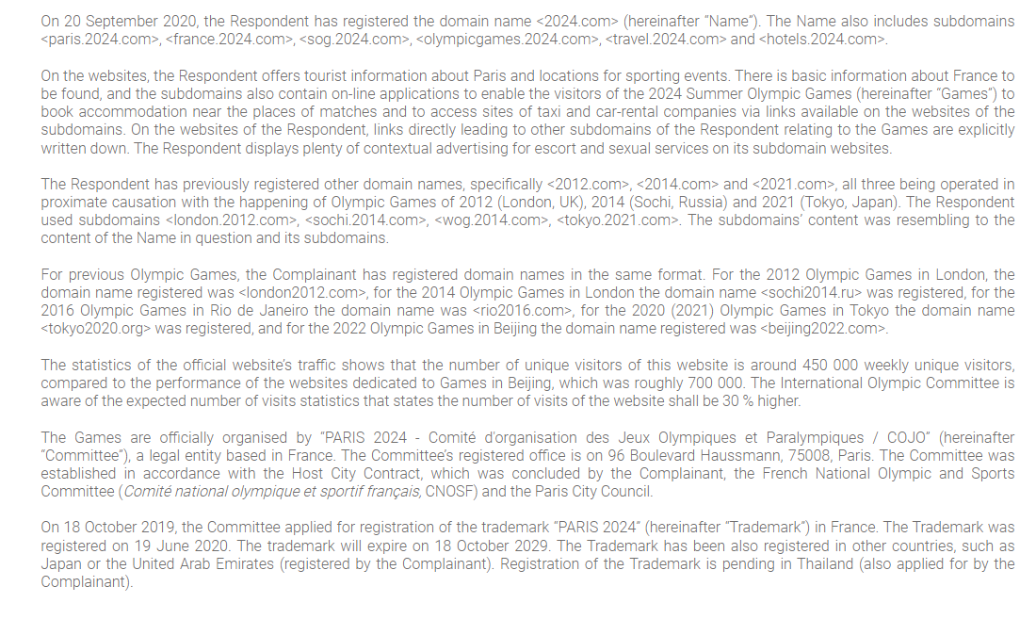
Excellent
Clear
Not too long
Be more specific!

Slide 4
Good use of case law

Slide 5
Bad faith – can be better
More reasoning – UDRP and case law

Slide 6
Response

Slide 7
Good structure
Writing can be improved
The Respondent is prepared to add features and visuals on its subdomain<paris.2024.com> that will link even more prominently to theofficial Games website.

Slide 8
Legitimate interests
Event tourism argument
is used in a convincing way

Slide 9
Bad faith - convincing

Slide 10
Probable outcome:
Dismissed (in UDRP)
Transfer (everywhere else: .eu .cz)

Slide 11
Just dont do IT

Slide 12
Us?

Slide 13
Maybe a little too many

Slide 14
Do you understand what „in detail“ means?

Slide 15
This is good

Slide 16
Response

Slide 17
Good use of case law

Slide 18
Accurate references to UDRP

Slide 19
Excellent!

Slide 20
Probable outcome:
Dismissed

