Slide 2
Buying and selling a website

Slide 3
Legal concept of a domain name

Slide 4
Domain name as a contractual relationship?
Domain name holder
Registrator
Administrator/ Authority

Slide 5
The legal relationship between the Administrator and the Registrar
Administrator
Independent and non-profit institution
Concludes contracts with registrars
Registrar
Entrepreneur
Mediates the assignment of „ domain names “
Concludes contracts with users himself (not an agency)
He has a right to conclude contract with a user, but not an obligation
Under the Czech law, this contract is most similar to a mandate

Slide 6
The legal relationship between the User and the Registrar
Usually a service interconnected with a web-hosting
The duty of Registrar is to register a domain name at Administrator
User has the right to change a Registrar
Cancelling the contract with registrar, does not mean the cancellation of a domain name

Slide 7
The relationship between the User and the Administrator
Administrator has a duty to keep the domain name in his DNS database
Innominate contract
Contract for a limited time period
User has a duty to follow the terms and conditions of the domain

Slide 8
TRANSFERING A DOMAIN NAME

Slide 9
Transferring a domain name
Domain name is a contractual relationship between user and sponsoring organization (administrator) of a domain name
The registration of a domain name is usually mediated by “registrars”

Slide 10
Possible transfers of a domain name
Transfer of a domain name between two users
Individual user switches registrars
Transfer of the domain name between two users,
new holder transferring a domain name to his registrar

Slide 11
Traditional scheme
Administrator
Registrar 1
Registrar 2
Registrar 3
User

Slide 12
User switches registrar
Administrator
Registrar 1
Registrar 2
Registrar 3
User

Slide 13
User switches registrar
User gives authorization to a new registrar
New registrar (Gaining registrar) contacts former registrar (Registrar of Record)
Administrator (Registry operator) updates record in the DNS server

Slide 14
The Registrar may deny a transfer request only in case of:
Evidence of fraud
UDRP action
Court order by a court of competent jurisdiction
Reasonable dispute over the identity of the Registered Name Holder
No payment for previous registration period
Express written objection to the transfer from the Transfer Contact
A domain name is in the first 60 days of an initial registration period.
A domain name is 60 days after being transferred

Slide 15
Scenario 2:
User transfers a domain name to a new user

Slide 16
User transfers a domain name to a new user
Administrator
Registrar 1
Registrar 2
Registrar 3
USER
BUYER

Slide 17
User transfers a domain name to a new user
Buyer and Seller conclude a contract
Buyer notifies his registrar
Registrar notifies Administrator
Eligibility check
Administrator updates DNS record

Slide 18
Practical part of transfering domain name
How do you find who owns the domain?
How do you conclude a contract?

Slide 19
Searching for an owner
WHOIS database
„WHO IS?“
  service of administrator

Slide 20
Step 2 – Making a contract

Slide 21
Contracting Excercise I.
Your Client, the company Meta Platforms, wants to invest into the Czech website fb.cz.
It desires to use website for completely different purpose, but wants to make transfer of the domain name sensitively, due to its content.
FB would like to use the services of KRAXNET s.r.o. as his registrar.

Slide 22
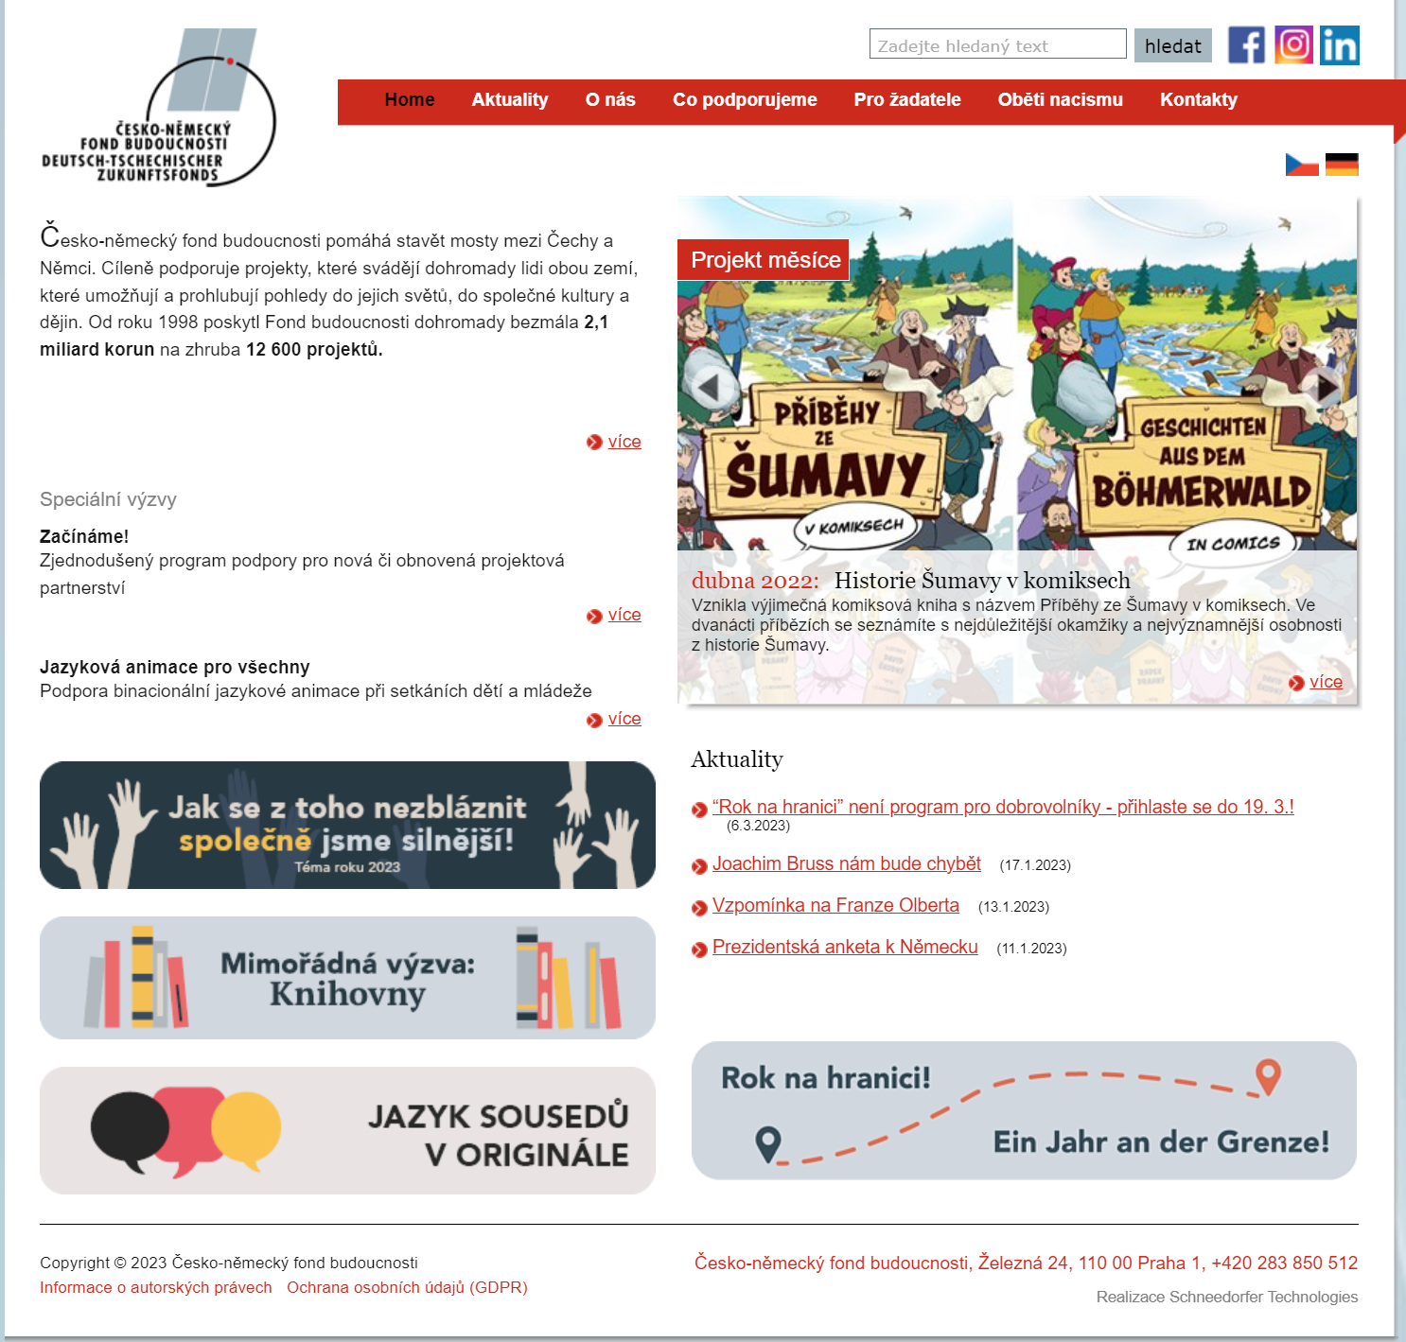

Slide 23
Areas of contract
Identify parties
  Must be eligible
Identify domain name(s) (possible alterations)
Identify the duty of the seller
  Give a written request to the registrar/administratior of the domain name
Idenfy obligations of the buyer
  Pay the price
  Information duty etc.

Slide 24
Vocabulary
Eligibility
Escrow
Installment
Idemnify and hold harmless
Right of withdrawal

Slide 25
Structure of the contract
Parties
Introductory notes
Transfer of the domain name
Transfer of other rights
Intellectual property claims
Payment provisions
Other provisions
Concluding provisions

Slide 26
Other Important issues
Copyright issues
Data protection issues
Content issues

Slide 27
Intellectual property of a website
(Web) Design rights
Trademarks
Software licenses e.g. (editing system)
Copyrighted content (pictures, movies, sounds)

Slide 28
Problem
Intellectual property is a RIGHT not property
Cannot be “sold” to a third party without the consent of licensor
Even if the seller has all the IP rights, he cannot transfer them - only license

Slide 29
Data protection issues
User databases
  Personal data (e-mails, names, familily status)
  Sensitive personal data
Privacy and personal right issues
  Emails, communication records, history of transactions
  Pictures

Slide 30
Other Issues
In case the site offers service/goods –
  Orders
  Performance of contracts
  Goods „on store“
  Logistics (delivery systems)

Slide 31
Discussion points

Slide 32

Thank you

