Slide 1
Other types of ADR regarding domain names and ODR
Pavel Loutocký

Slide 2
URS & PDDRP
URS = Uniform Radpid Suspension (https://www.worldtrademarkreview.com/brand-management/urs-procedure-what-it-and-what-it-does)
PDDRP = Trademark Post Delegation Dispute Resolution Procedure (https://icannwiki.org/Trademark_Post-Delegation_Dispute_Resolution_Procedure)
2

Slide 3
What is ODR
Definitions:
  dispute settlement which may or may not involve a binding decision being made by a third party, implying the use of online technologies to facilitate the resolution of disputes between the parties
3 aspects:
  dispute settlement
  distant exchange of information
  software assistance
3

Slide 4
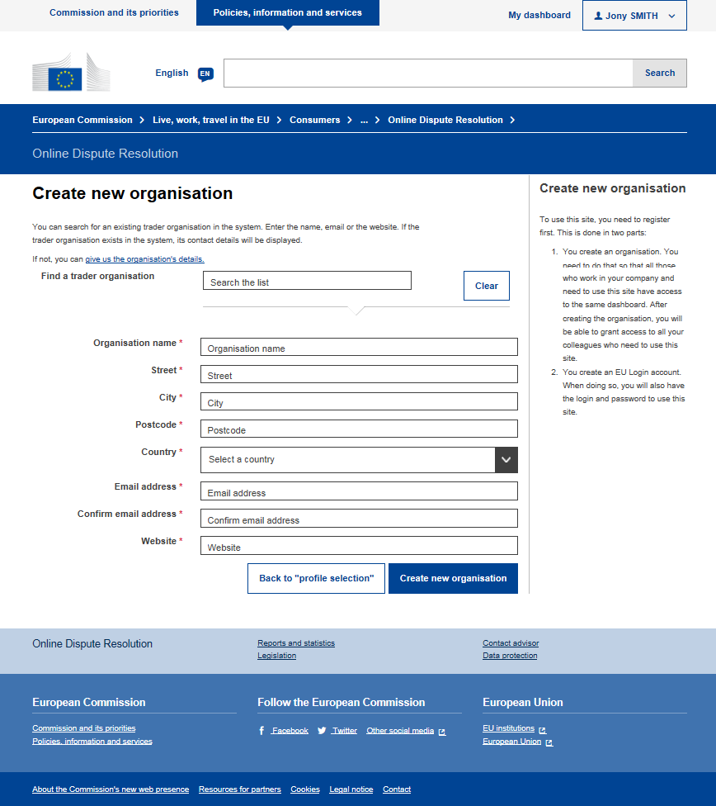
Out-of-court ODR examples & parameter analysis
4

Slide 5
8 parametrs of efficient ODR system
The scope of the disputes where ODR is used
The position of the ODR provider
The use of modern technologies
The use of direct or indirect private enforcement mechanisms
Existence of other dispute resolution provider
Legal regulation
The tradition in alternative dispute resolution
The transparency
5

Slide 6
3 case studies
EU Consumer ODR
UDRP (domain name dispute resoution)
eBay & PayPal
6

Slide 7
1. EU Consumer ODR
Directive 2013/11/EU of the European Parliament and of the Council of 21 May 2013 on alternative dispute resolution for consumer disputes and amending Regulation (EC) No 2006/2004 and Directive 2009/22/EC
  The directive should ensure that consumers can turn to quality alternative dispute resolution entities for all kinds of contractual disputes
  It doesn‘t matter, what they purchased (excluding disputes regarding health and higher education) and whether they purchased it online or offline, domestically or across borders
  It does not apply to traders’ complaints against consumers (such as claims for payment) or to trader-to-trader complaints
7
7

Slide 8
1. EU Consumer ODR
  Regulation (EU) No 524/2013 of the European Parliament and of the Council of 21 May 2013 on online dispute resolution for consumer disputes and amending Regulation (EC) No 2006/2004 and Directive 2009/22/EC
  The regulation is setting up EU-wide online platform
  For the disputes that arise from online transactions
  The platform will link all the national alternative dispute resolution entities and will operate in all official EU languages
  Establishment of a free, interactive website through which parties can initiate ODR in relation to disputes concerning online transactions (offline transactions are excluded)
  National ADR entities will receive the complaint electronically and seek to resolve the dispute through ADR, using the ODR platform exclusively if they wish
8
8

Slide 9
1. EU Consumer ODR
CONSUMER DISPUTES IN THE SINGLE MARKET
Submission of a complaint
(ODR Reg. Art. 7)
Defines information of complaint form
Complainant accesses platform’s website
Processing of a complaint
(ODR Reg. Art. 8)
ODR Platform
All ADR entities electronically registered with platform
Information on ADR entities
Complaint form in all EU languages
Put in contact the parties
Proposes 1/+ competent ADR entities
Network of ODR facilitators
Transmission of a complaint
(ODR Reg. Art. 8)
If agreement by parties,
automatic transmission of complaint
ADR Entities
ADR entity apply its own RoP
Dispute resolution within 30 days
(ODR Reg. Art. 9(b) )
Resolution of the consumer dispute
9

Slide 10
1. EU Consumer ODR
Problems? There are some..
  Missing presence of online negotiation under ODR platform
  Misleading reference to the use of ODR platform
  Language issues
  Forum shopping
10
10

Slide 11
1. EU Consumer ODR
More problems?
  Unsatisfactory legal basis of ADR and ODR regime in EU
  General issues relating to the functionality of the ODR platform
  The absence of evaluation and incentive for the parties to settle dispute
  Non-existing interconnection of the ODR with the small claims procedure
Attempt to offer quick and easy solution to the consumers (did it fail?)
11
11

Slide 12
1. EU Consumer ODR
1. the scope of the disputes where ODR is used
  online consumer disputes (goods & services)
  quite broad
2. the position of the ODR provider
  ODR platform is only clearing house
  in fact no dispute settlement
  dispute settlement is left to the ADR entities
3. the use of modern technologies
  very limited
  only exchange of information, no other processing
4. the use of direct or indirect private enforcement mechanisms
  no use of enforcement mechanisms
  it is NOT supporting the position of the ODR platform
12

Slide 13
1. EU Consumer ODR
5. existence of other dispute resolution provider
  many other consumer schemes
  overlapping with other possibilities
6. legal regulation
  very complicated regulation
  confusing for consumers
7. the tradition in alternative dispute resolution
  building on previous experience
8. the transparency
  No possibility to verify
RESULT: NOT WORKING SCHEME
13

Slide 14
2. UDRP
1. the scope of the disputes where ODR is used
  domain name disputes
  very limited
2. the position of the ODR provider
  very strong
  ICANN (national authorities) are controlling the CODE (infrastructure)
3. the use of modern technologies
  full possibilites of online communication
  online form to exchange the information
4. the use of direct or indirect private enforcement mechanisms
  ICANN (national authorities) are controlling the CODE
  non-binding arbitration
14

Slide 15
2. UDRP
5. existence of other dispute resolution provider
  N/A
6. legal regulation
  transparent rules
  national legal regulation only very broad and distant
7. the tradition in alternative dispute resolution
  N/A
8. the transparency
  Rules, decisions, guidelines available
RESULT: VERY EFFICIENT SCHEME
15

Slide 16
3. eBay & PayPal
1. the scope of the disputes where ODR is used
  e-commerce online disputes under eBay platform
  quite broad
2. the position of the ODR provider
  very strong (PayPal does the disputes)
  controlling the behaviour
3. the use of modern technologies
  full possibilites of online communication
  automatization of decision making process
4. the use of direct or indirect private enforcement mechanisms
  Reputation mechanisms (indirect private enforcement)
  modified escrow (direct private enforcement)
16

Slide 17
3. eBay & PayPal
5. existence of other dispute resolution provider
  N/A (not used by other platforms in such broad meaning, others are using only limited potential)
6. legal regulation
  Not transparent & complicated rules
  national legal regulation only very broad and distant
7. the tradition in alternative dispute resolution
  N/A
8. the transparency
  Problematic rules
  Decisions or guidelines NOT available
RESULT: VERY EFFICIENT SCHEME
17

Slide 18
Results?
the scope of the disputes where ODR is used
  does not matter
the position of the ODR provider
  strong position is important
the use of modern technologies
  broad implementation of IT is necessary (automatization as well)
the use of direct or indirect private enforcement mechanisms
  crucial for effectiveness and success

Slide 19
Results?
existence of other dispute resolution provider
  should NOT be overlapping
legal regulation
  should NOT be limiting and complicated
the tradition in alternative dispute resolution
  NOT important
the transparency
  SURPRISE – NOT important

Slide 20
Online courts
Online court X ODR
  ODR – online dispute resolution – tools for settling the disputes (court and out-of-court)
  Online court – institution providing the opportunity to resolve disputes using online tools shielded by the public power
Incorporation of modern technologies:
  Communication
  Data processing (file management, big data, open data?)
  Redesign of current court processes
  New approaches unknown to current justice (e.g. blind bidding) or facilitation

Slide 21
Important to realize!
Inclusion of out-of-court settlements
Negotiation / mediation / software assistance in pre-trial proceedings
Possibility of transition to classical court proceedings
The whole process is shielded by binding decision-making process (in the case of out-of-court ODR, there was often a problem with the motivation of the parties, unless enforcement mechanisms were set up)
Dworkin - easy X hard cases

Slide 22
State of eJustice in Czechia
An exemplary example of an inappropriate grasp of the electronic justice system
The inconceivability of the approach to the whole issue is evident from the individual fragmented strategies
Electronization not mentioned as a separate goal
One of the worst countries in EU (eGovernment Benchmark 2017)
OECD statistics – better, but general categories (not mentioning more sophisticated implementation)
eFile management system is trying to be complexly presented more than 10 years without greater achievement (fragmentation, different systems, different providers)
But in the moment, strong push on digitalization in general in eGovernment (Act on Digital Services)

Slide 23
Lessons to be learnt
Theoretically - Richard Susskind
  3 Tiers
Practically e.g. Civil Resolution Tribunal (Canada)
  Negotiation / software assistance
  Mediation (mediator) or facilitation (clerk, facilitator)
  Online court proceedings
The area of disputes is usually limited to civil disputes (but this is not the rule); but it is certainly not limited only to online disputes

Slide 24
Examples of online courts?

Slide 25
1. Full (Total) Approach to Online Justice
Singapore
Total approach to dispute resolution and justice
It is more about full eJustice than the introduction of a specialized court
Singaporean specifics - trading state, autoritorial state establishment
for civil disputes it is the Integrated Electronic Litigation System (eLitigation), for criminal disputes it is the Integrated Criminal Case Filing and Management System

Slide 26
2. Specialized Online Courts to Offer Binding Decision
Hanghzou Internet Court (2017); Beijing Internet Court and Guangzhou Internet Court (2018)
they specialize primarily in disputes arising in the online environment
the main principle is to review online cases using online tools in order to effectively resolve disputes related to modern technologies
e-commerce (validity of contracts, liability for provided goods or services), disputes arising from copyright infringement on the Internet, disputes over the violation of personal rights or disputes over domain names
court proceedings enabling the mediation phase, electronic document management, the possibility to appeal online to a second instance court

Slide 27
3. Interconnection of Binding and Non-Binding Decision-Making Process
Civil Resolution Tribunal in Canada
https://civilresolutionbc.ca/how-the-crt-works/getting-started/
Introductory phase
Negotiation phase
Third party participation phase (mediation)
Binding dispute resolution
Decisions: https://decisions.civilresolutionbc.ca/crt/crtd/en/nav_date.do
Statistics: https://civilresolutionbc.ca/tag/data/ ; CRT-Annual-Report-2019-2020.pdf (civilresolutionbc.ca)

Slide 28
3. Interconnection of Binding and Non-Binding Decision-Making Process
for the annual period ending March 31, 2017, a total of 5,505 disputes were initiated (respectively, they were initiated at least at the Solution Explorer level), as of March 31, 2020 (again for the annual period), 54,680 disputes were initiated at this level
Within the next stages (from Phase II of negotiations), a total of 49 disputes were resolved in the above mentioned period in 2017, in the period in 2020 a total of 6,079 disputes were resolved
For the above-mentioned period in 2017, 13 disputes were finally resolved within the binding decision-making, for the period in 2020, a total of 1,274 disputes were resolved in binding phase
28

Slide 29
3. Interconnection of Binding and Non-Binding Decision-Making Process
UK Online Court
Very similar to the Civil Resolution Tribunal
Not yet functional (year 2023?), preparations have been going on for a long time (approx. 2015)
It should combine existing limited solutions in UK
Additional year to deliver ambitious court reforms - GOV.UK (www.gov.uk)
29

Slide 30
A Way Forward?
Specialized institution not connected fully to whole eJustice
May and should offer inspiration to eJustice
Rethinking the design of judiciary and access to justice
Simplifying the proces
Extension of classical decision-making proces (bonus), not its replacement!

Slide 31
A Way Forward? – multi step process
Education
Concretization of the Procedure before the Initiation of the Dispute
Initiating the dispute
Negotiation
Mediation
Binding Dispute resolution

Slide 32
Project of Online Court in Czechia
Not a rocket science – inspiration in Canada:
  85% of cases are solved in pre-binding (out-of-court) stages at online court
In the Czech Republic, a similar construction, involvement within one specific judicial institution – e.g. the Municipal Court in Prague?

Slide 33
Project of Online Court in Czechia
Multi-stage process (education, negotiation, software assistance, mediation / facilitation, court decision)
The need for sufficiently long preparation, otherwise there are a number of risks
Specialized institution partly cut off from classical court processes (and offered as something extra) is the KEY (in our opinion)
It is not possible to penetrate whole justice with this process model

Slide 34
Problems
Classical challenges
  Resistance
  Constancy
  Fragmentation of systems (different providers, different systems)
  Unwillingness to change something, pessimistic staff, etc.
More complex challenges
  Wider use of modern technologies (more complex tools, automatization)
  Open data
  Problems associated with modern technologies in automation (transparency issues, human rights)
  etc.
EU regime (ODR platform) is really NOT the inspiration

Slide 35
Conclusion
All the problems can be overcome
Many arguments are faulty and arising from the unwillingness to changes (judge Briggs, legal realism etc.)
Necessary reaction to nowadays challenges
No replacement of „classical“ approaches -> upgrade and utilization of the tools we already know (private ODR mechanisms)
etc.

Slide 36
Tank you for your attention.
Any questions?
loutocky@muni.cz

