Slide 1
EEA LAW VIII.
Bail IN

Slide 2
The backround
The fundamental idea behind a bail-in is to pre-package and accelerate the insolvency process so that it can take place over a weekend to prevent financial shocks. By Monday morning, a wobbly bank can again be a viable institution, now owned by former creditors.

Slide 3
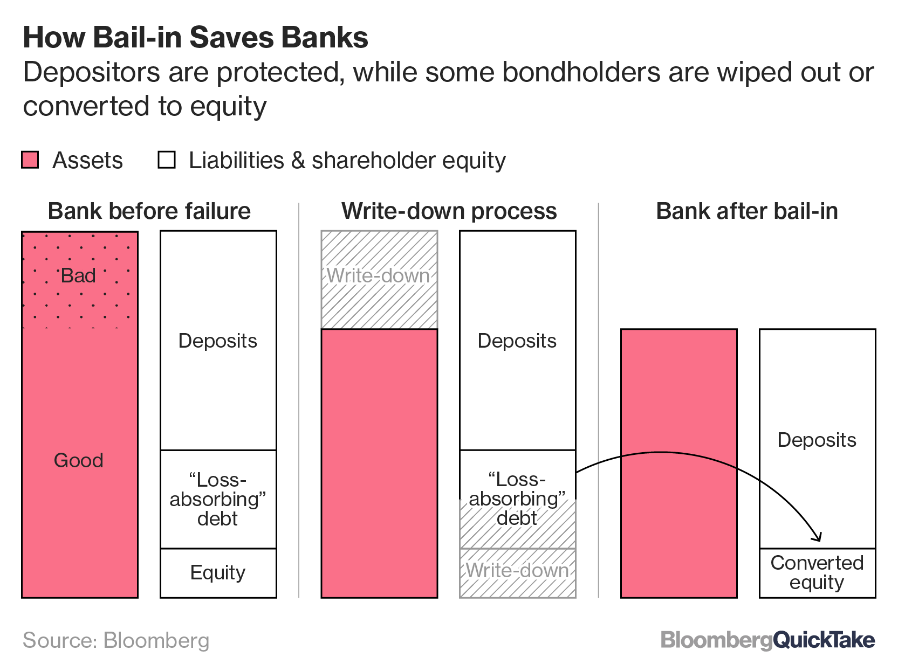
How does it work

Slide 4
What If there are not enough „non covered deposits“
Covered
deposits
Non covered
deposits
Good assets

Slide 5
