Slide 1
Administrative Procedural Law
Legal Guarantees in Public Administration (Judicial Review, Ombudsman)
Lecture 3: 15th April 2024
SOC003: Public Administration in the Czech Republic
dr. Tomáš Svoboda

Slide 2
Lecture 4: 15th April 2024
1/ System of (Czech) Administrative Law
  For context of the lecture
2/ Legal regulation of administrative procedure
  Administrative Procedural Law
  Administrative procedure in CAP
  Decisions and other procedural forms
3/ Legal Guarantees in Public Administration
  Principle of legality and other basic principles
  Administrative Justice in the Czech Republic
  Ombudsman institution in the Czech Republic

Slide 3
1/ System of (Czech) Administrative Law
Function of Public Administration in the society
  To achieve public goals and to protect public interest
  It is generally based on (intentional) activity
  Possibility of using public power
Administrative Law („Správní právo“)
  The biggest (and also important) branch/part of law/legal system (of each „legal“ / „administrative“ state); part of public law
  Regulates relations in Public Administration
    a) its organization (at different levels) and
    b) its functions/activities
  Where is the place of Administrative Procedural Law?

Slide 4
1/ System of (Czech) Administrative Law
First possible classification:
Administrative Law
General part
What is common: general rules, institutes, organization, sources of legal regulation, forms of activity, liability, control of public administration, etc., also different procedural aspects of conducting public administration
Special part
Legal regulation of different „branches“ of public administration and administrative law – „building law“, „healthcare law“, „education law“, „cultural law“, „police law“, „refugee law“, law of electronic communication, expropriation, etc. (hundreds of laws and other norms, also law of the EU)

Slide 5
1/ System of (Czech) Administrative Law
Second possible classification:
Administrative Law
Organizational Administrative Law
Procedural Administrative Law
Substantive Administrative Law
Administrative Punishment Law/Criminal Administrative Law
„Who“ – legal regulation of organization of public administration – state administration (central, regional, local), self government,…
„How“ – different procedural aspects of administrative law, procedural forms of activity, also (subsequent) judicial control – administrative justice
„What“ – rights and duties at different branches of public administration
„What will happen if the regulation is violated“; it contains all features of organization, procedural and substantive administrative law

Slide 6
1/ System of (Czech) Administrative Law
Administrative Procedural Law
  = Procedural part of Administrative Law
  Consists of different procedures that can be found in public administration
  Emphasis on protection of (individual) rights and freedoms
  Generally regulated in…
  Code of Administrative Procedure (Act no. 500/2004 Coll.) – „CAP“
  Code of Administrative Justice (Act no. 150/2002 Coll.) – „CAJ“

Slide 7
1/ System of (Czech) Administrative Law
What does CAP regulate?
  Art. 1 section 1 of act nr. 500/2004 Coll., Code of Administrative Procedure
    „This Act regulates the procedure of executive bodies, bodies of territorial self-governing units and other bodies, legal and natural persons, if they exercise competence in the field of public administration (hereinafter referred to as "administrative body").“
  Public administration is a system of different administrative bodies
  And system of their functions and forms
    See schemes further
  But CAP does not regulate the area of public administration which does not exercise any public authority (public power)
    Providing of public services, public property management etc. – there are also legal rules, but special ones (generally based on modifications of private law)

Slide 8
1/ System of (Czech) Administrative Law
State administration
Self government
Public administration
State administration belongs to the state:
  important part of public administration, different task of the state are performed by the state and its bodies („direct state administration“),
  but also „indirectly“ by other bodies that are not part of the state administration („indirect/ transferred state administration“) – on a legal basis bodies of territorial self-government are performing state administration duties („mixed model of state administration“)
Self-government includes local, regional and also „university/ interest and professional“ self-government

Slide 9
1/ System of (Czech) Administrative Law
Government and ministries (14) (and other central administrative bodies – 17: 1. Czech Statistical Office, 2. Czech Office for Surveying, Mapping and Cadaster, 3. Czech Mining Authority, 4. Industrial Property Office, 5. Office for the Protection of Competition, 6. Administration of State Material Reserves, 7. State Office for Nuclear Safety, 8. National Security Authority, 9. Energy Regulatory Office, 10. Office of the Government of the Czech Republic, 11. Czech Telecommunication Office, 12. Office for Personal Data Protection, 13. The Council for Radio and Television Broadcasting, 14. Office for the Supervision of the Management of Political Parties and Political Movements; 15. Office for Access to Transport Infrastructure, 16. National Office for Cyber and Information Security, 17. National Sports Agency and „independent“ bodies as Czech National Bank or Supreme Control Office
State administrative bodies with the whole state/national scope: National Heritage Institute, Czech Social Security Administration, Labor Office, State Labor Inspection Office, Civil Aviation Office, General Financial Directorate, Specialized Tax Office, Railway Authority, Office for International Legal Protection of Children, State Institute for Drug Control, National Accreditation Office
Local Specialized bodies: Tax offices (14), regional sanitary stations (14), regional military headquarters (14), district social security administration (84), district mining offices (8), cadastral offices, inspectorates (84)
Indirect state administration performed by the bodies of regions and municipalities

Slide 10
2/ Legal regulation of administrative procedure
Sources of regulation
  In general CAP (art. 1 sec. 2) – „This Act or its individual provisions shall apply unless a special law provides otherwise.“
  But also in various special laws (special procedural regulations – about 300 laws)
    Special regulation of Building proceedings under Building Act etc.
    Various modifications of CAP procedure
CAP
  about 180 provisions, in effect since 2006
  can be excluded by lex specialis, but its not possible to exclude CAP without special regulation in place
  Regulates also basic principles of administrative bodies activities (art. 2 – 8 CAP)
    Those are legal principles (are legally binding for authorities), many of them are principles of good administration in nature

Slide 11
2/ Legal regulation of administrative procedure
Administrative procedure in CAP
  Is one of the procedural forms (not the only one), that are regulated by CAP
    CAP ≠ administrative procedure, but CAP ≥ administrative procedure
  Regulation for issuing administrative decisions
  Is important part of public administration
    The decision enables/permits/constitutes new right (e.g. to study, to build, to do business, to drive, grant social benefit, authorization…), but also constitutes duties (e.g. to pay a fine); sometimes is the decision is in the beginning, sometimes it follows what happened (administrative offence)
  Needs to have its participants, who have different rights and duties among the procedure; these are also addressee of the final decision
  If started, should be ended with a decision (but usually takes some time, but should be reasonable time) – if not administrative silence/inactivity
  Can be reviewed by superior administrative bodies and later by the administrative courts

Slide 12
2/ Legal regulation of administrative procedure
Administrative procedure in CAP
  The proceedings are conducted by a competent administrative body and authorized public officials
  The participants have the right to propose and demand and many other procedural rights
    Make proposals/demands/objections
    To comment, explanate
    Access to the files…
  Various activities of the administrative body before, during and after the proceedings
    Some pre-litigation procedures, oral hearing during the proceedings, appellate proceedings etc.
  Initiation of proceedings – upon request or ex officio
  Written form is dominating, but also oral hearings (but written protocol)
  An administrative file is established and maintained in each case

Slide 13
2/ Legal regulation of administrative procedure
Administrative decision
  Specifying the rights and duties for a given case and circumstances (act of application of law), creates decision-making practice – binding in the future
  “Parts”
    Statement
    Justifications/reasoning
    Information about remedies
  Review
  Principle of two instances – common principle of the administrative law (in the Czech law not constitutionally guarantied but generally respected)
    Appeal = ordinary form of remedy against a decision
    Remonstrance = special form of appeal against decisions of ministries or other central administrative bodies
  Some other “extraordinary remedies” (but more protection of legality than individual rights)
  Administrative justice (see further)

Slide 14
2/ Legal regulation of administrative procedure
Not only decisions…
  Other forms of public administrative activities regulated by law
    Outcome/result of public administration activity; several forms (due to complexity of public tasks and goals)
    Shows in which ways/forms is the public administration realized and applicated
    Presents scope of administrative and judicial protection
  See scheme further…
    (But its not required to memorize the details of the scheme as it is meant only for basic orientation in categorization of forms and scope of CAP)

Slide 15
2/ Legal regulation of administrative procedure
Forms of public administration activity (theory) |  | Where is it regulated (CAP) | Form of protection (CAP)
Administrative acts | Normative administrative acts | Not provided for; however, the CAP shall be applied at least in the scope of its basic principles contained in Part one (Sections 2 to 8 CAP) | No provisions
 | Individual administrative acts | 1) Administrative decisions – Parts two and three (Section 9 to 153 CAP) 2) So-called other acts – Part four (Sections 154 to 158 CAP) | 1) Remedial measures (ordinary and extraordinary, Sections 81 to 100 CAP) 2) Ex-officio revision and the form of so-called review proceedings (Section 156 CAP)
 | Mixed administrative acts | Acts of a general measure – Part six (Sections 171 to 174 CAP) | Ex-officio form of so-called review procedure (Section 174 par. 1 CAP)
Public law contracts |  | Part five (Sections 159 to 170 CAP) | Ex/officio form of so-called review procedure (Section 165 CAP)
Factual act and immediate interventions |  | No provisions; however, the CAP shall be applied at least in the scope of its basic principles contained in Part one (Sections 2 to 8 CAP) | No provisions
15

Slide 16
3/ Legal Guarantees in Public Administration
Principle of legality
  Constitution, Charter of Fundamental Rights and Freedoms, CAP…
  Legal guarantees = different measures that enable and ensure legality in public administration
  Important role of the control of public administration
    Internal – by PA itself
    External – by other state bodies (courts, ombudsman, etc.) or citizens (right to information, petitions etc.)
  How can we know if the state is democratic and legal?
  Adolf Merkl (Austrian legal scholar) wrote in the 1930’s that such state recognizes:
    Principle of legality, rule of law
    Existence of self-government and
    Judicial control of public administration – administrative justice
  Example: In the Czechoslovakia from 1948 to 1989 (under so-called communist era) these requirements were systematically undermined and more or less destroyed

Slide 17
3/ Legal Guarantees in Public Administration
General rules/principles of public administration activity
  In Constitution (Act no. 1/1993 Coll. – principle of legality, legal basis for the establishment of authorities, government regulation, etc.
  Charter of Fundamental Rights and Freedoms (Act no. 2/1993 Coll.) – right for a fair trial (art. 36 sec. 1) and judicial protection (art. 36 sec. 2) + many other fundamental rights and freedoms (free speech, voting, right to property, education, healthcare etc.)
  European Convention on Protection of Rights and Freedoms – existence of judicial protection + guarantees of many other fundamental rights and freedoms
  CAP – basic principles, focused on a concept of good administration (Art. 2-8): legality, proportionality, protection of good will, legitimate expectations, public service, alternative solutions, speed and economy, minimalization of interventions, equality, cooperation – legally binding for the administrative bodies
  Soft law: Council of Europe – https://rm.coe.int/16807096b9

Slide 18
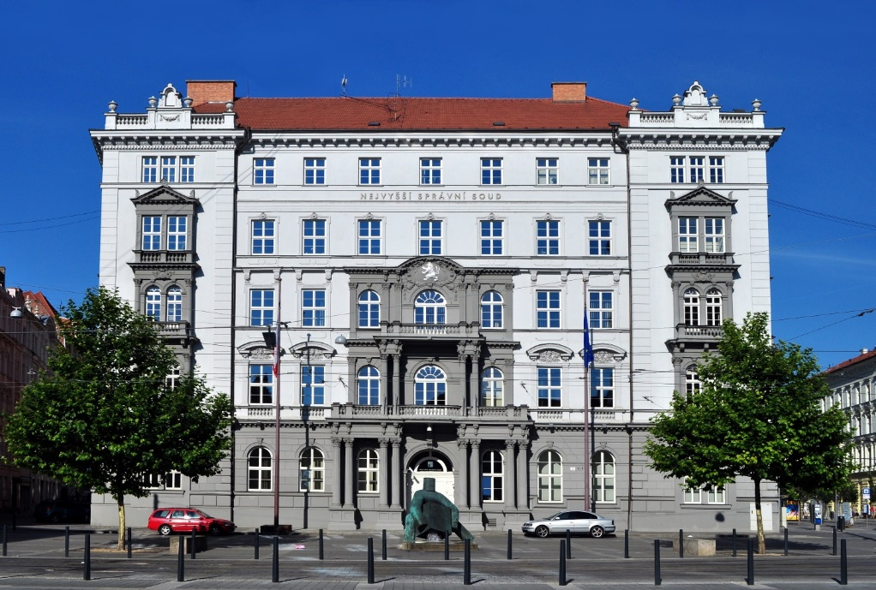
3/ Legal Guarantees in Public Administration
Administrative Justice in the Czech Republic
  Roots in Austrian administrative law
    1867 and 1876 in Austrian Empire – Code of Administrative Justice (Act No. 36/1876 Coll.)
    Act No. 3/1918 Coll. – Code of Administrative Justice
  During the communist era generally dysfunctional
  Restoration in 1992, reform in 2003
  Now regulated in Code of Administrative Justice (Act no. 150/2002 Coll.) – „CAJ“
  New system – possibility to take an action against:
    Decisions, inactivity, factual acts, acts of general measure
    = Wide scope of judicial protection
  Supreme Administrative Court (Brno --->)
  + 8 regional administrative courts

Slide 19
3/ Legal Guarantees in Public Administration
Administrative Justice in the Czech Republic
  Administrative Justice and „Code of Administrative Justice is by its nature a “defensive” act. It is not a “control” standard that would allow anyone to initiate, by bringing an action in the administrative justice, to control any act of the public administration. It is only intended to ensure legal protection in cases where public administration enters into the legal sphere of natural or legal persons. The limitation criterion for prominence is the alleged interference with public subjective rights. Not all the activity (or any misconduct) of public administration is subjected to judicial control …., but only when the activity of the administration exceeds their public subjective rights. "
  Supreme Administrative Court (8 As 47/2005, 1764/2009 Coll., SAC)

Slide 20
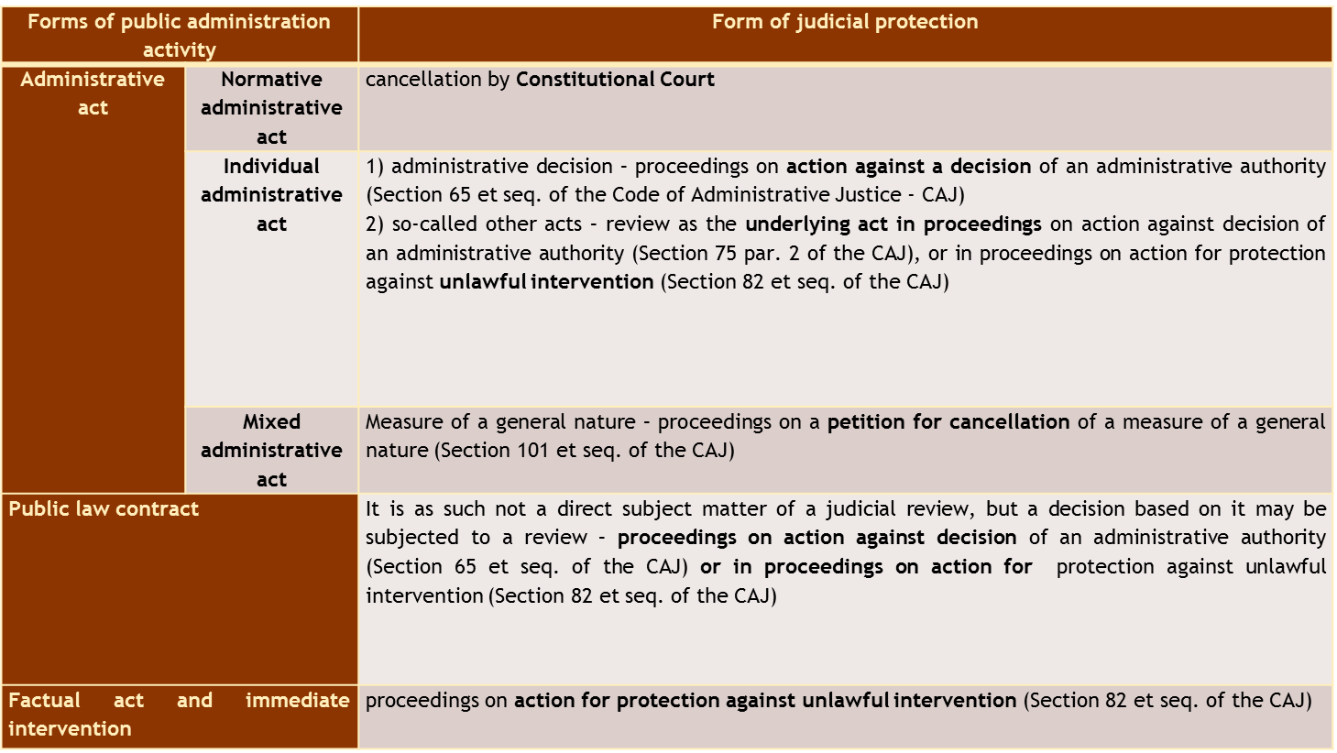
3/ Legal Guarantees in Public Administration
Administrative Justice in the Czech Republic
20

Slide 21
3/ Legal Guarantees in Public Administration
Ombudsman institution in the Czech Republic
  Established in 2000, Act no. 349/1999 Coll., seated in Brno
  One universal institution, considered as a body of Parliament (of Chamber of Deputies)
  „Public Defender of Rights“ - https://www.ochrance.cz/en/
  One representative of the institution + one deputy (and administrative office)
  Ordinary aspects of this type of institution (Ombudsperson)
    Protects citizens against state bureaucracy
    Nonformal, accessible, fast
    Cannot decide, instead using its nonformal authority to persuade administrative bodies to follow its findings
    Autonomous on the executive power (elected by the Chamber of Deputies)
    Gather complains and informs executive power
  Primary and secondary (added later) competences

Slide 22
3/ Legal Guarantees in Public Administration
Ombudsman (Ombudsperson) institution
  Primary competences
    Protects citizens against the conduct of authorities and other institutions if the conduct is against the law, does not correspond to the principles of a democratic legal state and the principles of good administration, or the authorities are inactive.
    Controls most state authorities
    Special emphasis on the use of principles of good administration
  Secondary competences
    Mainly…
    He/she also carries out preventive systematic visits to places where people are restricted in their freedom and seeks to ensure that their rights are respected. The Defender also contributes to promotion of the right to equal treatment and protection against discrimination and also systematically deals with the rights of the people with disabilities.
    And some other competences (e.g. public interest litigation)

Slide 23
Administrative Procedural Law
Legal Guarantees in Public Administration (Judicial Review, Ombudsman)
Questions?
Thank you for your attention

