Slide 1
BASICS OF THE EU ENVIRONMENTAL LAW
SOURCES OF LAW, SYSTEM OF ENVIRONMENTAL REGULATION AND RELATION TO OTHER EU POLICIES, ENVIRONMENTAL LAW PRINCIPLES
Spring 2024
JUDr. Vojtěch Vomáčka, Ph.D., LL.M.

Slide 2
This lecture:
Aims of EU environmental policy:
High level of protection
Integration
Sustainable development
(Public participation)
Environmental principles (in narrow sense):
Prevention
Precautionary principle
Polluter pays
Rectification at source
Harmonization of environmental requirements
EU law transposition and implementation
The role of national courts and the role of CJEU

Slide 3
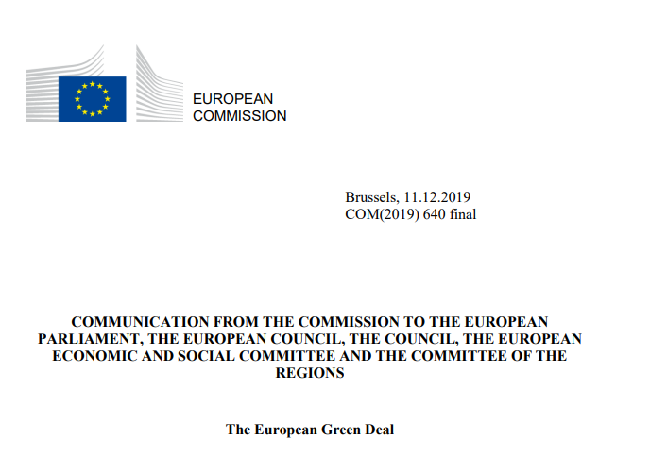

Slide 4
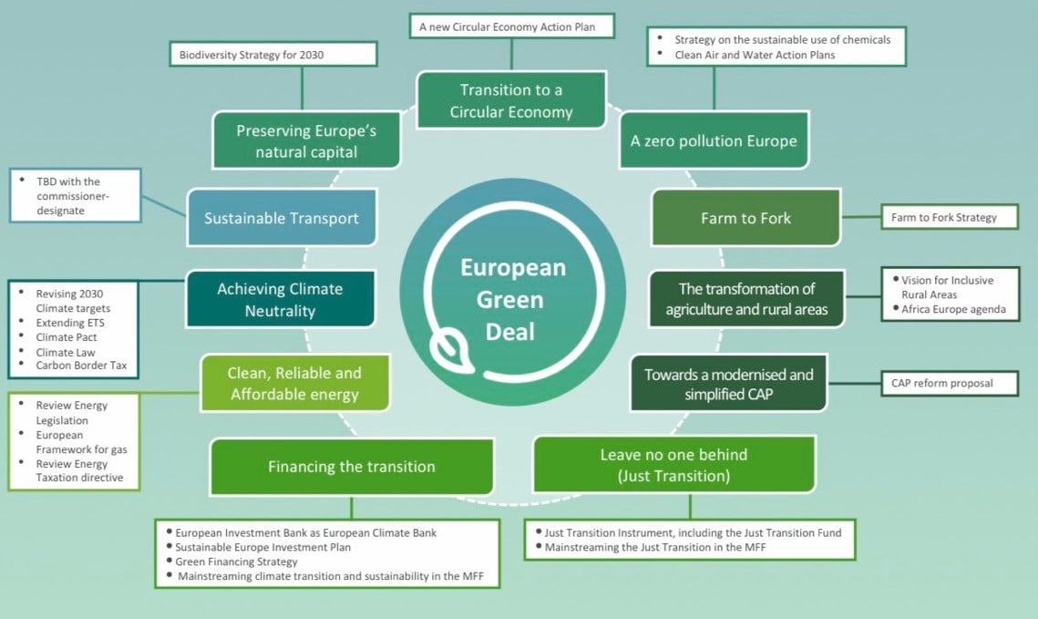

Slide 6
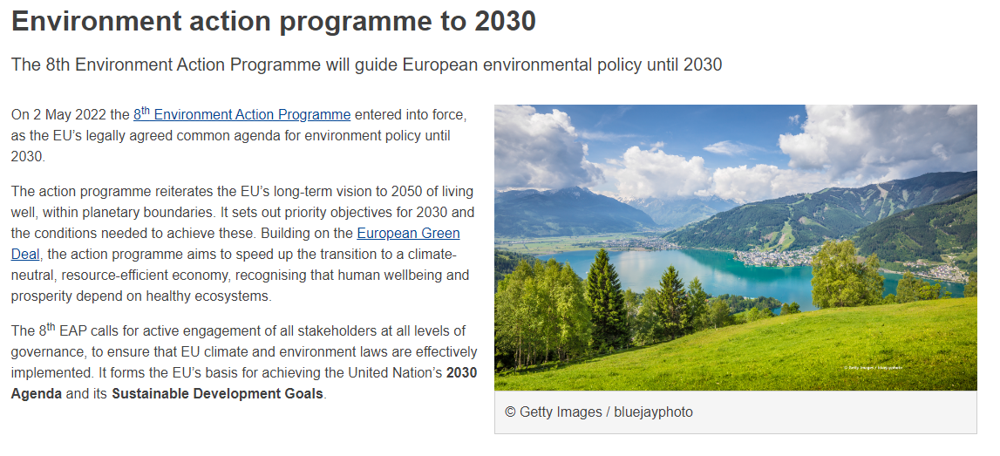

Slide 7
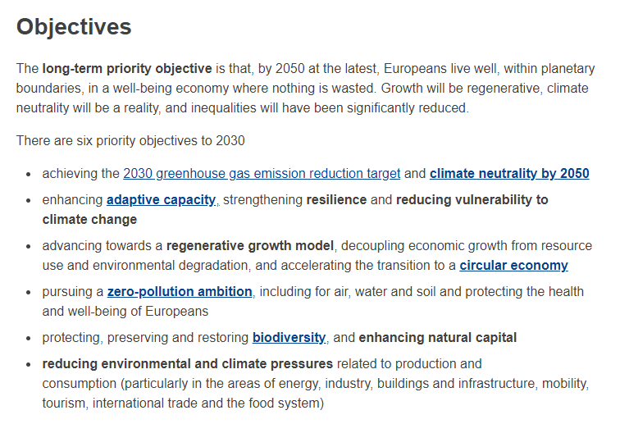

Slide 8
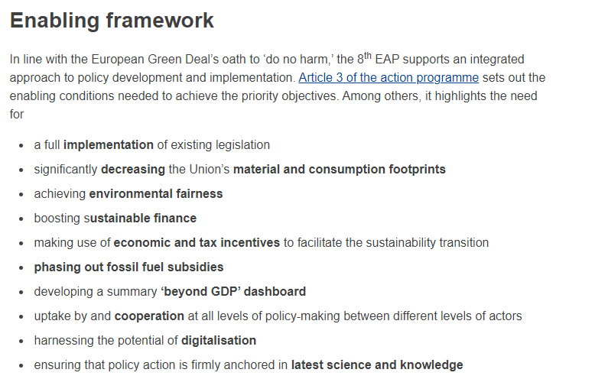

Slide 9
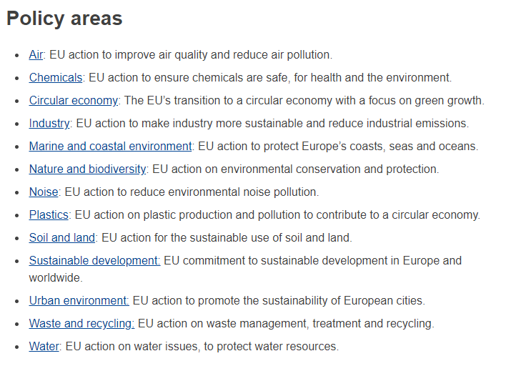

Slide 10
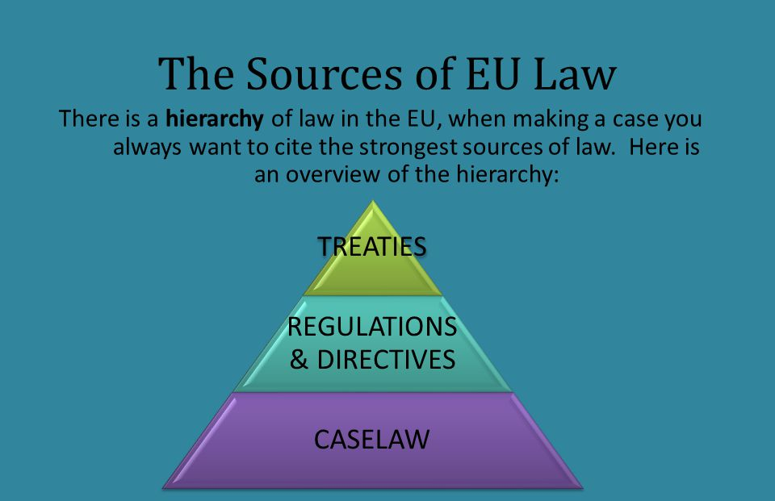

Slide 11
Horizontal legislation
- general environmental management issues rather than legislation regarding specific sectors, products or types of emissions.
Environmental impact assessment,
Integrated pollution prevention and control,
Environmental liability,
Public access to environmental information, participation in proceedings, access to justice.
Sectoral legislation
Air pollution
Water pollution and quality
Waste
Chemicals
Nature and Biodiversity
Land and soil protection
Marine and Coast
Noise

Slide 12
Legal base of EU environmental law - TFEU
Article 3 TEU Objectives
Article 4(2)(e) Shared competence
Article 13 Animal Welfare
Article 191 Environment
Article 194 TFEU Energy

Slide 13
Legal base of EU environmental law - TFEU
Article 3/3 TEU
The Union shall establish an internal market. It shall work for the sustainable development of Europe based on balanced economic growth and price stability, a highly competitive social market economy, aiming at full employment and social progress, and a high level of protection and improvement of the quality of the environment. It shall promote scientific and technological advance.

Slide 14
Legal base of EU environmental law - TFEU
Article 191
1. Union policy on the environment shall contribute to pursuit of the following objectives:
- preserving, protecting and improving the quality of the environment,
- protecting human health,
- prudent and rational utilisation of natural resources,- promoting measures at international level to deal with regional or worldwide environmental problems, and in particular combating climate change.
2. Union policy on the environment shall aim at a high level of protection taking into account the diversity of situations in the various regions of the Union. It shall be based on the precautionary principle and on the principles that preventive action should be taken, that environmental damage should as a priority be rectified at source and that the polluter should pay.

Slide 15
Transposition and implementation
Art. 4 (3) TEU:
Pursuant to the principle of sincere cooperation, the Union and the Member States shall, in full mutual respect, assist each other in carrying out tasks which flow from the Treaties.
The Member States shall take any appropriate measure, general or particular, to ensure fulfilment of the obligations arising out of the Treaties or resulting from the acts of the institutions of the Union.
The Member States shall facilitate the achievement of the Union's tasks and refrain from any measure which could jeopardise the attainment of the Union's objectives.

Slide 16
Characteristics
MULTI-LAYERED SYSTEM
Where the EU regulation does not specifically provide any specific means of enforcement or refers for that purpose to national laws, regulations and administrative provisions, the Member States are required to take all measures necessary to guarantee the application and effectiveness of EU law.
For example, the sanction provided for must be analogous to those applicable to infringements of national law of similar nature and importance, and must be effective, proportionate and dissuasive.

Slide 17
The main characteristics of the EU environmental law
Correct application = protection of the environment
(specific measures, quality of air or water)
Caretta caretta (C-103/00)

Slide 18
The main characteristics of the EU environmental law
Member State may not plead difficulties of implementation
Commission v. France (C-121/07)

Slide 19
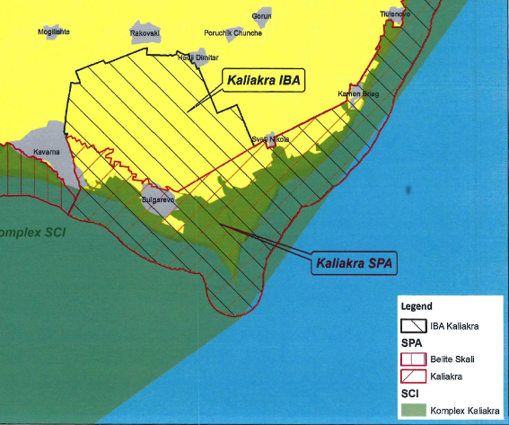
The main characteristics of the EU environmental law
Science comes into play
Commission v Bulgaria (C-141/14)

Slide 20
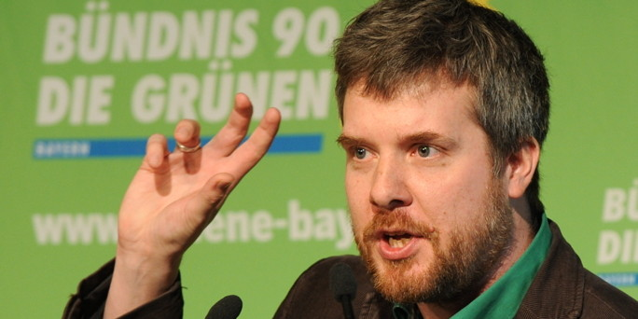
The main characteristics of the EU environmental law
Modified rules for direct effect of the EU directives
Dieter Janecek (C‑237/07)

Slide 21
To regulate certain aspect of environmental protection, the EU must meet the following conditions:
Competence
Principle of subsidiarity
Reasons for regulation (principles?)
Means of regulation
3. Principle of proportionality

Slide 22
Article 191
1. Union policy on the environment shall contribute to pursuit of the following objectives:
- preserving, protecting and improving the quality of the environment,
- protecting human health,
- prudent and rational utilisation of natural resources,
- promoting measures at international level to deal with regional or worldwide environmental problems, and in particular combating climate change.
2. Union policy on the environment shall aim at a high level of protection taking into account the diversity of situations in the various regions of the Union. It shall be based on the precautionary principle and on the principles that preventive action should be taken, that environmental damage should as a priority be rectified at source and that the polluter should pay.

Slide 23
Legal base of EU environmental law - TFEU
Article 4
2. Shared competence between the Union and the Member States applies in the following principal areas:
(e) environment;
(i) energy;
Principles of subsidiarity (cannot be sufficiently achieved by the Member States) and proportionality (necessary for the aims).

Slide 24
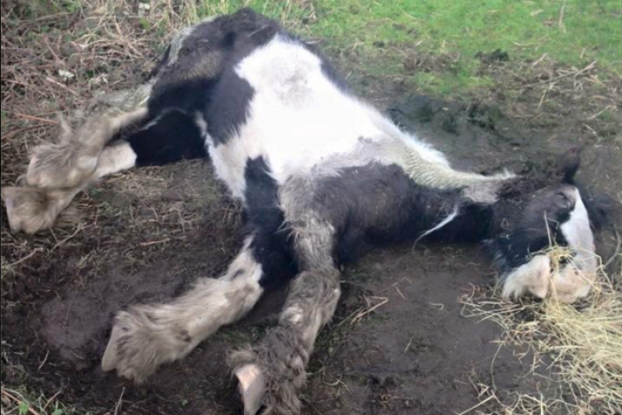
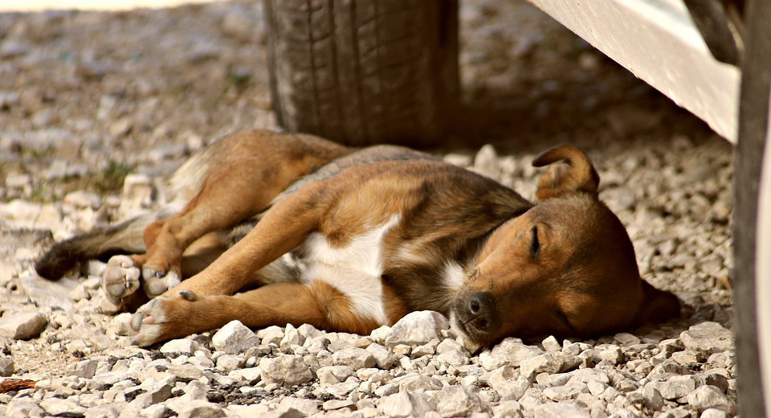
Competence: examples

Slide 25
Examples: Subsidiarity x proportionality

Slide 26
Examples: Subsidiarity x proportionality

Slide 27
To regulate certain aspect of environmental protection, the MS must meet the following conditions (Art. 35 + 36 TFEU):
It is not regulated by the EU
It is not discriminatory
It is proportionate

Slide 28
112/84 (Humblot)
It is not regulated by the EU
It is not discriminatory
It is proportionate

Slide 29
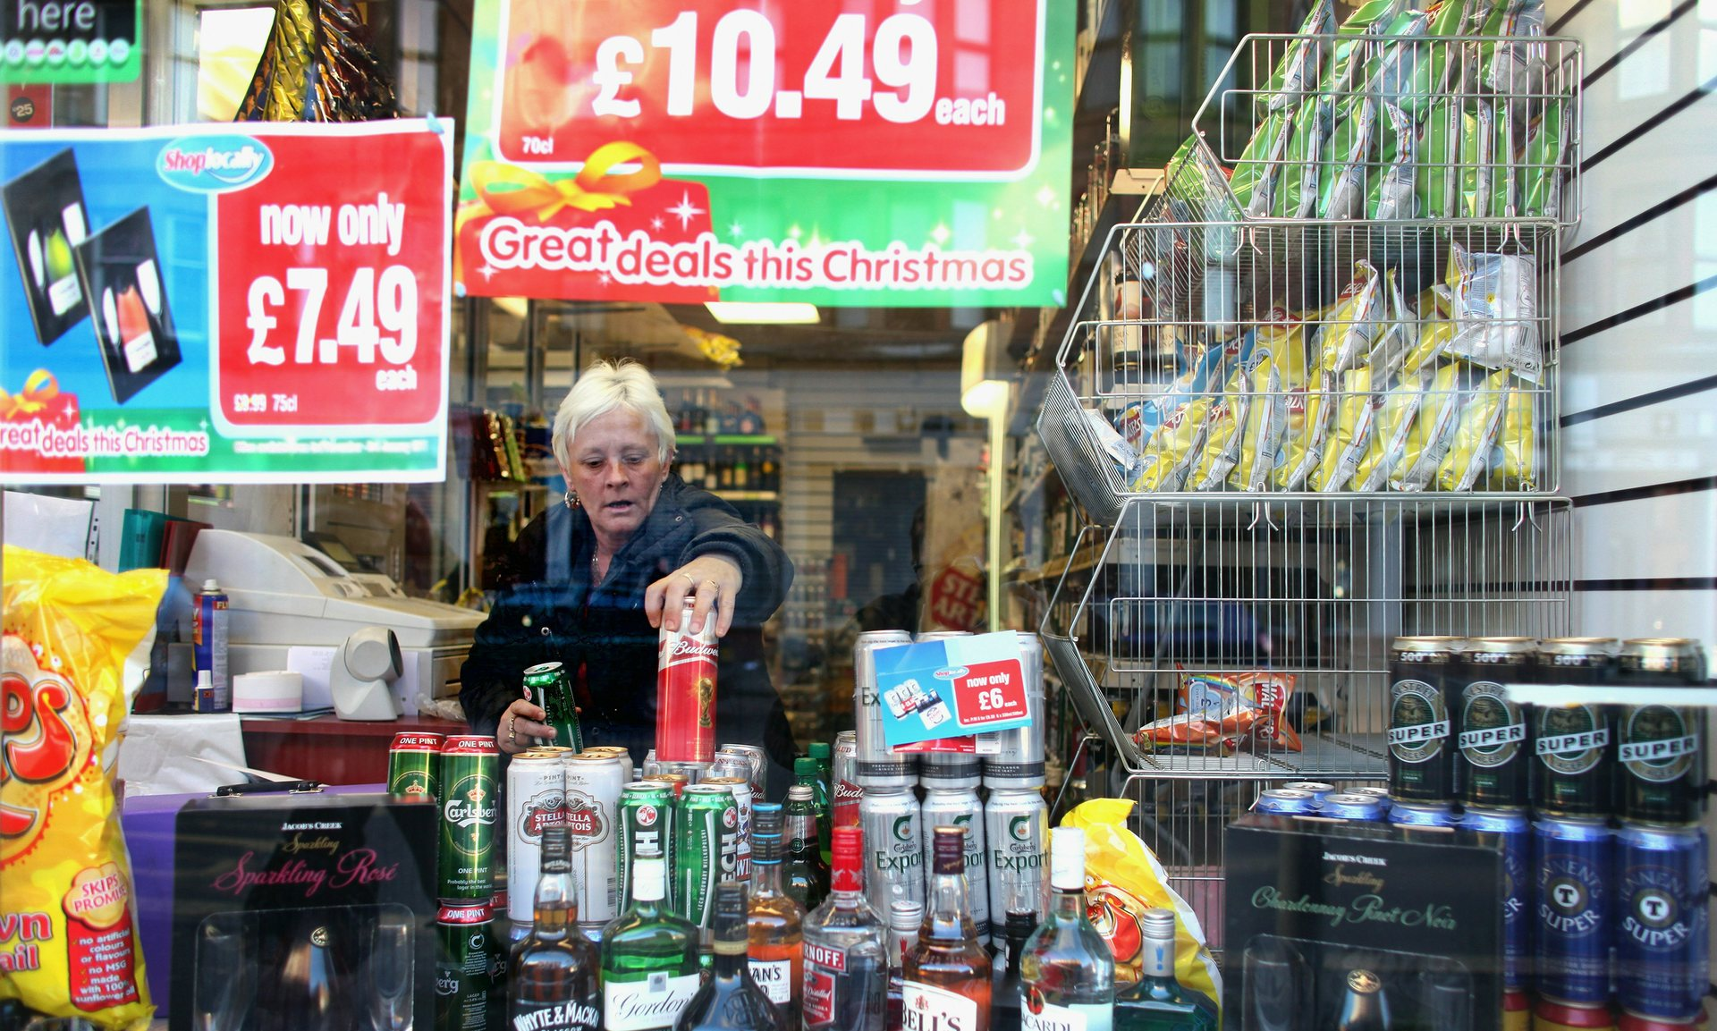
Level of protection
C‑333/14 (The Scotch Whisky Association)
It is not regulated by the EU
It is not discriminatory
It is proportionate
http://www.theguardian.com/society/2015/dec/23/minimum-alcohol-price-in-scotland-could-breach-eu-law-court-rules

Slide 30
Is it proportionate?
The legislation pursues a twofold objective, that of reducing, in a targeted way, both the consumption of alcohol by consumers whose consumption is hazardous or harmful, and also, generally, the population’s consumption of alcohol.
It does not seem unreasonable to consider that a measure that sets a minimum selling price of alcoholic drinks, the very specific aim of which is to increase the price of cheap alcoholic drinks, is capable of reducing the consumption of alcohol, in general, and the hazardous or harmful consumption of alcohol, in particular, given that drinkers whose consumption can be so described purchase, to a great extent, cheap alcoholic drinks.
It follows that the national legislation at issue in the main proceedings appears to be an appropriate means of attaining the objective that it pursues.

Slide 31
Is it proportionate?
National legislation or practice cannot benefit from the derogation laid down in Article 36 TFEU if human life and health can be as effectively protected by measures that are less restrictive of trade within the European Union.
Yet a fiscal measure which increases the taxation of alcoholic drinks is liable to be less restrictive of trade in those products within the European Union than a measure imposing an MPU.
The reason is that the latter measure, unlike increased taxation of those products, significantly restricts the freedom of economic operators to determine their retail selling prices and, consequently, constitutes a serious obstacle to access to the United Kingdom market of alcoholic drinks.
It is however for the referring court, which alone has available to it all the matters of fact and law pertaining to the circumstances of the main proceedings, to determine whether a measure other than that provided for by the national legislation at issue in the main proceedings, such as increased taxation on alcoholic drinks, is capable of protecting human life and health as effectively as that legislation, while being less restrictive of trade in those products within the European Union.

Slide 32
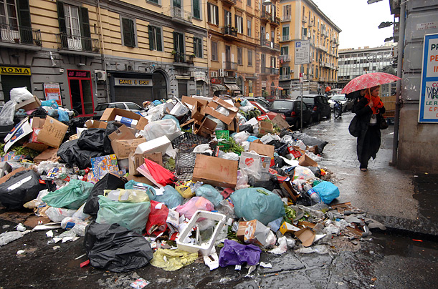
The main characteristics of the EU environmental law
Specific principles
Prevention, rectification at source, polluter pays principle

Slide 33
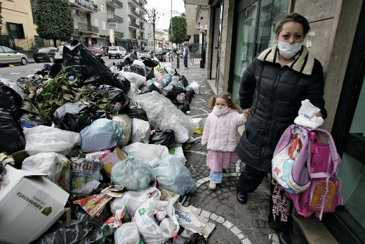
Principles
C-2/90: The principle that environmental damage should as a matter of priority be remedied at source, laid down by Article 130r (2) of the Treaty as a basis for action by the Community relating to the environment, entails that it is for each region, municipality or other local authority to take appropriate steps to ensure that its own waste is collected, treated and disposed of; it must accordingly be disposed of as dose as possible to the place where it is produced, in order to limit as far as possible the transport of waste.
(Moreover, that principle is consistent with the principles of self-sufficiency and proximity set out in the Basel Convention of 22 March 1989 on the control of transboundary movements of hazardous wastes and their disposal, to which the Community is a signatory.)

Slide 34
Principles - Rectification at source
Rectification at source – emphasises proximity, opposite to end-of-pipe approach, BAT
C-364/03: „Accordingly, inasmuch as it is undisputed that emissions of sulphur dioxide and nitrogen oxide have harmful effects on human health and on biological resources and ecosystems, the obligation on Member States to adopt the measures necessary to reduce the emissions of those two substances is not dependent, contrary to the assertion of the Hellenic Government, on the general environmental situation of the region in which the industrial plant in question is located.“

Slide 35
Principles – Polluter pays
Directive 2000/60/EC of the European Parliament and of the Council of 23 October 2000 establishing a framework for Community action in the field of water policy:
„Member States shall take account of the principle of recovery of the costs of water services, including environmental and resource costs, having regard to the economic analysis conducted according to Annex III, and in accordance in particular with the polluter pays principle.“

Slide 36
Principles – Polluter pays
C‑254/08 (wide margin of appreciation ):
While the Member States as the addressees of Directive 2006/12 are bound as to this result to be achieved in terms of financial liability for the cost of disposing of waste, in accordance with Article 249 EC they may, however, choose the form and the methods to be applied in order to attain that result.
…as Community law currently stands, there is no legislation adopted on the basis of Article 175 EC imposing a specific method upon the Member States for financing the cost of the disposal of urban waste, so that the cost may, in accordance with the choice of the Member State concerned, equally well be financed by means of a tax or of a charge or in any other manner.

Slide 37
Principles – Polluter pays
C-172/08 - Pontina Ambiente:
„…cost of disposing of the waste must be borne by the waste holders. It forms part of the objective of Directive 1999/31 which, according to Article 1(1) thereof, is to meet the requirements of Directive 75/442, and in particular Article 3 thereof, which inter alia requires the Member States to take appropriate measures to encourage the prevention or reduction of waste production.“
The consequence, in particular, is that whatever the national rules may be governing landfill sites, they must ensure that that all the operating costs of such a site is actually borne by the holders of the waste deposited in the landfill for disposal.“
(…) Causing the operator to bear such charges would amount to charging to him the costs arising from the disposal of waste which he did not generate but of which he merely disposes in the framework of his activities as a provider of services.

Slide 38
Principles – Polluter pays
C-172/08 (Standley) – Polluter pays x Proportionality
the Member States are to take account of the other sources of pollution when implementing the Directive and, having regard to the circumstances, are not to impose on farmers costs of eliminating pollution that are unnecessary. Viewed in that light, the polluter pays principle reflects the principle of proportionality

Slide 39
Principles – Prevention
Dannish bottles case
Various environmental standards.
EIA Directive thresholds
Usually on legislative level.

Slide 40
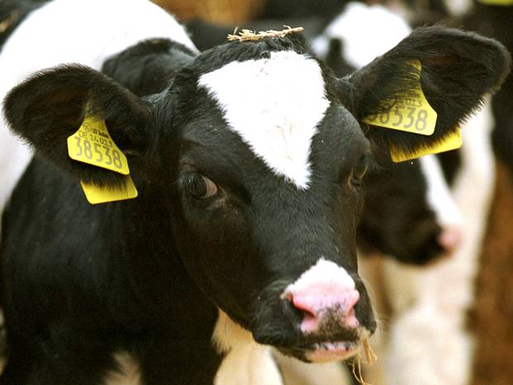
Principles – Precautionary principle
Time limit x Number of endangered persons x hypothetical risk
C-157/96 (National Farmers' Union)
C-180/96 (Mad cow disease)
bovine spongiformencephalopathy

Slide 41
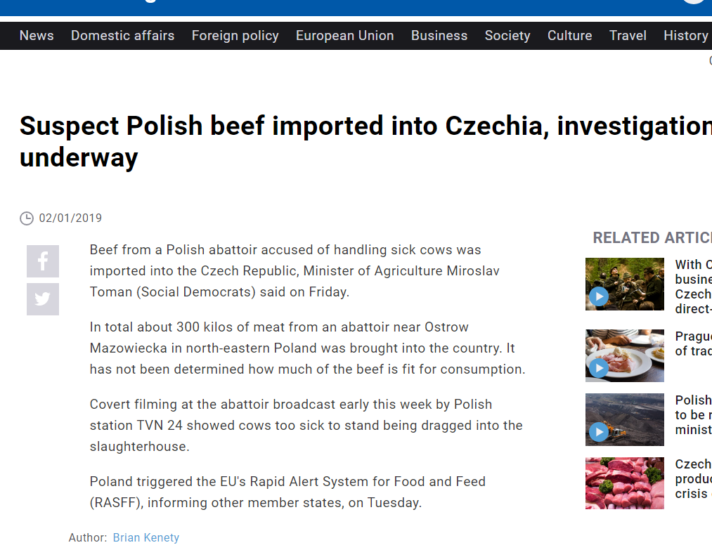
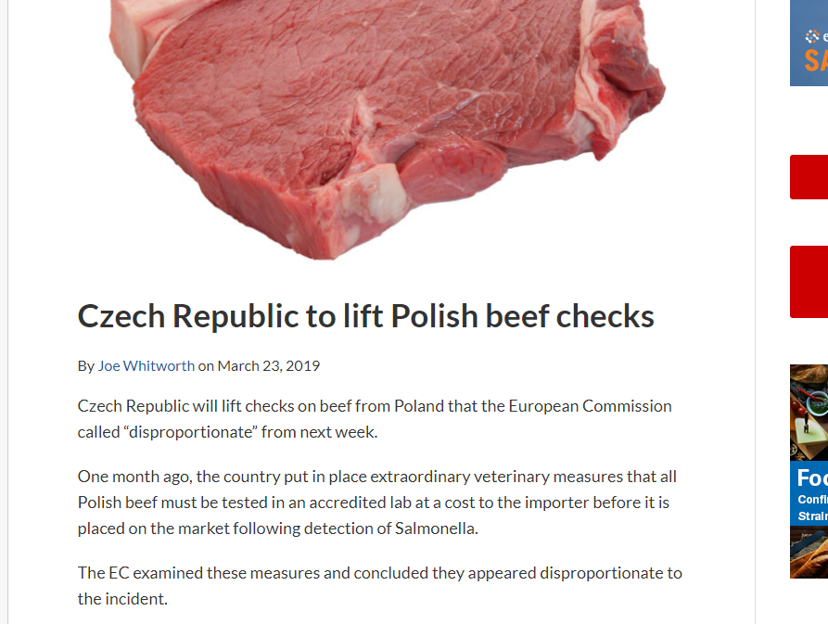

Slide 42
Principles – Precautionary principle
Where action is deemed necessary, measures based on the precautionary principle should be, inter alia:
proportional to the chosen level of protection,
non-discriminatory in their application,
consistent with similar measures already taken,
based on an examination of the potential benefits and costs of action or lack of action (including, where appropriate and feasible, an economic cost/benefit analysis),
subject to review, in the light of new scientific data, and
capable of assigning responsibility for producing the scientific evidence necessary for a more comprehensive risk assessment.

Slide 43
Today: Harmonization of environmental requirements and their implementation
What are the obligations of the Member States towards the EU environmental law?
to refrain from any measures which would jeopardise its effects
to implement (transpose) it correctly
to apply it correctly (interpretation, effectiveness)
to inform the Commission
What if not?
There are three main procedures at the Court of Justice:
• Direct actions against EU acts initiated by MS, institutions or individuals (Article 19 (3) (a) TEU, Article 263 TFEU)
• Preliminary reference procedures, initiated by Member State Courts (Article 19 (3) (b) TEU, Article 267 TFEU)
• Infringement proceedings against MS initiated by the Commission or other MS (Article 19 (3) (a) TEU, Article 258 to 260 TFEU)

Slide 44
Today: Harmonization of environmental requirements and their implementation
What are the obligations of the Member States towards the EU environmental law?
to refrain from any measures which would jeopardise its effects
(even before the time limit for the implementation?)
to implement (transpose) it correctly
(not just copy paste)
to apply it correctly (interpretation, effectiveness)
(inspections, sanctions, public participation)
to inform the Commission
Infringement proceedings against MS initiated by the Commission or other MS (Article 19 (3) (a) TEU, Article 258 to 260 TFEU)
(lengthy proceedings, burden of proof, systematic failures, high sanctions)

Slide 45
EXAMPLE 1: Transposition within a time limit
C-126/96 (Inter-Environnement Wallonie)
The Belgian Conseil d'État referred to the Court for a preliminary ruling
Proceedings brought by an NGO for annulment of the Order of the Walloon Regional Executive on toxic or hazardous waste
Part of the Order infringes (?) the EU directives as it excludes from the permit system the operations of setting up and running an installation intended specifically for the collection, pre-treatment, disposal or recovery of toxic or dangerous waste, where that installation forms an integral part of an industrial production process.

Slide 46
EXAMPLE 1: Transposition within a time limit
During the period laid for implementation? C-129/96
Since the purpose of such a period is, in particular, to give Member States the necessary time to adopt transposition measures, they cannot be faulted for not having transposed the directive into their internal legal order before expiry of that period.
Nevertheless, it is during the transposition period that the Member States must take the measures necessary to ensure that the result prescribed by the directive is achieved at the end of that period.
Although the Member States are not obliged to adopt those measures before the end of the period prescribed for transposition, it follows from the second paragraph of Article 5 in conjunction with the third paragraph of Article 189 of the Treaty and from the directive itself that during that period they must refrain from taking any measures liable seriously to compromise the result prescribed.

Slide 47
EXAMPLE 2: SANCTIONS
1) Particular requirements
Numerous directives require MS to establish 1) effective system of sanctions, 2) effective system of sanctions with particular sanctions and measures (withdrawal of permit, measures to ensure that compliance is restored within the shortest possible time)
2) Duty of cooperation of the member states
Geelhoed in C-304/02:
Member States are under a general obligation under Article 10 EC to take all measures necessary to ensure that Community law is applied and enforced effectively and that its ‘effet utile’ is achieved.(…) to ensure ‘that infringements of Community law are penalised under conditions, both procedural and substantive, which are analogous to those applicable to infringements of national law of a similar nature and importance and which, in any event, make the penalty effective, proportionate and dissuasive.
- Taken as a whole, the system of remedies must be dissuasive (see C‑565/12)

Slide 48
Transposition and implementation
The adequacy of enforcement still remains a major issue
The European Commission only exercises a relatively marginal control over the proper implementation of EU secondary law
additional control over financing from EU funds
Important role of national courts and the role of CJEU.

Slide 49
National judge and EU environmental law
Does the national law respect (transpose correctly) the EU Directive?
Not perfectly = but is it possible to interpret it in compliance with the directive? (understand the directive)
It is not possible = the conflicting national law must be dissapplied.
Now there is a gap in law = is it possible to apply the EU Directive directly?
The national law was not in compliance with EU law = liability?
The EU law does not seem correct? What to do?

Slide 50
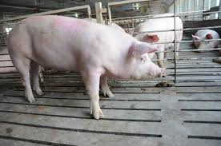
CORRECT APPLICATION = CORRECT INTERPRETATION
A sow is a female that has reproduced. A gilt is a female that has not reproduced.

Slide 51
TERMINOLOGY
A sow is a female that has reproduced. A gilt is a female that has not reproduced.
STARTING POINT: It is therefore necessary also to examine the general scheme and purposes of Directive 96/61 (C-585/10 Møller, para. 28)
The Kommune submits, before the Vestre Landsret, that it was justified in including the places for gilts in the number of places for sows. It maintains that the objective of Directive 96/61 is to protect the environment and that there is no reason to take the view that a gilt pollutes less than, or in a different manner to, a sow. It concludes that places for gilts are covered by the expression ‘places for sows’. According to the Kommune, the legislation on animal welfare is not relevant in that regard.
CONSEQUENCE:
31 As the purpose of Directive 96/61 has therefore been broadly defined, subheading 6.6(c) of Annex I to that directive cannot, as Mr Møller and Ireland suggest, be interpreted restrictively in such a way as to exclude places intended for gilts (see, by analogy, Association nationale pour la protection des eaux et rivières and OABA, paragraph 27).

Slide 52
CONTROL EXCERCISED BY THE COMMISSION
Non-communication
Non-conformity (non-transposition: delayed, incorrect)
Bad application (non-enforcement: no monitoring, no sanctions, non-application)
Commission gets information from reports, petitions, complaints, press, previous proceedings
EU Pilot: scheme designed to resolve compliance problems without having to resort to infringement proceedings
Only a few cases end up before the CJEU.

Slide 53
Correct application
Burden of proof - science comes to play
C-335/07, C-438/07: Treatment of urban waste water - Failure to require more stringent treatment of nitrogen in all treatment plants of urban waste water.

Slide 54
Correct application
Burden of proof - science comes to play
37 The submissions made by the parties indicate that, in general, one of the nutrients, whether it be phosphorus or nitrogen, is present (…).
38 In such circumstances, it is necessary to adopt different measures to reduce eutrophication in one part of the Baltic Sea as compared with another part. Directive 91/271 provides in this respect that the Member States are to assess, on the basis of the local situation, the substances – phosphorus and/or nitrogen – which contribute to eutrophication and, in accordance with that assessment, adopt appropriate treatment measures.

Slide 55
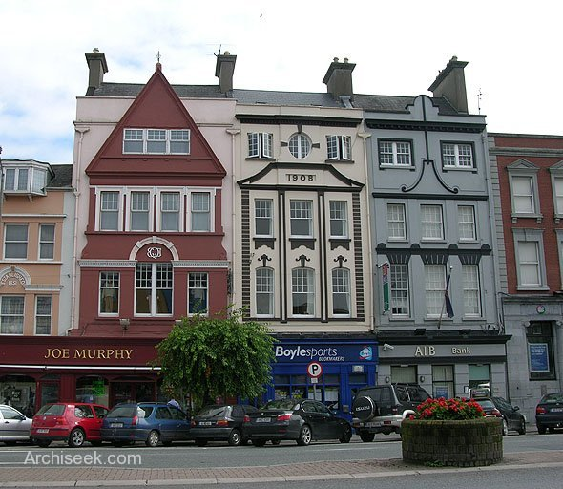
Correct application
Systematic failure of a Member State to fulfil obligations
C-494/01: waste operation at Fermoy, County Cork

Slide 56
Correct application
C-494/01:
“…in principle nothing prevents the Commission from seeking in parallel a finding that provisions of a directive have not been complied with by reason of the conduct of a Member State’s authorities with regard to particular specifically identified situations and a finding that those provisions have not been complied with because its authorities have adopted a general practice contrary thereto, which the particular situations illustrate where appropriate.“

Slide 57
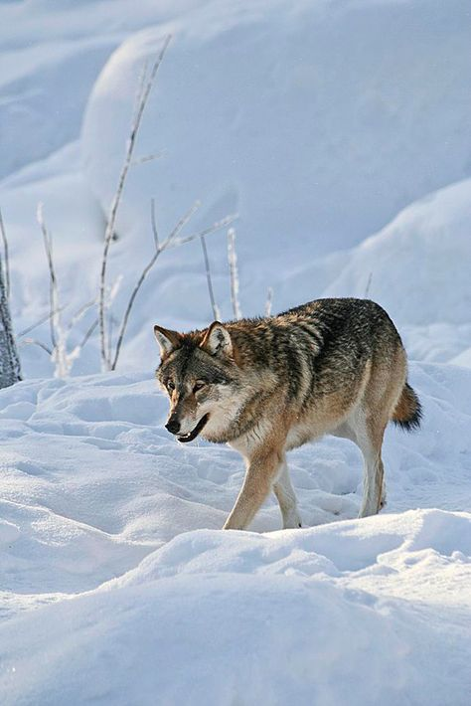
Correct application
Consistent and general nature:
C‑342/05:
- Commission has never pleaded a lack of sincere cooperation by the Finnish authorities as regards the communication of decisions relating to the issuing of hunting permits
- in spite of the wolf hunting authorised by way of derogation in Finland, the conservation status of the species concerned substantially and consistently improved

Slide 58
Correct application
Systematic failure of a Member State to fulfil obligations – how long, how many times
C-420/02 – ‘Pera Galini’ site of waste: 4 years:
The direct inference may not in principle be drawn that the Member State concerned has necessarily failed to fulfil its obligations under that provision to take the requisite measures to ensure that waste is disposed (…). However, if that situation persists and leads in particular to a significant deterioration in the environment over a protracted period without any action being taken by the competent authorities, it may be an indication that the Member States have exceeded the discretion conferred on them by that provision.
C- 248/05 - While the extracts from the reports quoted by the Commission emphasise the contamination of water supplies, they do not establish to the requisite legal standard a causal link between that contamination and the presence of substances in list II.

Slide 59
Court of Justice (CJEU)
Moving the environmental protection further:
Interpretation of EU Law
Procedure: Art. 258 – 260 TFEU
Maastricht Treaty: Financial sanctions
(C-304/02: both lump sum and a penalty payment)
– the seriousness of the infringement,
– its duration,
– the need to ensure that the penalty itself is a deterrent to further infringements.

Slide 60
Court of Justice (CJEU)
Article 260
1. If the Court of Justice of the European Union finds that a Member State has failed to fulfil an obligation under the Treaties, the State shall be required to take the necessary measures to comply with the judgment of the Court.
2. If the Commission considers that the Member State concerned has not taken the necessary measures to comply with the judgment of the Court, it may bring the case before the Court after giving that State the opportunity to submit its observations. It shall specify the amount of the lump sum or penalty payment to be paid by the Member State concerned which it considers appropriate in the circumstances. If the Court finds that the Member State concerned has not complied with its judgment it may impose a lump sum or penalty payment on it.
This procedure shall be without prejudice to Article 259.
3. When the Commission brings a case before the Court pursuant to Article 258 on the grounds that the Member State concerned has failed to fulfil its obligation to notify measures transposing a directive adopted under a legislative procedure, it may, when it deems appropriate, specify the amount of the lump sum or penalty payment to be paid by the Member State concerned which it considers appropriate in the circumstances. If the Court finds that there is an infringement it may impose a lump sum or penalty payment on the Member State concerned not exceeding the amount specified by the Commission. The payment obligation shall take effect on the date set by the Court in its judgment.

Slide 61
Court of Justice (CJEU)
Seriousness of the infringement:
– the loss of Community own resources,
– the impact of the infringement on the way the Community functions,
– serious or irreparable damage to human health or the environment,
– economic or other harm suffered by individuals and economic operators, including intangible consequences, such as personal development,
– the financial sums involved in the infringement,
– any possible financial advantage that the Member State gains from not complying with the judgment of the Court,
– the relative importance of the infringement taking into account the turnover or added value of the economic sector concerned in the Member State in question,
– the size of the population affected by the infringement (the degree of seriousness could be considered less if the infringement does not concern the whole of the Member State in question),
– the Community’s responsibility with respect to non-member countries,
– whether the infringement is a one-off or a repeat of an earlier infringement (for example, repeated delay in transposing directives in a certain sector).

Slide 62
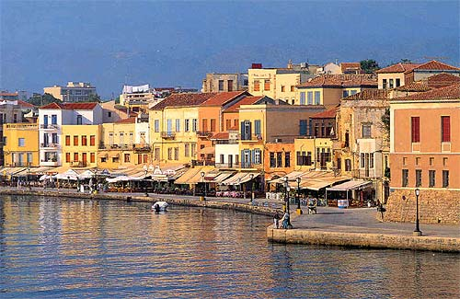
Court of Justice (CJEU)
C-387/97 – first fine
Waste management in Chania (Crete), problems known from 1987, first judgment C-45/91
24.600 EUR/day requested

Slide 63
Thank you for your attention

