Slide 1



BASICS OF THE EU ENVIRONMENTAL LAW/CLIMATE LAW
EU Climate Policy
Spring 2024
JUDr. Vojtěch Vomáčka, Ph.D., LL.M.

Slide 2
Why does the EU protect the environment?
PRIMARY LAW
(competence )
Policy
Framework legislation,
specific legislation, binding plans and programmes…
Administrative and judicial decisions, direct action…

Slide 3
European Union environmental legislation has developed over the last 50 years.
Environmental policy was not regulated at the Community level in the beginning, the Treaty of Rome does not contain regulations regarding this. Economic integration was the focus.
Awareness about environmental pollution began to develop because of:
- Intensive economic growth
  - The fast growth of industrialization
  - Increasing energy consumption
  - on the international level + national level

Slide 4
Phase 1: 1958 - 1972
1958 EEC Treaty
No specific attention to development of environmental policy
Minor measures (common market based – dangerous chemicals, motor vehicles, detergents)
Phase 2: 1972 - 1987
European Council Summit in 1972: Heads of States and Governments decided that a Community environmental policy was necessary
The basis of the environmental policy was established in the First Environmental Action Programme (1973). Basic goals, principles of environmental law, and activities regarding certain fields of the environment.
The main goal was the efficient operation of the Community and the Common Market – but extensive interpretation of economic expansion.

Slide 5
Phase 3: 1987 - 2008
1987 Single European Act
Independent title of environment was accepted
1993 Treaty on the European Union (Maastricht)
Protection of the environment became part of the internal common policy. The scope of environmental policy was enlarged and supplemented it with new objectives.
1997 Treaty of Amsterdam
„Environmental protection requirements must be integrated into the definition and implementation of the Community policies and activities referred to in Article 3, in particular with a view to promoting sustainable development.”

Slide 6
Phase 4: Lisbon and further
2009: Treaty of Lisbon
the 3 pillars structure disappears
TUE + TFUE (former TEC) + Nice into a single Treaty
Strengthened role of the EU Parliament
Broader Union’s competences
Birth of the European External Action Service (EEAS)
EU Charter
DG Environment
DG Energy
DG Climate Action

Slide 7
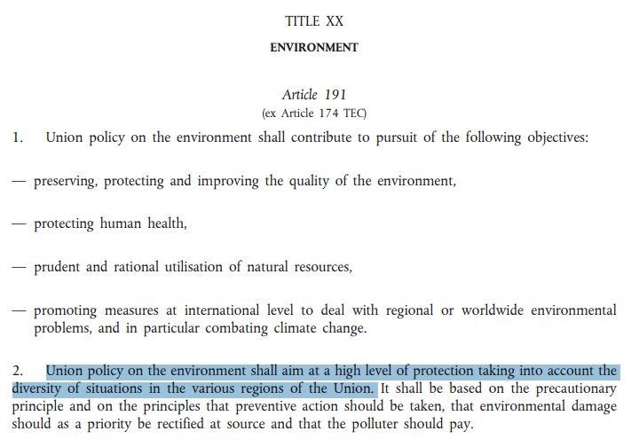

Slide 8
1970 The US Environmental Protection Agency is established.
1971 The international environmental organisation Greenpeace is founded in Vancouver, Canada.
1972 The United Nations Conference on the Human Environment is held in Stockholm. This leads to the creation of government environment agencies and the UN Environment Programme.
1972 The Club of Rome publishes The Limits to Growth. It stresses, for the first time, the importance of the environment, and the essential links with population and energy.
1973 In January, Denmark, Ireland and the United Kingdom join the European Community, bringing membership up to nine.
1973 A small Environment and Consumer Protection Service is set up and attached to the European Commission department for industrial policy and a Standing Committee on the Environment is created in the European Parliament.
1973 The Arab–Israeli war of October leads to an oil price shock and economic problems in Europe, sparking action on energy efficiency. Car-free Sundays are organised throughout Europe.
1974 Scientists suggest for the first time that chlorofluorocarbons (CFCs) may be causing a thinning of the ozone layer.
1975 The Community starts building its body of environmental legislation with the adoption of — among others — the Waste Framework Directive (1975), the Bathing Water Directive (1976) and the Birds Directive (1979).

Slide 9
1976 An explosion occurs on 10 July at a chemical plant near Seveso, north of Milan in Italy. A toxic cloud containing dioxin contaminates a densely populated area. In 1982, the Seveso Directive is issued to prevent major accidents with dangerous substances.
1978 Oil tanker Amoco Cadiz spills 68 million gallons off the coast of France.
1979 A partial meltdown of the Three Mile Island nuclear plant in USA puts the future of nuclear energy in question.
1979 The first World Climate Conference takes place in February in Geneva, Switzerland. A panel on climate change set up by the National Academy of Sciences in USA advises that ‘A wait-and-see policy may mean waiting until it is too late’ to avoid significant climate changes.
1981 The European Commission creates its Environment Directorate-General.
1985 First observation of an ozone hole over Antarctica.
1986 On 25 April, an uncontrolled chain reaction in a reactor in the Chernobyl nuclear power plant, 80 miles north of Kiev, blows off the reactor's lid. More than 31 workers die instantly and around 135 000 people are evacuated from the surrounding area. A plume of radioactive fall-out drifts over western Soviet Union, eastern and western Europe, and eastern North America.
1987 The Brundtland Commission’s report, Our Common Future, defines sustainable development as ‘development that meets the needs of the present without compromising the ability of future generations to meet their own needs.’

Slide 10
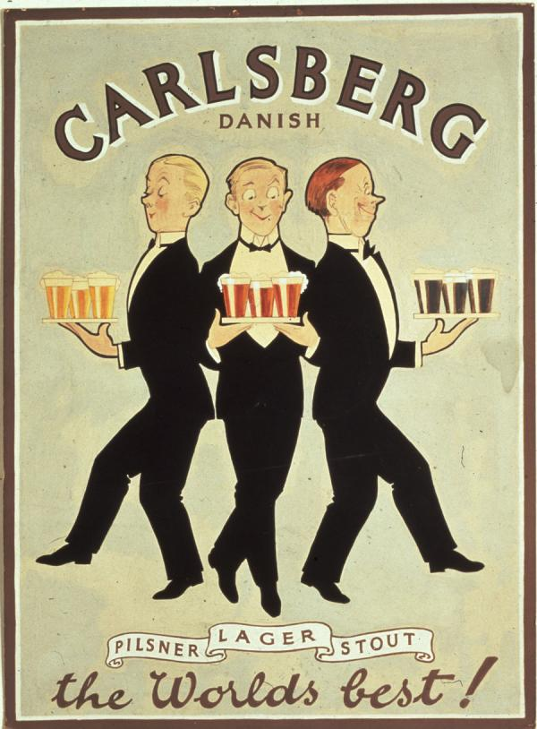
Major role of the Court of Justice
For example Case C-302/86 (Dannish bottles)
The protection of the environment is "one of the Community's essential objectives" which may as such justify certain limitations of the principle of the free movement of goods.
Article 35 :
Quantitative restrictions on exports, and all measures having equivalent effect, shall be prohibited between Member States.
Article 36: The provisions of Articles 34 and 35 shall not preclude prohibitions or restrictions on imports, exports or goods in transit justified on grounds of public morality, public policy or public security; the protection of health and life of humans, animals or plants; the protection of national treasures possessing artistic, historic or archaeological value; or the protection of industrial and commercial property. Such prohibitions or restrictions shall not, however, constitute a means of arbitrary discrimination or a disguised restriction on trade between Member States.

Slide 11
Before 1986 (Treaty of Rome) | Single European Act (1986) | Maastricht Treaty (Treaty of the Union - 1992) | Amsterdam Treaty (1999) | Lisbon Treaty (2009)
Art. 100 Harmonization (internal market) | ➔ Art 100a Harmonization + safeguard clause | ➔ Art 100a Harmonization + safeguard clause | ➔ Art 95 Harmonization + safeguard clause | ➔ Art 114 Harmonization + safeguard clause
Art. 235 Objectives of the Community | Art. 235 (not in use any longer!) | Art. 235 (not in use any longer!) | Art. 308 (not in use any longer!) | Art.352 (not in use any longer!)
- | Art. 130r - Objectives - Principles - Grounds - Int. coop. | ➔ Art. 130r - Objectives - Principles - Grounds - Int. coop. | ➔ Art. 174 - Objectives - Principles - Grounds - Int. coop. | ➔ Art. 191 - Objectives - Principles - Grounds - Int. coop.
- | Art. 130s Legal basis and procedure | ➔ Art. 130s Legal basis and procedure | ➔ Art. 175 Legal basis and procedure | ➔ Art. 192 Legal basis and procedure
- | Art. 130t Minimum stringency | ➔ Art. 130t Minimum stringency | ➔ Art. 176 Minimum stringency | ➔ Art. 193 Minimum stringency

Slide 12
System and structure:
Sectoral legislation
Air pollution, Water pollution and quality, Waste, Chemicals, Nature and Biodiversity, Land and soil protection, Marine and Coast, Noise
Horizontal legislation - general environmental management issues rather than legislation regarding specific sectors, products or types of emissions.
Environmental impact assessment,
Public access to environmental information, participation in proceedings, access to justice,
Environmental liability,
Integrated pollution prevention and control,
Reports on the implementation.

Slide 13
Environmental Action Programmes
= political declarations
EAPs define the framework of the EU environmental policy. They set up the challenges and priorities for a given period and create a frame for EU measures on the environment
The First Action Programme (1973 - 1977)
need for a comprehensive assessment of the impacts of other policies
ideas behind sustainable development
The Second Action Programme (1977 - 1981)
priority of the protection of water, air and noise
rational use of land, environment and natural resources
Limited success, critical evaluation, economic recession (75 - 78, 81 - 83)
Principles introduced, number of framework directives adopted (water and waste)

Slide 14
The Third Action Programme (1982 - 1986)
Change in emphasis from pollution control to pollution prevention
Land use planning (a tradition of strategic environmental planning from the Netherlands)
Integration of environment into other EC policies
Emissions control policy (Germany)
The Fourth Action Programme (1987 - 1992)
Emphasizes the analysis of benefits and cost, the polluter pays principle, responsibility in the environmental field
The Fifth Action Programme (1993 - 2000)
Sustainable development, sectoral approach
Pubic participation
Medium and long-term objectives

Slide 15
The Sixth Action Programme (2001 - 2010):
Climate change as an outstanding challenge
Protecting, conserving, restoring and developing the functioning of natural systems, natural habitats, wild flora and fauna
Contributing to a high level of quality of life and social well being for citizens
Better resource efficiency and resource and waste management
More stringent objectives
Critical review in 2007
Financial crysis
And then?

Slide 16
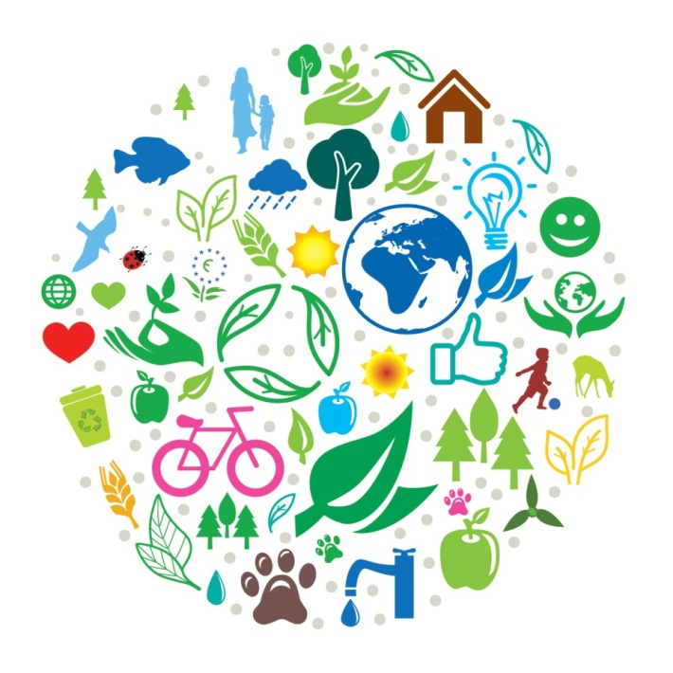
The Seventh Action Programme (2013 - 2020):
"Living well, within the limits of our planet„
No specific objectives (levels of pollution)
Towards a resource-efficient, low-carbon economy
2020 timeframe, 2050 vision, 9 priority objectives
3 Thematic priority objectives:
Protecting nature and strengthening
ecological resilience
Boosting sustainable, resource-efficient,
  low-carbon growth, and
Effectively addressing environment-related
threats to health.

Slide 17
The Seventh Action Programme (2013 - 2020):
EU Environmental policy is linked to the EU budget:
Green funding, 5 % - 20 % GC
Private investors
Europe 2020 - the EU's growth strategy
2015 Action Plan on circular economy
to become a smart, sustainable and inclusive economy. These three mutually reinforcing priorities should help the EU and the Member States deliver high levels of employment, productivity and social cohesion.

Slide 18
Too vague? Example – air quality
The 5th EAP: “WHO values [on air quality] become mandatory et EU level” by the year 2000.
The 6th EAP declared that WHO standards, guidelines and programmes “will be taken into consideration”
The 7th EAP declared that by 2020, “outdoor air pollution is significantly improved”, without mentioning that the binding limit values had to be respected by 2010 already (by 2015 for PM2.5).
Question of nuclear safety and radiation protection, discussed in the 5th EAP, were altogether omitted in the 6th and 7th EAP, in the same way as specific measures aiming at industrial, agricultural, transport, energy and touristic activities which had been discussed in some detail in the 5th EAP. The 7th EAP vaguely referred to integration and coherence in general.

Slide 19
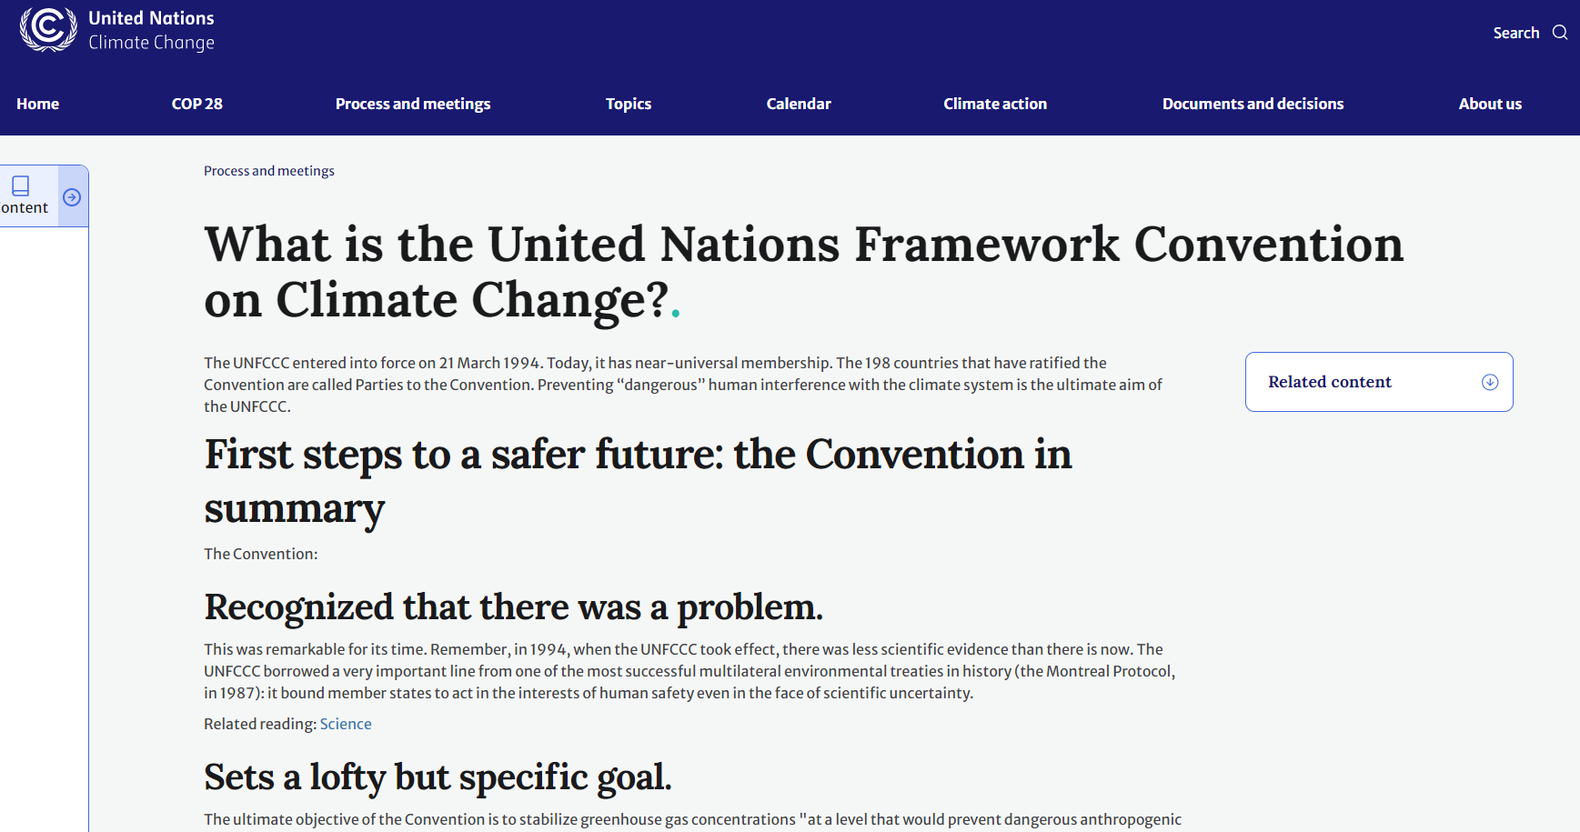

Slide 20
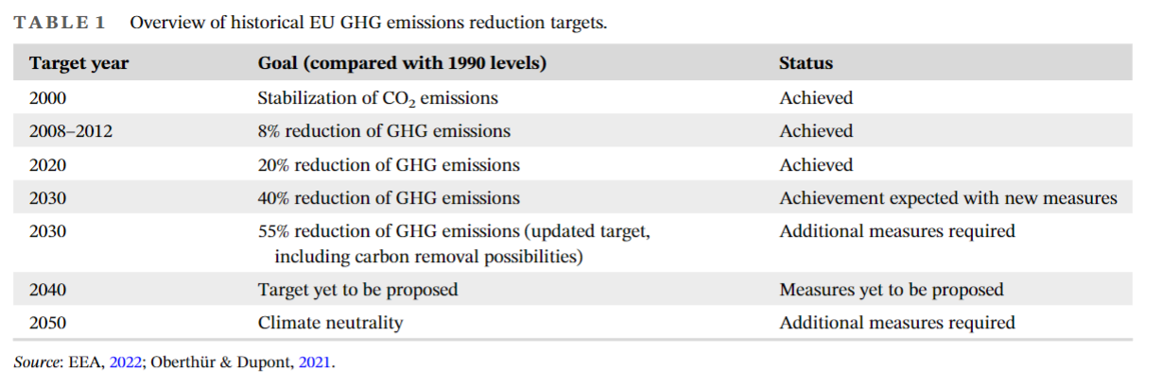
History:
Directive on Soil Protection? Failed
Directive on carbon tax? Failed

Slide 21
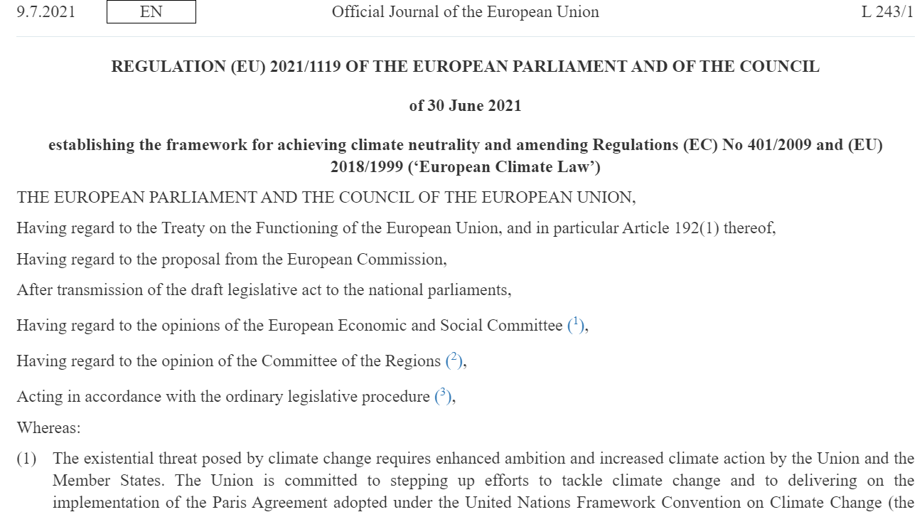
European Climate Law sets out a legally binding target for net-zero emissions by 2050.
Notes:
The main actions included in the regulation are:
mapping out the pace of emission reductions until 2050 to give predictability to businesses, stakeholders and citizens
developing a system to monitor and report on the progress made towards the goal
ensuring a cost-efficient and socially-fair green transition
Following the provisional agreement reached with the European Parliament in April 2021, the Council approved the agreement in May 2021. The regulation is in force.

Slide 22
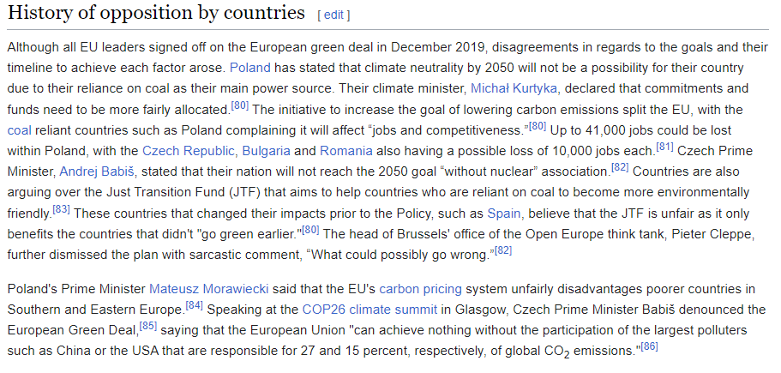
European Climate Law sets out a legally binding target for net-zero emissions by 2050.
Notes:
The main actions included in the regulation are:
mapping out the pace of emission reductions until 2050 to give predictability to businesses, stakeholders and citizens
developing a system to monitor and report on the progress made towards the goal
ensuring a cost-efficient and socially-fair green transition
Following the provisional agreement reached with the European Parliament in April 2021, the Council approved the agreement in May 2021. The regulation is in force.

Slide 23
In February 2024, the European Commission published its long-awaited recommendations for climate targets for 2040. The commission, which is the executive arm of the European Union, is recommending that EU member states cut greenhouse-gas emissions by 90% by 2040, compared with 1990 levels.
The EU’s existing policies could reduce emissions by 88% by 2040, according to its own projections. This would be achieved mainly through phasing out coal, converting most fossil-fuel power to renewable sources such as solar, wind and tidal energy, and electrifying transport. There will still be emissions from some vehicles on the road, from shipping and from aviation. Some oil and gas power will also be in use.
The Commission is, therefore, proposing to accelerate technologies, such as carbon capture and storage (CCS), that can take up some of those remaining emissions and store the gases, possibly underground.

Slide 24
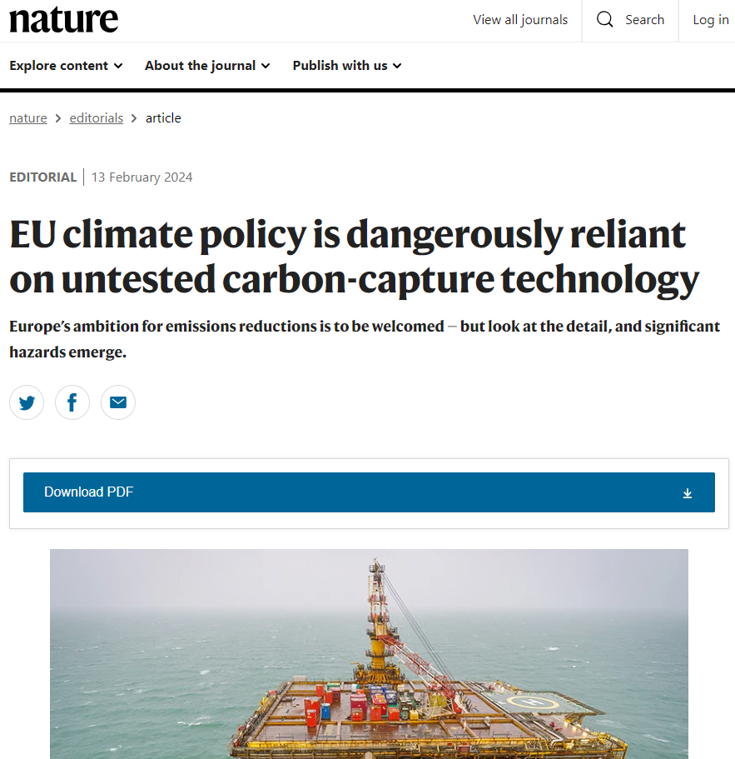

Slide 25
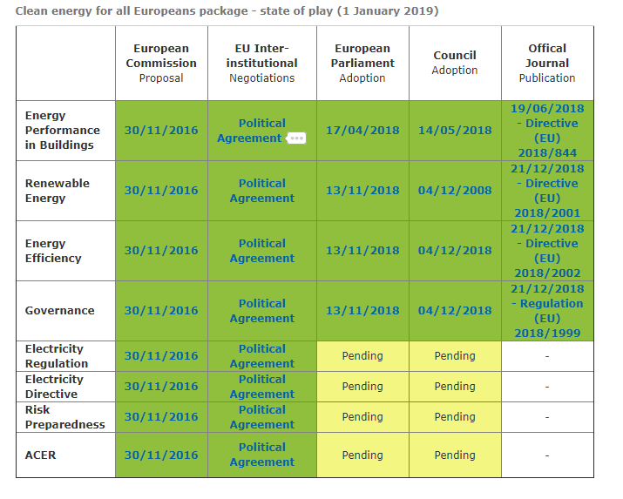
EU: Energetika x Životní prostředí

Slide 26
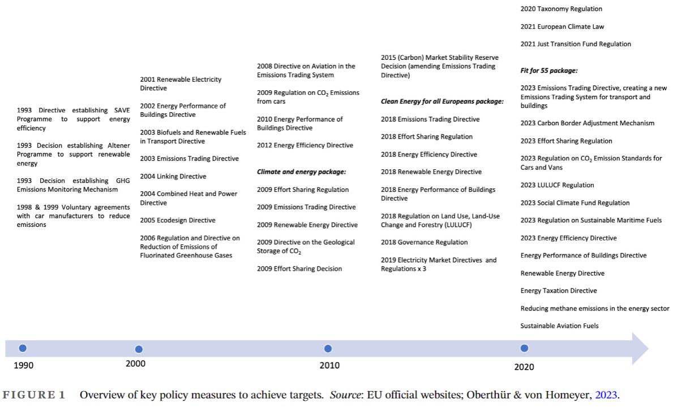

Slide 27
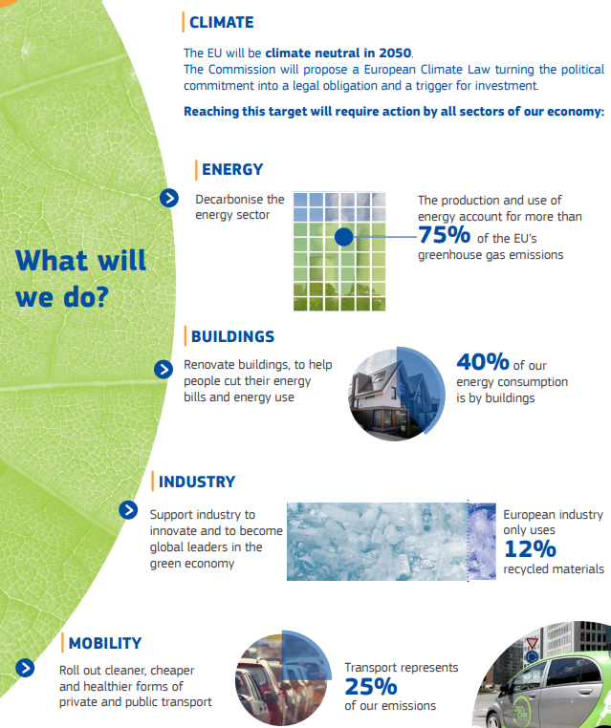
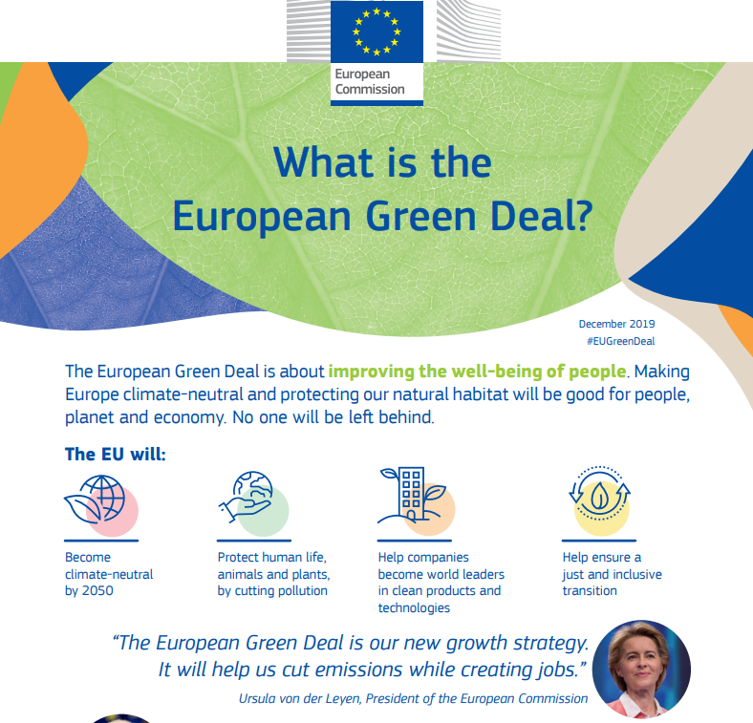
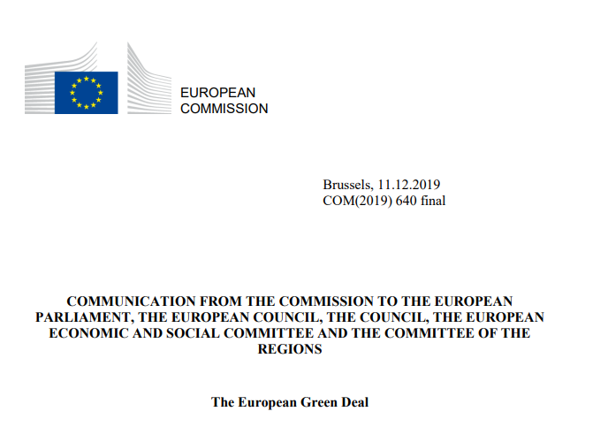
Notes:
The main aim of the European Green Deal is to become climate neutral by the year of 2050. The reasons pushing for the plan's creation are based upon the environmental issues such as climate change, a loss of biodiversity, ozone depletion, water pollution, urban stress, waste production and more. The following statistics highlight the climate related issues within the European Union:
In regards to climate change, carbon dioxide levels are predicted to double by the year of 2030 with Europe's temperature expected to increase by 2-3 °C in the summer season.^{[57]}
Europe is responsible for nearly one third of the world's gas emissions that deplete the ozone.^{[57]}
More than 50% of all surface area where ecosystems are in Europe are presented with threats from management problems and stresses.^{[57]}
On average, 700,000 hectares of woodland are burnt annually by fires “often caused by socioeconomic factors” within the European Union, leading to the degradation of forests.^{[57]}

Slide 28
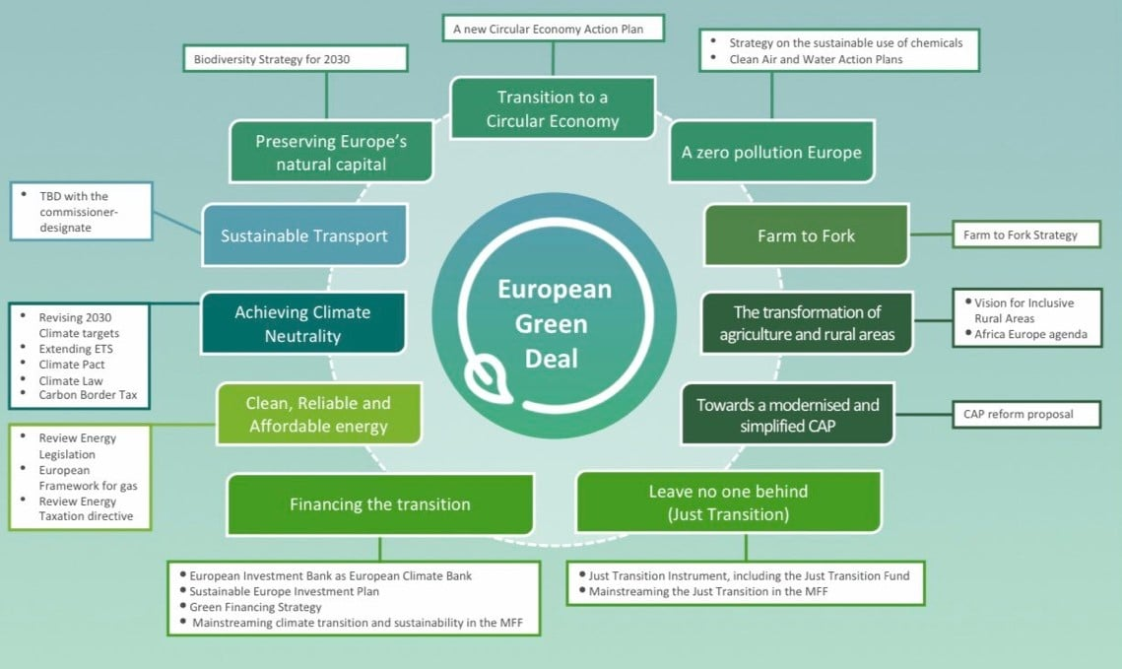

Slide 29
Effort Sharing Regulation:
sets emissions reductions targets for the EU and individual Member States in a wide range of sectors. It covers domestic transport (excluding aviation), buildings, agriculture, small industry and waste.
LULUCF Regulation:
sets out how the land use sector contributes to the EU’s climate goals. The LULUCF Regulation was revised in 2023 for the period up to 2030.
To help reach climate neutrality, for the first time, the revised LULUCF regulation has a separate land-based net carbon removals target of 310 million tonnes of CO2 equivalent by 2030.
This EU-wide target is to be implemented through ambitious, fair and binding net removal national targets for the LULUCF sector.
Carbon Boundary Adjustment Mechanism (CBAM):
sets the price of (some) products entering the EU market to take account of the emissions associated with their production, a new emissions trading scheme covering buildings and transport, and a social climate fund set up to offset the negative impacts of this new, expanded emissions trading scheme.
What else? Green public procurement, ESG, etc.

Slide 30
FIT FOR 55
- aims to translate the climate ambitions of the Green Deal into law.
- a set of proposals to revise climate-, energy- and transport-related legislation and put in place new legislative initiatives to align EU laws with the EU’s climate goals.
EU STRATEGY ON ADAPTATION TO CLIMATE CHANGE
In June 2021, EU environment ministers approved conclusions endorsing the new EU strategy on adaptation to climate change. The strategy outlines a long-term vision for the EU to become a climate-resilient society that is fully adapted to the unavoidable impacts of climate change by 2050.
The measures set out in the strategy include:
better gathering and sharing of data to improve access to and exchange of knowledge on climate impacts
nature-based solutions to help build climate resilience and protect ecosystems
integration of adaptation in macro-fiscal policies
The conclusions give political guidance to the Commission on the implementation of the strategy.
In March 2022, the Council adopted conclusions calling for the adaptation of civil protection to extreme weather events resulting from climate change.
Ministers called for the adaptation of civil protection systems with a focus on:
prevention
preparedness
response
recovery

Slide 31
FARM TO FORK STRATEGY
- aims to help the EU achieve climate neutrality by 2050, by shifting the current EU food system towards a sustainable model.
In addition to food security and safety, the strategy’s main goals are to:
ensure sufficient, affordable and nutritious food within planetary limits
support sustainable food production
promote more sustainable food consumption and healthy diets
In October 2020, the Council adopted a set of conclusions on the strategy, endorsing the goal of developing a European sustainable food system, from production to consumption.
EUROPEAN INDUSTRIAL STRATEGY
The EU relies on Europe’s industry to lead the transitions towards climate neutrality.
The aim of the EU’s industrial strategy is to support the industry in its role as an accelerator and enabler of change, innovation and growth.
An update to the industrial strategy, published by the Commission in May 2021, is aimed at strengthening resilience and advancing Europe’s competitiveness. It strives to enable Europe’s industry to lead the green and digital transformation and become the global driving force in the shift towards climate neutrality and digitalisation.
CIRCULAR ECONOMY ACTION PLAN
Decoupling economic growth from resource use and shifting to circular systems in production and consumption is key to achieving EU climate neutrality by 2050.
The action plan envisages over 30 action points on designing of sustainable products, circularity in production processes and empowering consumers and public buyers. It targets sectors such as electronics and ICT, batteries, packaging, plastics, textiles, construction and buildings, and food.

Slide 32
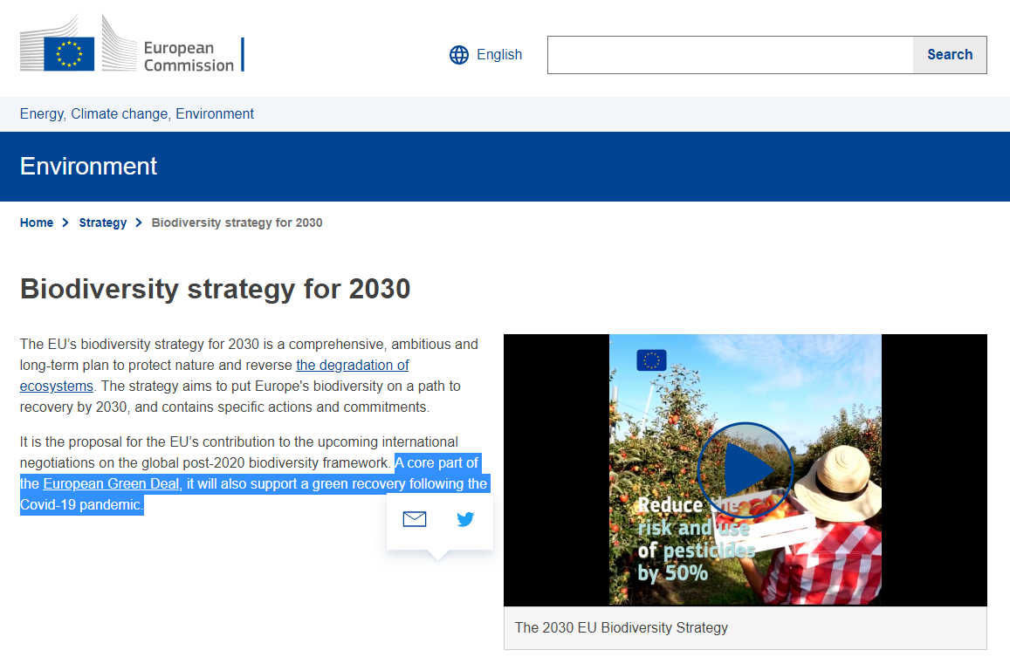

Slide 33
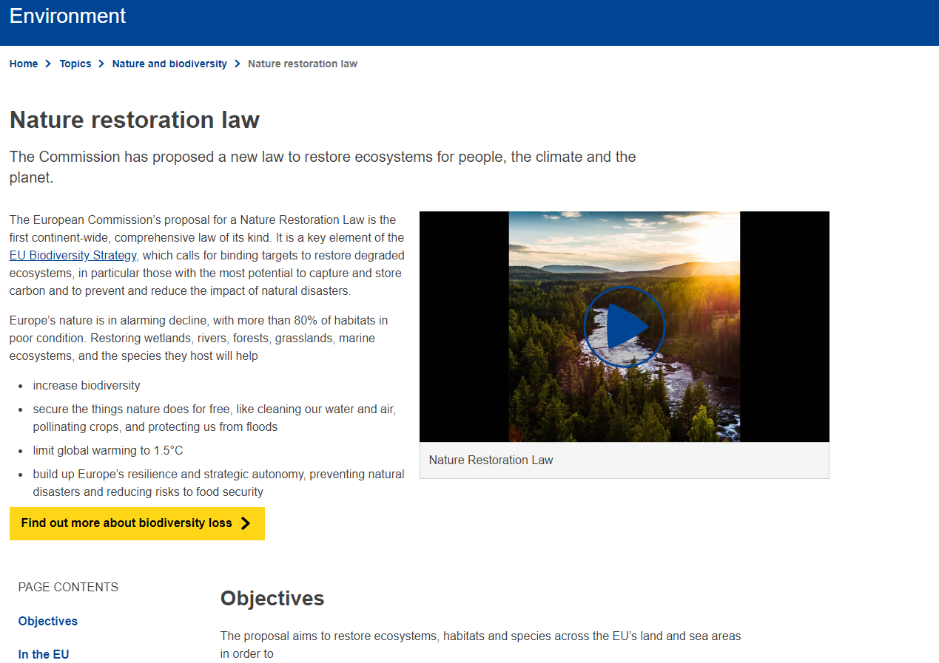

Slide 34
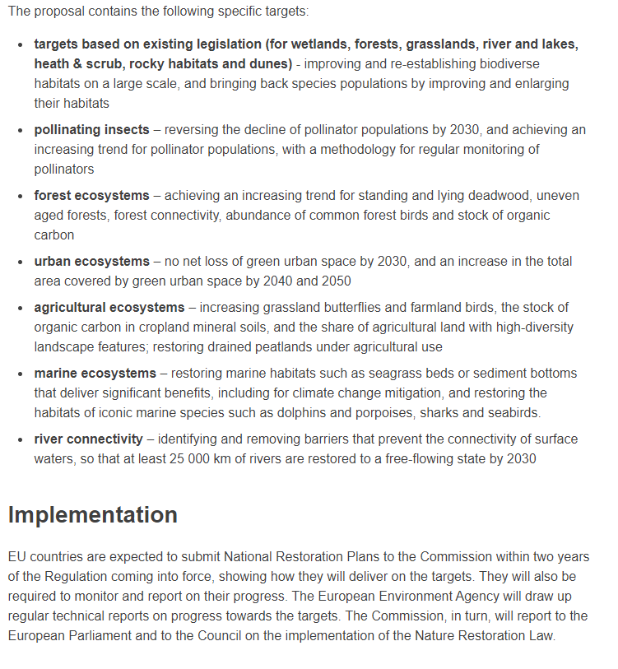

Slide 35
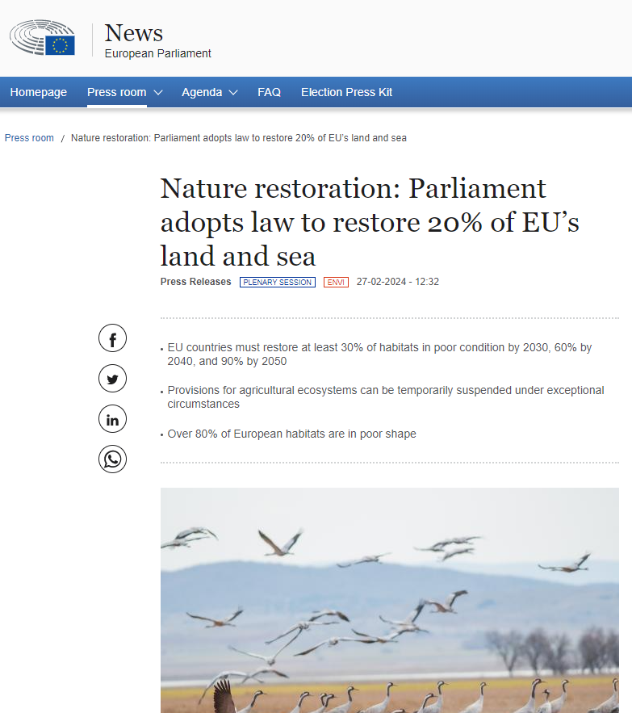

Slide 36
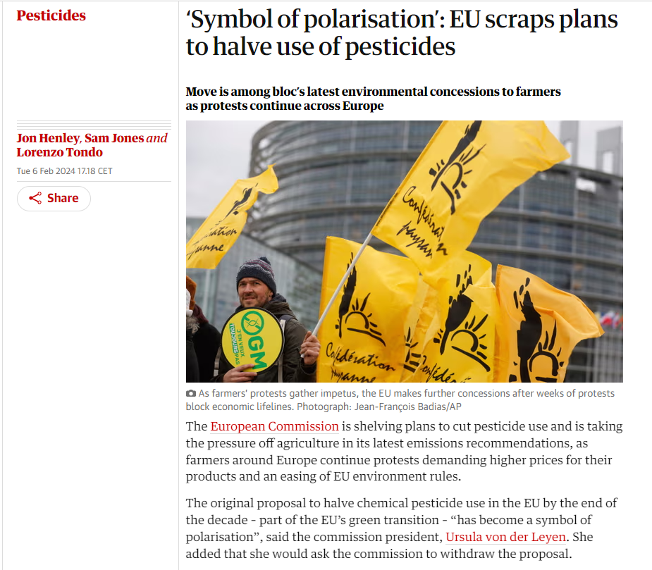
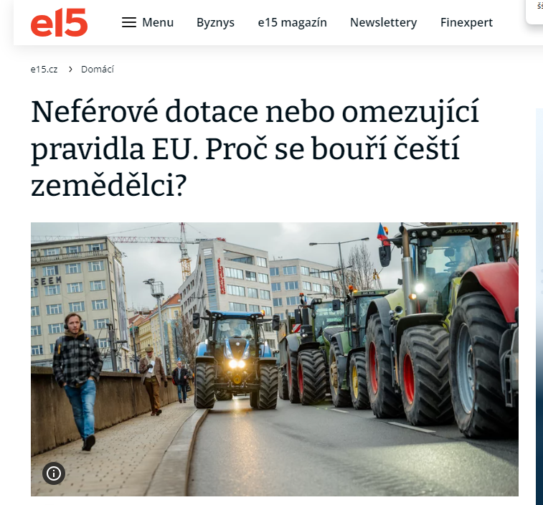
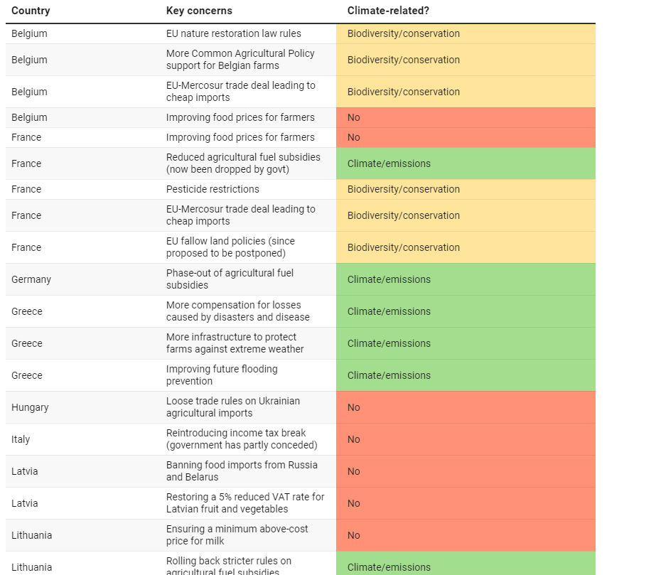
Co je ekopolitika?

Slide 37
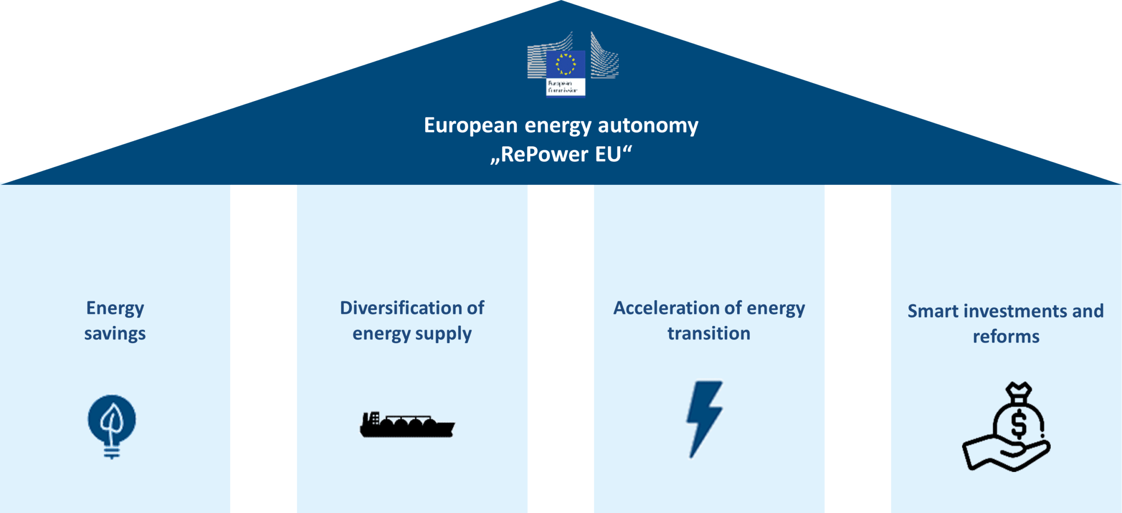

Slide 38
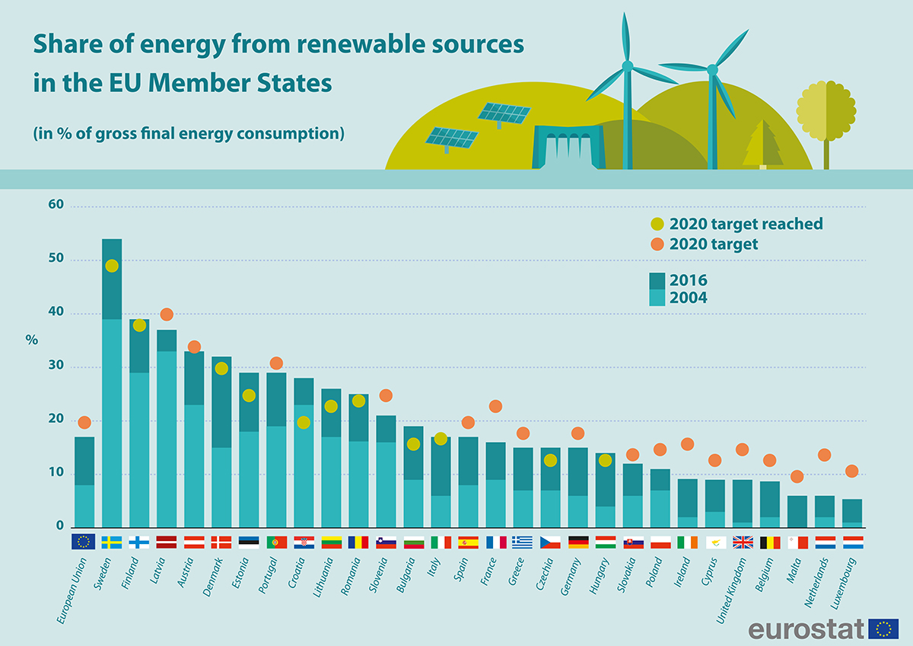

Slide 39
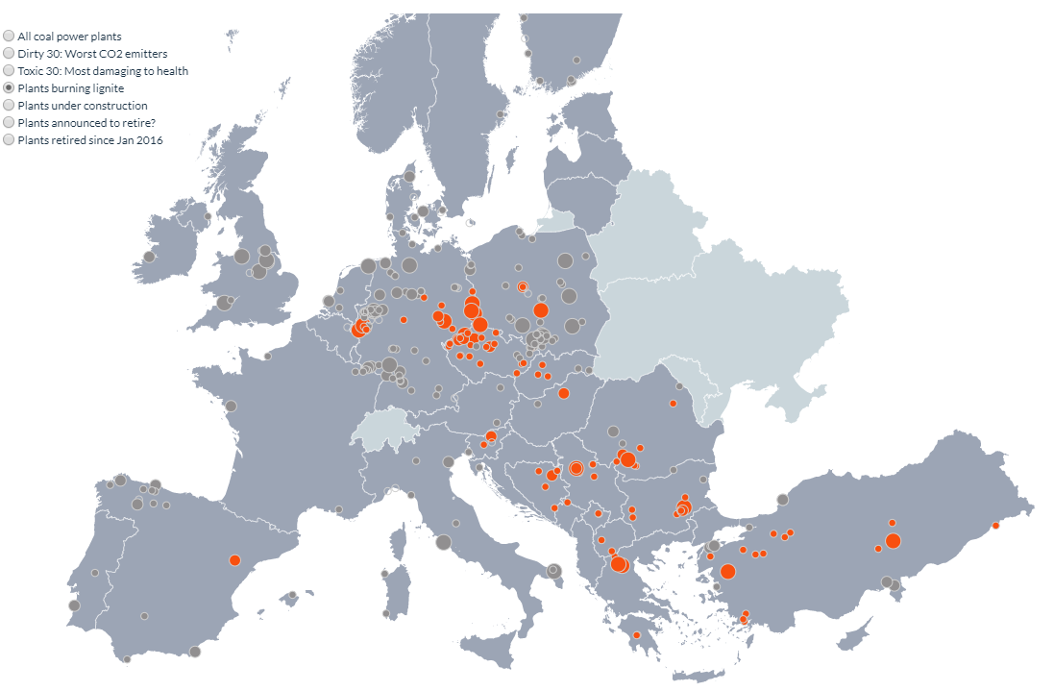
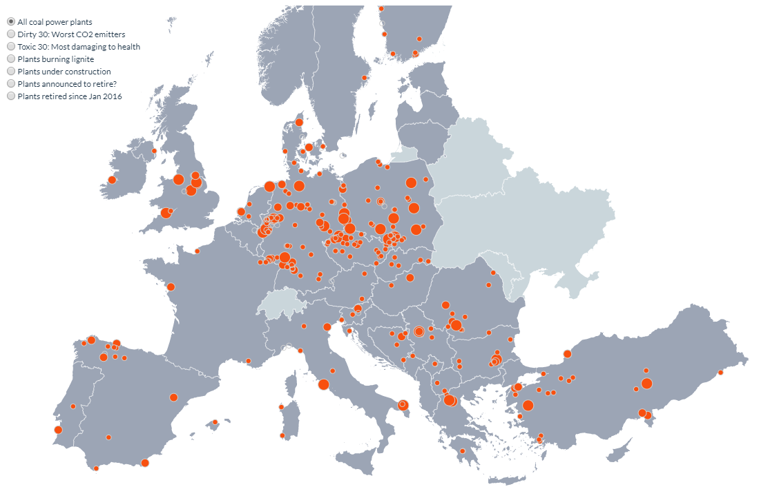
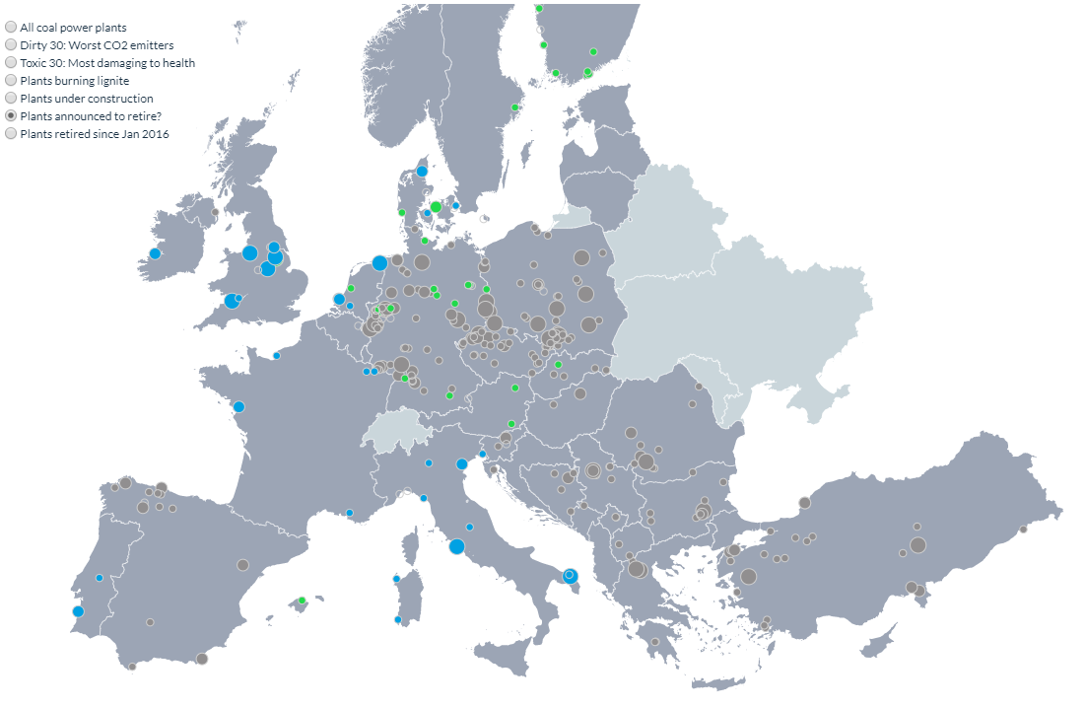
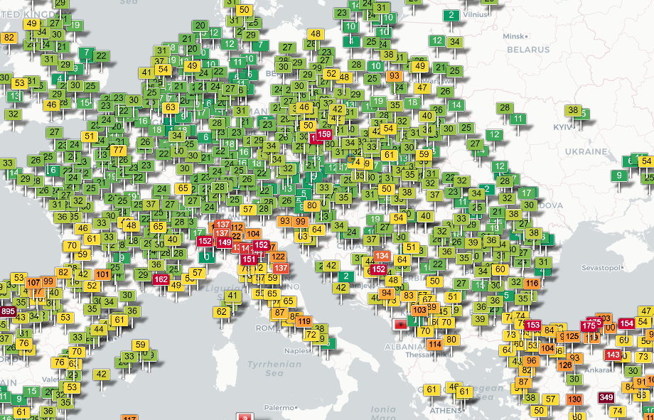

Slide 40
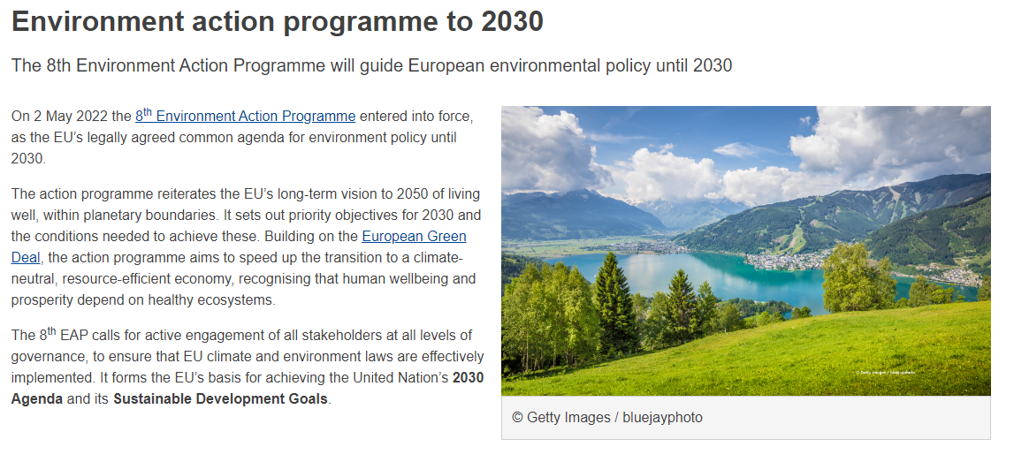

Slide 41
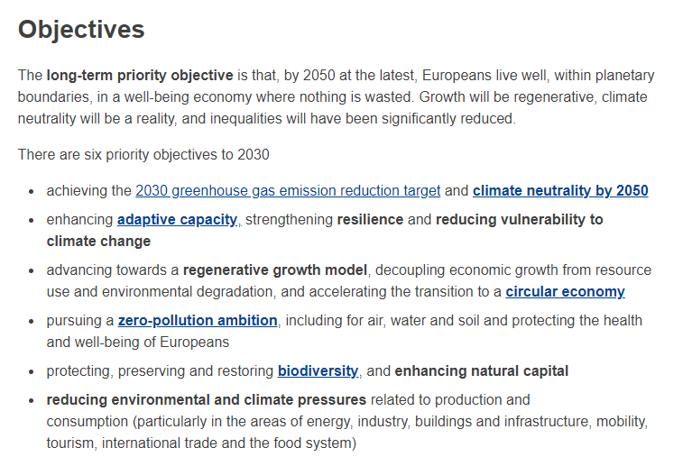

Slide 42
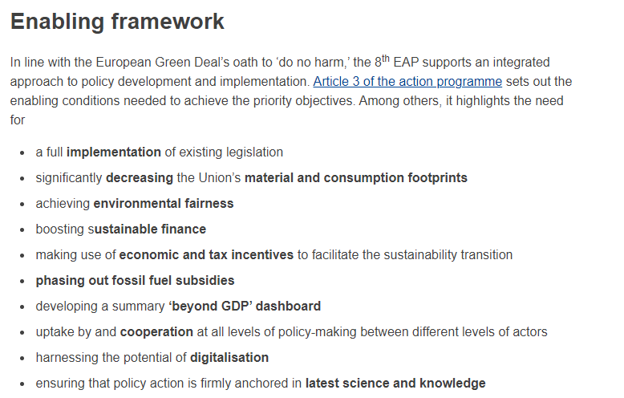

Slide 43
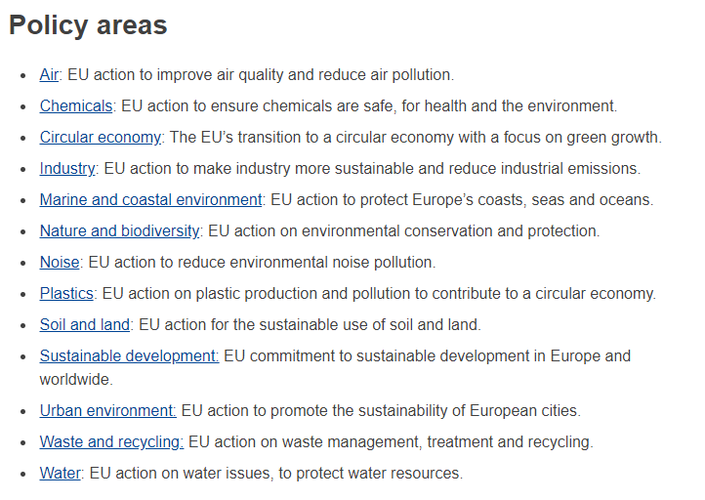

Slide 44
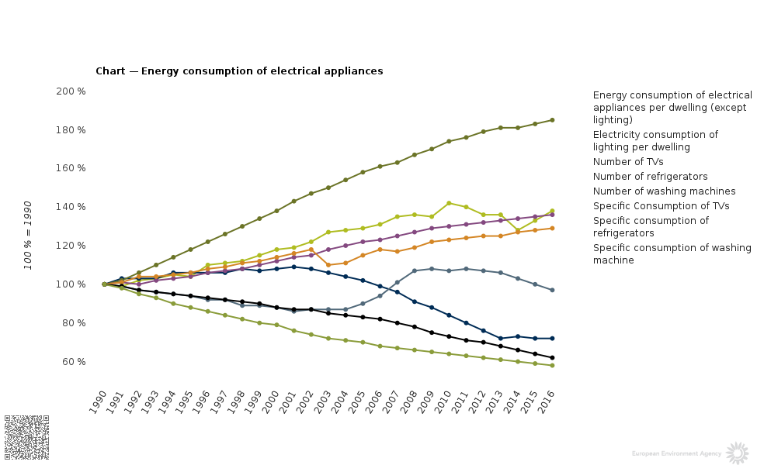

Slide 45
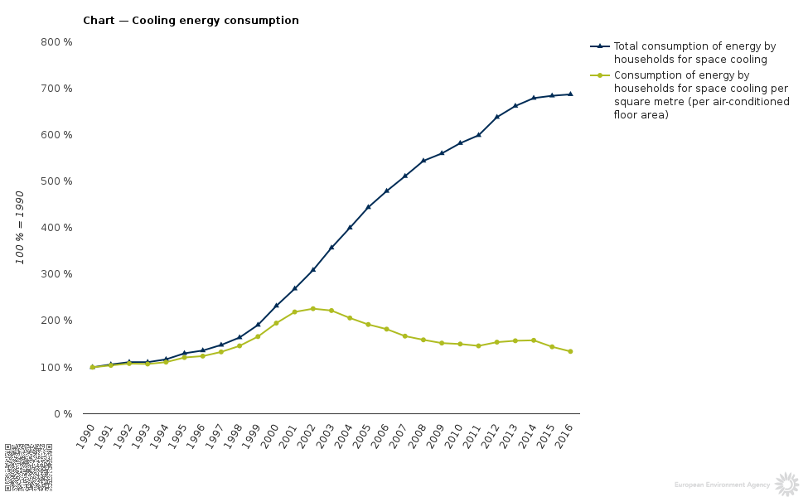

Slide 46
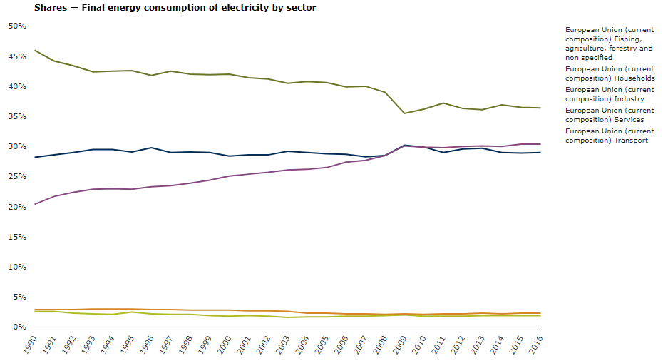

Slide 47
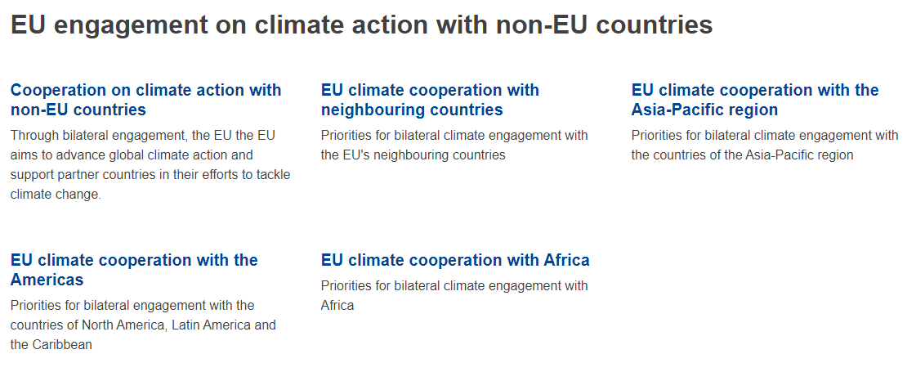
INTERNATIONAL ACTION ON CLIMATE CHANGE

Slide 48
INTERNATIONAL ACTION ON CLIMATE CHANGE

Slide 49
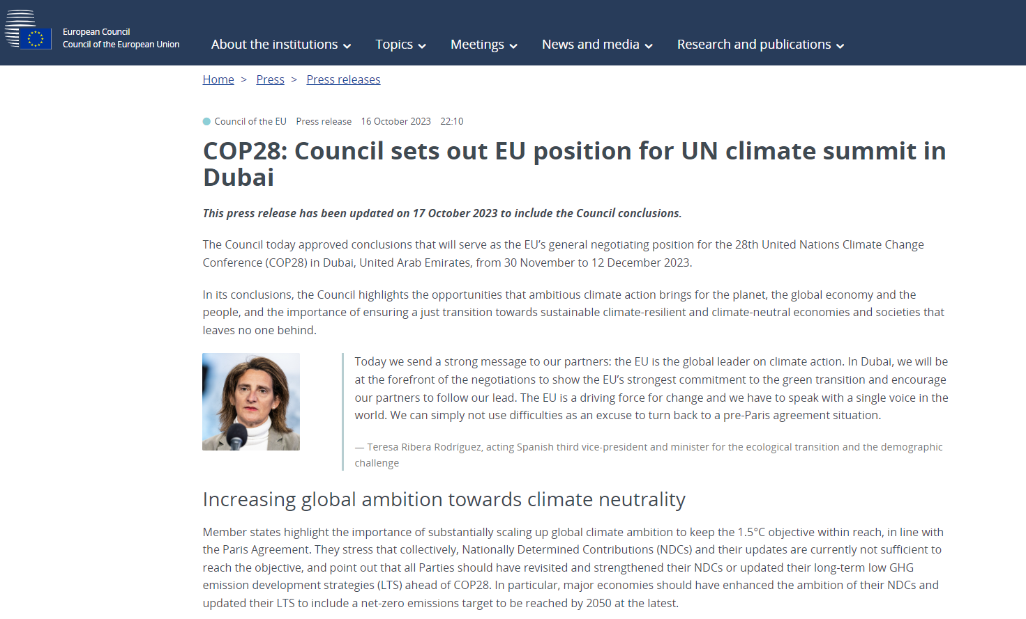
INTERNATIONAL ACTION ON CLIMATE CHANGE

Slide 50
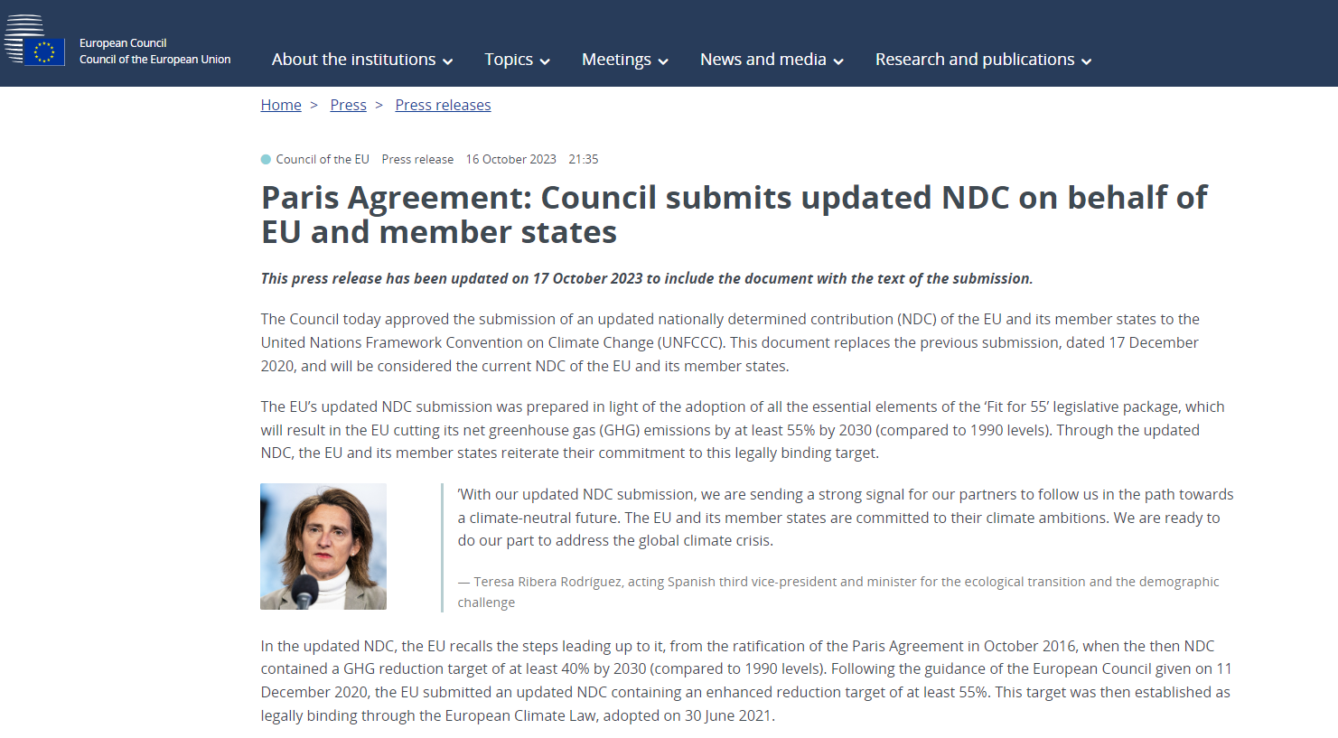
INTERNATIONAL ACTION ON CLIMATE CHANGE

Slide 51
INTERNATIONAL ACTION ON CLIMATE CHANGE

Slide 52
THANK YOU FOR YOUR ATTENTION!
vomacka@mail.muni.cz

