Slide 1



Urban Planning & Construction
Climate Law
JUDr. Vojtěch Vomáčka, Ph.D., LL.M.
Climate Law
Spring 2024

Slide 2
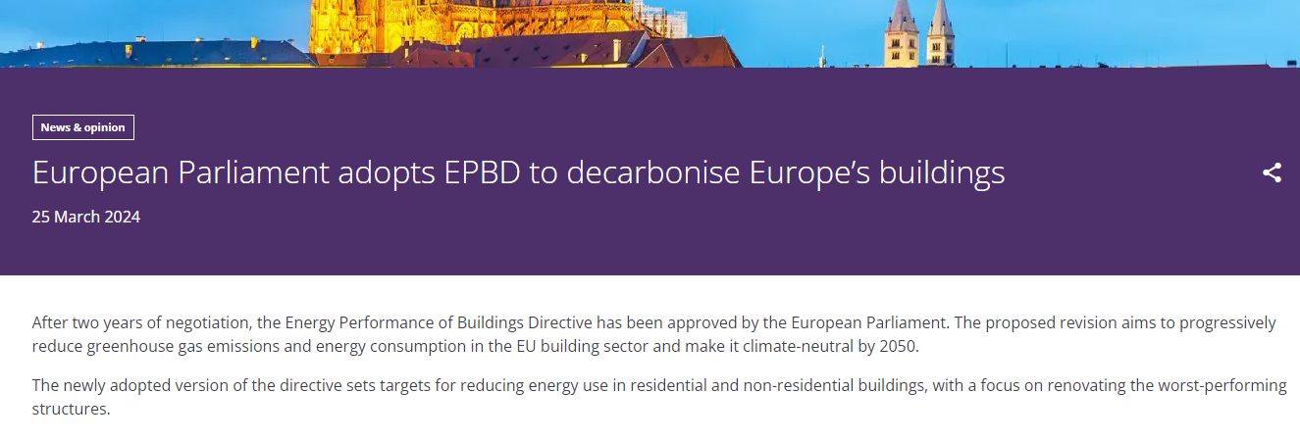

Slide 3
Urban Planning & Construction? Framework
International law, positive obligations of the State to prevent disasters (Fadeyeva v Russia)
EU Law
limited competence to adopt measures concerning town and country planning and specific rules on the maritime spatial planning
EU Environmental Law
Public procurement
State aid
Corporate Social Responsibility
Protection of workers
Climate Law

Slide 4
LIMITED COMPETENCE – Art. 192(2)(b) TFEU
Adoption of measures affecting town and country planning and land use or choice between different energy sources and the general structure of its energy supply is expressly foreseen by Art. 192(2)(b) TFEU.
Such competence does not equal direct harmonisation, though. Besides targeting exclusively environmental measures, the EU may only adopt measures that affect but do not harmonise national laws and regulations. In addition, such competence is subject to the principles of subsidiarity and proportionality.
This means that the EU can only act if the objectives of a proposed measure cannot be achieved by Member States acting alone. The EU must also ensure that any proposed measure is proportionate to the objectives it seeks to achieve.
To provide an example of its application, Art. 192 TFEU was used as a legal basis for the adoption of directives and regulations on energy efficiency and renewable energy between 2001 and 2009. Settled case law on the choice of a legal basis seems to preclude using Art. 192 TFEU as a legal basis for direct action in the energy sector after the adoption of Art. 194 TFEU.

Slide 5
EU ENVIRONMENTAL LAW
main requirements affecting planning and construction
strategic environmental impact assessment (SEA) of the plans and programmes,
environmental impact assessment (EIA) of the projects,
impact assessment of the plans, programmes, and projects on Natura 2000 sites,
technical requirements for building materials and waste management,
public participation in environmental protection
EU’s Regional Policy and the Transport Policy concerning projects of common interest (Art. 171 and Art. 172 TFEU) provides the definitions of essential key transport networks, effectively forming the Trans-European Network for Transport (TEN-T) Policy.

Slide 6
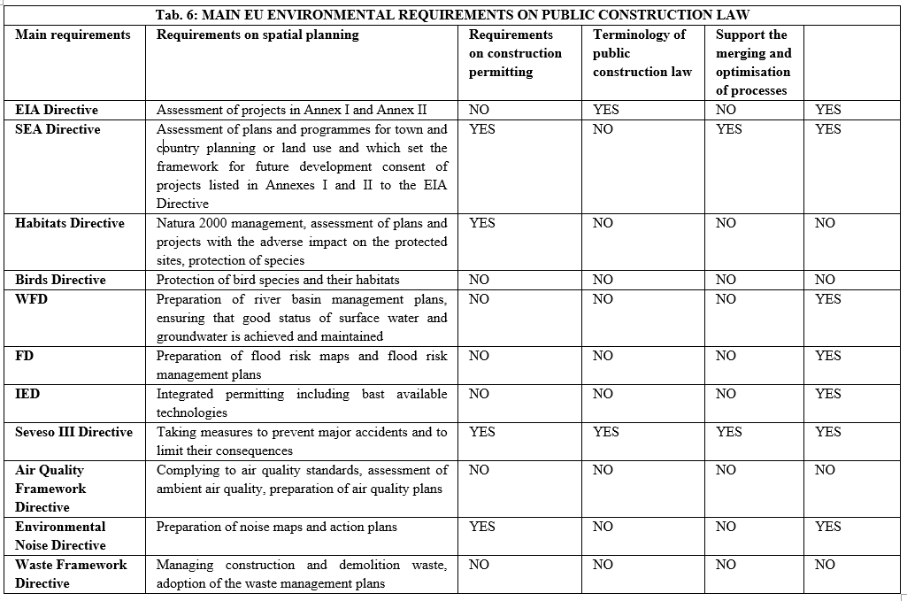

Slide 7
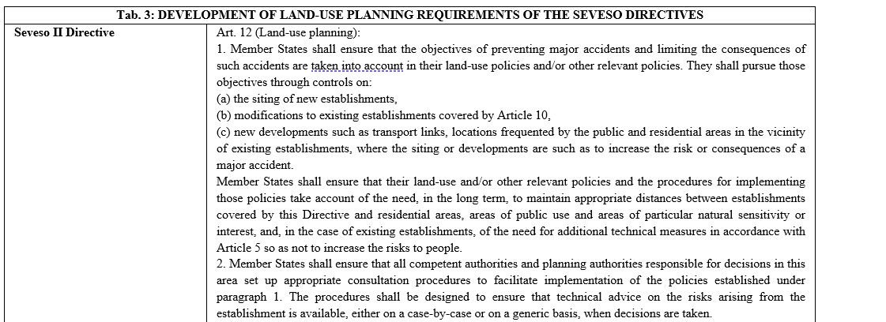

Slide 8
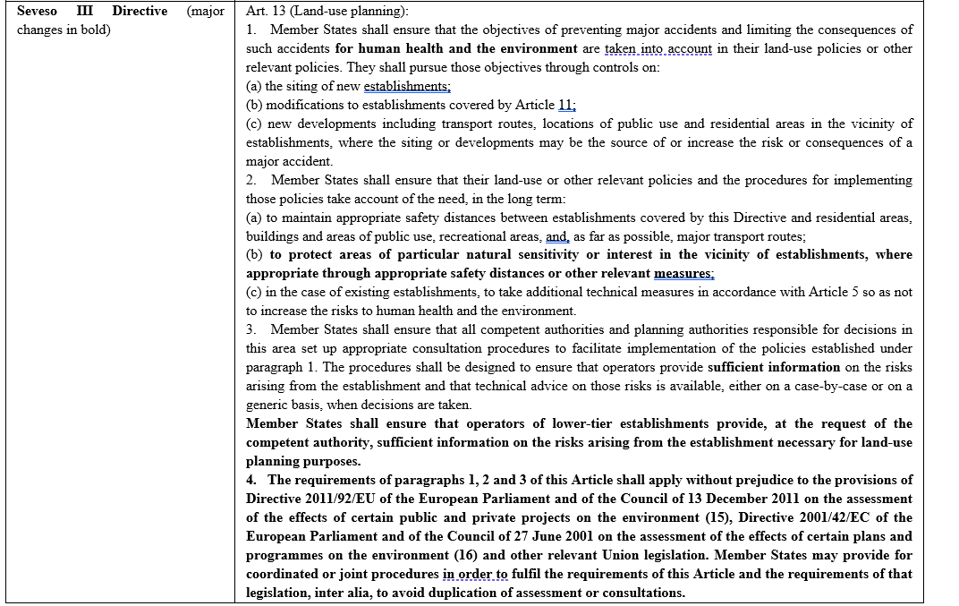

Slide 9
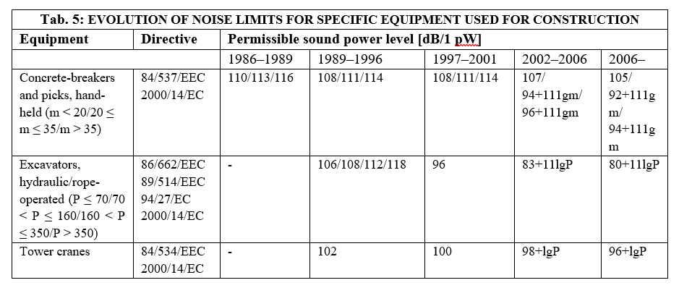

Slide 10
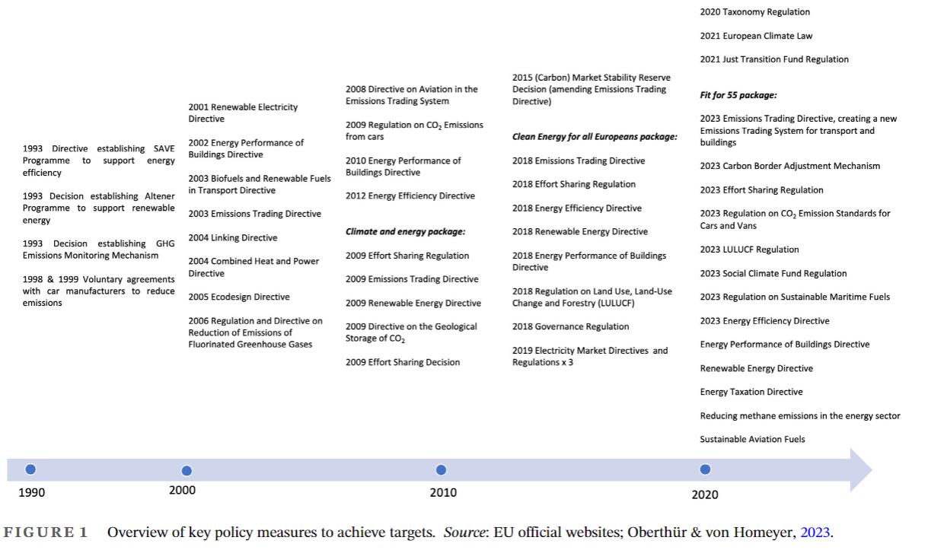

Slide 11
Effort Sharing Regulation:
sets emissions reductions targets for the EU and individual Member States in a wide range of sectors. It covers domestic transport (excluding aviation), buildings, agriculture, small industry and waste.
LULUCF Regulation:
sets out how the land use sector contributes to the EU’s climate goals. The LULUCF Regulation was revised in 2023 for the period up to 2030.
To help reach climate neutrality, for the first time, the revised LULUCF regulation has a separate land-based net carbon removals target of 310 million tonnes of CO2 equivalent by 2030.
This EU-wide target is to be implemented through ambitious, fair and binding net removal national targets for the LULUCF sector.
Carbon Boundary Adjustment Mechanism (CBAM):
sets the price of (some) products entering the EU market to take account of the emissions associated with their production, a new emissions trading scheme covering buildings and transport, and a social climate fund set up to offset the negative impacts of this new, expanded emissions trading scheme.
What else? Green public procurement, ESG, etc.

Slide 12
EU ETS
As part of the 2023 revisions of the ETS Directive, a new emissions trading system named ETS 2 was created, separate from the existing EU ETS. This new system will cover and address the CO2 emissions from fuel combustion in buildings, road transport and additional sectors (mainly small industry not covered by the existing EU ETS).
The ETS 2 will become operational in 2027. Although it will be a ‘cap and trade’ system like the existing EU ETS, the ETS 2 will cover emissions upstream. It will be fuel suppliers, rather than end users such as households or car users, that will be required to purchase and surrender allowances to cover their emissions. The ETS 2 cap will be set to bring emissions down by 42% by 2030 compared to 2005 levels.

Slide 13
EFFORT SHARING REGULATION
sets emissions reductions targets for the EU and individual Member States in a wide range of sectors. It covers domestic transport (excluding aviation), buildings, agriculture, small industry and waste.
Initially adopted in 2018, the Regulation was amended in 2023.With their new national targets Member States will collectively contribute to an emission reduction at EU level, in the Effort Sharing sectors, of 40% compared to 2005 levels. The revision was adopted as part of a package of proposals aimed at reducing the EU’s emissions by 55% by 2030 (compared to 1990 levels) and deliver the European Green Deal.

Slide 14
PROMOTION OF RENEWABLE ENERGY
The RED II requirements assumably present a massive impact on the building industry.
First, Member States must introduce a minimum level of renewable energy in new buildings and buildings undergoing major renovations in their building regulations and codes. Member States should aim to increase the share of renewable energy in heating and cooling by an indicative 1.3% per year between 2020 and 2030.
Second, Member States must ensure that qualified authorities at national, regional, and local levels include measures facilitating the deployment of renewables when carrying out spatial planning and when building or renovating urban infrastructure and commercial or residential areas. They must introduce appropriate measures in their building regulations and codes to increase the share of all kinds of energy from renewable sources in the building sector.

Slide 15
PROMOTION OF RENEWABLE ENERGY
Most significantly, adjustments must be made to administrative procedures, regulations, and codes according to Art. 15 of RED II. Member States must ensure that any relevant national rules concerning the authorisation, certification, and licensing procedures are proportionate and necessary and contribute to the implementation of the energy efficiency first principle. This general rule is further elaborated on to several steps: a) streamlining administrative procedures; b) objective, transparent, and proportionate rules concerning authorisation, certification, and licensing which take fully into account the particularities of individual renewable energy technologies, c) cost-related administrative charges, d) simplified and less burdensome authorisation procedures for decentralised devices, and for producing and storing energy from renewable sources.

Slide 16
PROMOTION OF RENEWABLE ENERGY
Third, the RED II introduced detailed procedural requirements for construction permitting procedure in its Art. 16, which are also a complete novelty in EU law. There is a direct requirement to link construction and operational procedures, which requires Member States to establish or designate contact points that “shall, upon request by the applicant, guide through and facilitate the entire administrative permit application and granting process. The applicant shall not be required to contact more than one contact point for the entire process. The permit-granting process shall cover the relevant administrative permits to build, repower and operate plants for the production of energy from renewable sources and assets necessary for their connection to the grid.”

Slide 17
PROMOTION OF RENEWABLE ENERGY
There are several additional EU legislative and policy measures promoting the use of renewable resources with an impact on public construction law.
The EU Offshore Renewable Energy Strategy was approved in 2020. To scale up the deployment of offshore renewable energy in Europe, the Strategy assumes the need to identify and use a much larger number of sites for offshore renewable energy production and connection to the power transmission grid. Simultaneously, offshore renewable energy development must comply with the EU environmental legislation and the Integrated Maritime Policy. For this purpose, maritime spatial planning must be used.
The Hydrogen Strategy mentions the possibility of building on the provisions of RED II to regulate different aspects of this energy carrier further and promote its development. For example, the adoption of support measures, including demand-side policies in end-use sectors.

Slide 18
PROMOTION OF RENEWABLE ENERGY
The Alternative Fuels Infrastructure Regulation (AFIR) adopted in July 2023 within the sustainable transport initiative under the Fit for 55 introduces requirements on recharging points and alternative fuel refuelling points in the EU for the cars, planes, and ships that use them. Recharging stations on main roads (TEN-T) for cars (light-duty electric vehicles) must be available at least every 60 km by the end of 2025 and for heavy-duty vehicles by the end of 2030. On other roads, the number of recharging stations must grow with the number of registered cars; for heavy-duty vehicles, at least two recharging points must be available in each safe and secure parking area by 2027 (and four by 2030). Similarly, hydrogen refuelling stations and liquefied methane refuelling points are supported. Regarding seaports, at least 90% of container ships and passenger ships must have access to shore-side electricity supply in the busiest seaports, and there must be at least one installation providing shore-side electricity in most of the inland waterway ports by 2030. All aircraft stands next to the terminal must be equipped with an electricity supply by 2025 and remote stands by 2030, except for the small airports.

Slide 19
PROMOTION OF RENEWABLE ENERGY
An unprecedented short-term measure in the area of support for renewable energy was introduced by Council Regulation (EU) 2022/2577, laying down a framework to accelerate the deployment of renewable energy (ARE Regulation).
The ARE Regulation mainly serves as an exception from EU environmental requirements limited to 18 months with a review clause allowing the Commission to propose an extension if necessary.
The ARE Regulation establishes a rebuttable presumption that there is an overriding public interest in renewable energy projects and that such projects serve public health and safety for the purposes of the relevant EU environmental legislation, namely the WFD Directive, the Habitats Directive and the Birds Directive
Art. 4 of the ARE Regulation then focuses on speeding up the permitting procedure for the installation of solar energy installations. It states explicitly that in the case of the authorisation procedure for the installation of solar energy installations, including self-consumers of renewable energy, with a capacity of 50 kW or less, the authorisation shall be deemed to have been granted if the competent authorities or bodies have not replied within one month of the application being submitted, provided that the capacity of the solar energy installation does not exceed the existing capacity of the connection to the grid.

Slide 20
BUILDING MATERIALS
There is no specific EU law exclusively focused on building materials. However, several EU regulations and directives govern aspects related to construction products and their use in buildings. Generally, these regulations aim to ensure building materials’ safety, health, and environmental performance.
The Consturction Products Directive was revised in 2011 and replaced by Regulation (EU) No 305/2011, also known as the Construction Products Regulation (CPR), which came into force in 2013. It remains a key legislation that sets out harmonised rules for marketing construction products in the EU.
The new regulation aims to simplify and streamline the procedures for assessing the performance of construction products and to promote the use of sustainable materials and energy-efficient technologies in construction. The CPR covers a wide range of construction products, including materials such as cement, steel, insulation, windows, and many others.
The CPR also establishes the conditions for CE marking

Slide 21
BUILDING MATERIALS
In 2022, the Commission adopted a proposal for a revised CPR. Compared to the current version, the proposed regulation explicitly mentions the introduction of rules on how to express the environmental, climate, and safety performance of construction products in relation to their essential characteristics, as well as the establishment of environmental, climate, functional, and safety product requirements.
The scope of the regulation would also include, for instance, 3D-datasets permitting the 3D-printing of construction products and materials used in 3D-printing; construction products manufactured on the construction site for immediate incorporation into construction works; and some types of pre-fabricated one-family houses. The regulation would also apply to used construction products in some cases, e.g., if the intended use has changed compared to the use assigned by the initial manufacturer.

Slide 22
ENERGY EFFICIENCY OF BUILDINGS
the 2002 Energy Performance of Buildings Directive (2002 EPBD, 2002/91/EC) was adopted to boost the energy performance of buildings. Its aim was not to harmonise the planning or permitting procedures but to set rules for the calculation of energy performance and certification of buildings, and to apply minimum requirements on the energy performance of new buildings or large existing buildings that are subject to major renovation
The 2002 EPBD was recast in 2010 (2010 EPBD, 2010/31/EU) and amended twice in 2018 (by Directive 2018/844 and Regulation 2018/1999) as part of the Clean Energy for All Europeans package. The 2010 EPBD lays down requirements in several key areas.
First, the 2010 EPBD sets minimum energy performance requirements for new buildings, major renovations, and existing buildings undergoing renovation (Minimum Energy Performance Requirements). These requirements aim to ensure that buildings meet certain energy efficiency standards and contribute to the overall reduction of energy consumption.

Slide 23
ENERGY EFFICIENCY OF BUILDINGS
Second, the 2010 EPBD establishes a target for all new buildings to be nearly zero-energy buildings by a specific date (Nearly Zero-Energy Buildings, NZEBs). NZEBs are buildings with a very high energy performance, with most of their energy needs met by renewable sources produced on-site or nearby.
Third, the EPB standards are promoted as the Member States are required to describe their national calculation methodology following the national annexes of the overarching standards, namely ISO 52000-1, 52003-1, 52010-1, 52016-1, and 52018-1. The 2010 EPBD thus does not force Member States to apply a set of EPB standards but forces them to explain where and why they deviate from these standards, which is likely to lead to a greater recognition and promotion of the EPB set of standards.
Fourth, the 2010 EPBD requires Member States to develop and implement long-term renovation strategies (LTRS). These strategies outline plans and objectives for the renovation of existing building stock to improve energy efficiency, reduce emissions, and promote sustainable practices.

Slide 24
ENERGY EFFICIENCY OF BUILDINGS
The 2010 EPBD requires all buildings being constructed, sold, or rented to have an Energy Performance Certificate (EPCs). EPCs provide information about a building’s energy performance and recommendations for improvements. They help prospective buyers or tenants make informed decisions regarding energy consumption and costs. Moreover, in buildings occupied by public authorities and frequently visited by the public (with a total useful floor area over 250 m²) or other buildings frequently visited by the public (with a total useful floor area over 500 m²), the EPCs must be is displayed in a prominent place clearly visible to the public.
The 2010 EPBD mandates regular heating and air conditioning inspections in buildings to assess their efficiency, identify potential energy-saving measures and improve overall performance. Independent control systems for energy performance certificates and inspection reports must be established.

Slide 25
ENERGY EFFICIENCY OF BUILDINGS
The next significant set of EU requirements on energy efficiency is embodied in the Energy Efficiency Directive (EED) after its significant 2018 amendment. The EED is aimed at promoting energy efficiency and reducing energy consumption. The Directive sets out measures to improve energy efficiency across various sectors, including buildings, transport, and industry.
The EED has significant implications for the construction industry, especially building standards and regulations. Member States must establish minimum energy performance requirements for new buildings and major renovations, ensuring that new constructions meet higher energy efficiency standards. This encourages the construction industry to adopt energy-efficient technologies and practices in their projects. The EED also emphasises the importance of renovating existing buildings to improve energy performance. Member states are encouraged to set renovation targets and develop long-term strategies to increase the energy efficiency of buildings. This creates opportunities for the construction industry to engage in retrofitting projects implementing energy-saving measures in older structures.

Slide 26
ENERGY EFFICIENCY OF BUILDINGS
One of the major requirements set by Art. 6(1) of the EED (Purchasing by public bodies) requires Member States to ensure that central governments purchase only products, services, and buildings with high energy-efficiency performance insofar as that is consistent with cost-effectiveness, economic feasibility, wider sustainability, technical suitability, as well as sufficient competition. Furthermore, public bodies at regional and local levels must be encouraged to follow the exemplary role of their central governments.

Slide 27
ENERGY EFFICIENCY OF BUILDINGS
The 2018 amendment introduced several fundamental changes. First, the amended Directive sets a new binding energy efficiency target for the EU, aiming for an energy efficiency increase of at least 32.5% by 2030. This headline energy efficiency target replaced the original EED’s non-binding target of 20%. However, it is still non-binding, and its achievement relies strongly on the savings resulting from the implementation of national measures, which must be reported to the Commission and EU legislation such as the 2010 EPBD.
There are additional links between the EED and the 2010 EPBD. For example, while the EED requires the Member States to establish clear and transparent criteria for energy audits and energy auditors and promote the availability of these to all final energy consumers, for the building sector, the 2010 EPBD requires financial support to be linked to targeted or achieved energy savings – and those savings can be documented by different tools, including with an energy audit according to the EED.

Slide 28
ENERGY EFFICIENCY OF BUILDINGS
Second, the amendment required EU member states to establish indicative national energy efficiency targets for 2030. These targets should be calculated based on methodologies set out in Annex IV of the amended Directive. The energy savings obligation, extended beyond 2020 (originally in force only for 2014–2020), requires Member States to save a certain amount of energy annually by either stablishing an energy efficiency obligation scheme or adopting alternative measures that achieve the same effect.
The amendment also introduced a new requirement for public bodies to lead by example in renovating at least 3% of their total floor area to meet minimum energy performance requirements each year. Besides emphasis on public bodies, there is a strong social element in the EED as the Member States must implement measures addressing vulnerable households, including those affected by energy poverty, and, where appropriate, social housing.

Slide 29
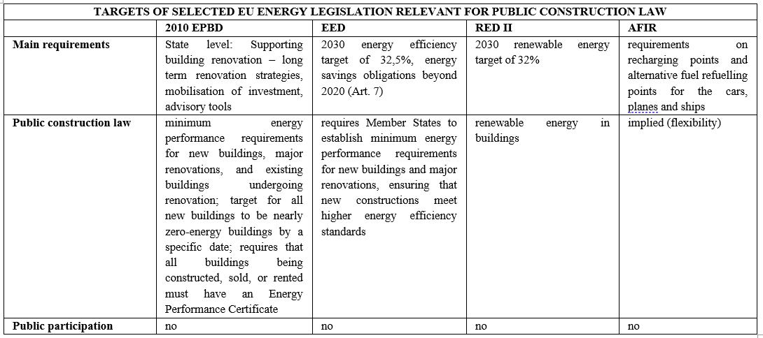
ENERGY EFFICIENCY OF BUILDINGS

Slide 30
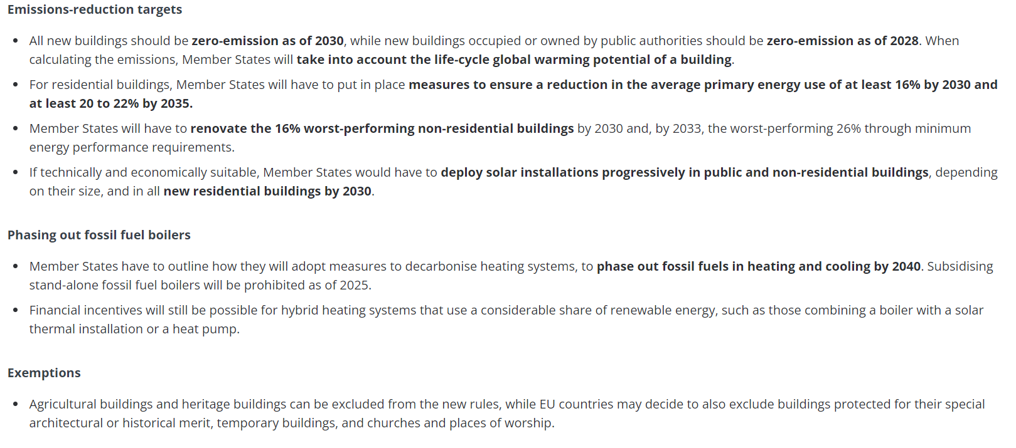
ENERGY EFFICIENCY OF BUILDINGS OUTLOOK

Slide 31
THANK YOU FOR YOUR ATTENTION!
vomacka@mail.muni.cz

