Slide 1
Introduction
Law of the European Law
JUDr. Radovan Malachta, Ph.D.
02/25/2025

Slide 2
Course Schedule
Date | Topic
25/02/2025 | Introductory session. Purpose and essence of the EU, distinction from other international organizations.
04/03/2025 | Sources of EU law – primary and secondary law, legislative process, non-legislative acts. Supremacy of EU law. Overview of EU institutions.
11/03/2025 | Direct and indirect effect, state liability. Court of Justice of the European Union. Interpretation of EU law. Preliminary ruling procedure, other proceedings before the CJEU.
18/03/2025 | Mid-term Test I. Student presentations (Part 1).
25/03/2025 | Economic integration. Free movement of goods.
01/04/2025 | Free movement of persons – general principles, free movement of workers.
08/04/2025 | Free movement of services and freedom of establishment. Free movement of capital.
15/04/2025 | Mid-term Test II. Student presentations (Part 2).
22/04/2025 | Competition law in the EU.
29/04/2025 | EU citizenship and human rights protection.
06/05/2025 | Schengen Area. Judicial cooperation in civil and criminal matters. Asylum and migration policy.
13/05/2025 | Common commercial policy. Common foreign and security policy.
20/05/2025 | Mid-term Test III. Student presentations (Part 3). Accession to and withdrawal from the EU.

Slide 3
Attendace
lectures are not mandatory (only recommended)
EXCEPT FOR THREE LECTURES
March 18
April 15
May 20
on these dates – written tests and your presentations

Slide 4
Tests and presentations
each test will have
6 multiple-choice questions a-b-c-d (where 1 to 4 answers may be correct)
5 short-answer questions (which required brief responses – about two sentences)
1 longer question (which may ask for your opinion or an analysis of a statement)
each test is worth up to 20 points (6 + 14), 60 points in total
the first test will cover lectures 1 to 3, the second test 5 to 7, the third test 9 to 12
presentation
In pairs
15 minutes
10 points
additional points – for exceptional participation

Slide 5
Grades
70 (and more than 70)-64 A (including bonus points)
63-57 B
56-50 C
49-43 D
42-36 E
35-0 F

Slide 6
Kahoot

Slide 7
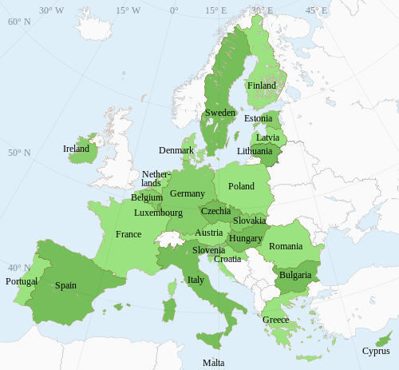
Why European Law?
Czech Republic is a member of the EU
27 members
bound by the law that EU creates
a direct influence on various aspects of our daily lives
Examples?

Slide 8
How EU Law Affects Our Everyday Life

Slide 9
NATIONAL
LAW
MEMBER STATE
EU
LAW
INTERNATIONAL
LAW

Slide 10
The Nature/Essence of the EU
EU is a supranational organization
superior, „above“ the Member States
Member States VOLUNTARILY TRANSFERRED CERTAIN POWERS TO THE EU IN SPECIFIC AREAS
EU exercise authority on their behalf in certain areas/fields – EU can create laws and rules
EU does not have authority in some areas – MS are free to set their own laws and rules

Slide 11
The Nature/Essence of the EU
European Union
voluntary transfer of powers to the EU
Member States
Etc.
customs
union
competion
rules
agriculture
enviroment
transport
industry
culture
education
tourism

Slide 12
The Nature/Essence of the EU II
inequality among Member States
MS are not equal to each other
the decision-making bodies of the EU
European Parliament
Council of the European Union
based on the population size of each state
European Union
MS
MS
MS
MS

Slide 13
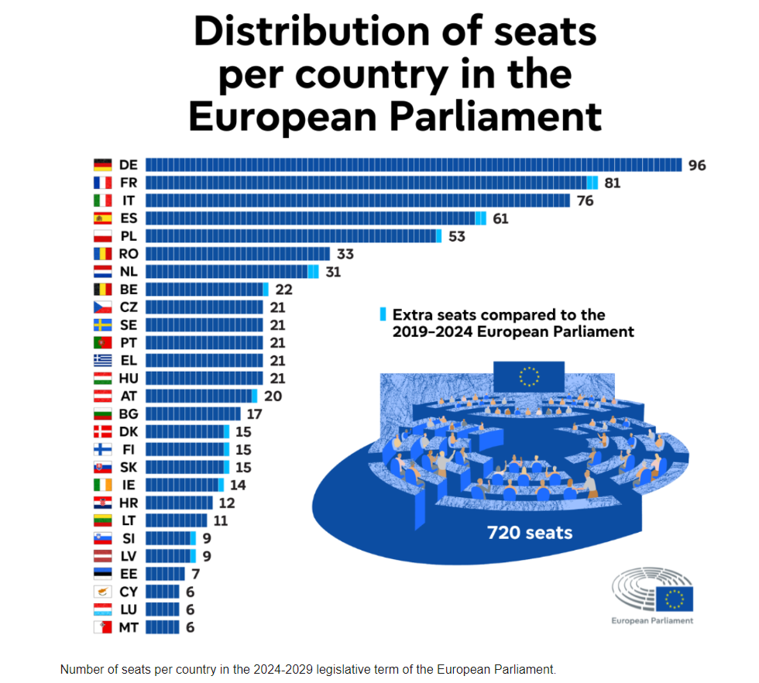

Slide 14
