Slide 1
History of Law, Islamic Law
A presentation by Tomáš Keseli

Slide 2
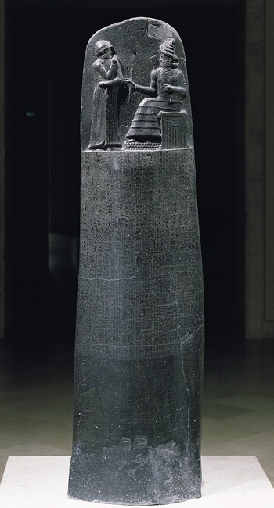
When (and where) did it all begin?
The earliest ever lawbook can be originated at around 2100 B.C. in the ancient Sumeria (Code of Ur-Nammu).
Three centuries later a babylonian king called Hammurabi collected a code of laws, which consisted of nearly 300 articles.
The Code of Hammurabi is very well known for its cruelty, which is best represented by “an eye for an eye”.
The stele containing the Code is on display at the Louvre Museum in Paris, France.
Code on diorite stele

Slide 3
Who enhanced it?
Greek lawgiver Draco replaced the prevailing system of oral law and blood feud by a written code, only enforceable by a court.
The laws of Draconian constitution very extremely harsh and thus the english word “draconian” means “marked by extreme severity or cruelty”.
China developed similar rules of conduct, as did Egypt and Israel.
However, it was the Romans, who created a legal system, whose basics have survived to this day and now form a core component in the continental law…

Slide 4
Why is Roman Law so important?
Roman lawyers observed legal relations such as those between family members or trade partners. They created abstract solutions that would help, when an argument couldn’t be settled informally.
These legal principles formed a legal science, i.e. jurisprudence.
The Roman legal system had a great impact on creation of the modern continental law, commonly known as the civil law.
The Latin words derived from the Roman law are now frequently used in all branches of modern law.

Slide 5
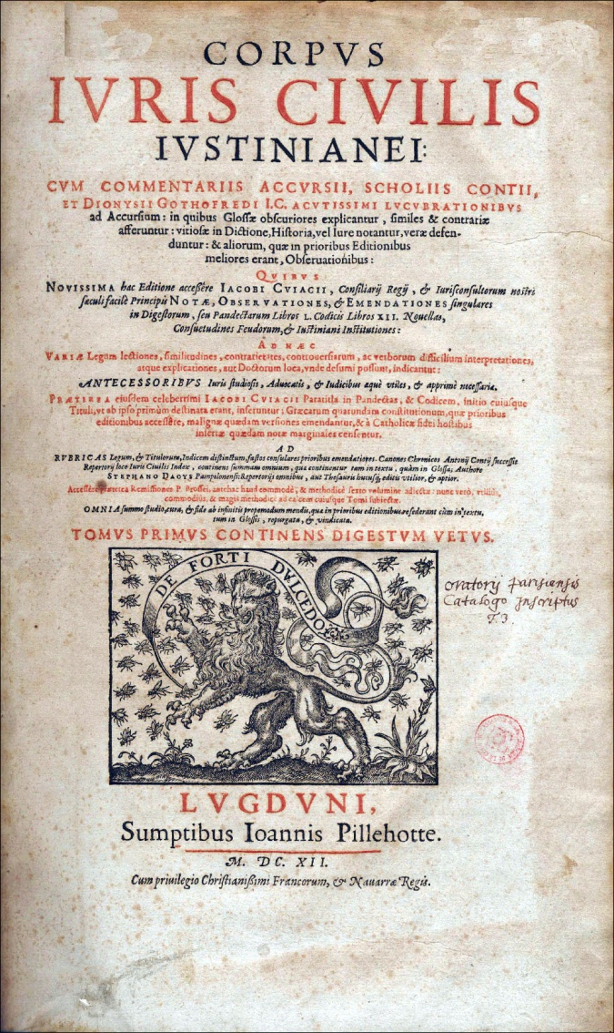
Which Roman lawgivers made the greatest contribution?
Servius Tullius (578-535 B.C.), the sixth king of ancient Rome, created a comitia centuriata, which divided Roman citizens according to wealth and formed the Rome’s central legislative body.
The Gracchi brothers, who both served as tribunes in 2nd century B.C., attempted to pass land reform legislation that would redistribute the major patrician landholdings among the plebeians. For this effort they were both assasinated.
The Byzantine (former eastern Roman) emperor Justinian formed a rewriting of Roman law, called Corpus Iuris Civilis, upon which most of the legal systems of most European nations are based to this day.

Slide 6
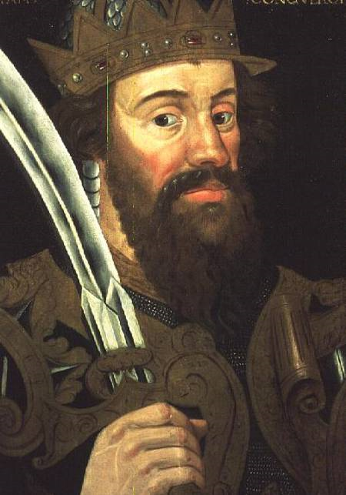
Where did common law come from?
The common law remains the principal source of Anglo-American law.
It has its roots about the same time as Justinian, among Angles, Britons and later Saxons in Britain.
William the Conqueror arrived in 1066 and mixed the best of Anglo-Saxon law with Norman Law which resulted in English common law.
However, common law exists as customs or precedents rather than as a written code.
William the Conqueror

Slide 7
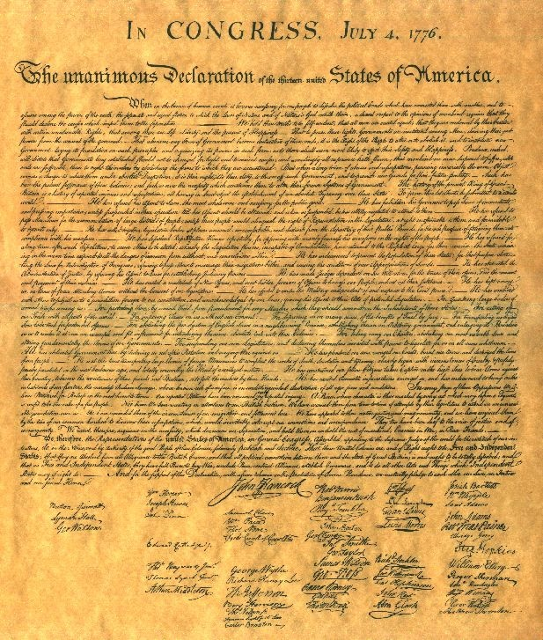
What are the important milestones in the history of Anglo-American law?
In 1215, the English King John was forced to publish Magna Carta Libertatum, a document that would partially limit his powers by law as well as grant the people of England certain liberties.
This was especially important, because the king had to accept that his will was not arbitrary.
The charter was a key influence that led to the rule of constitutional law in the English speaking world.
On July 4th 1776, The United States Declaration of Independence was adopted by the Continental Congress.
This document has set the very essentials of the first truly democratic country, the USA, best expressed by “all men are created equal”.
Declaration of Independence

Slide 8
What are the sources of Islamic law?
Islamic law, known as Sharia has neither been derived from Roman law, nor influenced by Anglo-American law and is therefore very different from the law of western civilization.
The Sharia itself contains rules by which the Muslim society is organized and governed and it provides the means to resolve conflict among individuals and between individual and the state.
There are two main sources of Islamic law, namely the Qur’an and the Sunnah.

Slide 9
What is Qu’ran and how it influences law?
Islam holds that the Qu’ran was revealed to Muhammad by God and is thus considered to be a holy book of Islam.
However, Qu’ran is also the principal source of Islamic Law.
It forms the basis for relations between man and God, between individuals, whether Muslim or non-Muslim as well as between man and things which are part of creation.
It is therefore obvious, that the Islamic law is vastly influenced by religion.

Slide 10
What is the role of Sunnah?
The sunan (pl. of sunnah) are precedents laid down by Muhammad through his sayings, acts and approvals and it too comes from Allah.
The Sunnah confirmed the rulings of the Qu’ran, detailed some of the concepts, laws and practical matters which are briefly stated in Qu’ran (definition of Islam, types of usury, etc.)
It also gave some rulings regarding matters not explicitly stated in the Qu’ran (e.g. wearing silk clothes for men).

Slide 11
Thank you for your attention

