Slide 1
Continental system
October 2010
Hánová Katrin

Slide 2
Content
Basic characters
History
Subgroups
World legal systems

Slide 3
Civil law
branch of private law (Občanské právo in Czech)
system of law
(built on Roman law)
= Continental law

Slide 4
Basic characters
Modern legal system based upon Roman law
Laws are written (= codified) into collection, not determined by judges (as in common law)
Separation of legislature and judiciary

Slide 5
Primary source of law:Legal code (compendium of statutes and legislations)
Legislators Law codes
Judicial independence:High, separate from executive and legislative branches of government

Slide 6
History
Major inspiration is Roman law
Codes produced in the 7th century under direction of the Roman Emperor Justinian
Model oh the canon law of the Roman Catholic Church

Slide 7
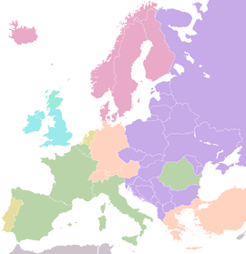
Subgroups
Romanistic(France, Belgium, Luxembourg, Quebec, Louisiana, Italy, Spain…)
Germanic (Germany, Austria, Switzerland, Greece, Brazil, Portugal, Turkey, Japan, South Korea, Taiwan)
Scandinavian (Denmark, Finland, Iceland, Norway, Sweden)
Chinese (except Hong Kong)

Slide 8
Legal systems of the world
Civil law
Bijuridical
Shariah
Common law
Customary law

Slide 9
Vocabulary
Canon law
Case law
Code
Codified
Compendium
Legislator

Slide 10
The End
…Thank you for your attention...
Sources:
Marta Chromá: New introduction to Legal English I.
Powel: Law Today
www.wikipedia.org
www.iuridictum.pecina.cz

