Slide 1
The legislation system in the UK
Ladislav Vrubel

Slide 2
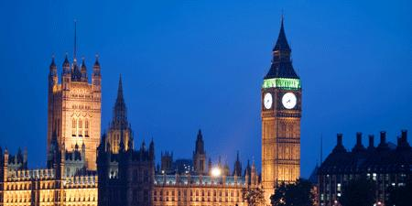
British Parliament
A) House of Commons
B) House of Lords
The Crown
Palace of Westminster

Slide 3
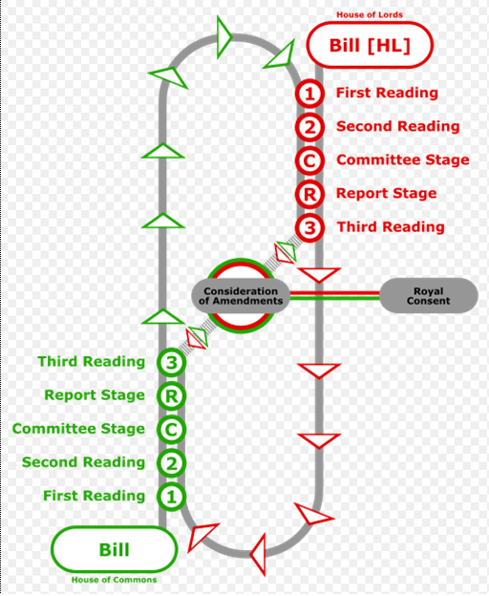

Slide 4
House of Commons First Reading
a “ dummy“ copy of the Bill
the Speaker calls the name of the sponsor
the Clerk reads the title
the Minister or a Whip names a day for Second Reading

Slide 5
Second Reading
printed Bill examinated for compliance
usually two weekends between printing and Second Reading
“ Guillotine“ or Programme Motion
considering principle
wide-ranging debate
the Bill is rarely denied

Slide 6
Committee Stage
clause by clause consideration of the measure
relevant amendments and clauses
by Minister, Opposition spokesman, Member of the Committee
if amended, reprinted and allocated
Report stage – amendments reviewed and could be corrected

Slide 7
Third Reading
often directly after the Second
the House take an overview
no substantive amendments allowed
usually very short, taken formally (except major political and constitutional events)

Slide 9
House of Lords – Lords Stage
similar manners
amendments
the Bill can travel several times
disagreement – Commons prevail
agreement – Royal Assent

Slide 10
Royal Assent
final formal procedure
the Bill becomes an Act
annual series of Public and General Acts
each Act – Chapter number
Public Acts – arabic figures
Personal and Local Acts – roman numerals

Slide 11
Questions?

Slide 12
Thank you for your attention …
and yes, I do agree with publication of my presentation on the website…☺

