Slide 1
The legislation system in the U.S.

Slide 2
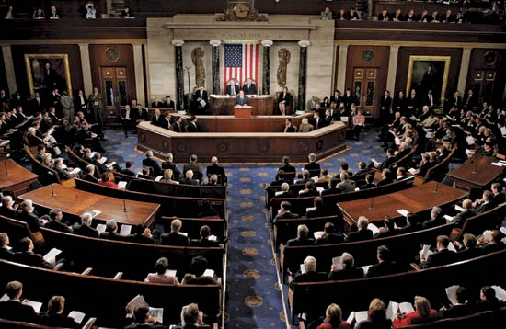
The united states congress

Slide 3
The united states congress
Represents the legislative branch of government
Is made up of two houses: - House of Representatives - Senate
This two house system is known as a bicameral legislature
The primary duty of Congress is to write, debate, and pass bills, which are then passed on to the president for approval

Slide 4
The united states congress

Slide 5
The House of representatives
Lower of the two legislative bodies
435 members – every two years voters get to choose all of them
Number of representatives per state depend upon that state’s population
Each member represents an area of a state, known as a congressional district
The number of representatives is based on the number of districts in a state
Each state is guaranteed one seat
Every ten years, the U.S. Census Bureau counts the population of the states to determine the number of districts in each state

Slide 6
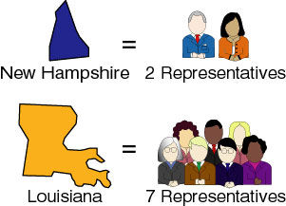
The House of representatives
Alaska, North Dakota, South Dakota Montana and Wyoming are sparsely populated states -> 1 representative
California: 53
Texas: 32
New York: 29

Slide 7
Representatives
Elected for two-year terms
Must be 25 years old
Citizen for at least seven years
Resident of the state from which they are elected
Five additional members from Puerto Rico, Guam, American Samoa, the Virgin Islands, and the District of Columbia represent their constituencies in the House. While they may participate in the debates, they cannot vote.

Slide 8
The Senate
Upper legislative chamber in the federal government
100 members – each state is granted 2 senators who represent the state
Voters get to choose one third every two years
More powerful body

Slide 9
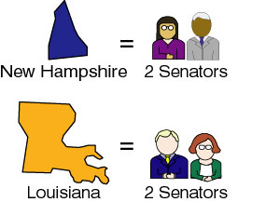
The senate

Slide 10
Representatives
Elected for six-year terms
Must be 30 years old
Citizen for at least nine years
Resident of the state from which they are elected

Slide 11
The united states congress
Is charged with drafting, debating and sending bills to the president to be signed into law
Each Congress has usually two sessions, one per each year, since members of the House of Representatives serve two-year terms

Slide 12
The Congress: Types of Session
There are different types of sessions, during which either one or both chambers of Congress meet
The Constitution requires a quorum, or majority, to be present in order for the chambers to conduct business
Types:
Regular session
Closed session
Joint session
“Lame Duck” session
Special session

Slide 13
The Legislative Process

Slide 14
The legislative process
Intoduction
Only a member of Congress (House or Senate) can introduce the bill for consideration
The Representative or Senator who introduces the bill becomes its "sponsor"
Other legislators who support the bill or work on its preparation can ask to be listed as "co-sponsors“
Important bills usually have several co-sponsors
Co-sponsors are not required to sign the bill
A bill or resolution has officially been introduced when it has been assigned a number (H.R. # for House Bills or S. # for Senate Bills), and printed in the Congressional Record by the Government Printing Office

Slide 15
The legislative process
Committee Consideration
Committee considers the bill in detail
Committee Action
Subcommittee Review
The committee sends some bills to a subcommittee for further study and public hearings
Mark Up
If the subcommittee decides to report a bill back to the full committee for approval, they may first make changes and amendments to it
Committee Action – Reporting a Bill
The full committee now reviews the deliberations and recommendations of the subcommittee

Slide 16
The legislative process
Publication of Committee Report
Once a bill has been reported a report about the bill is written and published. The report will include the purpose of the bill and its impact on existing laws
Floor Action – Legislative Calendar
The bill will now be placed on the legislative calendar of the House or Senate
Debate
Debate for and against the bill proceeds before the full House and Senate according to strict rules of consideration and debate
Voting
Once debate has ended and any amendments to the bill have been approved, the full membership will vote for or against the bill

Slide 17
The legislative process
Bill Referred to Other Chamber
Bills approved by one chamber of Congress (House or Senate) are now sent to the other chamber. The other chamber may approve, reject, ignore, or amend the bill.
Conference Committee
If the bill is changed, a conference committee made up of members of both chambers will be formed. The conference committee works to reconcile differences between the Senate and House versions of the bill.
Final Action – Enrollment
Once both the House and Senate have approved the bill in identical form, it becomes enrolled and sent to the President of the United States. The President may sign the bill into law. The President can also take no action on the bill for ten days while Congress is in session and the bill will automatically become law. If the President is opposed to the bill, he can veto it. If he takes no action on the bill for ten days after Congress has adjourned their second session, the bill dies. This action is called a "pocket veto."

Slide 18
The legislative process
Overriding the Veto
Congress can attempt to override a presidential veto of a bill and force it into law, but doing so requires a 2/3 vote by a quorum of members in both the House and Senate.

Slide 19
Vocabulary
Bicameral - consisting of two chambers
Bill - a form or draft of a proposed statute presented to a legislature, but not yet enacted or passed and made law
Amendment - an addition, alteration, or improvement to a motion, document, etc.
Reconcile - to bring into agreement or harmony
Adjourned - to suspend a session or meeting till another time or indefinitely

Slide 20
Thank You!

