Slide 1
Division of law
Johana Odstrčilková

Slide 2
We can divide law according to a several criteria:
1) Positive law
Natural law
2) National law
International law
3) Public law
Private law

Slide 3
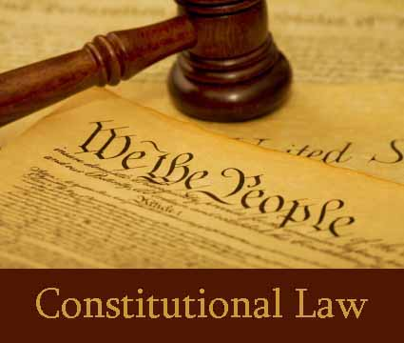
Public law
Constitutional law - regulation of how the law itself operates and of th relation between private citizen and government
International law - regulation of relations between governments and also between private citizens of the country and those of another

Slide 4
Administrative law - governs the activities of administrative agencies of government
Criminal law – the bodies of rules which establishes what type of dealing is teh crime, the sanctions for the crimes, how the state quests for the tortfeasors and how the state punishes them

Slide 5
Private (civil) law
Contract law
Law of torts
Property law
Probate law
Family law
Land law

Slide 6
Sources
http://iuridictum.pecina.cz/w/Hlavn%C3%AD_strana
Law Today, R. Powell
http://www.wikipedia.org/

Slide 7
Thank you for your attention
☺

