Slide 1
Legislation system in the USA
Jan Groborz

Slide 2
Vocabulary
bicameral – dvoukomorový
impeach officials – znevěryhodnit vysoké úředníky
cloture – ukončení neshody hlasováním – potřeba alespoň 3/5 senátu
committee – komise, výbor
revenue bills – daňové zákony
consent – souhlas

Slide 3
The law of the United States consists of many levels of codified and uncodified forms of law, of which the most important is the United States Constitution, the foundation of the federal government of the United States. The Constitution sets out the boundaries of federal law, which consists of constitutional acts of Congress, constitutional treaties ratified by Congress, constitutional regulations promulgated by the executive branch, and case law originating from the federal judiciary.

Slide 4
Sources of law
In the United States, the law is derived from four sources. These four sources are constitutional law, statutory law, administrative regulations, and the common law (which includes case law). The most important source of law is the United States Constitution. All other law falls under and is subordinate to that document. No law may contradict the Constitution.

Slide 5
The Legislative Branch
The United States Congress is the legislative branch of the Federal Government. It is bicameral, comprising the House of Representatives and the Senate. House of Representatives is called the lower house, and Senate the upper house. Other law comes from federal courts throught precedents.

Slide 6
House of Representatives
Each state receives representation in the House in proportion to its population but is entitled to at least one Representative. The most populous state, California, currently has 53 representatives. The total number of voting representatives is fixed by law at 435. Each representative serves for a two-year term.
The Constitution grants the House several exclusive powers: the power to initiate revenue bills, to impeach officials, and to elect the President in case of an Electoral College deadlock.

Slide 7
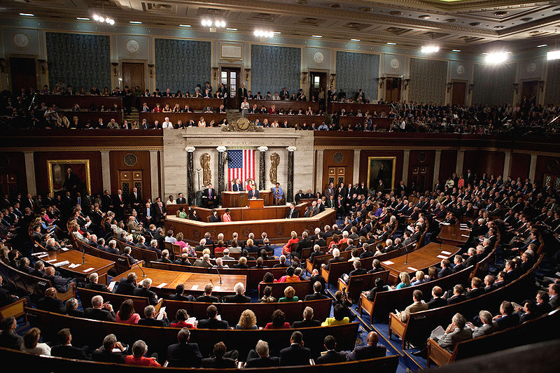

Slide 8
Senate
Each U.S. state is represented by two senators, regardless of population. Making it 100 chairs. Senators serve staggered six-year terms.
The Senate has several exclusive powers not granted to the House, including consenting to treaties as a precondition to their ratification and consenting or confirmation of appointments of Cabinet secretaries, federal judges, other federal executive officials, military officers, regulatory officials, ambassadors.

Slide 9
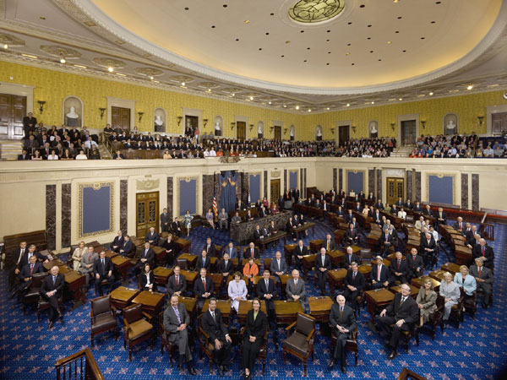

Slide 10
How a Bill Becomes Law
1) Legislation is Introduced
The bill is assigned a number. (e.g. HR 1 or S 1)
The bill is labeled with the sponsor's name.
The bill is sent to the Government Printing Office (GPO) and copies are made.
2) Committee Action
The bill is referred to the appropriate committee by the Speaker of the House or the presiding officer in the Senate. Most often, the actual referral decision is made by the House or Senate.

Slide 11
3) Floor Action
A) Legislation is placed on the Calendar
B) Debate
C) Vote
the bill is voted on
If either chamber does not pass the bill then it dies
4)Conference Committee
A) Members from each house form a conference committee and meet to work out the differences.
B) If the Conference Committee reaches a compromise, it prepares a written conference report, which is submitted to each chamber.

Slide 12
C) The conference report must be approved by both the House and the Senate.
5)The President
A) bill becomes law if signed by the President or if not signed within 10 days and Congress is in session.
B)If the President vetoes the bill it is sent back to Congress with a note listing his reasons.
6)The Bill Becomes A Law

Slide 13
Precedents
In common law legal systems, a precedent is a legal case establishing a principle or rule that a court or other judicial body may utilize when deciding subsequent cases with similar issues or facts. There are two types of precedents :
Binding precedent
Persuasive precedent

Slide 14
Summary
Senate and house of representatives equal legislative powers.
5 phases of making law : Legislation is Introduced, Committee Action, Floor Action, Conference Committee, The President
Precedental legislature, and 2 types of precedents : Binding precedent
Persuasive precedent

Slide 15
Questions ?
Feel free to ask in case you got any.

Slide 16
Thanks for your attention.

