Slide 1
SUBSTANTIVE LAW PROCEDURAL LAW CRIMINAL PROCEDURE CIVIL PROCEDURE
Eliška Charvátová

Slide 2
Substantive law
Establishes rules of conduct and penalties
Law which creates, defines, and regulates rights and obligations
Defines the legal relationship of people with other people or between them and the state
Stands in contrast to procedural law

Slide 3
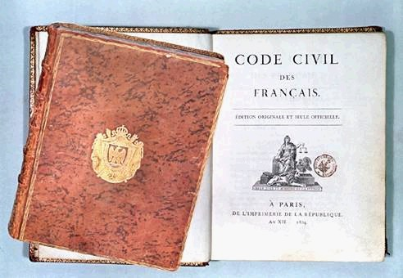
Civil Code

Slide 4
Procedural law
= adjective or remedial law
Prescribes the method of enforcing rights or obtaining redress
Prescribes how to proceed in court

Slide 5
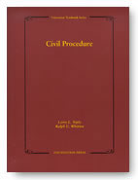
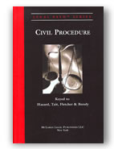
Civil procedure Code

Slide 6
CRIMINAL PROCEDURE
Procedure by which are detected crimes and their perpetrators, and ensure their fair punishment
Public Law
Parties
Stages
Principles
Punishments

Slide 7
Parties of criminal procedure
Bodies active in criminal proceedings
1) court
2) prosecuting authority
3) investigators (police)
Accused defendant convicted
Injured
Or other participant

Slide 8
Stages of criminal procedure
Preliminary proceedings
Preliminary hearing of the indictment
Trial
Appeal
Enforcement of judgment

Slide 9
Principles of criminal procedure
Principle of a prosecution on legal grounds
Principle of officiality
Principle of legality
Principle of public hearing
Principle of oral proceedings
The presumption of innocence
Etc.

Slide 10
Punishment
Conditional  Unconditional sentence
Imprisonment
Loss of honorary degrees and awards
Community service
Loss of military rank
Ban on work
Forfeiture of property
Fine
Deportation
Ban on residence

Slide 11
Protective measure
Protective treatment
offender is not criminally responsible due to insanity
Protective education
offender younger than 15 years old
 Head of the state has a right to grant a pardon or amnesty (general pardon) during the criminal procedure.

Slide 12
CIVIL PROCEDURE
One of three basic types of procedure (with criminal and administrative procedure)
Procedure of decision-making authority (court), parties and other participant in discussing and deciding private disputes and other legal matters
Private Law
Kinds of civil procedure
Principles

Slide 13
Kinds of civil procedure
Discover proceedings
Enforcement proceedings
Insolvency proceedings
Arbitration
Hedging proceedings

Slide 14
Principles of civil procedure
Disposition principle
Principle of public hearing
Principle of equality before the court
Principle of oral proceedings
Principle of free evaluation of evidence
Etc.

Slide 15
Can you tell me some examples of criminal and civil procedures?

Slide 16
Civil procedure
Criminal procedure
The debtor and the creditor
Divorce
Property disputes
Etc.
Murder
Robbery
Selling drugs
Etc.

Slide 17
Sources:
New Introduction to Legal English, Marta Chromá
Teorie práva, Jaromír Harvánek a kolektiv
Websites
My notes from lessons

Slide 18
Thank you for your attention and have a nice evening! ☺

