Slide 1
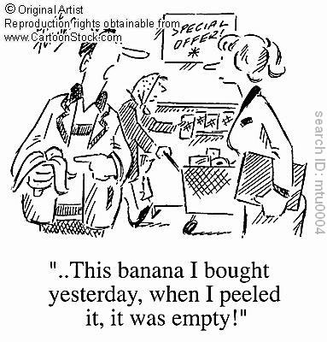

Slide 2
Consumer Law

Slide 3
CONSUMER = ? (definition)

Slide 4
CONSUMER = anybody
(an individual shopper or a business) buying goods or services

Slide 5
Faulty goods
Have you ever bought anything faulty?
What was wrong?

Slide 6
Faulty goods
Have you ever bought anything faulty?
What was wrong?
Did you complain?
Did they ask to see the receipt?
How did they solve the problem?
  Did they exchange it?
  Did they refund your money?
  Did they repair it?

Slide 7
Consumer Law – Contracts KEY
Consumer law is based on Contract law
a) F
b) F
c) T
d) T
e) F
f) T
g) F
h) F

Slide 8
Consumer Law – Contracts KEY
2. a) F (everyday transactions involving private individuals are informal)

Slide 9
Consumer Law – Contracts KEY
2. a) F (everyday transactions involving private individuals are informal)
b) F (the consumer must convince the supplier that he would have a good chance of winning if he took the case to court)

Slide 10
Consumer Law – Contracts KEY
2. a) F (everyday transactions involving private individuals are informal)
b) F (the consumer must convince the supplier that he would have a good chance of winning if he took the case to court)
e) F (a consumer can refuse the service if it is reasonable in the circustances)

Slide 11
Consumer Law – Contracts KEY
2. a) F (everyday transactions involving private individuals are informal)
b) F (the consumer must convince the supplier that he would have a good chance of winning if he took the case to court)
e) F (a consumer can refuse the service if it is reasonable in the circumstances)
g) F (a consumer can refuse delivery if the goods arrive late and time was of the essence)

Slide 12
Consumer Law – Contracts KEY
2. a) F (everyday transactions involving private individuals are informal)
b) F (the consumer must convince the supplier that he would have a good chance of winning if he took the case to court)
e) F (a consumer can refuse the service if it is reasonable in the circumstances)
g) F (a consumer can refuse delivery if the goods arrive late and time was of the essence)
h) F (of the essence = of vital importance = substantial)

Slide 13
Consumer Law – Contracts KEY
1. Consumer law contracts are mostly unwritten, they are implied by law.
2. Terms of the contract can be implied or express.
3. Implied terms concerning goods are called conditions.
4. Implied terms concerning services are called intermediate stipulations.

Slide 14
Consumer Law – Contracts KEY
5. Examples of implied terms for goods:
a) seller has a right to sell
b) goods correspond to the given description
c) goods are of merchantable quality

Slide 15
Consumer Law – Contracts KEY
6. Examples of implied terms for services:
a)service must be provided with reasonable care
b) service must be provided at a reasonable cost
c) service must be provided within a reasonable time

Slide 16
Consumer Law – Contracts KEY
7. We can refuse the goods (=discharge the contract) if the terms are breached.
8. We can refuse the service (=discharge the contract) if it is reasonable in the circumstances.
9. You can refuse delivery of the goods because it was late if time was of the essence.
10. "to waive one's right" means "to give up one's right"

