Slide 1
Juvenile Justice in the Czech Republic
Katarína Kandová

Slide 2
Legal Regulation
special treatment
special regulation
ACT ON JUVENILE JUSTICE

Slide 3
MODIFICATION
conditions of criminal liability
criminal sanctions
criminal procedure

Slide 4
Principle of Restorative Justice
REcovery of social and family relations
REstraining from other wrongful acts
REparation for the injury

Slide 5
Basic terminology
YOUTH
Juveniles
wrongdoing
otherwise criminl act
Children
otherwise criminl act

Slide 6
Children under 15
OTHERWISE
CRIMINAL
ACT
OBJECT
protected by
Criminal Code
SUBJECTIVE ELEMENT
intention / negligence
NO SUBJECT
(lack of age)
OBJECTIVE ELEMENT
acting →
causality →
consequence

Slide 7
Children under 15 - MEASURES
Protective Rehabilitation
Admonition with Warning
Probation Supervision
Reformatory Programme
Protective Treatment
Reformatory Restrictions
Reformatory Duties

Slide 8
Procedure against children under 15
POLICE
defers criminal proceedings
PROSECUTOR
files a motion to commencement
of civil proceedings
JUVENILE COURT
imposes
the measure

Slide 9
Criminal Liability of Juveniles
Intellectual Maturity
Moral Maturity
Relative Criminal Liability
WRONGDOING
OTHERWISE CRIMINAL ACT

Slide 10
Expiration of Criminal Liability
Effective Remorse
moderate conditions
Limination Periods
shortened to one half

Slide 11
Juveniles - MEASURES
Punitive
Protective
Reformative

Slide 12
Modification of Sanctioning
Withdrawal of Punitive Measure
Mitigating Circumstances
Effacement of Punitive Measure

Slide 13
Punitive measures
Suspended IMPRISON-MENT
Suspended Imprisonment with SUPERVISION
IMPRISON-MENT
COMMUNITY
SERVICE
BANISH-MENT
HOUSE ARREST
Suspended
Pecuniary
Measure
Pecuniary
Measure
PROHIBITION of entry to sport, cultural and other EVENTS
FORFEITURE
of
THING
PROHIBITION
to undertake ACTIVITY

Slide 14
Protective measures
Protective Rehabilition
Protective Treatment
Security Detention
Seizure
of
Thing

Slide 15
Reformative measures
Admonition with Warning
Reformatory Restrictions
Probation Programme
Probation Supervision
Reformatory Duties

Slide 16
Basic Principles of Criminal Procedure
SPECIAL TREATMENT
PREVENTIVE & EDUCATIVE EFFECT
RESTORATIVE EFFECT

Slide 17
Special Treatment
special qualification of law enforcement authorities
Police
Prosecutor
Juvenile Court
obligatory defence
higher protection
of
privacy

Slide 18
Preventive and Educative Effect
Cooperation with…
legal representatives, school, educative institutions
Office of Social-Legal Protection of Children
Probation and Mediation Service, NGO´s

Slide 19
Restorative Effect
DIVERSIONS
Compensating Aggrieved Party
Withdrawal from Criminal Prosecution
Settlement
Conditional Suspension of Criminal Prosecution

Slide 20
ANY QUESTIONS ?

Slide 21
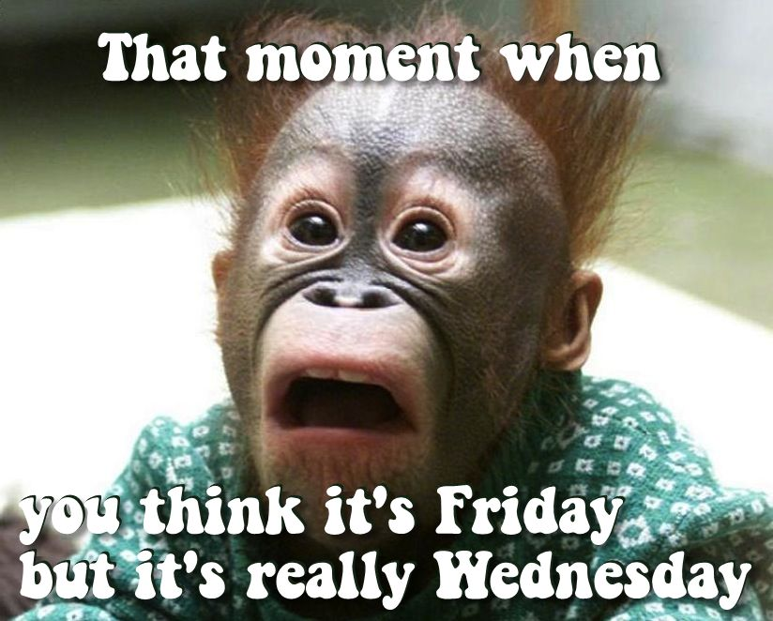
Thank you for attention ☺

