Slide 1
German Administrative Judiciary

Slide 2
Historical Development
Justizstaatlichkeit – pronouncing administrative disputes for civil ones, so that they could be judged
Otto Bahr – Rudolf von Gneist debate
Baden – first administrative court in 1863
Württemberg – first introduced general clause for administrative disputes

Slide 3
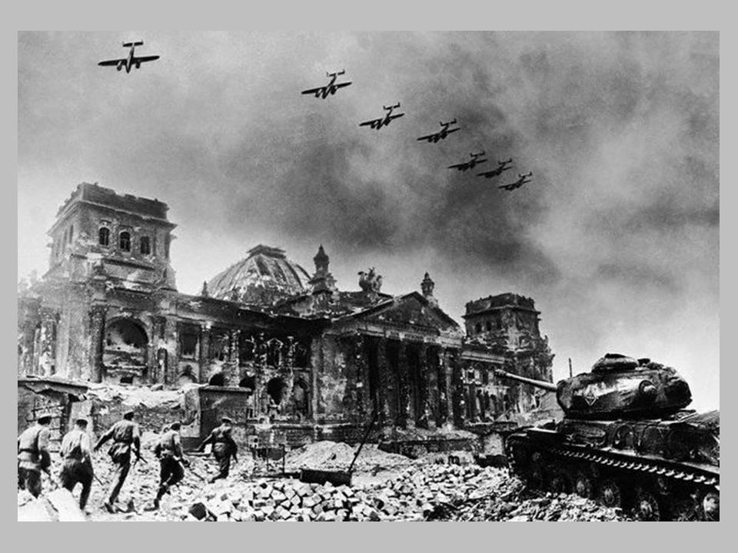

Slide 4
Historical Development
Vollstandige gerichtliche Kontrolle (full, integral judicial control)
Totaller Rechtsstaat (complete Rule of Law)
Experience of WWII

Slide 5
Critique of Full Judicial Control
Imbalance between private and public interest, in favor of the prior
Disregard of administrative authorities’ expertise
Lacks of democratic legitimacy of courts
Administration is also bound by the principle of legality
Hinders government’s policies and administrative action
Engages vast resources in administrative judiciary

Slide 6
Organization and Jurisdiction of Administrative Judiciary
Bundesverwaltungsgericht (1953)– Federal level, federal law
Oberverwaltungsgericht – Land level, federal and land law (up to one per land, one court for more lander)
Verwaltungsgericht - Land level, federal and land law (at least one per land)
Not all disputes are dealt with in three-instances
Damages claim, public procurement, fiscal and social security disputes, expropriation compensation disputes

Slide 7
Types of Lawsuits / Acts / Claims
Anfechtungsklage
annulment of an individual administrative act (Verwaltungsakt) setting down obligations for the party
Taking new facts into account is allowed
Annulment of the act since the moment he became illegal (as of its issuance or later)
‘Channelling’
Exceptions of unconstitutionality and of illegality (inter partes effect with respect to the general administrative legal act)
Amendment of the Verwaltungsakt prescribing pecuniary obligations – plein contentieux

Slide 8
Types of Lawsuits / Acts / Claims
Verpflichtungsklage
Concerns only Verwaltungsakt
Against rejection - Versagunggegenklage
Against administrative silence – Untatigkeitsklage
‘Channelling’ (difference between bound and discretionary acts)
Exceptions of unconstitutionality and of illegality (inter partes effect with respect to the general administrative legal act)

Slide 9
Types of Lawsuits / Acts / Claims
Leistungsklage
other types of acts of administration, especially factual actions – Realakt, schlichtes Verwaltungshandeln
Challenging illegally undertaken Realakt – Untelassungsklage
Requesting undertaking of illegally ommitted Realakt or payment of a sum due – allgemeine Leistungsklage
Could be combined with Anfechtungsklage (e.g. illegally fired civil servant – reemployment and payment of skipped salaries)
Created by case-law

Slide 10
Types of Lawsuits / Acts / Claims
Feststellungsklage
declaring existence or nonexistence of certain legal relationship
declaration of nullity of an administrative act – Nichtigkeitsfeststellungsklage
Conditions:
a) available only when other types of lawsuits cannot be used
b) plaintiff has to have an interest for this kind of legal protection (e.g. to have an administrative act declared illegal so that it would not be repeated or for reasons of legal certainty [e.g. preclusive deadline elapsed])
Exceptions of unconstitutionality and of illegality (inter partes effect with respect to the general administrative legal act)

Slide 11
Types of Lawsuits / Acts / Claims
Normenkontrollverfahren (abstrakte Normenkontrollklage)
Against general administrative legal acts (by-laws)
Erga omnes effect
Only against urban planning document issued by the local government (Art. 47 VwVG) or other acts indicated in Lander legislation
Interest has to be proven for locus standi
Does not remove final judgments based on unconstitutional and illegal by-law

Slide 12
Challengeable Acts / Claims
Individual administrative acts
General administrative acts
Factual acts of administration
Administrative silence

Slide 13
Judicial Control of Discretionary Acts
Control of formal and material legality (competence, procedure, form of act, application of the law)
Full control of determined facts (exception – nuclear power plant building permit – case Whyl – was the factual basis sufficient for deciding)
Ermessen – exces of powers and legal aim

Slide 14
Judicial Control of Discretionary Acts
Ermessen control through constitutional principles of equality before the law (Art. 3 GG) (legitimate expectations) and proportionality
Administration is bound by its internal acts and previous case-law even in case of discretionary acts – ‘filling the gaps in the legal norm’ or ‘dying out of discretion’
Ermessenreduzierung auf Null – application of the principle of equality and specific circumstances of the case
Beurteilungsspielraum – (not the same as unbestimmte Rechtsbegriffe) – judicially uncontrolled legal standards – decision is personal (exam) or unrepeatable (collegial authority)

Slide 15
Interim measures
Anfechtunsklage, as a rule, had suspensory effect
Preliminary measures by first-instance and appellate courts
Condition: if the danger exists that the enforcement of a right of the plaintiff could be prevented or considerably impeded by means of an alteration of the existing state

Slide 16
Oral Hearings
First-instance administrative courts decide on the basis of a public oral hearing.
Exceptions:
a) if all the parties agree
b) when a court issues a decision that is not a judgment
c) when it renders a summary decision in cases that do not show any particular factual or legal difficulties and where the facts have been clarified
d) when a higher court is deciding on the conflict of territorial jurisdictions of lower courts.

Slide 17
Decisions
Annulment of challenged individual administrative act (including ‘channeling’)
Ordering issuance of an act (administrative silence) or payment of sum due by the administration
Ordering ceasing or undertaking of a factual act of administration
Declarations
Annulment of general administrative acts

Slide 18
Legal Recourse
- Berufung -
against judgments of administrative courts
submitted to higher administrative courts
points of law and facts
The appeal shall be admitted if one the following conditions is met:
a) if serious doubts exist as to the correctness of the judgment
b) if the case has special factual or legal difficulties
c) if the case is of fundamental significance
d) if the judgment derogates from a ruling of a higher administrative court, of the Federal Administrative Court, of the Joint Panel of the supreme courts of the Federation or of the Federal Constitutional Court, and is based on this derogation
e) if a judgment is based on a procedural shortcoming.

Slide 19
Legal Recourse
- Revision -
against decisions of higher administrative courts
submitted to the Federal Administrative Court
only on points of law
The appeal before the Federal Administrative Court shall be admissible in one of the following instances:
a) if the legal case is of fundamental significance
b) if the judgment deviates from a ruling of the Federal Administrative Court, of the Joint Panel of the supreme courts of the Federation or of the Federal Constitutional Court and is based on this deviation
c) if a judgment is based on a procedural shortcoming.

Slide 20
Relations to Administrative Procedure
Widerspruch
Obligatory in case of Anfechtungsklage and Verpflichtungsklage

Slide 21
Thank you for your attention!

