Slide 1
Introduction into Serbian Administrative Law
Vuk Cucic
University of Belgrade
Faculty of Law

Slide 2

Source of Law

Slide 3
Sources of (Administrative) Law
Direct sources:
The Constitution (2006)
Ratified international agreements (Arts. 18, 20 Const.)
Laws / Acts (GAPA, ADA, SAA, LGA)
Bylaws and other general legal acts
Indirect source:
Administrative and judicial case-law (principle of legitimate expectations)
Precedents

Slide 4

Organization of Administration

Slide 5
Division of Powers
Constitutional Court?
Independent State Authorities
Legislation
Parliament
Executive
President
Government
Judiciary
Supreme Court of Cassation
Appellate Courts
Administration
High Courts
Basic Courts
Special courts (Administrative, commercial, misdeneanors)

Slide 6
Division of Powers
Independent State Authorities
Constitutional Court?
Legislation
Parliament
Executive
President
Government
Judiciary
Supreme Court of Cassation
Appellate Courts
Administration
High Courts
Basic Courts
Special courts (Administrative, commercial, misdeneanors)

Slide 7
Public Administration
State Administration
Ministries
Authorities within ministries
Special Organizations
Non-State Administration
Territorial Decentralization
Functional Decentralization

Slide 8
Non-State Administration
Territorial Decentralization
Territorial Autonomy (Autonomous Provinces)
Local Government
Functional Decentralization
Public Agencies
Public Enterprises
Public Institutions
Individuals (e.g. notaries)

Slide 9

Control of Administration

Slide 10
Political Control of the Administration
Parliament – ministerial responsibility, MPs questions, parliamentary commissions, ombudsman’s yearly report
Government – formulating policies, appointing and removing ministers and other administrative officials
Public

Slide 11
Legal Control of the Administration
Administrative (internal) control – hierarchal appeals, extraordinary legal remedies, administrative inspection
Judicial control – ordinary (civil and criminal courts), the Administrative Court, the Constitutional Court
Independent authorities control – Data Protection Commissioner, Public Procurement Commission

Slide 12
Ombudsman
External non-legal control with legal elements
On application or ex officio
Recommendations

Slide 13

Administrative Procedure

Slide 14
Administrative Procedure
General Administrative Procedure Act (1930) [GAPA]
1997 GAPA:
Individual legal administrative acts (decisions)
Public certificate issuance
2016 GAPA:
Also administrative contracts, factual acts of administration, provision of public services, guarantee acts

Slide 15
Administrative Procedure
1997 / 2016 GAPA:
General principles – legality, efficiency, economy, truth, consultation, assistance
First-instance procedure – issuance of administrative act and public certificates (2016 – guarantee acts)
Appellate proceeding – hierarchal remedy (factual acts of administration, provision of public services, adm. contracts)
Objection – remonstrative (gracious) remedy
Extraordinary legal remedies
Administrative execution

Slide 16

Administrative Judiciary

Slide 17
Judicial Control of Administration
Ordinary courts – civil litigation (damages), criminal procedure
The Constitutional Court:
Constitutionality and legality of general legal acts (administrative regulations)
Constitutional appeal (adm. acts and factual acts of administration)
The Administrative Court

Slide 18
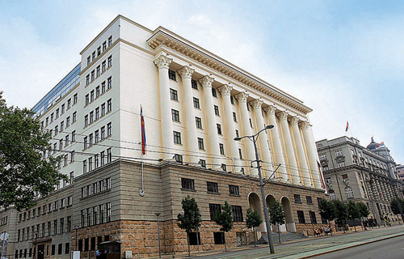
Administrative Judiciary
One Administrative Court
No Appeal
Supreme Court of Cassation – Request for judgment re-assessment

Slide 19
Administrative Judiciary
One Administrative Court
No Appeal
Supreme Court of Cassation – Request for judgment re-assessment

Slide 20
Administrative Judiciary
Mandatory administrative appeal
Administrative acts only
(mainly) written procedure
Not deciding on the merits of the case
No appeal, 2 extraordinary legal remedies

Slide 21


