Slide 1
Basics of EU Environmental Law
EU environmental law - sources of law, system of environmental regulation and relation to other EU policies, environmental law principles.
Autumn 2017
Mgr. Vojtěch Vomáčka, Ph.D., LL.M.

Slide 2
Course introduction
1. Environmental policy of EU, its history and development, aims and instruments. The role of environmental action plans.
2. EU environmental law - sources of law, system of environmental regulation and relation to other EU policies, environmental law
3. Harmonization of environmental requirements. EU law transposition and implementation. The role of national courts and the role of CJEU.
4. Access to environmental information, participation of public in environmental decision-makig and access to justice - the 3 pillars of Aarhus Convention.
5. Environmental impact assessment.

Slide 3
Last lecture summary
Environmental policy was not regulated at the Community level in the beginning, but has developed in the Treaties and CJEU case law.
In the beginning, economic integration was the focus.
Protection of the environment became part of the internal common policy and was followed by a huge bulk of legislation.
European Union environmental legislation has developed over the last 40 years.

Slide 4
Last lecture summary
EAPs define the framework of the EU environmental policy. They set up the challenges and priorities for a given period and create a frame for EU measures on the environment.
7 EAPs – 1972 – 2020
7th EAP: main goal to turn the Union into a resource-efficient, green, and competitive low-carbon economy
Formal law is limited in its capacity to harmonize environmental policy, e.g. of the different Member States in the EU.

Slide 5
Treaties – a summary of the major provisions
Before 1986 (Treaty of Rome) | Single European Act (1986) | Maastricht Treaty (Treaty of the Union - 1992) | Amsterdam Treaty (1999) | Lisbon Treaty (2009)
Art. 100 Harmonization (internal market) | ➔ Art 100a Harmonization + safeguard clause | ➔ Art 100a Harmonization + safeguard clause | ➔ Art 95 Harmonization + safeguard clause | ➔ Art 114 Harmonization + safeguard clause
Art. 235 Objectives of the Community | Art. 235 (not in use any longer!) | Art. 235 (not in use any longer!) | Art. 308 (not in use any longer!) | Art.352 (not in use any longer!)
- | Art. 130r - Objectives - Principles - Grounds - Int. coop. | ➔ Art. 130r - Objectives - Principles - Grounds - Int. coop. | ➔ Art. 174 - Objectives - Principles - Grounds - Int. coop. | ➔ Art. 191 - Objectives - Principles - Grounds - Int. coop.
- | Art. 130s Legal basis and procedure | ➔ Art. 130s Legal basis and procedure | ➔ Art. 175 Legal basis and procedure | ➔ Art. 192 Legal basis and procedure
- | Art. 130t Minimum stringency | ➔ Art. 130t Minimum stringency | ➔ Art. 176 Minimum stringency | ➔ Art. 193 Minimum stringency

Slide 6
EU Environmental Law
System and structure
Characteristics
Principles

Slide 7
System and structure
Sources:
Primary legislation – Treaties (TEU, TFEU, Charter) = base for legislation, principles
Secondary legislation – regulations, directives, decisions, opinions and recommendations
Conventions and Agreements
Supplementary law : international law and the general principles of law

Slide 8
System and structure
Horizontal legislation - general environmental management issues rather than legislation regarding specific sectors, products or types of emissions.
Environmental impact assessment,
Public access to environmental information, participation in proceedings, access to justice,
Environmental liability,
Integrated pollution prevention and control,
Reports on the implementation.

Slide 9
System and structure
Sectoral legislation
Air pollution
Water pollution and quality
Waste
Chemicals
Nature and Biodiversity
Land and soil protection
Marine and Coast
Noise

Slide 10
2. Characteristics
Around 1000 pieces of legislation
Addressee – both EU and member states
Not a comperhensive system – specific EU law
- what does it mean?

Slide 11
LEGAL BASE
Article 3 TEU Objectives
New Article 4(2)(e) Shared competence
New Article 13 TFEU Animal Welfare
Article 191(2) – New - Climate change
New Title XXI Energy
Article 194 TFEU

Slide 12
LEGAL BASE
Article 3/3 TEU
The Union shall establish an internal market. It shall work for the sustainable development of Europe based on balanced economic growth and price stability, a highly competitive social market economy, aiming at full employment and social progress, and a high level of protection and improvement of the quality of the environment. It shall promote scientific and technological advance.

Slide 13
Level of protection
TFEU:
Article 4
2. Shared competence between the Union and the Member States applies in the following principal areas:
(e) environment;
(i) energy;
Article 11 (ex Article 6 TEC)
Environmental protection requirements must be integrated into the definition and implementation of the Union's policies and activities, in particular with a view to promoting sustainable development.

Slide 14
Level of protection
TFEU:
Article 35 (ex Article 29 TEC)
Quantitative restrictions on exports, and all measures having equivalent effect, shall be prohibited between Member States.
Article 36 (ex Article 30 TEC)
The provisions of Articles 34 and 35 shall not preclude prohibitions or restrictions on imports, exports or goods in transit justified on grounds of public morality, public policy or public security; the protection of health and life of humans, animals or plants; the protection of national treasures possessing artistic, historic or archaeological value; or the protection of industrial and commercial property. Such prohibitions or restrictions shall not, however, constitute a means of arbitrary discrimination or a disguised restriction on trade between Member States.

Slide 15
Case 302/86 (Dannish bottles)
Dannish Order No 397 of 2. 7. 1981:
All containers for beer and soft drinks must be returnable approved by a National Agency

Slide 16
Case 302/86 (Dannish bottles)
CJEU (120/78, Cassis de Dijon): Obstacles to free movement of goods must be accepted when:
1. There is no EC rule regulating the marketing of the product in question, and
2. The rules apply to both domestic and imported products with no discrimination, and
3. The rules satisfy mandatory requirements recognized by Community law, and
4. The measures taken are proportionate and necessary in view of their aim.

Slide 17
Case 302/86 (Dannish bottles)
Regarding mandatory requirements, the court refers to Case 240/83: The protection of the environment is "one of the Community's essential objectives" which may as such justify certain limitations of the principle of the free movement of goods. The Single Act later confirmed this. [THE HIGH LEVEL OF PROTECTION-PRINCIPLE and THE INTEGRATION PRINCIPLE]

Slide 18
Case 302/86 (Dannish bottles)
4.Then ECJ have to decide if the Danish provisions are proportionate to the aim of protecting the environment. [THE PRINCIPLE OF PROPORTIONALITY]
The Danish system condition 1, that all containers for beer and soft drink must be returnable, is viewed as necessary to achieve the aims, and is not regarded as disproportionate by the court. [THE POLLUTER PAYS-PRINCIPLE]
The Danish system condition 2, as after the amendment, require that non-approved containers can only be used for market testing and limits the import of these containers to 3000 hectoliters.
ECJ recognizes that the approved containers insure a maximum re-use because the containers can be returned to any retailer of beverages, whereas the non-approved containers only can be returned to the retailer who sold the beverages because these containers doesn't fit the national system, resulting in what will probably be a lower protection of the environment.
But, the ECJ finds that the system for returning non-approved containers is capable of protecting the environment, as these containers also have to be returnable. An additional quantitative restriction is considered to be disproportionate, as non-approved containers affects only limited quantities of beverages.
4. Conclusion:
The Kingdom of Denmark has failed to fulfil its obligations under The EC Treaty art.30 regarding the limitation of 3000 hectoliters.

Slide 19
112/84 (Humblot)

Slide 20
112/84 (Humblot)
Special tax on motor vehicles
IN FRANCE, THERE WERE TWO DIFFERENT TYPES OF TAX DUE ANNUALLY ON MOTOR VEHICLES . FIRST THERE IS A DIFFERENTIAL TAX TO WHICH CARS RATED AT 16 CV ( FISCAL HORSEPOWER ) OR LESS ARE SUBJECT AND SECONDLY A SPECIAL TAX ON VEHICLES RATED AT MORE THAN 16 CV .
WHEREAS THE AMOUNT OF DIFFERENTIAL TAX PAYABLE INCREASES PROGRESSIVELY AND UNIFORMLY WITH THE POWER RATING FOR TAX PURPOSES , THE SPECIAL TAX IS LEVIED AT A SINGLE AND CONSIDERABLY HIGHER RATE .
4 IN 1981 MR HUMBLOT BECAME THE OWNER OF A CAR RATED AT 36 CV . BEFORE HE COULD PUT THE VEHICLE ON THE ROAD MR HUMBLOT HAD TO PAY THE SPECIAL TAX , WHICH , AT THAT TIME , AMOUNTED TO FF 5 000 .

Slide 21
112/84 (Humblot)
ARTICLE 95 OF THE EEC TREATY PROHIBITS THE CHARGING ON CARS EXCEEDING A GIVEN POWER RATING FOR TAX PURPOSES OF A SPECIAL FIXED TAX THE AMOUNT OF WHICH IS SEVERAL TIMES THE HIGHEST AMOUNT OF THE PROGRESSIVE TAX PAYABLE ON CARS OF LESS THAN THE SAID POWER RATING FOR TAX PURPOSES , WHERE THE ONLY CARS SUBJECT TO THE SPECIAL TAX ARE IMPORTED , IN PARTICULAR FROM OTHER MEMBER STATES .

Slide 22
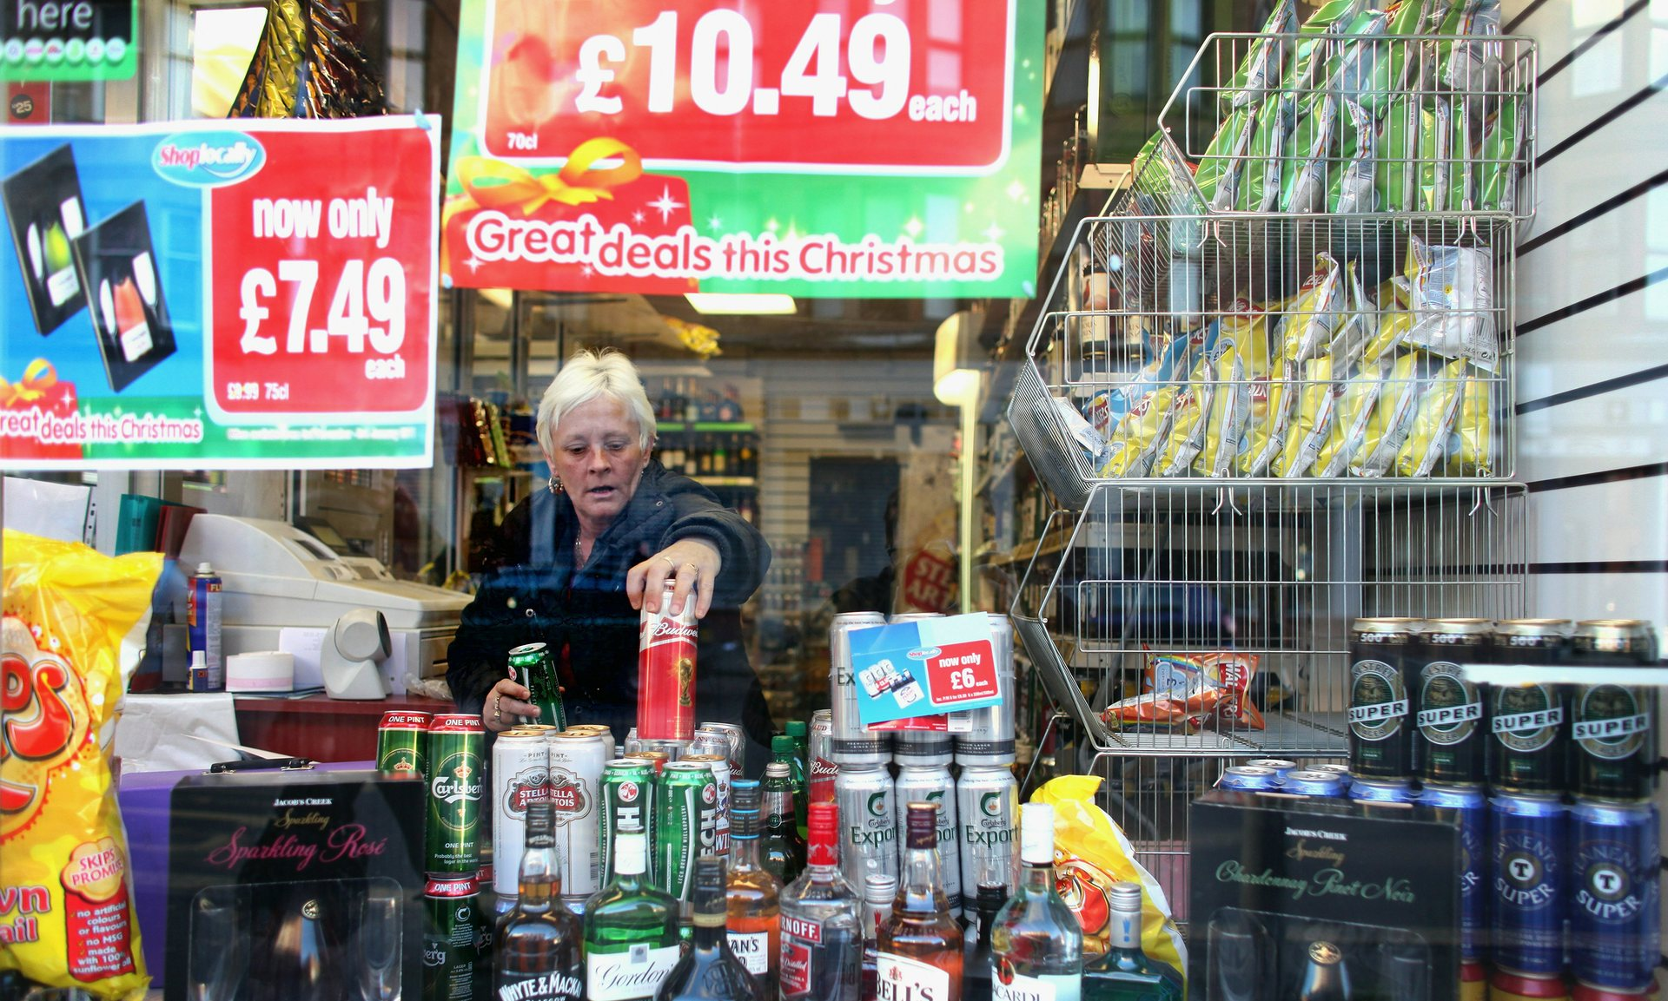
Level of protection
C‑333/14 (The Scotch Whisky Association)
http://www.theguardian.com/society/2015/dec/23/minimum-alcohol-price-in-scotland-could-breach-eu-law-court-rules

Slide 23
Level of protection
C‑333/14 (The Scotch Whisky Association)
Imposition of a minimum price per unit of alcohol (‘MPU’) with respect to the retail selling of alcoholic drinks in Scotland, which must be observed by the holder of any licence required for the retail selling of alcoholic drinks in Scotland.
The MPU was set at GBP 0.50 (approximately EUR 0.70).
There is a Regulation (EU) No 1308/2013 of the European Parliament and the Council of 17 December 2013 establishing a common organisation of the markets in agricultural products (selling of wines).
It contains neither provisions that permit the fixing of the retail selling prices of wines, either at national or EU level, nor provisions that prohibit Member States adopting national measures fixing such prices.

Slide 24
Level of protection
A restrictive measure such as that provided for by the national legislation at issue in the main proceedings must, however, satisfy the conditions set out in the Court’s case-law with respect to proportionality, that is, the measure must be appropriate for attaining the objective pursued, and must not go beyond what is necessary to attain that objective.
It must be observed that, in accordance with settled case-law, all measures of a Member State which are capable of hindering, directly or indirectly, actually or potentially, trade within the European Union are to be considered as measures having an effect equivalent to quantitative restrictions within the meaning of Article 34 TFEU.

Slide 25
Level of protection
The legislation pursues a twofold objective, that of reducing, in a targeted way, both the consumption of alcohol by consumers whose consumption is hazardous or harmful, and also, generally, the population’s consumption of alcohol.
It does not seem unreasonable to consider that a measure that sets a minimum selling price of alcoholic drinks, the very specific aim of which is to increase the price of cheap alcoholic drinks, is capable of reducing the consumption of alcohol, in general, and the hazardous or harmful consumption of alcohol, in particular, given that drinkers whose consumption can be so described purchase, to a great extent, cheap alcoholic drinks.
It follows that the national legislation at issue in the main proceedings appears to be an appropriate means of attaining the objective that it pursues.

Slide 26
Level of protection
National legislation or practice cannot benefit from the derogation laid down in Article 36 TFEU if human life and health can be as effectively protected by measures that are less restrictive of trade within the European Union.
Yet a fiscal measure which increases the taxation of alcoholic drinks is liable to be less restrictive of trade in those products within the European Union than a measure imposing an MPU.
The reason is that the latter measure, unlike increased taxation of those products, significantly restricts the freedom of economic operators to determine their retail selling prices and, consequently, constitutes a serious obstacle to access to the United Kingdom market of alcoholic drinks.
It is however for the referring court, which alone has available to it all the matters of fact and law pertaining to the circumstances of the main proceedings, to determine whether a measure other than that provided for by the national legislation at issue in the main proceedings, such as increased taxation on alcoholic drinks, is capable of protecting human life and health as effectively as that legislation, while being less restrictive of trade in those products within the European Union.

Slide 27
2. Characteristics
MULTI-LAYERED SYSTEM
Where the EU regulation does not specifically provide any specific means of enforcement or refers for that purpose to national laws, regulations and administrative provisions, the Member States are required to take all measures necessary to guarantee the application and effectiveness of EU law.
For example, the sanction provided for must be analogous to those applicable to infringements of national law of similar nature and importance, and must be effective, proportionate and dissuasive.

Slide 28
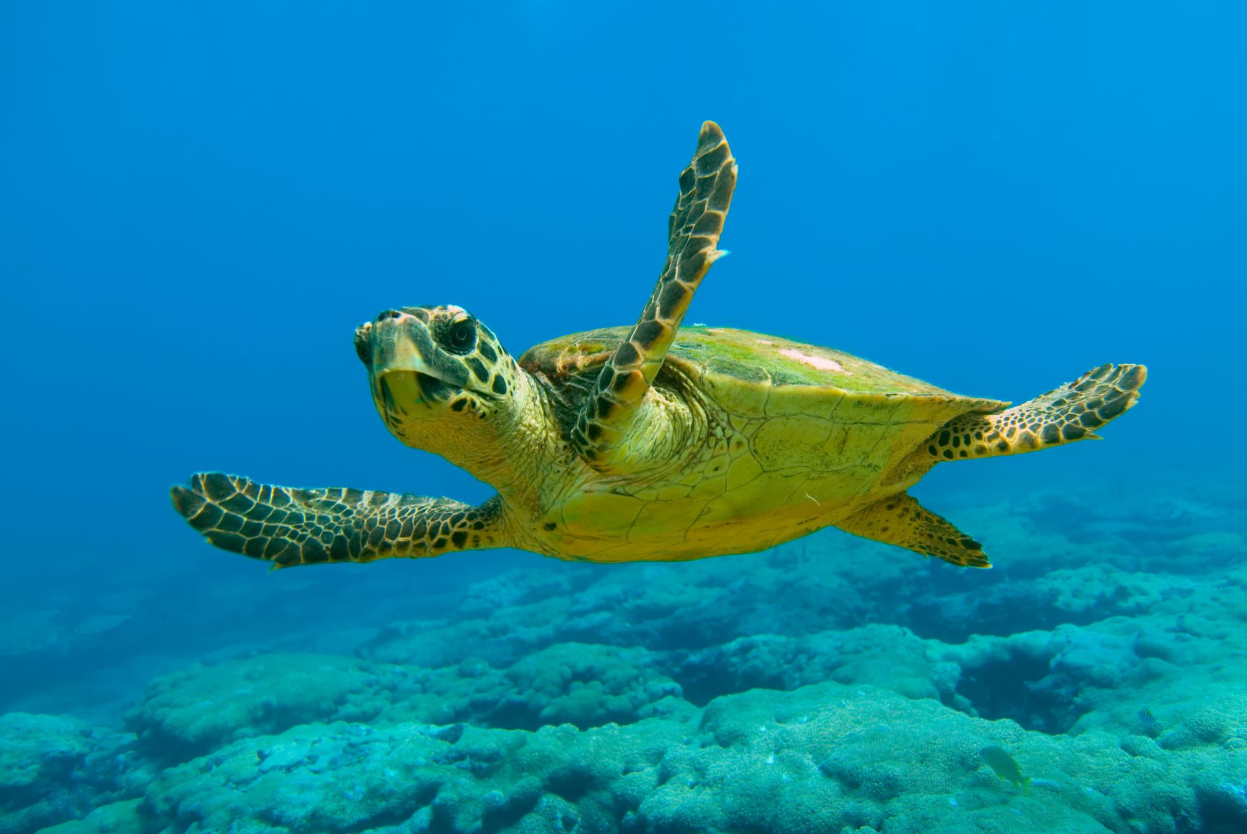
2. Characteristics
It is not enough to implement EU regulation, correct application is needed!
Caretta caretta (C-103/00) – national/EU inspections, no margin of appreciation

Slide 29
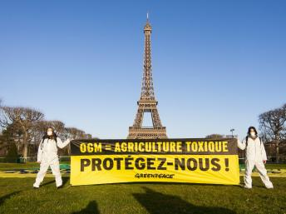
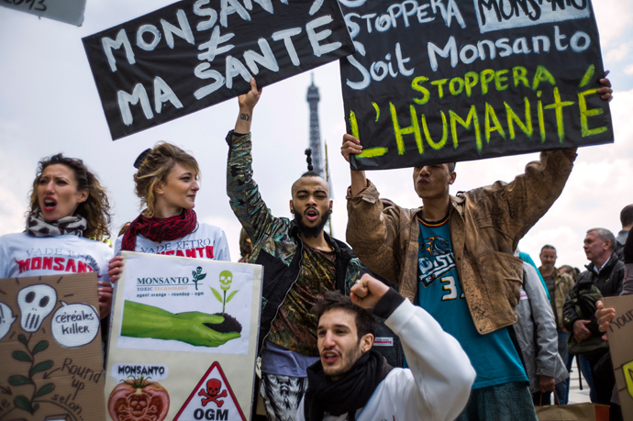
2. Characteristics
C-121/07: A Member State may not plead difficulties of implementation which emerge at the stage when a Community measure is put into effect, including difficulties relating to opposition on the part of certain individuals, to justify a failure to comply with obligations and time-limits laid down by Community law.

Slide 30
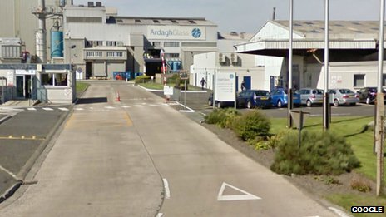
2. Characteristics
Acceptance of Euenvironmental law, role of the national courts, not always the NGOs
High Court of Justice Queen's Bench Division Administrative Court Ardagh Glass Ltd v Chester City Council & Anor. EWHC 745. 8. 4. 2009

Slide 31
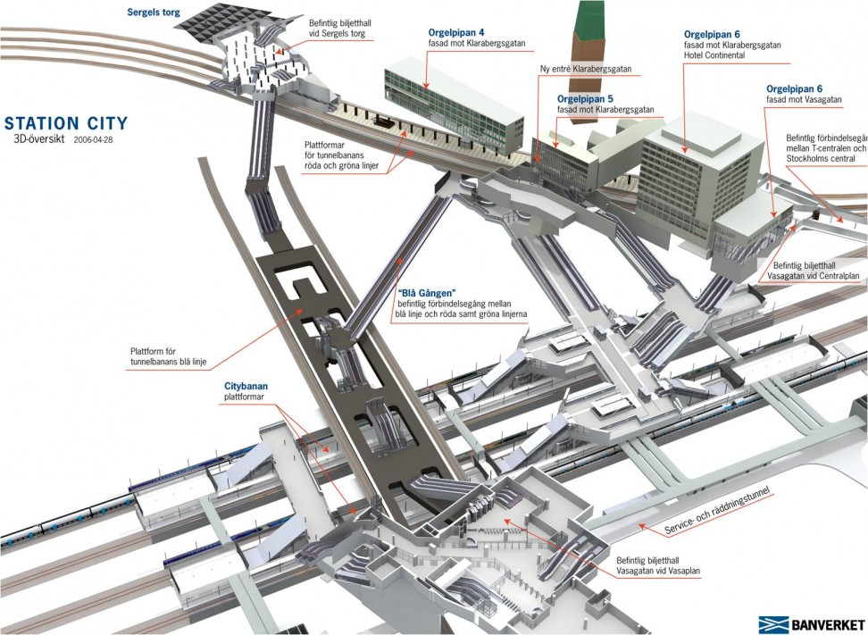
2. Characteristics
CLOSING THE GAPS VIA INTERPRETATION
IMPORTANCE OF PRINCIPLES
Stockholm City banan – complex assesment of tunnels

Slide 32
2. Characteristics
Direct application – much wider concept
European law not only engenders obligations for Member States, but also rights for individuals. Individuals may therefore take advantage of these rights and directly invoke European acts before national and European courts.
Such a provision should be
Clear and precise
Unconditional; and
Capable of producing rights for individuals

Slide 33
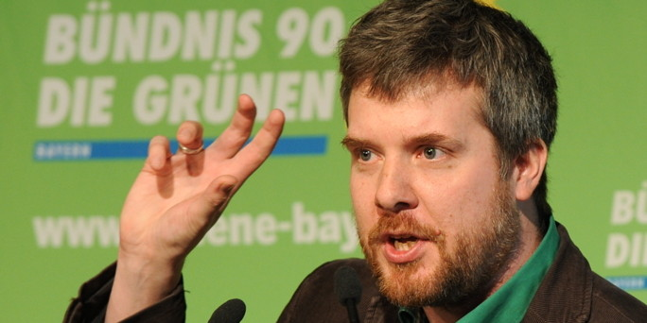
2. Characteristics
C‑237/07 (Dieter Janecek)
Direct effect, procedural law?

Slide 34
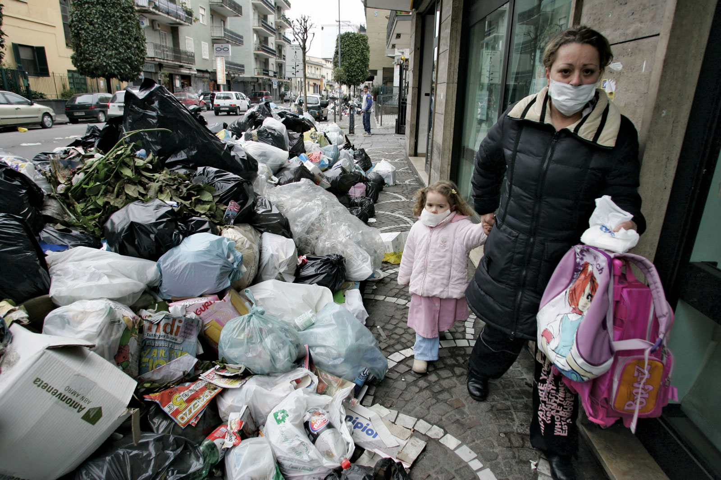
3. Principles

Slide 35
3. Principles
Aims of EU environmental policy:
High level of protection
Integration
Sustainable development
(Public participation)
Environmental principles (in narrow sense):
Prevention
The precautionary principle
Polluter pays
Rectification at source

Slide 36
3. Principles
191 (2) TFEU: Community policy on the environment shall aim at a high level of protection taking into account the diversity of situations in the various regions of the Community. It shall be based on the precautionary principle and on the principles that preventive action should be taken, that environmental damage should as a priority be rectified at source and that the polluter should pay. Environmental protection requirements must be integrated into the definition and implementation of other Community policies.

Slide 37
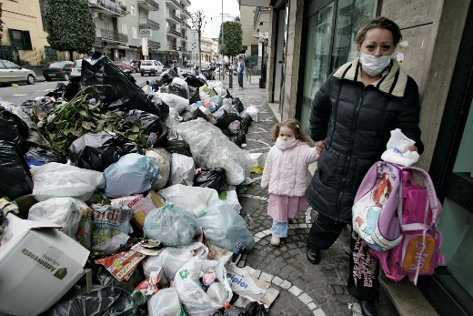
3. Principles
C-2/90: The principle that environmental damage should as a matter of priority be remedied at source, laid down by Article 130r (2) of the Treaty as a basis for action by the Community relating to the environment, entails that it is for each region, municipality or other local authority to take appropriate steps to ensure that its own waste is collected, treated and disposed of; it must accordingly be disposed of as dose as possible to the place where it is produced, in order to limit as far as possible the transport of waste.
(Moreover, that principle is consistent with the principles of self-sufficiency and proximity set out in the Basel Convention of 22 March 1989 on the control of transboundary movements of hazardous wastes and their disposal, to which the Community is a signatory.)

Slide 38
3. Principles - Rectification at source
Rectification at source – emphasises proximity, opposite to end-of-pipe approach, BAT
C-364/03: „Accordingly, inasmuch as it is undisputed that emissions of sulphur dioxide and nitrogen oxide have harmful effects on human health and on biological resources and ecosystems, the obligation on Member States to adopt the measures necessary to reduce the emissions of those two substances is not dependent, contrary to the assertion of the Hellenic Government, on the general environmental situation of the region in which the industrial plant in question is located.“

Slide 39
3. Principles – Polluter pays
Directive 2000/60/EC of the European Parliament and of the Council of 23 October 2000 establishing a framework for Community action in the field of water policy:
„Member States shall take account of the principle of recovery of the costs of water services, including environmental and resource costs, having regard to the economic analysis conducted according to Annex III, and in accordance in particular with the polluter pays principle.“

Slide 40
3. Principles – Polluter pays
C‑254/08 (wide margin of appreciation ):
While the Member States as the addressees of Directive 2006/12 are bound as to this result to be achieved in terms of financial liability for the cost of disposing of waste, in accordance with Article 249 EC they may, however, choose the form and the methods to be applied in order to attain that result.
…as Community law currently stands, there is no legislation adopted on the basis of Article 175 EC imposing a specific method upon the Member States for financing the cost of the disposal of urban waste, so that the cost may, in accordance with the choice of the Member State concerned, equally well be financed by means of a tax or of a charge or in any other manner.

Slide 41
3. Principles – Polluter pays
C-172/08 - Pontina Ambiente:
„…cost of disposing of the waste must be borne by the waste holders. It forms part of the objective of Directive 1999/31 which, according to Article 1(1) thereof, is to meet the requirements of Directive 75/442, and in particular Article 3 thereof, which inter alia requires the Member States to take appropriate measures to encourage the prevention or reduction of waste production.“
The consequence, in particular, is that whatever the national rules may be governing landfill sites, they must ensure that that all the operating costs of such a site is actually borne by the holders of the waste deposited in the landfill for disposal.“
(…) Causing the operator to bear such charges would amount to charging to him the costs arising from the disposal of waste which he did not generate but of which he merely disposes in the framework of his activities as a provider of services.

Slide 42
3. Principles – Polluter pays
C-172/08 (Standley) – Polluter pays x Proportionality
the Member States are to take account of the other sources of pollution when implementing the Directive and, having regard to the circumstances, are not to impose on farmers costs of eliminating pollution that are unnecessary. Viewed in that light, the polluter pays principle reflects the principle of proportionality

Slide 43
3. Principles – Prevention
Dannish bottles case
Various environmental standards.
EIA Directive thresholds
Usually on legislative level.

Slide 44
3. Principles – Precautionary principle
Differences:
Relevant to the management of risk – usually decision-makers = political decision.
Uncertainty - where scientific data do not permit a complete evaluation of the risk, recourse to this principle may, for example, be used to stop distribution or order withdrawal from the market of products likely to be hazardous.

Slide 45
3. Principles – Precautionary principle
Where action is deemed necessary, measures based on the precautionary principle should be, inter alia:
proportional to the chosen level of protection,
non-discriminatory in their application,
consistent with similar measures already taken,
based on an examination of the potential benefits and costs of action or lack of action (including, where appropriate and feasible, an economic cost/benefit analysis),
subject to review, in the light of new scientific data, and
capable of assigning responsibility for producing the scientific evidence necessary for a more comprehensive risk assessment.

Slide 46
3. Principles – Precautionary principle
Joined Cases C-58/10, C-59/10, C-60/10, C-61/10, C-62/10, C-63/10, C-64/10, C-65/10, C-66/10, C-67/10, C-68/10 (Monsanto, Genetically modified animal feed):
Directive 2001/18, Art. 23, Safeguard clause:
Where a Member State, as a result of new or additional information made available since the date of the consent and affecting the environmental risk assessment or reassessment of existing information on the basis of new or additional scientific knowledge, has detailed grounds for considering that a GMO as or in a product which has been properly notified and has received written consent under this Directive constitutes a risk to human health or the environment, that Member State may provisionally restrict or prohibit the use and/or sale of that GMO as or in a product on its territory.

Slide 47
3. Principles – Precautionary principle
Joined Cases C-58/10, C-59/10, C-60/10, C-61/10, C-62/10, C-63/10, C-64/10, C-65/10, C-66/10, C-67/10, C-68/10 (Monsanto, Genetically modified animal feed):
Regulation No 1829/2003, Art. 34:
In the case of GMOs to be used as seeds or other plant-propagating materials falling within the scope of this Regulation, the European Food Safety Authority] should be under an obligation to delegate the environmental risk assessment to a national competent authority. Nonetheless, authorisations under this Regulation should be without prejudice to the provisions of in particular, Council Directive 2002/53/EC , which provides in particular for] the rules and the criteria for the acceptance of varieties and their official acceptance for inclusion in the common catalogue of varieties of agricultural plant species…’

Slide 48
3. Principles – Precautionary principle
Joined Cases C-58/10, C-59/10, C-60/10, C-61/10, C-62/10, C-63/10, C-64/10, C-65/10, C-66/10, C-67/10, C-68/10 (Monsanto, Genetically modified animal feed):
Regulation No 1829/2003, Art. 34:
In the case of GMOs to be used as seeds or other plant-propagating materials falling within the scope of this Regulation, the European Food Safety Authority] should be under an obligation to delegate the environmental risk assessment to a national competent authority. Nonetheless, authorisations under this Regulation should be without prejudice to the provisions of in particular, Council Directive 2002/53/EC , which provides in particular for] the rules and the criteria for the acceptance of varieties and their official acceptance for inclusion in the common catalogue of varieties of agricultural plant species…’

Slide 49
3. Principles – Precautionary principle
Joined Cases C-58/10, C-59/10, C-60/10, C-61/10, C-62/10, C-63/10, C-64/10, C-65/10, C-66/10, C-67/10, C-68/10 (Monsanto, Genetically modified animal feed):
It should be borne in mind in this regard that the expressions ‘likely’ and ‘serious risk’ must be understood as referring to a significant risk which clearly jeopardises human health, animal health or the environment. That risk must be established on the basis of new evidence based on reliable scientific data.

Slide 50
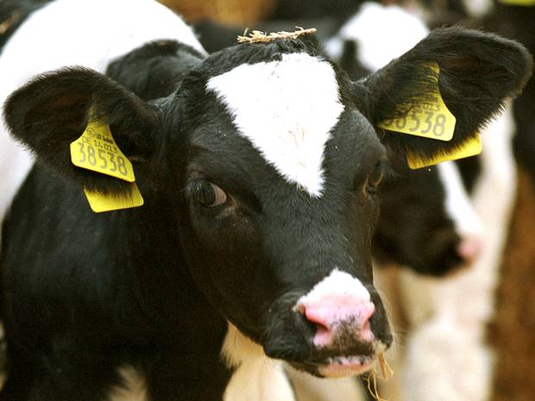
3. Principles – Precautionary principle
Time limit x Number of endangered persons x hypothetical risk
C-157/96 (National Farmers' Union)
C-180/96 (Mad cow disease)
bovine spongiformencephalopathy

Slide 51
3. Principles – Precautionary principle
C-157/96 (National Farmers' Union)
Commission Decision 96/239/EC of 27 March 1996 on emergency measures to protect against bovine spongiform encephalopathy
An independent scientific body advises the UK Government, concerning the existence of a possible link between BSE) and Creutzfeldt-Jakob disease
The plea alleging lack of competence and misuse of powers (disproportionality) – existing measures, no evidence
What had been prohibited and why?

Slide 52
3. Principles – Precautionary principle
C-157/96 (National Farmers' Union)
(…) the Community legislature has a discretionary power which corresponds to the political responsibilities given to it by Articles 40 to 43 of the Treaty. Consequently, the legality of a measure adopted in that sphere can be affected only if the measure is manifestly inappropriate having regard to the objective which the competent institution is seeking to pursue

Slide 53
3. Principles – Precautionary principle
At the time when the contested decision was adopted, there was great uncertainty as to the risks posed by live animals, bovine meat and derived products.
Where there is uncertainty as to the existence or extent of risks to human health, the institutions may take protective measures without having to wait until the reality and seriousness of those risks become fully apparent.
That approach is borne out by Article 130r(1) of the EC Treaty, according to which Community policy on the environment is to pursue the objective inter alia of protecting human health. Article 130r(2) provides that that policy is to aim at a high level of protection and is to be based in particular on the principles that preventive action should be taken and that environmental protection requirements must be integrated into the definition and implementation of other Community policies.

Slide 54
Thank you for your attention ☺
To be continued…

