Slide 1


Basics of EU Environmental Law
Access to environmental information, participation of public in environmental decision-making and access to justice - the 3 pillars of Aarhus Convention.
Autumn 2017
Mgr. Vojtěch Vomáčka, Ph.D., LL.M.

Slide 2

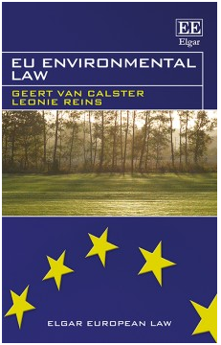


Where to get more info on the EU environmental law?
http://www.transworld-fp7.eu/wp-content/uploads/2013/04/TW_WP_21.pdf

Slide 3
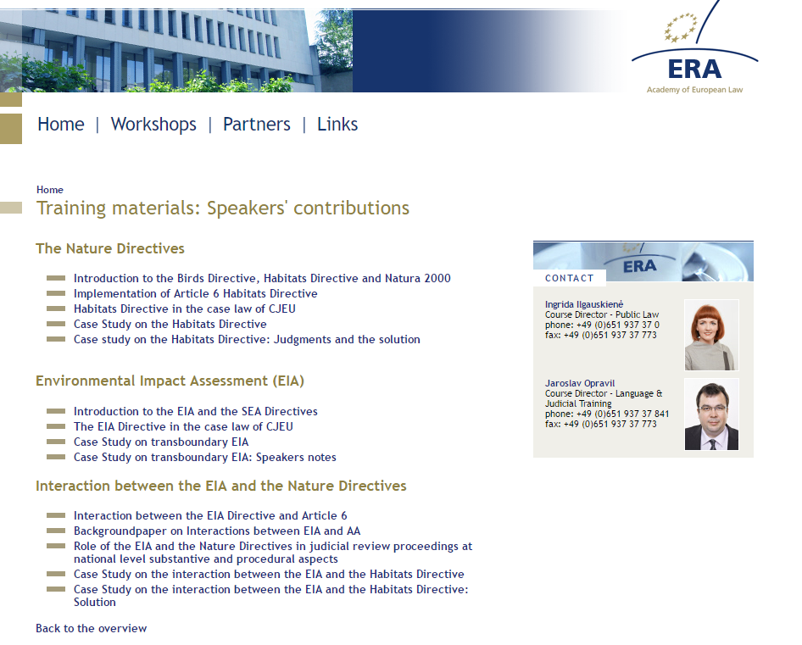
Where to get more info on the EU environmental law?
https://www.era.int/cgi-bin/cms?_SID=NEW&_sprache=en&_bereich=artikel&_aktion=detail&idartikel=125276

Slide 4
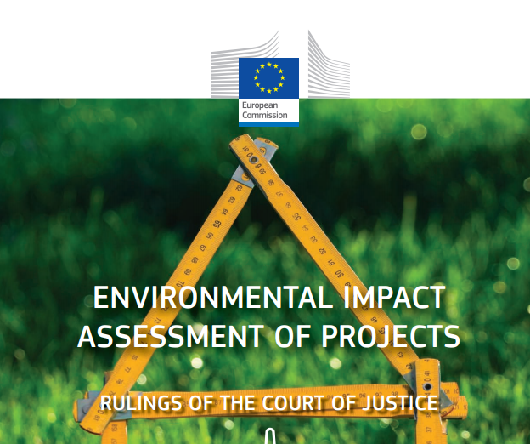
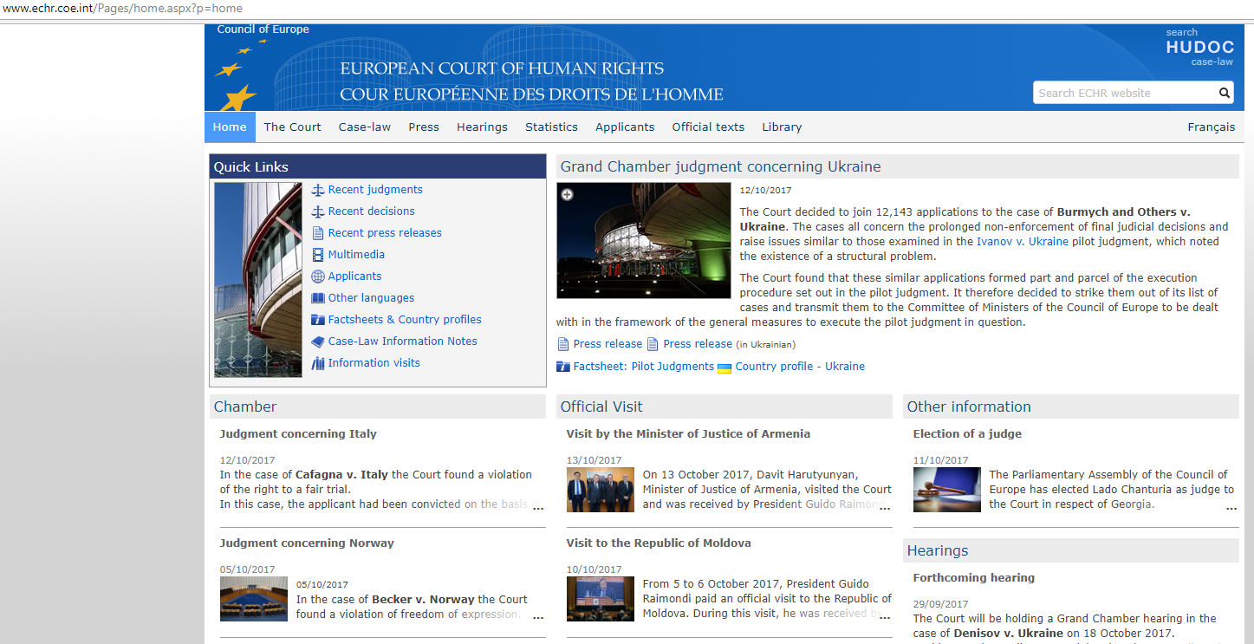
Where to get more info on the EU environmental law?
http://ec.europa.eu/environment/eia/pdf/eia_case_law.pdf

Slide 5
The role of national courts
National judges are EU judges!
Obligation to to ask for a preliminary question
Secondary EU Law interpretation after CJEU
EU Law ex offo where possible, but Waddenzee/Kraajiveld doctrine applies
Curia novit iura?

Slide 6
Interim measures - C‑416/10 (Križan)
Moreover, it is apparent from settled-case law that a national court seized of a dispute governed by European Union law must be in a position to grant interim relief in order to ensure the full effectiveness of the judgment to be given on the existence of the rights claimed under European Union law.
It must be added that the right to bring an action provided for by Article 15a of Directive 96/61 must be interpreted in the light of the purpose of that directive. The Court has already held that that purpose, as laid down in Article 1 of the directive, is to achieve integrated prevention and control of pollution by putting in place measures designed to prevent or reduce emissions of the activities listed in Annex I into the air, water and land in order to achieve a high level of protection of the environment.

Slide 7
The role of national courts and the role of CJEU.
The three instruments in the “toolkit” of the national court
1. Consistent interpretation
2. Direct effect
3. State liability

Slide 8
Consistent interpretation
Marleasing: „as far as possible‟
Pfeiffer: all national law
No duty before expiration implementation deadline, however, (Adeneler):
courts must refrain as far as possible from interpreting domestic law in a manner which might seriously compromise attainment of the objective pursued by that directive
Cannot depend on administrative practice (C-508/04, C-50/09)

Slide 9
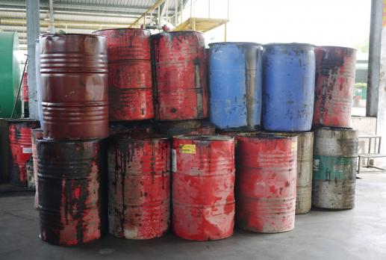
Consistent interpretation
C-424/02: Where technical, economic and organisational constraints so allow, Member States shall take the measures necessary to give priority to the processing of waste oils by regeneration.
…the definition of such constraints cannot be left to the exclusive discretion of the Member States. Apart from being contrary to the principle of the uniform interpretation and application of Community law, interpretation by the Member States alone would make the compatibility of processing (…) would depend entirely on a policy assessment on the part of the Member State concerned

Slide 10
Consistent interpretation
Limits to consistent interpretation
Constitutional position of national courts
Court is not a legislator or excecutive auhority
To do whatever lies within their jurisdiction
No contra legem (legal certainty)
„A cow is not a horse‟

Slide 11
Direct effect
Loosening up of the criteria through the years
In sum: unconditional and sufficiently precise
Kraaijeveld/ Waddenzee: reviewing available discretion
Dieter Janecek case
Consequences:
1. national law inapplicable
2. preclude valid adoption of new national
legislation
3. national law to set aside
4. cannot be applied against individuals
5. Duty for courts and public authorities alike
Problem: National authorities consider direct effect.

Slide 12
Direct effect
C-72/95 – Kraaijeveld
where the Community authorities have, by directive, imposed on Member States the obligation to pursue a particular course of conduct, the useful effect of such an act would be weakened if individuals were prevented from relying on it before their national courts…

Slide 13
Direct effect
C-72/95 – Kraaijeveld
Interpretation of a provision of Community law involves a comparison of the language versions (purpose and general scheme of the rules)
where under national law a court or tribunal hearing an action (…) must or may raise of its own motion pleas in law based on binding national rules which have not been put forward by the parties, it must, for matters within its jurisdiction, examine of its own motion whether the legislative or administrative authorities of the Member State have remained within the limits of their discretion under Articles 2(1) and 4(2) of the directive, and take account thereof when examining the action for annulment

Slide 14
State Liability
Member States can be held responsible for legislative, executive or factual acts.
Individuals who have suffered damage have a right to reparation if:
- the rule of law infringed is intended to confer rights on individuals;
- the breach is sufficiently serious;
- there is a direct causal link between the breach of the obligation and the damage sustained (environment?)

Slide 15

State Liability
C-201/02 – no EIA
How far? C-420/11
EU liability?

Slide 16
Last seminar summary
Harmonization of environmental requirements
- principle of subsidiarity: cannot be sufficiently achieved by the Member States, obligation to refrain from any measure which could jeopardise the attainment of the Union's objectives
2) EU environmental law transposition and implementation.
- also during period laid for implementation, implementation and the enforcement: member states, problems of EU control: remote, burden of proof
3) The role of national courts and the role of CJEU.
- conflict: annulment, non-application (exemptions)
- CJEU: interpretation, systematic failures, financial sanctions
- national courts: consistent interpretation, direct effect, state liability

Slide 17
Today
Participation in general
The Aarhus Convention
Three pillars at the EU level
Three pillars at the national level

Slide 18
Public participation?
Environmental democracy
Affected and close to the source
Fundamental rights
(to be able to assert this rights, citizens must participate)
Helping hand
  to further the accountability of and transparency
  to strengthen public support for decisions
  to promote environmental education

Slide 19
Public participation? Negatives?
Only procedural rights
Wide scope
Free or almost free of charge
Not necessarily protection of environment – personal interests

Slide 20
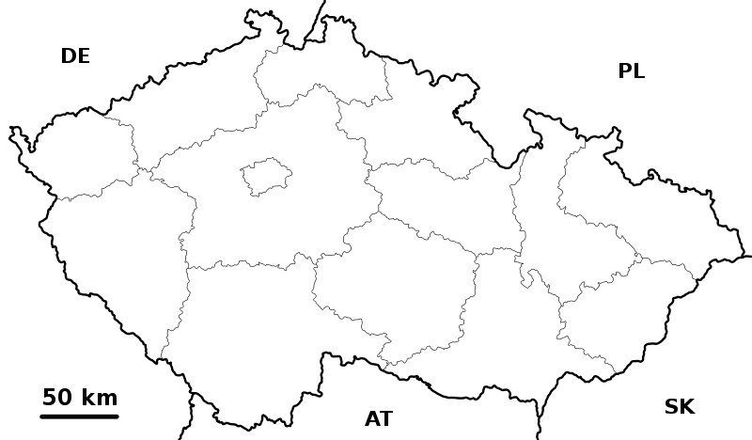
2012 – 2016
(approx. 220 cases)
© Vomáčka, Strouhal, Židek, Giňová, Holcnerová

Slide 21

Public participation? How?
Petition
Demonstration
Referendum
Information
Participation in proceedings
Judicial Protection

Slide 22
Balancing the system
C-115/09 Bund für Umwelt und Naturschutz Deutschland, Landesverband Nordrhein-Westfalen eVvBezirksregierung Arnsberg Trianel Kohlekraftwerk Lünen
The German system of judicial review
involves a “careful and detailed” scrutiny of administrative decisions,
admissibility criteria are such that few are able to access this system, particularly groups bringing actions alleging environmental harm.

Slide 23

Legal regulation

Slide 24
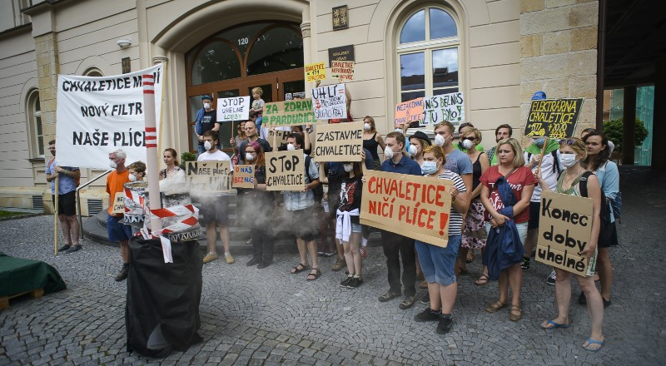
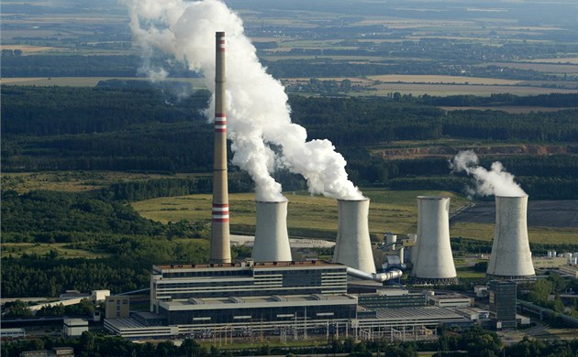

Effective participation?

Slide 25

Public participation? How?
Capercaillie - a large, turkeylike Eurasian grouse of mature pine forests. The male has a courtship display in which it fans the tail and makes an extraordinary succession of sounds.

Slide 26
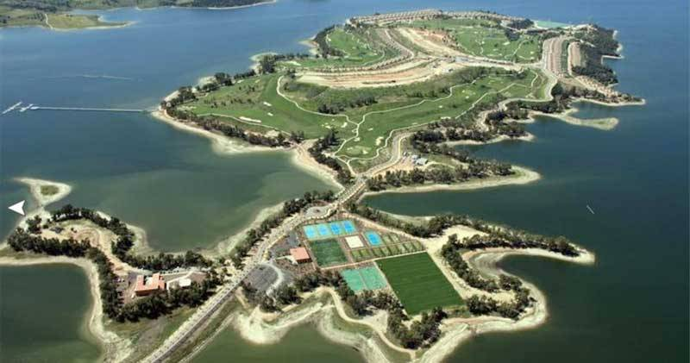
Marina Isla de Valdecañas

Slide 27
Public participation? How?
Marina Isla de Valdecañas
The tourist resort in the province of Caceres, which comprises hotels, 200 luxury villas, a golf course and a marina.
It was declared illegal by a Spanish Supreme Court ruling of 6 February 2014. The resort is located within a Natura 2000 protected area.
The ruling comes after almost a decade of court proceedings, and at this stage the resort is already close to completion.

Slide 28
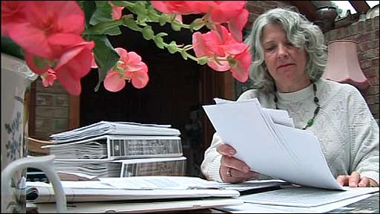
The Aarhus Convention – national level
Various restrictions:
Costs of the proceedings? Costs follow the event rule?
Lilian Pallikaropoulos from Rugby – £ 90.000
Maximum, legal aid, moderation, C-260/11 (Edwards)

Slide 29
Sources of legal regulation
Participation at the national level
IL
EU
NL
+ +
= 28 different systems

Slide 30
International level
Principle l of the Stockholm Declaration on the Human Environment (1972)
Principle 10 of the Rio Declaration on Environment and Development
UN General Assembly resolutions (1982) on the World Charter for Nature and (1990) on the need to ensure a healthy environment for the well-being of individuals
The Aarhus Convention
Principle of EU environmental law
Customary international law?

Slide 31

The Aarhus Convention on Access to Information, Public Participation in Decision-making and Access to Justice in Environmental Matters

Slide 32
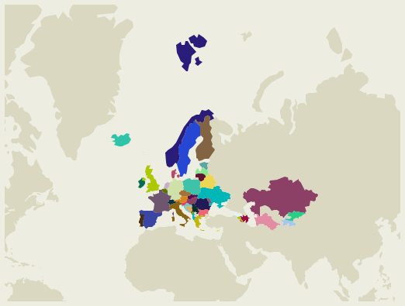
The Aarhus Convention on Access to Information, Public Participation in Decision-making and Access to Justice in Environmental Matters

Slide 33
The Aarhus Convention
Adopted on 25 June 1998 in the Danish city of Aarhus (Århus)
Entered into force in 2001
All Member States and EU are parties
Links environmental rights and human rights
Acknowledges that we owe an obligation to future generations
Establishes that sustainable development can be achieved only through the involvement of all stakeholders
Links government accountability and environmental protection
Focuses on interactions between the public and public authorities in a democratic context.

Slide 34
The Aarhus Convention
Rights-based approach
A 'floor', not a 'ceiling'‚
Non-discrimination
Definition of public authorities
Non-compliance mechanism
GMO amendment

Slide 35
The Aarhus Convention
“The public” means one or more natural or legal persons, and, in accordance with national legislation or practice, their associations, organizations or groups;
“The public concerned” means the public affected or likely to be affected by, or having an interest in, the environmental decision-making; for the purposes of this definition, non-governmental organizations promoting environmental protection and meeting any requirements under national law shall be deemed to have an interest.
https://www.unece.org/fileadmin/DAM/env/pp/documents/cep43e.pdf

Slide 36
The Aarhus Convention
Meeting of the Parties
Bureau
Working Group of the Parties
Compliance Committee

Slide 37
The Aarhus Convention
IL (The Aarhus Convention)
EU
MS
Art. 216 (2) TFEU

Slide 38
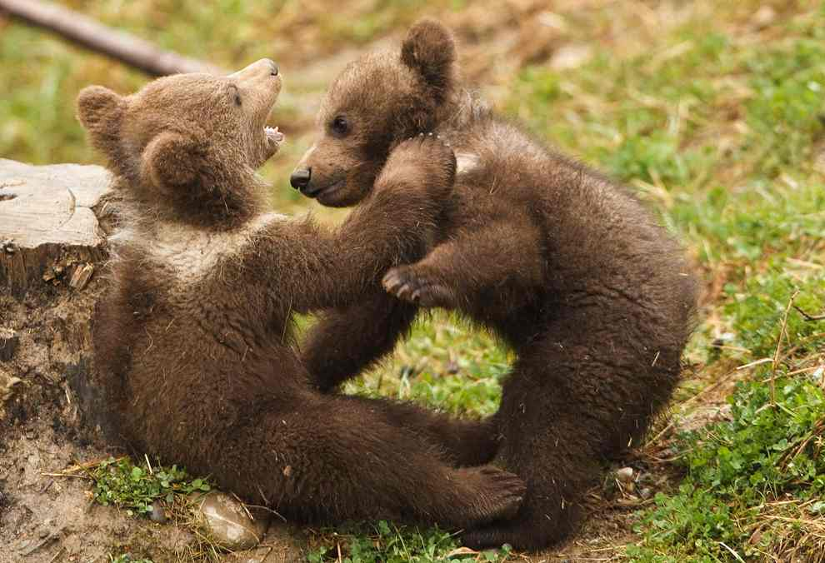
The Aarhus Convention
Binding nature? Direct application?
C-240/09: As far as possible

Slide 39
The Aarhus Convention – EU law
Directive 2003/4/EC of the European Parliament and of the Council of 28 January 2003 on public access to environmental information
Directive 2003/35/EC of the European Parliament and of the Council of 26 May 2003 providing for public participationin respect of the drawing up of certain plans and programmes relating to the environment and amending with regard to public participation and access to justice Council Directives 85/337/EEC and 96/61/EC
+ number of other environmental directives
Proposal for a Directive of the European Parliament and of the Council on access to justice
Regulation (EC) N° 1367/2006 of the European Parliament and of the Council on the application of the provisions of the Aarhus Convention on Access to Information, Public Participation in Decision-making and Access to Justice in Environmental Matters to Community institutions and bodies
(information - extends Regulation (EC) No 1049/2001)
+ petitions (EP), ombudsman

Slide 40
The Aarhus Convention – EU level
Information (also Art. 15 TFEU, Art. 42 Charter)
Wide definiton of information (up-to-date, accurate
and comparable)
Active (treaties, report on the state of the environment, …/passive)
Exceptions (concerning possible infringements, adversely affect the protection of the environment)
- wider than AC!

Slide 41
The Aarhus Convention – EU level
Public participation concerning plans and programmes relating to the environment (EIA, IPPC)
partnership, consultation (EAP, Green books)
internal review of administrative acts (Any NGO which meets the criteria – independence, objective of promoting environmental protection, active for 2 years)
The non-governmental organisation which made the request for internal review may institute proceedings before the Court of Justice

Slide 42
The Aarhus Convention – EU level
Public participation – problems: narrow scope of acts:
‘administrative act’ means any measure of individual scope under environmental law, taken by a Community institution or body, and having legally binding and external effects;
Wide exceptions from administrative acts and administrative omissions in Art. 2 (2).:
2. Administrative acts and administrative omissions shall not include measures taken or omissions by a Community institution or body in its capacity as an administrative review body, such as under:
(a) Articles 81, 82, 86 and 87 of the Treaty (competition rules);
(b) Articles 226 and 228 of the Treaty (infringement proceedings);
(c) Article 195 of the Treaty (Ombudsman proceedings);
(d) Article 280 of the Treaty (OLAF proceedings).
This provision provides illustrative list of exceptions (“such as”) and goes far beyond Art. 2 (2) of Aarhus (which applies only to decisions of court)

Slide 43
The Aarhus Convention – EU level
C 401/12 P to C 403/12 P: Art. 9 (3) decision
Kind of disappointing.
Setting aside a ruling of the General Court it uphelds the validity of EC regulation No 1367/2006 hat strictly confines access to justice to administrative acts of only individual (!) scope.
There is now a specific “Aarhus gap”. The Court of Justice does not bridge the gap by a strong interpretation in the light of Aarhus.

Slide 44
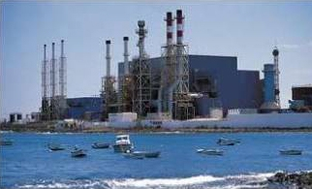
The Aarhus Convention – EU level
Acces to justice
scope of review
individual concern - strictly individual economic interests 25/62 (Plaumann).
T-585/93 (Greenpeace)
NGOs + locals
T-142/03 (waste management in Belgium)

Slide 45
The Aarhus Convention – EU level
Only the Commission turns out to be personaly affected
What about the Charter ? (Art. 42, 47)

Slide 46
The Aarhus Convention – national level
Participation at the national level
IL
EU
NL
+ +
= 28 different systems

Slide 47
The Aarhus Convention – national level
Access to information:
- generally wide and non problematic (Aarhus + EU + CJEU case law + national law)
one comperhensive system or 1 general and 1 specific for environmental information
role of national courts
„Any other natural or legal persons having public responsibilities or functions, or providing public services, in relation to the environment…“

Slide 48
The Aarhus Convention – national level
Participation in proceedings
EU: only EIA, IPPC (IED) – not all activities listed in AC
Schutznormtheorie x interest theory
National law: specific conditions (in accordance with national legislation or practice)
Participation fees
- not regulated by AC or EU law
- C-216/05 (Ireland)

Slide 49
The Aarhus Convention – national level
Access to justice – national systems
Standing for the members of the public (definition of “the members of the public”, standing for individuals, standing for ENGOs and groups, participation as a prerequisite for standing)
The intensity or scope of the review
Costs in the environmental procedure (“not prohibitively expensive”, loser pays principle, experts’ costs, Alternative Dispute Resolution)
Effectiveness of the procedure (Criteria for injunctive relief, Bonds or cross-undertakings in damages, timeliness, malicious or capricious actions )

Slide 50
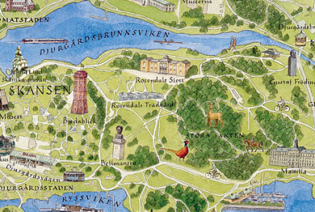
The Aarhus Convention – national level
Various restrictions:
C-263/08 (Djurgården-Lilla Värtans)
– only NGOs with environmental objectives
- active for 3 years
    - 2.000 members

Slide 51
Thank you for your attention ☺
To be continued…

