Slide 1
Introduction into Roman Law and its Further Development
Notes:
Note: This presentation serves only as an introduction into the subject. Nothing from it will be required for the exam.

Slide 2
SOC046 Roman Law
Teachers:
JUDr. Mgr. Radek Černoch, Ph.D.
Mgr. Lucie Mrázková
JUDr. Pavel Salák, Ph.D.
Written exam
Syllabus (order subject to change)
1. Introduction into Roman Law and its Further Development
2. Possession and Types of Thing (dr. Salák)
3. Roman State and Sources of Law
4. Ownership and Easements (Mgr. Mrázková)
5. Law of Obligations – General Part (dr. Salák)
6. Legal Personality and Family
7. Juridical Acts and Procedural Law
8. Torts
9. Contracts – Verbal Contracts, Literary Contracts, Real Contracts
10. Consensual Contracts
11. Law of Succession – Testamentary and Intestate Succession
12. Law of Succession – Position of Heir and Singular Succession

Slide 3
Literature
PLESSIS, Paul du. Borkowski’s Textbook on Roman Law. 4th ed. Oxford: Oxford University Press, 2010. xvi+427 p. ISBN 978-0-19-957488-9.
Any other you may encounter in almost any language (usually not problem if an older one):
Kaser, Brutti, Guarino, O. F. Robinson, Longchamps de Bérier, Dajczak, Zimmermann, etc. (no particular order)

Slide 4
It‘s Your Turn
Where are you from, your studies, language skills, previous knowledge of Roman law, expectations, etc.

Slide 5
Roman Law
Legal Order of Ancient Roman Empire
University subject (introduction to legal thinking and system)
Aid for Interpretation

Slide 6
Roman Law – When?
From 753? BC
Till AD: 476, 486, 1453, 1900, 1946, still in force?

Slide 7
Roman Law – Where?
Rome
Italy
Mediterranean Area
Continental Europe
England
Germany
Japan
USA
RSA

Slide 8
Ancient Rome
Of course
See other lessons
Then Reception of Roman Law
Byzantine Empire
Leges Romanae Barbarorum
Middle Ages and Modern Period (next slides)
Church (ecclesia vivit lege Romana)

Slide 9
Italy
CTh, 1070 Littera Florentina, Bologna, mos italicus
Unum sit ius cum unum est imperium.
Glossatores
Irnerius: Quattuor doctores (Martinus,Bulgarus,Jacobus,Hugo)
Accursius: Glossa ordinaria
Chi non ha Azzo non vada in palazzo.
Quidquid non adgnoscit glossa, non adgnoscit iura.
Commentatores
ius commune (PIL)
Bartolus de Saxoferrato (Nemo iurista nisi Bartolista),
Baldus de Ubaldis

Slide 10
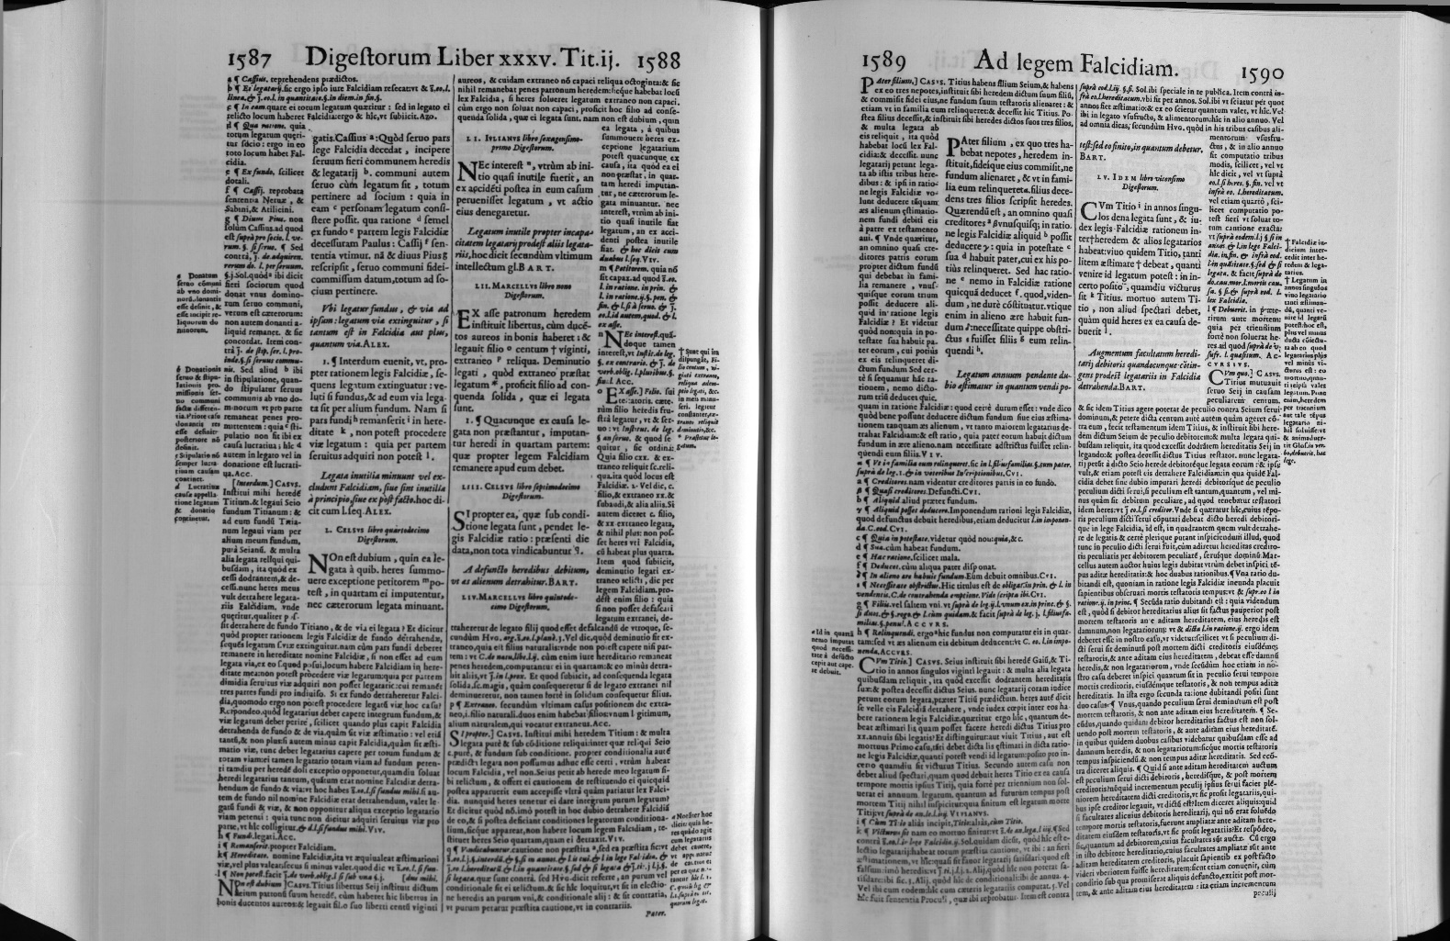
Glossa ordinaria

Slide 11
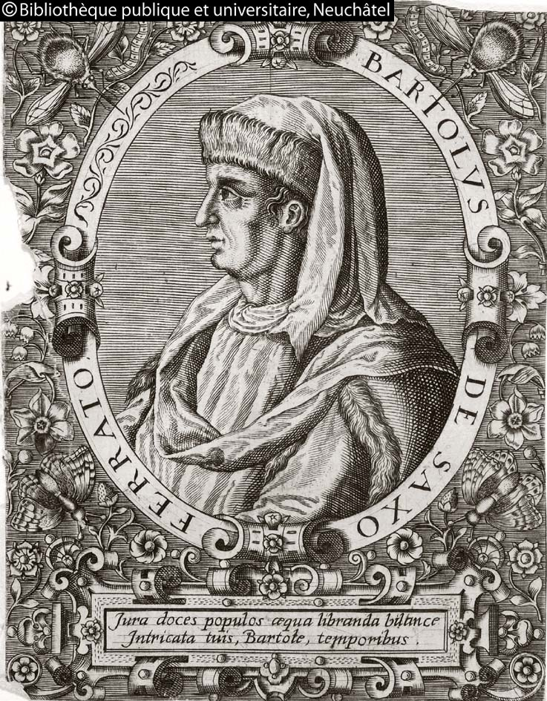

Slide 12
France
Breviarium Alaricianum, Provence, Bourges, Montpellier
provensálsky Lo Codi (summa ke Codici Iustinianeo)
Pope Honorius III.: 1219 bulla Super specula: Teaching Roman Law in Sorbonna forbidden
Rex Franciae est imperator in regno suo. => imperio rationis
Humanismus 16. st.=> mos gallicus
kriticko-historická a filologická metoda (příklad)
Absynthium Accursianum bibere. Hotomanus: Antitribonianus
Graeca (non) leguntur
Alciatus, Duarenus, Haloender, Cuiacius,
1572 Massacre de la Saint-Barthélemy
1583 Dionysius Gothofredus: CIC (obrázek)

Slide 13
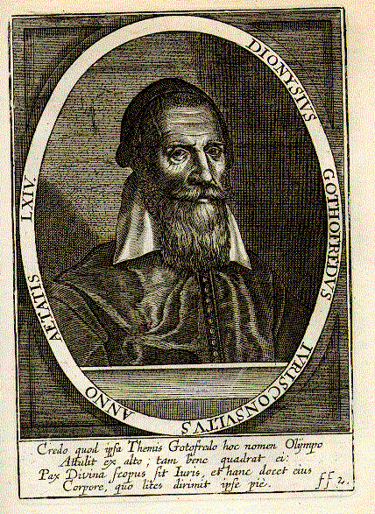

Slide 14
Germany
Translatio imperii, 1125–1137. Lotharische Legende
1495 Reichskammergericht => cameral jurisprudence
ius commune=mos italicus=gemeines Recht, no need to prove
16th–18th Usus modernus Pandectarum
Samuel Stryk,Benedict Carpzow,Ulrich Zasius,Samuel Pufendorf
19th Historickoprávní škola
Volksgeist, CIC
Friedrich Carl von Savigny, Georg Friedrich Puchta, Mommsen
2nd half of19th. Pandektenrecht
BGB: Allgemeiner Teil, Recht der Schuldverhältnisse, Sachenrecht, Familienrecht, Erbrecht
Karl Ludwig Arndts von Arnesberg (Lehrbuch der Pandekten)
Rudolph von Jhering: Geist des Römischen Rechts, Begriffsjurisprudenz

Slide 15
UK
1139 Vacarius (Bologna/Oxford): Liber Pauperum
1236 Nolumus leges Angliae mutari
Common law v. Law of equity
Scotland (reception under the Houses of Tudor and Stuart)

Slide 16
The Netherlands
1572 Massacre de la Saint-Barthélemy
1575 Leyden
School of Elegant jurisprudence
critical-historical studies and legal praxtice
Roman-Dutch Law
Donellus, Johannes de Voet, Gerhard Noodt

Slide 17
Are There Any Questions?
… if not, thank You for Your attention

