Slide 1
Roman State and Sources of Law

Slide 2
Roman State
Monarchy
  Rex, senatus, comitia curiata
Republic
  Magistratus cum imperio/potestate
    Consul, praetor, questor, censor, aedilis, dictator, tribunus plebis,…
  Senatus
  Comitia curiata, calata, centuriata, tributa, plebis tributa
Principate+Dominate
  Emperor, imperial officers/offices

Slide 3
Sources of Law
Formal
Material
Cognitive

Slide 4
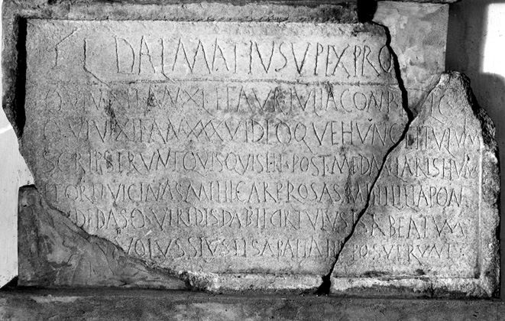
Notes:
http://cil.bbaw.de/test06/bilder/datenbank/PH0003944.jpg (only for illustration)

Slide 5
Sources of law - overview
Lex duodecim tabularum
Lex x ius
See Gai Inst. 1, 2: acts, plebeian statutes, resolutions of the Senate, imperial enactments, edicts, answers by jurists
Edictum perpetuum Hadriani
Leges
Codex Theodosianus (CTh)
Lex citationis
CIC
  Digesta seu Πανδέκται
  Codex
  Institutiones
Byzantine: Ἐκλογή, βασιλικά
Notes:
Note: Byzantine Law is mentioned only for illustration, it will not be required for exam.

Slide 6
Are There Any Questions?
… if not, thank You for Your attention

