Slide 1
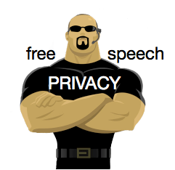
Privacy protection online II
Free Speech and Media law
MVV1368K Privacy and Personal Data
Matěj Myška
František Kasl

Slide 2
Structure of the seminar
1) Essays
  Basic info + readings
2) Topics
  Do celebrities have any privacy?
  Protection of whistleblowers
  Free press as a watchdog
3) Slides
  Title – Question – Discussion - Information

Slide 3
Essays - Topics
Essay Deadline: 31 October, 8:00 AM
approx. 10 500 - 16 000 characters long (+ footnotes) = 5-8 pages
For further essay requirements see interactive sylabus
Presentation day (only students with Presentation No. 1): 1 November
  Do celebrities have any privacy?
  Protection of whistleblowers - a necessity in the transparent democratic society?
  Free press as a watchdog and the obligation to protect sources - are there any limits?

Slide 4
Readings
Padawan level:
  GULDE, Jonas, 2013. An Assessment of the European Court of Human Rights’ Balancing of the Rights to Privacy and Freedom of Expression - Is It Satisfactory. Edinburgh Student Law Review [online]. 2015 2013. Vol. 2, p. 29–41. [Accessed 29 September 2018]. Available from: https://heinonline.org/HOL/P?h=hein.journals/edinslr2&i=40
  REID, Elspeth, 2012. Rebalancing Privacy and Freedom of Expression Analysis. Edinburgh Law Review [online]. 2012. Vol. 16, p. 253–258. [Accessed 29 September 2018]. Available from: https://heinonline.org/HOL/P?h=hein.journals/edinlr16&i=254

Slide 5
Readings
Initiate level:
  WESTKAMP, Guido, 2012. Private Life and the Margin of Appreciation, Introductory Note to the European Court of Human Rights: Alex Springer AG v. Germany and Von Hannover v. Germany (No. 2). International Legal Materials [online]. 2012. Vol. 51, p. 631–684. [Accessed 29 September 2018]. Available from: https://heinonline.org/HOL/P?h=hein.journals/intlm51&i=677 (contains text of the cases)
  SMITH, Robin Callender, 2012. From von Hannover (1) to von Hannover (2) and Axel Springer AG: Do Competing ECHR Proportionality Factors Ever add up to Certainty. Queen Mary Journal of Intellectual Property [online]. 2012. Vol. 2, p. 389–393. [Accessed 29 September 2018]. Available from: https://heinonline.org/HOL/P?h=hein.journals/qmjip2&i=389

Slide 6
Readings
Knight level:
  KROTOSZYNSKI, Ronald J. Jr., 2014. Reconciling Privacy and Speech in the Era of Big Data: A Comparative Legal Analysis The Contemporary First Amendment: Freedom of Speech, Press, and Assembly Symposium. William & Mary Law Review [online]. 2015 2014. Vol. 56, p. 1279–1338. [Accessed 29 September 2018]. Available from: https://heinonline.org/HOL/P?h=hein.journals/wmlr56&i=1326
Master level:
  CANATACI, Joseph, ZHAO, Bo, VIVES, Gemma, MONTELEONE, Shara, BONNICI, Mifsud, PIA, Jeanne and MOYAKINE, Evgeni, 2016. ID 2883043: Privacy, Free Expression and Transparency: Redefining Their New Boundaries in the Digital Age [online]. SSRN Scholarly Paper. Rochester, NY: Social Science Research Network. [Accessed 29 September 2018]. Available from: https://papers.ssrn.com/abstract=2883043
Recommended & Interesting
  The Global Principles on Protection of Freedom of Expression and Privacy - http://article19.shorthand.com/
  https://globalfreedomofexpression.columbia.edu/cases/
  Case Law - https://rm.coe.int/freedom-of-expression-the-media-and-journalists-iris-themes-vol-iii-de/16807c1181 - introduction 33-39

Slide 7
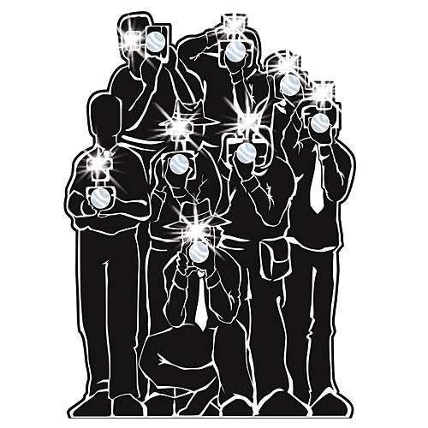
  Do celebrities have any privacy?

Slide 8
Quick recap: Privacy
Privacy and why does it matter?
control over self-determination
  freedom to choose one´s future – „freedom to make mistakes“
  expression and development of unique personality + social profile
  control over one´s outside image – self-esteem/self-representation
personal data = data about an individual
private sphere = intimate / vulnerable / „true self“
types of privacy – spatial x social x intellectual x informational
levels of privacy - solitude x intimacy x anonymity x reserve
=> surveillance = attempts to profile for outside control = public – excessive behaviour / private – customer behaviour
data profile + data processing
  control over profile => categorization => prediction („pre-crime“ / „minitrue“ / „what is not on the menu?“)
  control over individual - capacity for discrimination / normalization / manipulation
Notes:
pre-crime – minority report
minitrue – ministry of truth - orwell

Slide 9
Quick recap: Surveillance v Privacy
Why worry, if you have nothing to hide?
„systematic investigation or monitoring of the actions or communications of one or more persons“
Electronic communications => Dataveillance => Data Trail
  chilling effect
    omnipresent surveillance in public places
    surveillance through private online activities
  Freemium business model
  ISP liability – eCommerce directive
    notice-and-action framework
      delegated enforcement
      Private censorship vs. protection from „info-pollution“

Slide 10
Freedom of expression
What is the underlying value for free speech?
value – purpose – moral justification
  basic foundation of any democratic society
  central part in protection of the fundamental rights
  protection of public debate, opposite views, speaking one´s mind, discourse, dissent
conflict of rights
  personality rights = privacy / dignity / reputation...
abuse of free speech
  fake news / disinformation / slander / libel / hate speech

Slide 11
Sharing v harassment
How does the context matter in free speech?
Context
  consent / awareness / avoidance
  positive x negative x embarassing x misleading
Targeted attention => intrusion of privacy?
  actively seeked attention X undesired attention
  position of the target
  position of the observer / public
free speech + social media
  new platform of presence / mass communication
  reporting about others X reporting about oneself
  fragmentation of sources – users become reporters

Slide 12
In the spotlight
What is public an what is private?
public life vs private life
  exercise of official function x
  activities of purely private nature
    hobbies, walks, visit to restaurant, holiday activities
  paparazzi => omnipresent surveillance?
  recognizable face => nowhere to hide?
reporting what the people want?
  contributing to public debate in democratic society X satisfying the interest of viewers/readers

Slide 13
Dark side of attention
How to take into account morals in free speech?
information obtained in bad faith
  hacking of celebrity cloud
    dissemination of intimate pictures
    iCloud hacking 2014 – 4 perpetrators jailed
  fake pictures / deep fake videos
    machine learning + database of images => fake reality
information shared in bad faith
  revenge porn
    victims – undesired attention – abuse of trust
  cyber abuse / virals
    online public shaming, social media / youtubers / twitter
  cyber hate
    discrimination, threats
    political / xenofobic / chauvinistic / religious

Slide 14
Von Hannover case
What public deserves to know about royalty?
right to reasonable expectation of privacy for celebrities?
„it ain´t what you do, but the way that you do it“
  Melvin „Sy“ Oliver
paparazzi in public places – free speech?
protection of privacy X protection of media – equal rights
5 criterion test
  relevant to debate of general interest
    public interest in publication – particular reason that goes beyond mere „interested public“
  status of the person in question
    degree of fame – figure of contemporary society „par excellence“
  subject of accompanying report
    illness of the monarch and behaviour of the family
  person´s prior conduct in press
    Von Hannover case (2004)
  specific content, form and consequences of publication
    circumstances in which the photos were taken – surrreptitiously or by secret means?

Slide 15
Public interest
How to separate gossip from reporting?
public debate
  benefitial informative value X mere interest
  interest of a group (fans) X broader public
  position of the person (royalty/politician/celeb)
  broader impact (role model/influencer/trend)
public recognition and fame
  waiver of one´s right to complete anonymity X limits
  official acts and apperances X private activities
  attention by media X constant shadowing and harassement (online / offline)

Slide 16
Publicly known persons
Privacy of suspect v privacy of victim?
famous by their own choice?
Publicly active persons
  politicians, head state officials, judges, state attorneys, royalty
  news anchors, reporters, journalists, moderators, actors, musicians, models, celebrities
  youtubers / influencers
„one-time heroes“ / suspects and criminals
victims of crime / of shaming (viral videos)

Slide 17
Justified criticism
What conditions should be met?
Venice commission 2004 - Council of Europe - Amicus Curiae Opinion on the Relationship between the Freedom of Expression and Defamation
permissiblity of evaluative judgement
  standard of need to prove the truthfulness of the claimed facts
    fact vs. opinion
  legitimate criticism
  reasonable reasons for truthfulness of the defamatory information
  prove of adequate attempts towards verification of its truthfulness
    questioning the affected person included - publication of his/her position
  absence of known reasons for holding the information for untruthful
  motivation for publication
  complex assessment of the claimed defamatory facts + impact of context factors

Slide 18
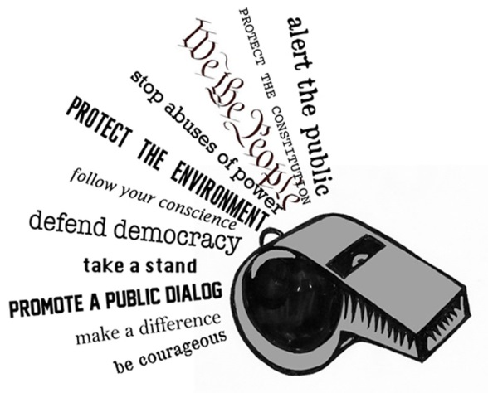
  Protection of whistleblowers

Slide 19
Protection of whistleblowers
People „who stand up for what is right“?
not only free speech vs. privacy, but also privacy of free speakers
public interest in their story X personal reprecusions
  Wikileaks, Dieselgate, Luxleaks, the Panama Papers, Cambridge Analytica...
uncovering unlawful activities that damage the public interest
proposal for EU-wide standards – April 2018
  Safe (clear, confidential) channels for reporting within an organisation / to public authorities
    three tier reporting system
      internal reporting channels
      reporting to competent authorities
      public/media reporting
  All forms of retaliation (dismissal, demotion...) are forbidden and should be sanctioned
  Training for public authorities on how to deal with whistleblowers
  feedback obligations for authorities and companies (follow-up to the whistleblowers' reports within 3 months)
  The burden of proof will be reversed in such cases
  Whistleblowers will also be protected in judicial proceedings (exemption from liability for disclosing the information)

Slide 20

  Free press as a watchdog

Slide 21
Media
What role do media play?
traditional (established) media
  editorial boards – scrutiny of published content
  ethic standards – neutrality / verification of sources
  public vs. private media
  legal limits concerning content (young viewers protection / time slot allocation / advertisement limitations / minority rights to authentic content)
new media (online/audiovisual)
  social networks / youtubers / online media portals
  fragmented / limited regulation / platform rules
  passive public => active contributors – content quality?

Slide 22
Axel Springer case
Right to one´s reputation v press as watchdog?
Parameters
  contribution to the debate of general interest
    arrest and conviction of drug abuse
  fame of the person
    actor – public figure – role model
  subject of the report
    cocaine abuse
  conduct of the person prior to publication
    „actively sought the limelight“ => legitimate expectation of privacy?
  how the information was obtained
    bad faith? – balancing test – reliable source + verified information

Slide 23
Protection of sources
Is anonymous information trustworthy?
Without guarantee of anonymity, many would be deterred from coming forward
  X traceable electronic communications => surveillance = possible to determine the origin of information
    Secure and private web browsing - Tor
    End-to-end encryption communication – Signal
    Secure file storage and encrypted sharing – VeraCrypt
    Password managers – KeePassXC
    Two-factor authentication and its innovations - physical security key
„[p]rotection of journalistic sources is one of the basic conditions for press freedom“
  ECHR case of Goodwin v. United Kingdom (1996)
Council of Europe - Recommendation No. R (2000) 7 of the Committee of Ministers to member states on the right of journalists not to disclose their sources of information
Recent cases - NYT White House opinion piece / Syrian war reporters

Slide 24
Right to response
Free speech v equal voice on the issue?
In traditional media – relative personality right
  obligation to publish free of charge a response of the affected person with similar form as the original story
    against factual claims (= where test of truthfulness applicable) X not applicable to assessments, polemics or criticism
  common in EU – based on Directive 89/552/EHS (as modified by 97/36/ES)
X new media = online audiovisual media services
  Council of Europe 2004 - Recommendation Rec(2004)16 of the Committee of Ministers to member states on the right of reply in the new media environment
  Recommendation of the European Parliament and of the Council of 20 December 2006 on the protection of minors and human dignity and on the right of reply in relation to the competitiveness of the European audiovisual and on-line information services industry (OJ L 378, 27.12.2006, p. 72–77)

Slide 25
Social media and free speech
How effectively mitigate the environment of hate?
Increasing pressure on ISP providers to effectively identify and suppress illicit content
  Terorrist propaganda, incitement of hatred, hate-speech, cyber-bulling, fake news, propaganda disinformation or interference with personality rights
  Social media content moderator – impossible job => role for AI?
Netzwerkdurchsetzungsgesetz in Germany
EC operational measures on tackling illegal content online 2018
High-Level Expert Group on Fake News and Disinformation Spread Online by the European Commission
3/2018 Report on a multi-dimensional approach to disinformation

Slide 26

Thank you for your attention!
Questions?
Ideas?
Answers?
Looking forward to your essays!

