Slide 1
17th-19th century

Slide 2
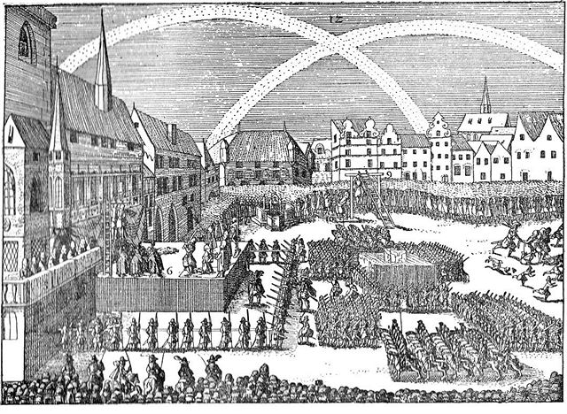
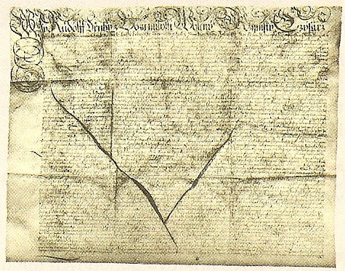
Czech war 1618-1620
1618 – defenestration of catholic memebers of the governament
1618- 1620 war
1620 – the protestants bohemian army defeat in battle of Bílá Hora at Prague
1620 – rigth of the victor – the state lost all privilegies, principle „Quius regio, eius religo - recatholistation
1621 – Old town execution od 27 heats of protestant governament (lords, knihgts, citizens)
1627 – Verneuete landesordnung für Erbkönigsreich Beheim
1628 - Verneuete landesordnung für Erbkönigsreich Mähren
Neu legal order of the land law –the end of the medieval law

Slide 3
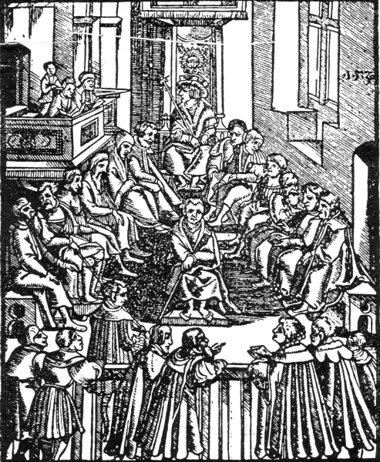
Verneuete Landesordnungen
New legal order
New sources of law
Codification and Kings acts
Ius legis ferrendae
Condress has no more legislativ initiativ (crimen laese maiestatis)
New court praxis
German language
Written procedure (roman-canonic)
Secret
Medieval legal Order
Medieval sources of law
Custom law
Precedens
Privilege
Codifications
Act of congress (15century)
Medieval court praxis
Only czech language
Oral procedure
Public

Slide 4
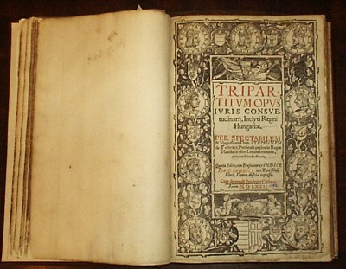
Hungary
Custom law
Tripartitum Opus Iuris – draft of codification by Stephan Verböczy
Acts x until half 19th century has custom law priority
End of custom law after the WW2

Slide 5
Reforms of Maria Theresia and Joseph II
Pragmatic sanction - (Charles VI.)
1749 – Centralisation of state – all bureaus in Wienna and germanisated
Enlighted feudalism
1769 - Constitutio criminalis Theresiana
1774 – Obligatory basic school
1176 – Tortury prohibited
1781 – Serfhood abolishment
1781 – Decree of Tolerance – for protestants and ortodox church
1781 – General Code of civil procedure – první stupeň dle stavů x 2. a 3. stupeň již pro všechny stejný – všichni jsou si rovni
1787 - General Code on Crime and their Punishment – first time the principle: nullum crimen sine lege a nulla poena sine lege, inspiration in Code of Leopold II (Tuscana), the ideas of Caesare Becaria

Slide 6
19th century constitutional developement
Metternich´s absolutisms – an effort to maintain feudalism
1848 – Revolution
1848 Pillersodrf´s constitution (april 1848) – ordered by empor
Congres in Kroměříž – new constitution
1849 – Stadion´s constitution (march 1849) - ordered by empor
Hungarian uprising (Hungarian republic) 1849 x capitulation at Siria (today Rumenia) hugarian name Vilagos
Alexander Bach´s absolutisms (neoabsolutism)
Political niveau – Patents of Silvester (31. 12. 1851) – abolishment of Constitution x guaranted no more serfdom, tolerance of conffesion, equality befor the law, byrocratical regime, security police, „everthing for peolpe, but not per people“
Economical nieveau – trade reguation, ralway act, mining act
1859 battle of Solferino – end of Absolutism, exchequer was empty
1860 – end of absolutism by Empor´s diplom of october 1860, special position of Hungary
1861 – Schmerling´s (february) constitution – centralistic + ordered by empor
1867 – December constitution - not ordered

Slide 7
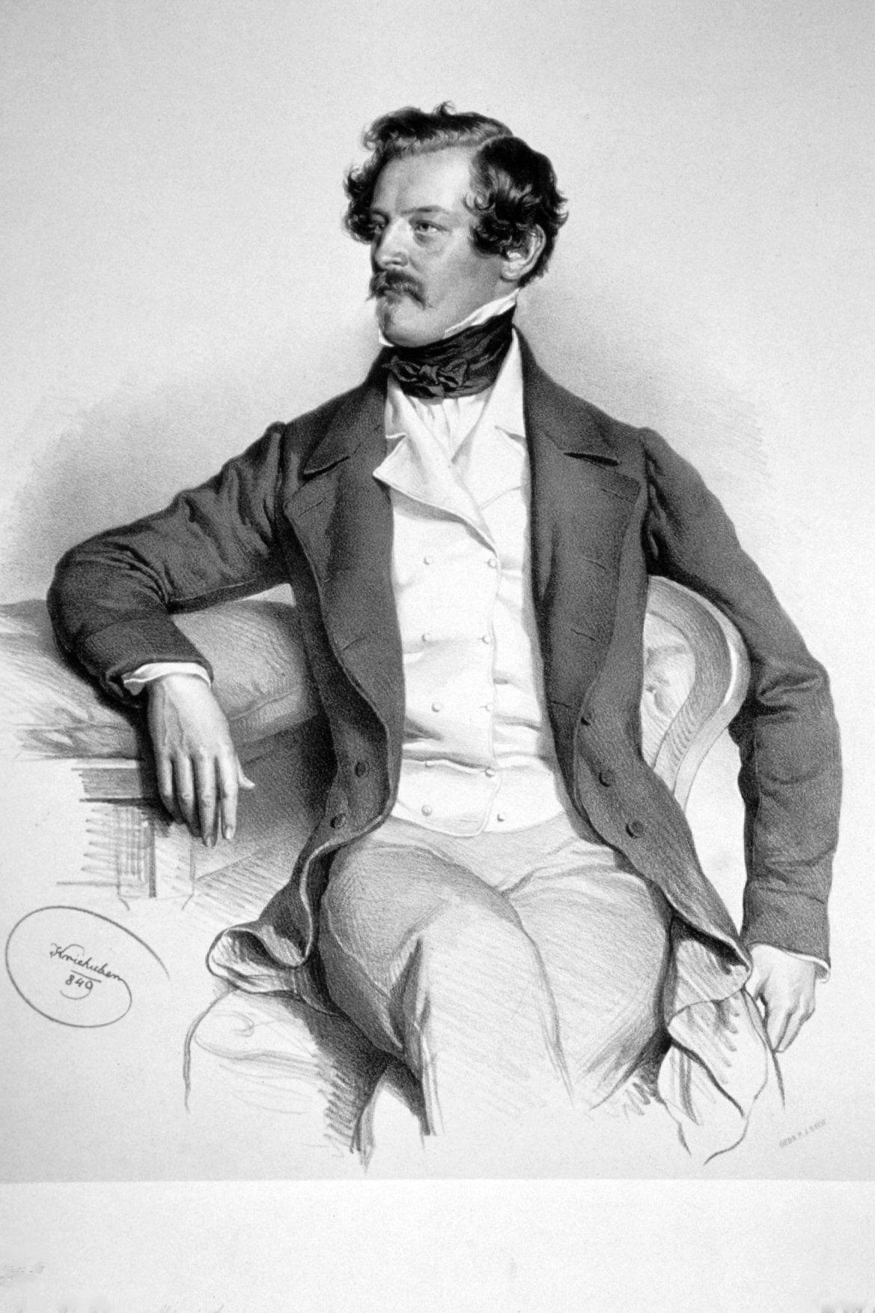
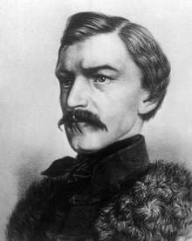
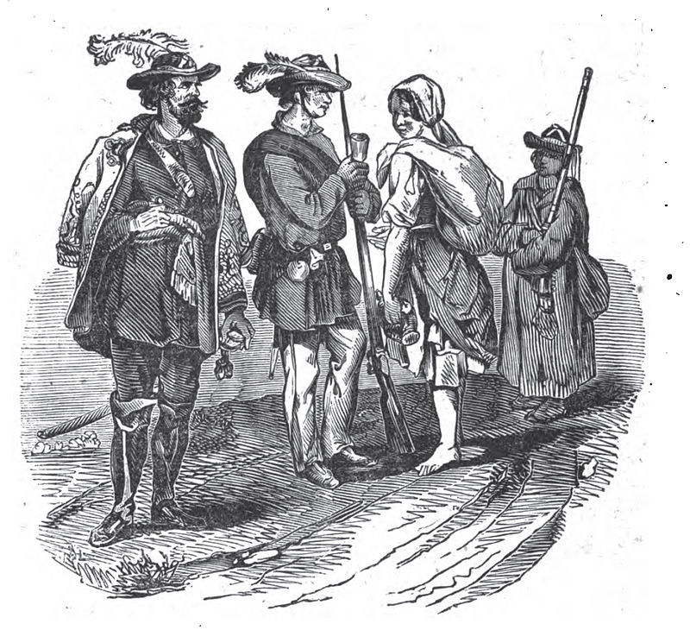
Neoabsolutism, Czechs and Slovaks
Czech
Time of oppression
Persecution of czech activities, czech newspaper
Slovak
Persecutions of Hungarians
Hungarian law lost validity (austrian law is valid until 1861)
Germanization, political persecution of Hungarian – they don´t have time for hungarisation of other citizen of hungary
Time of release for Slovaks
See also: https://en.wikipedia.org/wiki/Slovak_Uprising_of_1848%E2%80%9349

