Slide 1
Internet governance and the The domain name

Slide 2
Domain vs domain name?
Domain name:
muni.cz
Domain:
.cz = domain
muni = subdomain

Slide 3
How the system works?
The user enters a domain name into the browser
The browser sends an inquiry to the “name server”
Name server searches the “domain sentence” in the DNS database and “translates” the domain name into the IP adress
The browser connects to the server
=> DNS (domain name system)

Slide 4
Structure of a domain name
Root domain . (always the highest position – depends on the situation)
Top level domain (TLD)
Generic- .com .gov .org .biz .edu
National- .cz .uk .de .sk .ru
Subdomain
muni.cz seznam.cz google.com
Subdomains of lower levels
law.muni.cz pocasi.seznam.cz mail.google.com

Slide 5
wikipedia.org

Slide 6
Functions of a domain name
Technical
?Identification?
Not necessarily – e.g.goodwill.com
Search
Promotion
Competitive

Slide 7
How domain names are assigned
Assignation is based on registration
The database of domain names is maintained by Administrators/Sponsors
Each top level domain has its administrator ICANN, EURid, CZ nic
The main task of administrator is to run DNS
The registration of domain names to individual users is performed by REGISTRARS
Registrars are entrepreneurs and compete

Slide 8
Main principles of registration
Singularity principle (uniqueness)
The domain name can be registered only for one user
One user can have more domain names
Priority principle
First come first served

Slide 9
ICANN – top authority
Internet corporation for assigned names and numbers
responsible for managing and coordinating the Domain Name System (DNS)
ICANN is also responsible for accrediting the domain name registrars

Slide 10
Domain speculations
And abusive registrations

Slide 11
The ultimate consequence of priority and singularity principles
Competition for privileged domain names
Fastest user wins the race
Creates space for abusive domain name registrations
Cybersquatting
Typosquatting
Domain Kiting
Domain Hijacking

Slide 12
Legal concept of a domain name

Slide 13
Legal definition of a domain name
Property (?)
Contract (?)
Legal institute sui generis (?)
Practical meaning
Can you sell a domain name?
Can we apply the fundamental right of property?
Is there any “absolute right” for a domain name?
Can you inherit a domain name?

Slide 14
Domain name as a contractual relationship?
Domain name holder
Registrator
Contract ?
Contract ?
Contract ?
Administrator

Slide 15
Domain name as a Property ?
Owner
Domain name

Slide 16
International perspective
(US, UK,)
Domain names are creatures of contract Discussion – they are also intangible property with limitations (UK, US)
Germany
Not a „thing“ but „contract“ (vertraglich Anspruch)
It is a part of property/has value (Vermögenswert)
Protected by trademark law (globally) in certain cases
Discussion –
Should the concept be reviewed

Slide 17
Who controls the DNS?

Slide 18
Internet governance

Slide 21
Proprietory or open format ?
The first proprietory format was unsuccessfull
Telecommunications
Cable TVs
Banks(SWIFT)
Intranet
LAN

Slide 22
1982
TCP/IP –
Vyvinul Stanford a UCL
Army – the first user
After that IBM, AT&T and DEC

Slide 23
1988
Established by US government
Administers IP adresses and domains
LDNS“ Office

Slide 24
1991 Browser

Slide 25
ISOC 1992
Non-profit organization
Standards coodination
Internet Engineering Task Force (IETF),
Internet Architecture Board (IAB),
Internet Engineering Steering Group (IESG),
Internet Research Task Force (IRTF).

Slide 26
1998
Internet Corporation for Assigned Names and Numbers
From „single stakeholder“ to „multi-stakeholder“

Slide 27
ICANN

Slide 28
After 2016
The contract between USA and ICANN runs out
Either – completion of multi-stakeholder model
Or – return under US government

Slide 29
ICANN – top authority
Internet corporation for assigned names and numbers
responsible for managing and coordinating the Domain Name System (DNS)
ICANN is also responsible for accrediting the domain name registrars

Slide 31
https://www.icann.org/en/system/files/files/iana-stewardship-transition-proposal-10mar16-en.pdf

Slide 32
ICANN – top authority
Internet corporation for assigned names and numbers
responsible for managing and coordinating the Domain Name System (DNS)
ICANN is also responsible for accrediting the domain name registrars

Slide 33
How to get a new TLD?

Slide 34
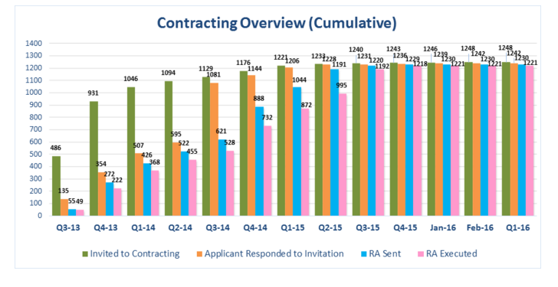
HOW many TLD are there now?
CCA 1400
https://en.wikipedia.org/wiki/List_of_Internet_top-level_domains

Slide 35
What do they have in common?
In terms of registration eligibility?
Not much
In terms of registration proces?
Not much – not every site needs to operate via „registrators“
In terms of jurisdiction
Not much

Slide 36
What is harmonized?
Trademark protection
Alternative dispute resolution
Applies to new TLD
LTD prior to such

Slide 37
Alternative dispute resolution
The harmonized solution

Slide 38
Reasons
Increased volumes of squatting cases
Problems with international element
Insufficient national regulation
Low experience of judges with cybersquatting and IP law in general

Slide 39
Alternative resolution - principle
Arbitration clause in the terms and conditions of registrations
Third parties have the right (not duty) to file a complaint at a selected arbitration institution
Arbitration clauses are contained in the majority of domain names

Slide 40
UDRP
Response
Panel
Notification
File complaint
Decision
Implementation
Review
0
+3
+1
+20
+5
+14
+3
+10
Commencement
56 days

Slide 41
UDRP
Trademark holder
?
Domain name holder
Registrar
Administrator

Slide 42
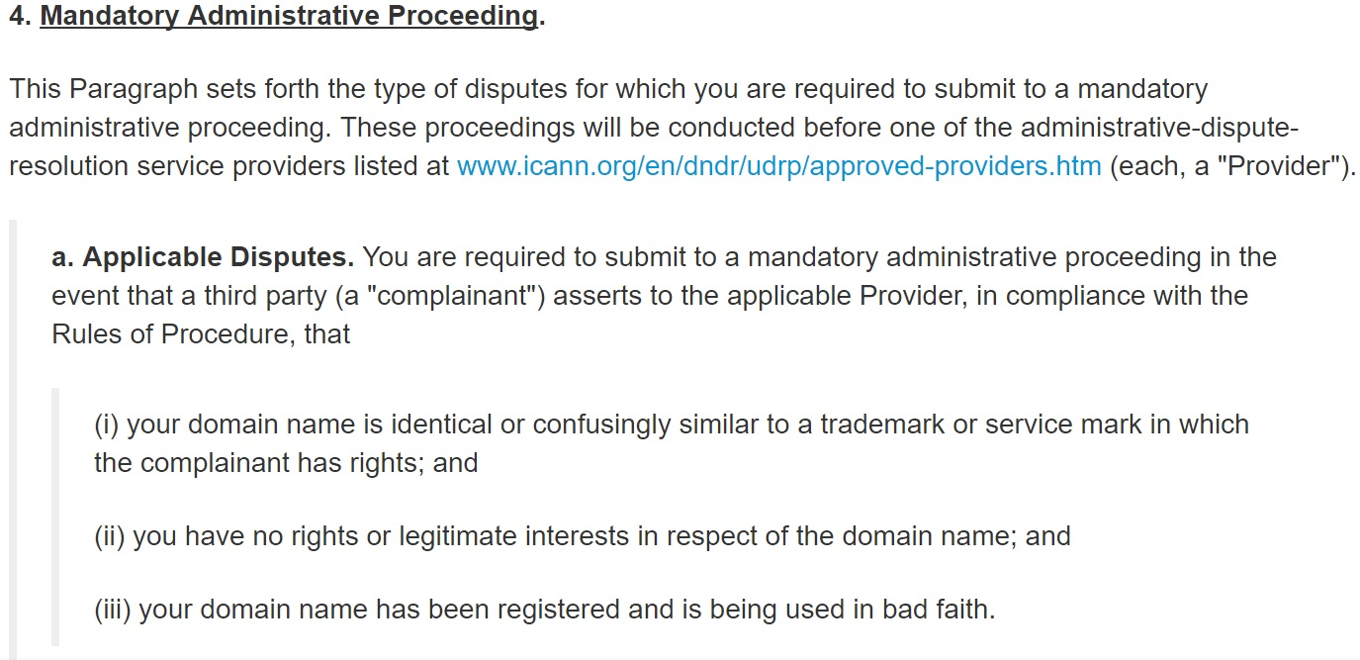
Cumulative condition

Slide 43
Another problem
Defensive registrations
215,835 .xxx domains. 132,859 are, adult-related sites, while 82,976 are merely defensive registrations

Slide 44
Why Taylor Swift is buying adult web domains (fortune.com)

Slide 45
.porn as a business model?
COSTS
INCOME
1 million dollars
150 dollars per registration per 5 years
1 000 000 / 150
All you need is 6 000 Celebrities and companies who make „smart business move“

Slide 46
Trends to help trademark and personal rights

Slide 47
RESERVED NAMES
SUNRISE PERIODS
UDRP procedure
RRP procedure

Slide 48
RESERVED NAMES
https://www.icann.org/sites/default/files/packages/reserved-names/ReservedNames.xml

Slide 49
Trademark Clearinghouse

Slide 50
SUNRISE PERIODS

Slide 51
Domain disputes

Slide 52
How to be legally protected from squatters?
Competition law
Trademark law
Geographical indications
Commercial name (firma)
Right for privacy

Slide 53
UNFAIR COMPETITION
§2976 –
"conduct in economic competition
conflicts with the accepted practices of competition
may be detrimental to other competitors or customers.
Unfair competition is prohibited.

Slide 54
UNFAIR COMPETITION
misleading marking of goods and services
svycarskehodinky.cz, gooogle.com, vikipedia.org
parasitic use of the reputation of another competitor's enterprise, products or services

Slide 55
Domain names and right for privacy and personality rights
UDHR Article 12
No one shall be subjected to arbitrary interference with his privacy, family, home or correspondence, nor to attacks upon his honour and reputation. Everyone has the right to the protection of the law against such interference or attacks.
Charter of human rights – Article 10(1)
Everyone has the right to demand that his human dignity, personal honor, and good reputation be respected, and that his name be protected.

Slide 56
Possible violations of personal rights
Paroubeknamars.cz
bushsucks.com
Ihategates.com (inactive)
Juliaroberts.com
Britneyspears.com

Slide 57
Protection of company names - § 423 Civil code
FIRMA
FIRMA is potected by unfair commercial rules

Slide 58
Trademark
Exclusive right to use the trademark in connection with goods and services

Slide 59
Example
Squatter registers a domain sony.cz and offers it for sale
Can these companies rely on the protection on the company name claims?
Sony Music Entertainment Czech Republic s.r.o.
Sony Music Entertainment Czech Republic s.r.o.
SONY Czech, spol. s r.o.
Sony Ericsson Mobile Communications International AB Branch Office Czech Republic,

Slide 60
Example
Squatter registers the domain lego.cz
He does not use this domain and offers it for sale for 200 000 Kč
Can the trademark owner claim violation of his rights?
Can the trademark owner claim transfer of the domain name?
What if the owner is based in denmark, administrator is Czech and squatter Russian?

Slide 61
.eu domain
Established „by law“
733/2002/EC
To accelerate e-commerce
Promote common market
Accelerate benefits of information society

Slide 62
Structure of the .eu domain
REGISTRY
REGISTRARS
USERS

Slide 63
REGISTRY (sponsor)
Administers the .eu domain
EURid
Non profit company
Established under Belgian law

Slide 64
Registrars
Independent entities
Have to be accredited by the registry
Do not have to be European
Currently cca 900 accredited registrars

Slide 65
USERS - Eligibility criteria (Art 3)
undertaking having its registered office, central administration or principal place of business within the Community, or
organisation established within the Community without prejudice to the application of national law, or
natural person resident within the Community;

Slide 66
Policy rules (874/2004)
Requirements for domain name applications
Requirements for registrars
Requirements for registrar accreditation
Languages
Registration procedures

Slide 67
Language
For any communication by the Registry that affects the rights of a party in conjunction with a registration, such as the grant, transfer, cancellation or revocation of a domain, the Registry shall ensure that these communications are possible in all official languages.

Slide 68
Protection of rights in .eu domain

Slide 69
Protection of rights
1. “sunrise perionds”
2. Alternative dispute resolution

Slide 70
Sunrise periods
1st period
only registered national and Community trademarks, geographical indications, public authorities
2nd period
names that can be registered in the first part as well as names based on all other prior rights
3rd period – all other users

Slide 71
Alternative dispute resolution

Slide 72
2 POSSIBLE ADR PROCEDURES
Rightholder vs. domain name holder
Domain name applicant vs. registry

Slide 73
Rightholder vs. User
Compulsory for the holder of a domain name and the Registry.
Not for the Rightholder
Question of “speculative or abusive registration”

Slide 74
Speculative or abusive registration Is
When a domain name
a) has been registered by its holder without rights or legitimate interest in the name;
or
(b) has been registered or is being used in bad faith.

Slide 75
Legitimate interest
(a) the holder has used the name for the offering of goods or services
(b) the holder has been commonly known by the name,
even in the absence of a right recognised by law
(c) the holder is making a legitimate and non-commercial or fair use of the domain name,
without intent to mislead consumers
or harm the reputation of a name on which a right is recognised or established by national and/or Community law.

Slide 76
Bad faith
(a) registered primarily for the purpose of selling, renting, or transferring to the holder of a protected name
(b) prevent the holder from reflecting this name in a corresponding domain name,
provided that:
(i) a pattern of such conduct by the registrant can be demonstrated;
(ii) the domain name has not been used in a relevant way for at least two years
(c) primarily for the purpose of disrupting the professional activities of a competitor; or
(d) intentionally used to attract Internet users, for commercial gain, by creating a likelihood of confusion
(e) the domain name registered is a personal name for which no demonstrable link exists

Slide 77
Comparison ADR and UDRP
UDRP
ADR
1.Confusing similirarity
2. No legitimate interest
3. Bad faith
1. Confusing Similarity
2 No legitimate interest
or
1 Confusing Similarity
2 Bad Faith

