Slide 1

The European Union‘s biggest challenges
Financially, socially and ecologically

Slide 2
Structure
I. Introduction
II. Ecological Challenges
III. Highlight
IV. Financial Challenges
V. Highlight
VI. Social Challenges
VII. Highlight
VIII. Recapitulation

Slide 3

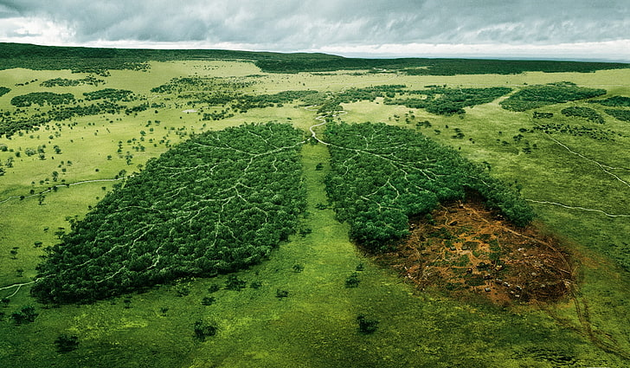
Ecological Challenges
Environmental challenges the European Union will face this decade
  Climate change/Global Warming
  Pollution of air, land and water
  High CO²-emissions
  Deforestation
  The loss of biodiversity

Slide 4

Primary Goals
Ecological Challenge Highlighted: Climate Change (and a possible solution)
The EU‘s Game Plan
and…
Boosting the economy by using “green” tech
  Using environmental problems as opportunities to transition to green energy
Creating sustainable transport and economy
  Using alternative, sustainable fuel for transport + promoting electric vehicles
  Sustainable product policy (ensuring products can be recycled and reused) to create a circular economy
Reducing pollution
  Many new initiatives in every sector; i.e. a chemical strategy called “toxic-free environment”
Climate Neutral Europe by 2050
  Net-zero greenhouse gas emissions
  Zero pollution of air, soil and water

Slide 5

Financial Challenges
Financial challenges the European Union will face this decade
  Funding of projects and plans
  Impact of Brexit on the economy
  Impact of Covid-19 on the economy

Slide 6
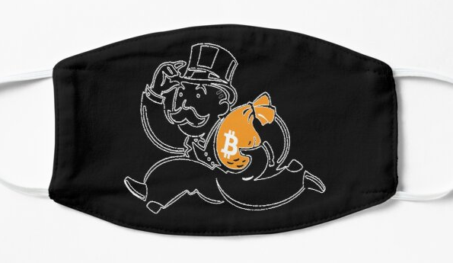
The EU‘s plan for the economic recovery:
„Next Generation EU“-Recovery Plan aims to address the damage caused by the pandemic
Financial Challenge Highlighted: The impact of Covid-19 on the economy
Facts:
The pandemic is having a major impact on the economy, disrupting it entirely
Substantial increase in unemployment worldwide
Impact on production and consumer-behavior (less supply and demand)
Impact on manufacturing industries, i.e. the automotive industry in Germany
€750 billion Euros as a recovery measure to reach three main goals
  Supporting Member States to recover (= financial support for reforms and investments)
  Kick-starting the economy and helping private investment (helping enterprises with solvency)
  Learning the lessons from the crisis (investing money into research)

Slide 7
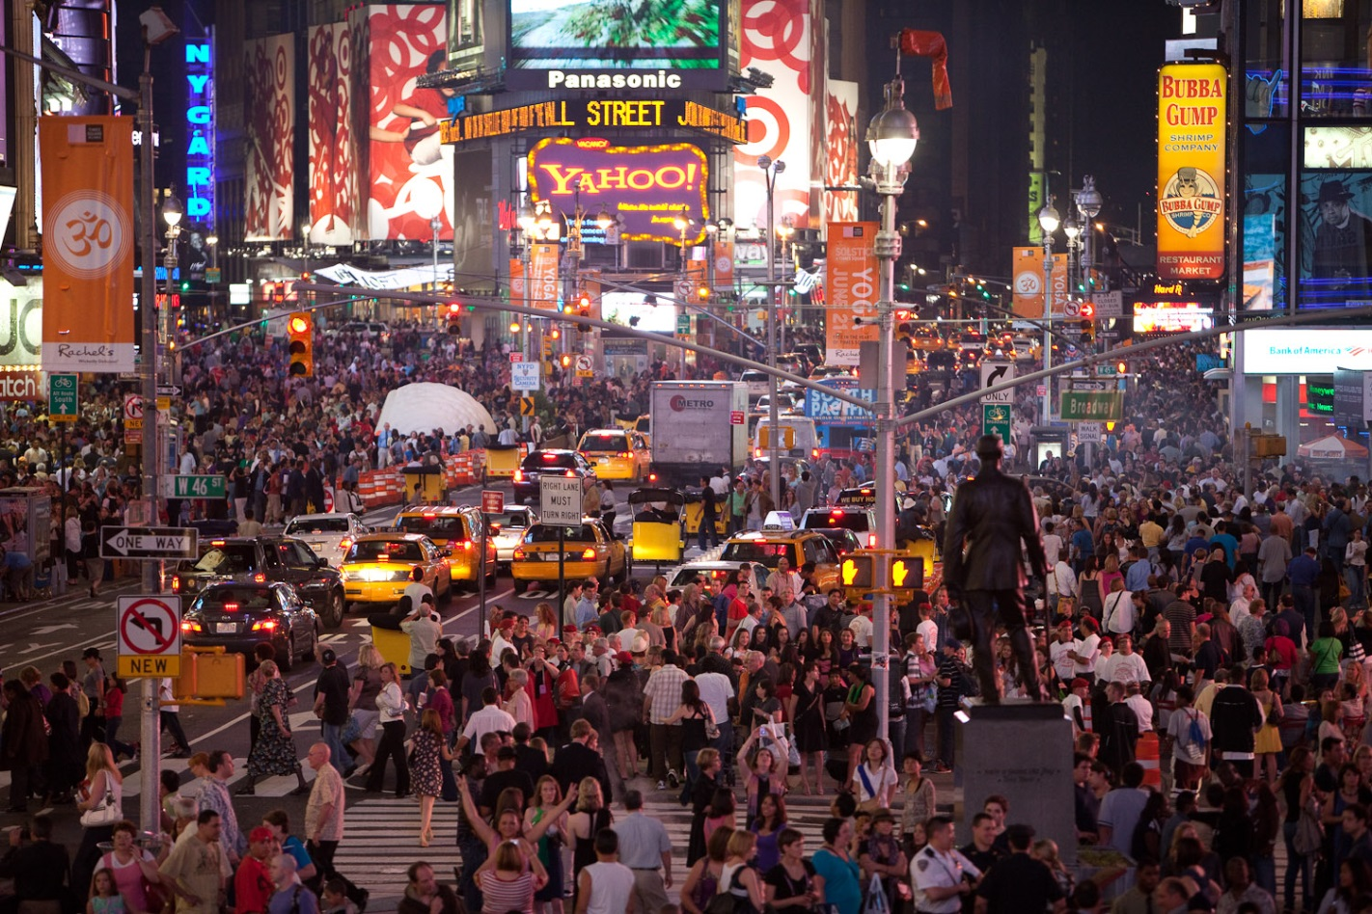
Social Challenges
Social challenges the European Union will face this decade
  Demographic change (aging population)
  Securing societies
    Fight crime and terrorism
    Increase cyber-security due to digitalisation
  Health and wellbeing in general
    i.e. increase of Alzheimer‘s disease or diabetes
  Migration-related problems
    Illegal immigration
    Integrating migrants
    Organization of Asylums

Slide 8
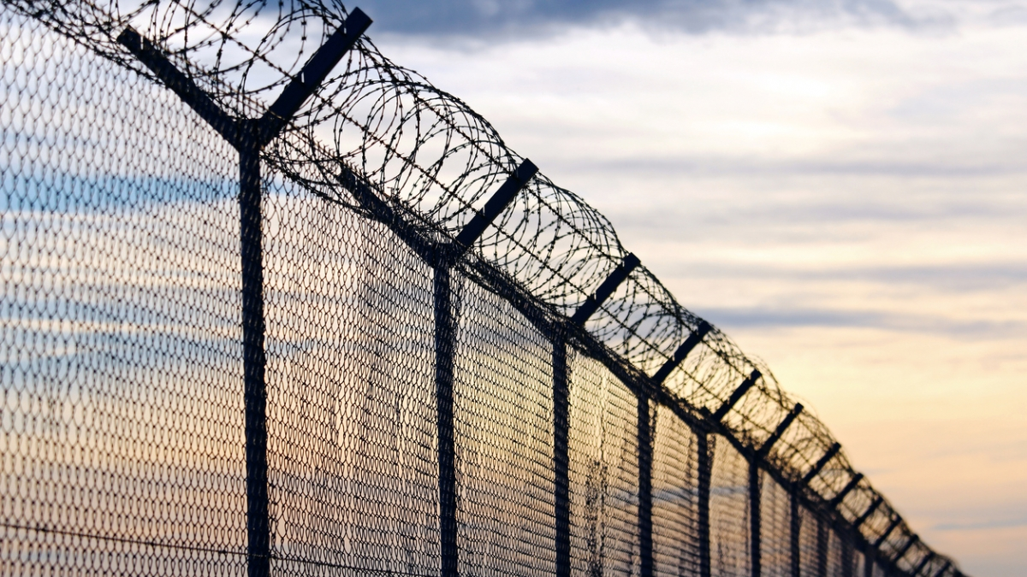
What has to be done to solve these problems?
Social Challenge Highlighted: Migration-related Problems in the EU
Why is that significant?
Strong increase of migrants in the EU
  Number of migrants in Europe has tripled in the last 10 years
  Migrants can help solve other problems
What are the main problems?
Migrants are more likely to experience poverty
Social exclusion of migrants (-> integration is failing)
Migrants being unable to apply for asylum
The European Union has to reform their policies on:
  Migration
  Asylum application
  Social inclusion
Migrants should experience more support in/with:
  Accessing health care
  Education and employment
  Language learning

Slide 9
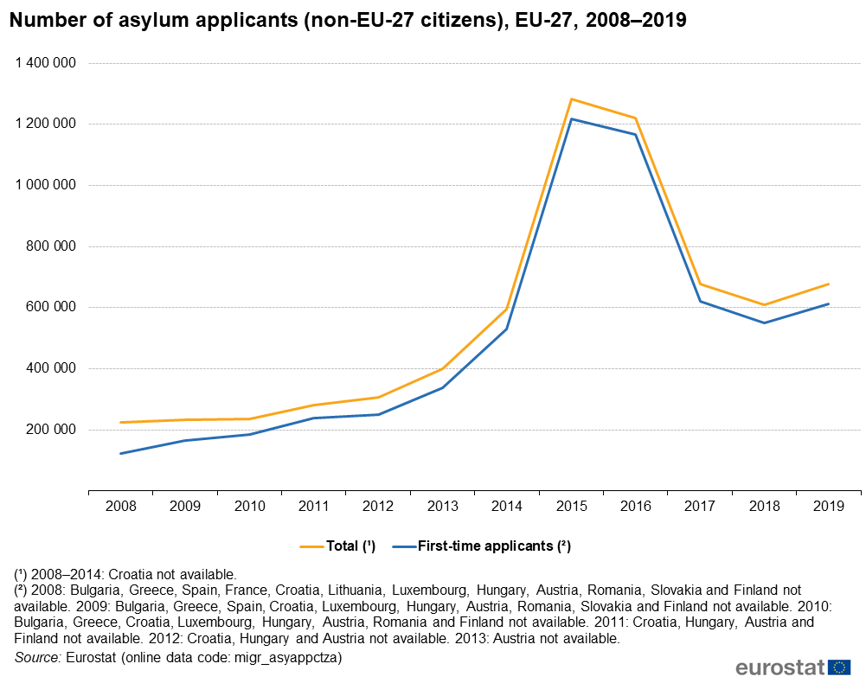

Slide 10
Recapitulation
Take aways from this presentation:
The European Union has to face a number of challenges in the upcoming decade in every field
The contemporary circumstances define a new, unique character for some challenges (Covid-19 for example)
The member states of the European Union are working together in some areas to conquer these challenges (European Green Deal)
Many of the problems are intertwined with each other (one problem may be the cause for another)

Slide 11
Sources
https://wallpaperaccess.com/european-union
https://www.wallpaperflare.com/green-forest-trees-landscape-nature-river-wallpaper-ecology-wallpaper-fk
https://www.versicherungsforen.net/portal/de/veranstaltungen_2/konferenzen_und_messekongresse/finanzen_und_risikomanagement_2019/standardseite_236.xhtml
https://www.eea.europa.eu/publications/92-827-5122-8/page014.html
https://www.volkswagenag.com/en/news/stories/2020/06/green-deal--ceo-initiative.html
https://ec.europa.eu/info/law/better-regulation/have-your-say/initiatives/12264-Chemicals-strategy-for-sustainability
https://www.climatechangenews.com/2019/12/12/eu-releases-green-deal-key-points/
https://ec.europa.eu/info/strategy/priorities-2019-2024/european-green-deal/actions-being-taken-eu_en
https://ec.europa.eu/info/strategy/priorities-2019-2024/european-green-deal_en
https://mikejohnson.house.gov/issues/immigration
https://www.eurodiaconia.org/resources/social-policy-toolkit/chapter-ii-social-policies-in-europe-today/what-are-the-key-challenges-for-social-europe-today/#1445169288983-02400664-1da0
https://ec.europa.eu/commission/presscorner/detail/en/qanda_20_949
https://ec.europa.eu/info/live-work-travel-eu/health/coronavirus-response/recovery-plan-europe/pillars-next-generation-eu_en

