Slide 1

Liability for a conduct of Artificial Intelligence
VERONIKA ŽOLNERČÍKOVÁ
INSTITUTE OF LAW AND TECHNOLOGY, FACULTY OF LAW, MASARYK UNIVERSITY

Slide 2
Artificial Intelligence / Autonomous Machines
Terminology
Basic information on function of ai
examples

Slide 3
Characteristics of an AI driven machine
Perception of the environment
Differentiation of objects, events and situations
Assesment of relations among them
Creation of internal models of the environment
Adoption of decisions
Perception of consequences of those decisions

Slide 4
Autonomous Agent
Autonomous behaviour – AI is further capable of gathering information through its own sensors or by data exchange and of making independent decisions based on that information, all without further human input
Autonomous agent - a software entity (goal-oriented) capable of executing actions in its environment: virtual, physical
Examples of autonomous agents: autonomous intelligent cars (AIC), drones/unmanned aircraft vehicles (UAV), satellites
Sources of information: sensors, cameras, data connection, lasers

Slide 5
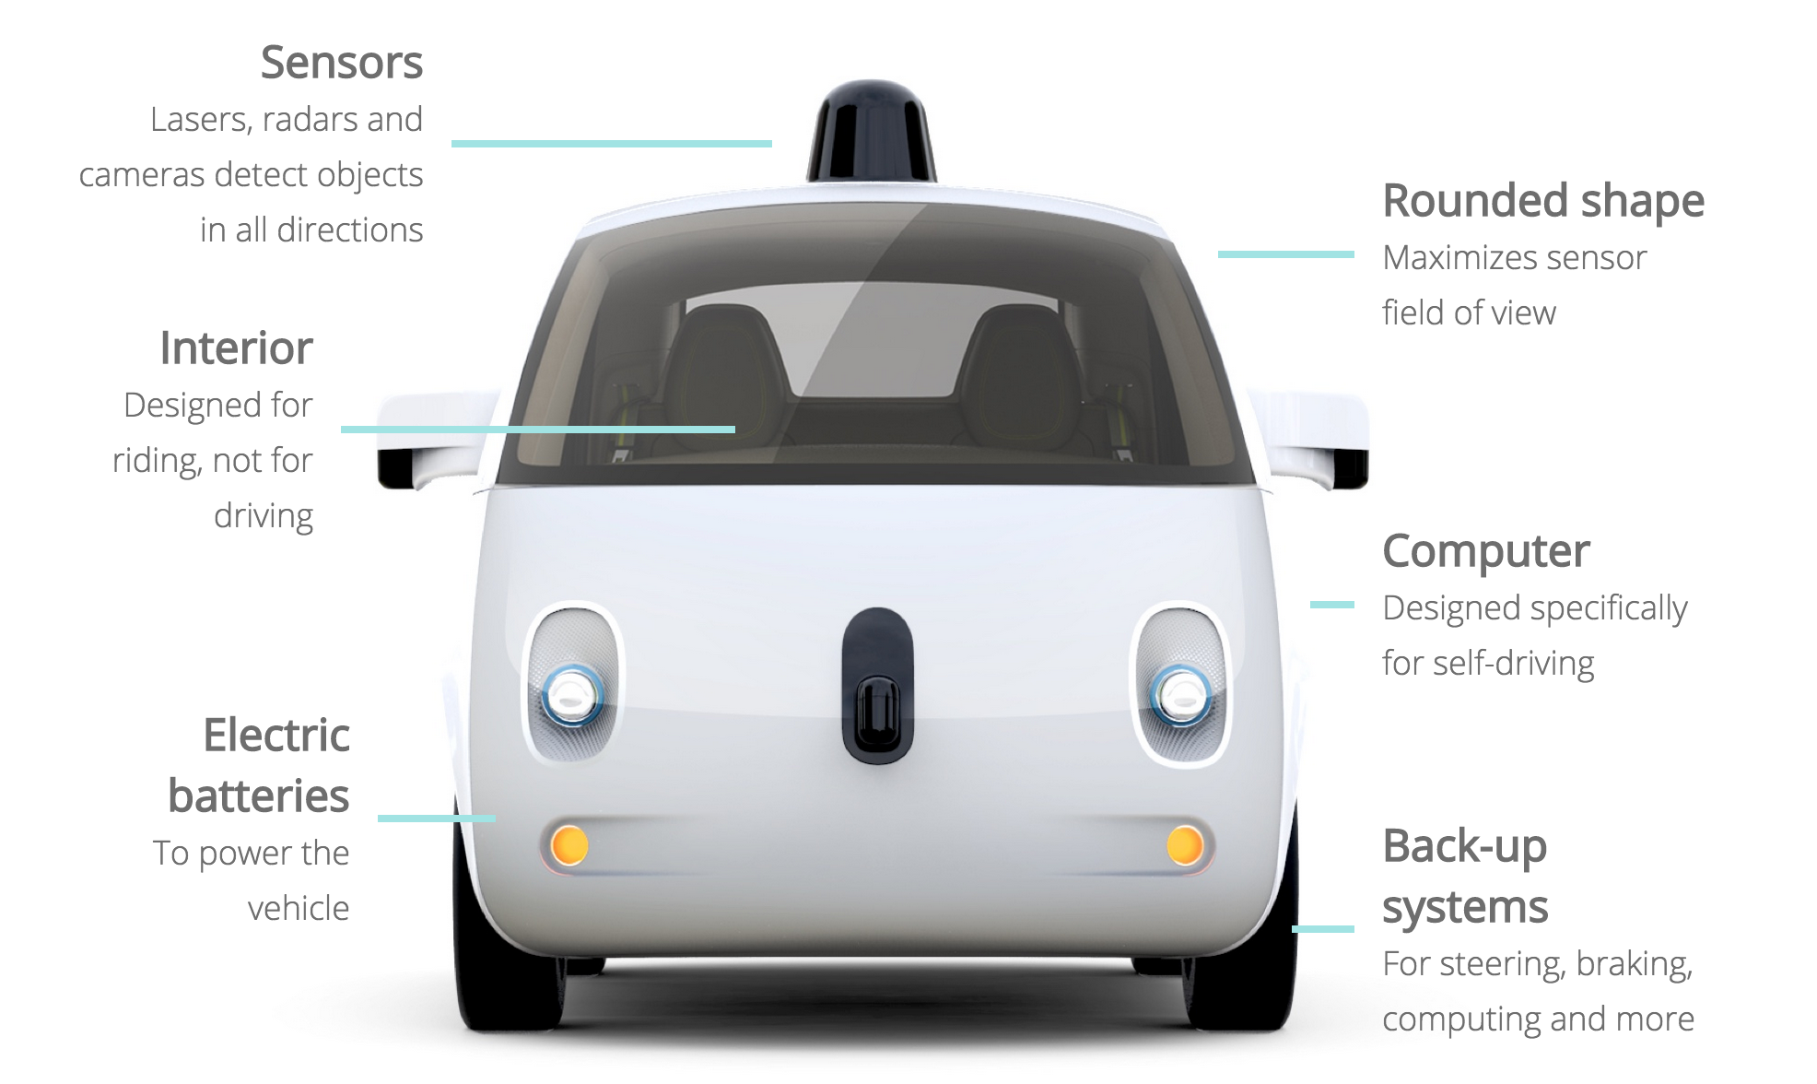
Autonomous / Driverless Vehicles

Slide 6
General Classification of Autonomous Agents I.
Is the classification used for AIC applicable for other autonomous agents?
Different level of:
  connectivity (interaction, user input)
  mobility (virtual x physical, means of movement)
  intelligence (programming, machine learning)
Variability in data input
  sensors
  data exchange
  products

Slide 7
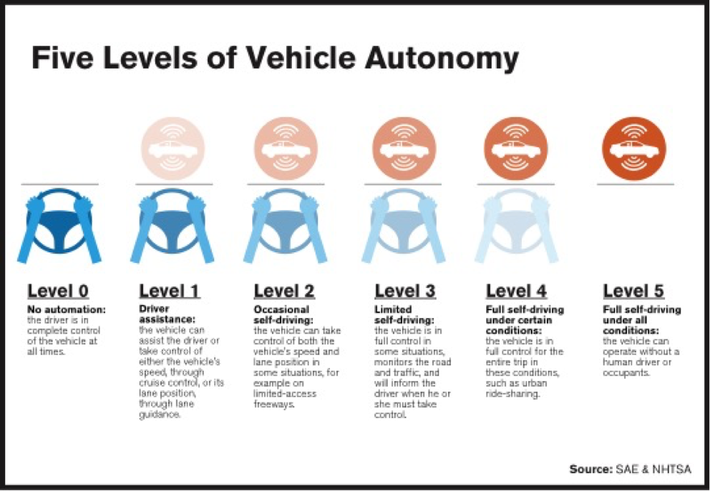
Level of Automation/Autonomy in Autonomous Intelligent Cars

Slide 8
General Classification of Autonomous Agents II.
Failure of AIC on one level of autonomy will not be the same as the failure of another AIC on the same level
Level of autonomy as a useful concept for classification but not for liability distribution
UAVs, planes, ships – similar autonomy level concepts (applicable), yet different purpose, users
Possible to compare liability concepts according to certain features used in autonomous agents

Slide 9
Overview of Legal Materials & Preparation Works
EUROPEAN UNION
COUNCIL OF EUROPE
CZECH REPUBLIC

Slide 10
European Union
10. 5. 2017 – Single Digital Market – development of AI
21. 7. 2017 – Report with Recommendations to the Commission on Civil Law Rules on Robotics – law, ethics
10. 4. 2018 – Declaration of Cooperation on Artificial Intelligence
25. 4. 2018 – Artificial Intelligence for Europe – common european approach
7. 12. 2018 – Coordinated plan for artificial intelligence – part Ethics by design and the regulatory framework
8. 4. 2019 – Draft of the Ethics Guidelines for Trustworthy AI
AI H-LEG (High-Level Expert Group)

Slide 11
Council of Europe
Specific issues in the protection of human rights and democracy
Governing the Game Changer – Conclusions from the conference – 27 February 2019
The European Commission for the Efficiency of Justice (ECFEJ) – monitoring body bringing together the national experts
Artificial Intelligence at the Service of the Judiciary – September 2018
European ethical charter on the use of artificial intelligence in judicial systems and their environment – December 2018

Slide 12
Czech Republic
The Czech Republic is one of the signatories of the Declaration on Cooperation on Artificial Intelligence
December 2018 - Analysis of the Development Potential of Artificial Intelligence in the Czech Republic – 3rd part on legal and ethical aspects
National Strategy of Artificial Intelligence which builds on the recommendations in the study and the EU-wide Coordinated Plan for Artificial Intelligence
Platforms – academical, industrial, focus on autonomous vehicles

Slide 13
LIABILITY AS THE KEY ISSUE
WHY IS LIABILITY AN ISSUE IN AI
WHAT ARE THE POSSIBLE SOLUTIONS
LIABILITY CONCEPTS

Slide 14
Liability as the Key Legal Issue in AI
Actions are carried out by the machine independently (liability for damages)
Software x physical components (preventive liability)
Software service – level x Driving school for humans
Changes in the code, unpredictability

Slide 15
Liability for Emerging Digital Technologies
Commission Staff Working Document - Liability for emerging digital technologies
  Accompanying the document Communication from the Commission to the European Parliament, the European Council, the Council, the European Economic and Social Committee and the Committee of the Regions - Artificial intelligence for Europe
  Issued on 25th of April 2018
https://ec.europa.eu/digital-single-market/en/news/european-commission-staff-working-document-liability-emerging-digital-technologies

Slide 16

Liability Principles
Liability - responsibility of one party for harm or damage caused to another party, may be a cause for compensation, financially or otherwise, by the former to the latter
Civil law x Administrative law x Criminal law
Contractual x Extracontractual
Fault-based (subjective) x Strict-based (objective)

Slide 17
Principles of European Tort Law
Non – harmonized accross EU
The European Group on Tort Law - a group of scholars in the area of tort law
Principles of European Tort Law (PETL) similar to the Principles of European Contract Law: http://civil.udg.edu/php/biblioteca/items/283/PETL.pdf
Attribution to a concrete person (PETL):
  Whose conduct have caused the damage
  Whose abnormally dangerous activity has caused the damage
  Whose auxiliary has caused the damage within the scopes of its functions

Slide 18
Liability Principles in Civil Law
1) Illegal action (tort)
2) Damage
3) Causal Nexus
4) Fault (intent, negligence)
In strict – based liability fault is not one of the conditions – causal nexus – the element present in every liability principle
Causal nexus – causa / conditio sine qua non / but – for principle – would the negative effect appear without the conduct of the defendant?

Slide 19

Causal nexus for the conduct of AI
  Lower ability to control an autonomous machine – does not follow the will of the driver, decision making is not fully predictable (even by the programmer) as the machine learns itself while in function
  Inherent level of uncertainty in software „The long-term operation of complex systems entails a fundamental uncertainty, especially in the context of complex environments, including new or unpredictable environments“

Slide 20

Causal nexus for the conduct of distributed AI
  In complex processing environment, it is not possible to simply impose liability on any identifiable unit – multiple units means: multiple programmers, vast number of users, unpredictable number of interactions between the machines on number or platforms, operating systems, data exchanges, telecommunications programmes

Slide 21
Different Approaches to Causation
Full liability x Proportional liability
Multicausual damage:
  Alternative causes
  Concurrent causes
  Cumulative causes
Three types of approaches towards causation in Europe
  Overarching
  Bounded
  Pragmatic

Slide 22

Liability Concepts
Options : keep, discard, amend
No-fault/strict (product/design defect) liability
Risk based liability
Quick claim resolution in certain scenarios
Legal personhood (subjectivity)

Slide 23
Technical Standardisation
Standardisation as a preventive measure
Standards vs. Legal regulation
homologation

Slide 24
Technical Standards & Product Safety
Part of preventive liability concept
Way of ensuring product safety
Directive 2001/95/EC of the European Parliament and of the Council of 3 December 2001 on general product safety
Specific product safety rules: dangerous goods, vulnerability of consumers, need for compatibility
Involvement of all parties – manufacturers, distributors, users, law-makers
Technical standards – description of a product from a technical perspective, construction, materials and other criteria
Homologation – when a product needs prior certification before it can be available on the market (motor and aerial vehicles)

Slide 25
Technical Standards
Although normative, do not have legal nature
Recommendation for manufacturers, best practice
Can be binding, if referenced in law – often published as subordinate legislation
Adopted by specialized authorities – ISO, NIST, ETSI…
Legislation designates which products must be safe and technical standards determines how to achieve it.
Technical standards as a necessary addendum to regulatory approach

Slide 26
Missing Role Model
Technical standards in the field of avionics – are they usable for other technologies, f.e. autonomous vehicles?
Software in autonomous vehicles has different challenges
  Pedestrian crossings, objects in the road, other vehicles
  Changing traffic conditions
  „Piloted“ by a citizen, consumer, not by a professional
  Multitude of sensors – radar, lidar, camera
Technical standards for autonomous trains – similar problems

Slide 27
Testing / Homologation Methods
Real – life testing
Report with recommendations to the Commission on Civil Law Rules on Robotics (2015/2103(INL))
Good for testing standard behaviour, but subjective, possibly biased (OICA)
Black – box testing
Only the desirability of the output is assessed
Hardware-in-loop
Real-time testing, capability of the controller is tested by virtual stimuli coming from a computer integrated in the simulation environment
Research on how to adapt it for AI

Slide 28
Possible Solutions
Preventive measures – testing, standardisation, homologation
Mandatory insurance (common insurance – predictability of risks)
Explainable AI
Reallocation of the burden from the victim towards the person with most information
Proximal causation - Harmonisation of criteria (at least doctrinally) for proving of causal nexus across EU
Compensation fund/ liability fund

Slide 29
How to Regulate AI
Unanswered questions
methodology

Slide 30
New Technologies & the Law
Challenges of new technologies
  Multidisciplinary approach is needed to comprehend how the technology works
  Multidisciplinary approach is to be taken also in the field of law itself
  Rapid development, unpredictability
  Solutions?
  Concentration on the content and the purpose of legal regulation
  The use of analogy is needed
  It is impossible to regulate the current phenomena as well as the future ones

Slide 31
Artificial Intelligence as the New Legal Challenge
Is new regulation for AI needed?
When is it possible to use analogy?
Is it just another „new technology“ or are there differences?
Is it possible to regulate AI as such or should sectorial approach be taken?
Which measures are more suitable for regulating AI?

Slide 32
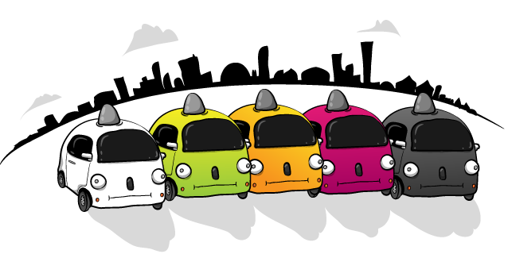
Questions?
The Oatmeal

Slide 33
Thank you for your attention!
zolnercv@mail.muni.cz

