Slide 1
Nasciturus as a subject of international rights: the vo V. FRANCE CASE AND WHAT IF IT WAS RESOLVED
IN FAVOUR OF MRS. VO
DENISA KÁRNÍKOVÁ
458306
2022/2023

Slide 2
OUTLINE
1) FACTS
2) RULINGS
3) WHAT IF

Slide 3

FACTUAL BACKGROUND
Death of a foetus due to substandard medical care
  Mrs. Vo received substandard medical care during her pregnancy appointment. Due to a mix-up caused by the fact that she shared the same surname with another patient her doctor tried to remove
  a non-existing coil from her uterus, which was an operation scheduled for the other patient. This inevitably led
  to Mrs. Vo needing an emergency hospital admission and the death of her 20-week-old foetus.

Slide 4
LEGAL PROCEEDINGS
Mrs. Vo tried to have the doctor prosecuted for unintentional homicide of her child:
French Criminal Court:
  Doctor G. was found guilty of causing injuries that led to temporary unfitness to work
  „A foetus becomes viable at the age of 6 months; a 20- to 21-week-old foetus is not viable and is not a ‘human person’ or ‘another’ within the French Criminal Code.“ → doctor G. could not be found guilty of homicide, because the foetus was not considered a human person
Mrs. Vo appealed
Lyons Court of Appeal found Doctor G. guilty of unintentional homicide
  „The accused has himself acknowledged that a clinical examination would have alerted him to the fact that the patient was pregnant and had been mistaken for another patient.“
  French Civil Code: ‘The law secures the primacy of the person, prohibits any assault on human dignity and guarantees the respect of every human being from the beginning of its life.’ → these statutory provisions cannot be regarded as mere statements of intent
  „foetuses born between 23 and 24 weeks after conception could now be kept alive…the age of the foetus was very close to that of certain foetuses that have managed to survive in the United States“
Doctor G. appealed
Court of Cassation reversed the judgment of the Lyons Court of Appeal
  „Criminal Law provisions must be strictly construed“ → there was noone to kill – nulla poena sine lege

Slide 5

EUROPEAN COURT OF HUMAN RIGHTS
Mrs. Vo argued that the absence of criminal legislation to prevent and punish such an act amounted to a violation of article 2 of the European Convention, which requires protection of the right to life by law

Slide 6
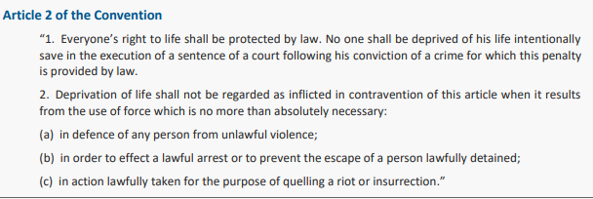

Slide 7
ECHR RULING
DETERMINING QUESTION:
  Is Article 2 applicable to a foetus?
  „The Court is convinced that it is neither desirable, nor even possible as matters stand, to answer in the abstract the question whether the unborn child is a person for the purposes of Article 2 of the Convention“ → pointing at the absence of a European legal, medical, ethical, or religious consensus as to when life begins
  a civil remedy for damages was an appropriate redress for medical negligence in the present case, and that there was no need to make criminal sanctions
  „there has been no violation of Article 2 of the Convention“
  The Convention = a living instrument?

Slide 8
WHAT IF IT WAS DECIDED IN FAVOUR OF MRS. VO
Question of abortions
    exemption? (X v. the UK)
Endangerment of women‘s health
    protection of foetus vs. protection of woman‘s life
Risks for medical professionals
Differences between individual European countries

Slide 9
CONCLUSION
The ECHR‘S decision on Vo v. France is not ideal
There would be more negative consequences if it was decided in favour of Mrs. Vo

